Slide 1

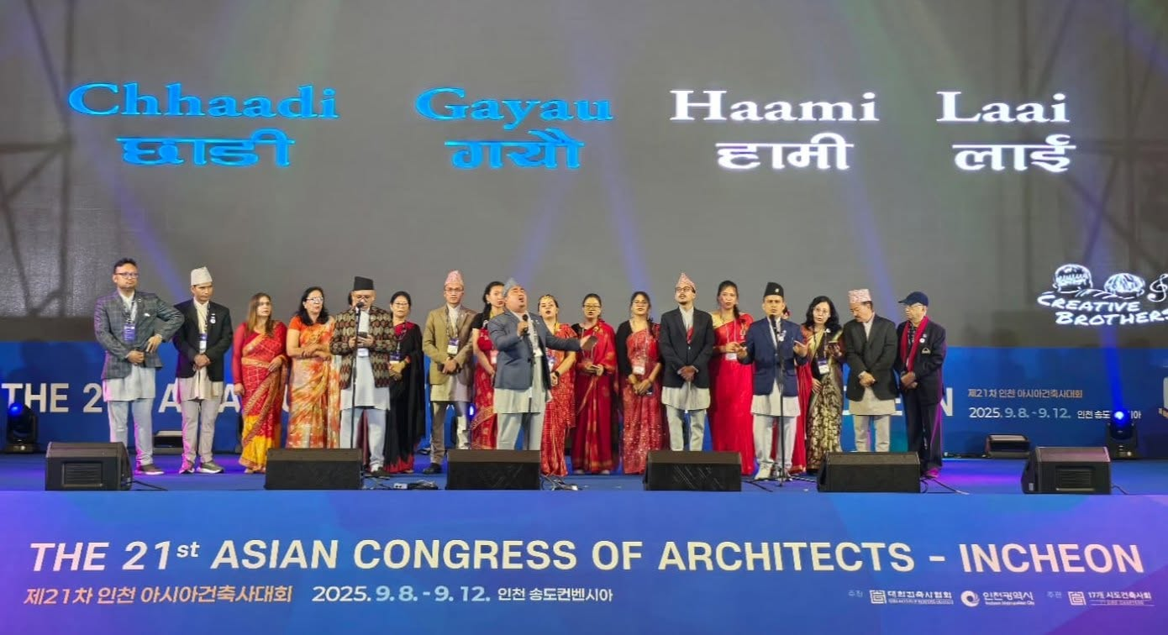
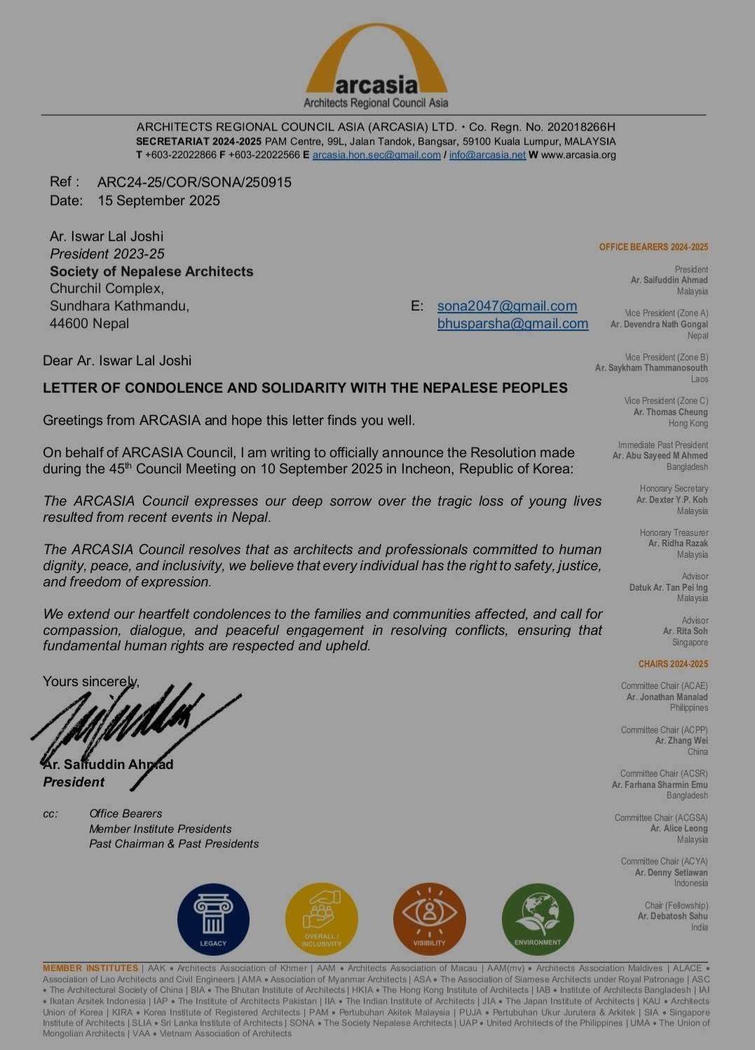
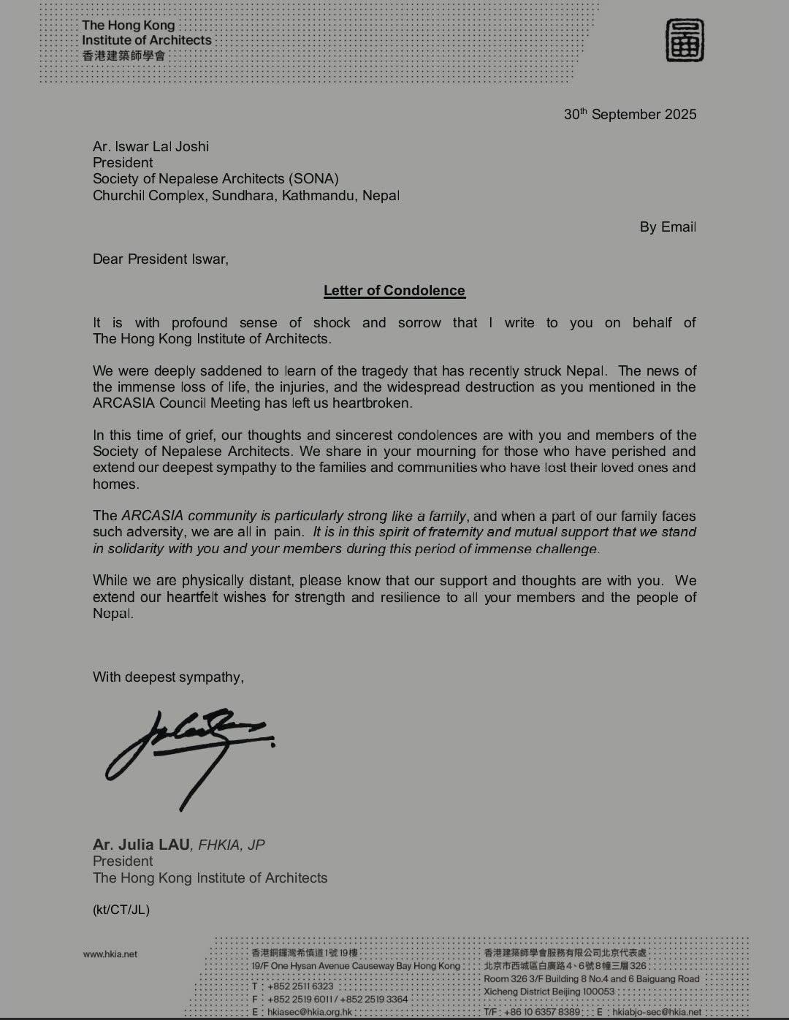
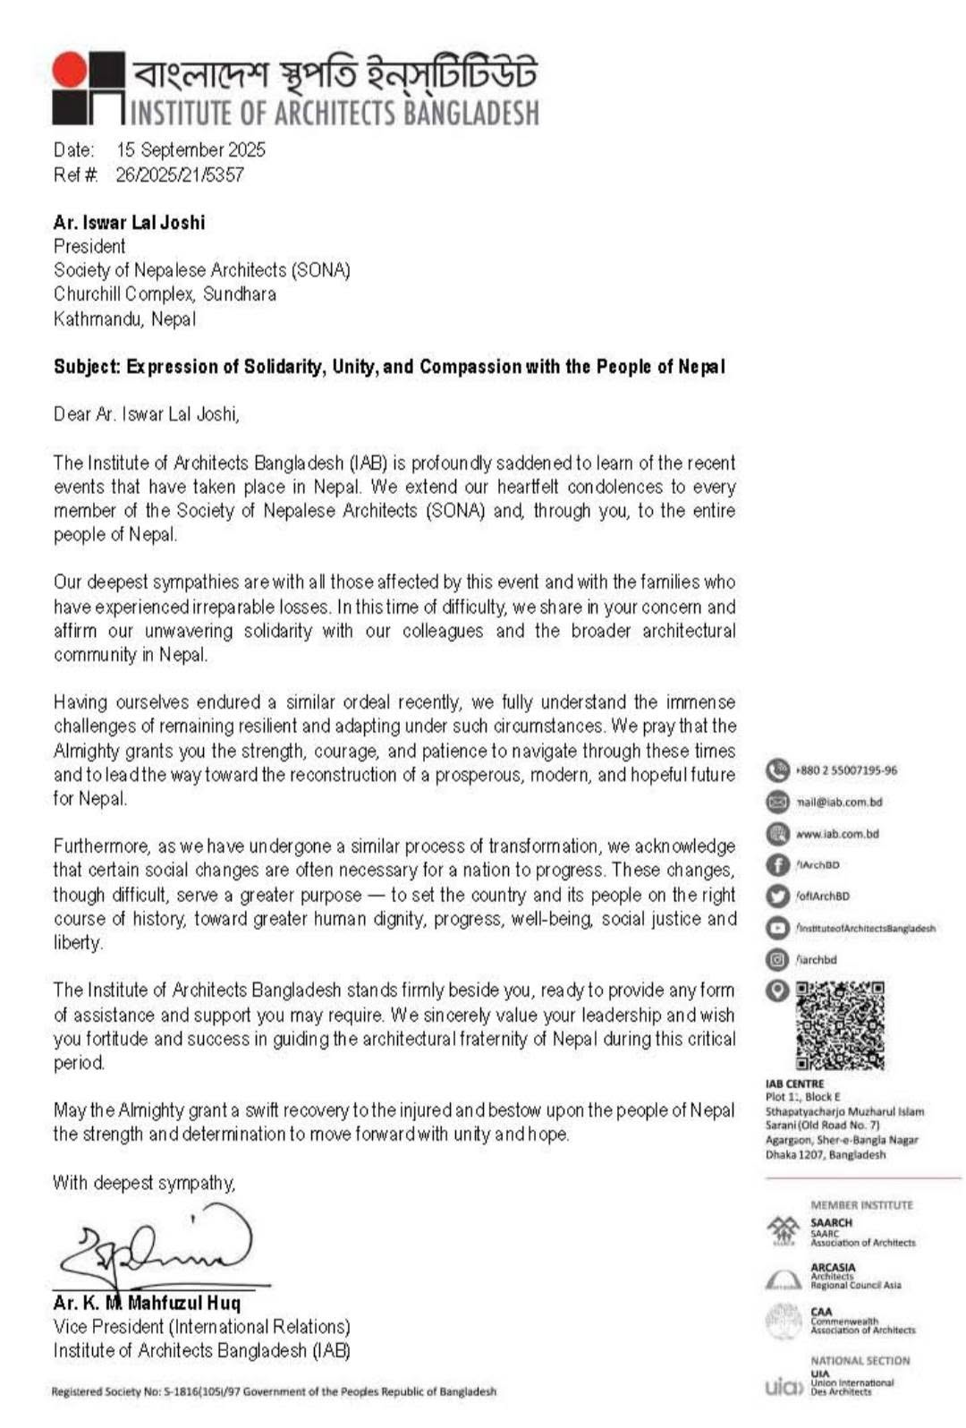
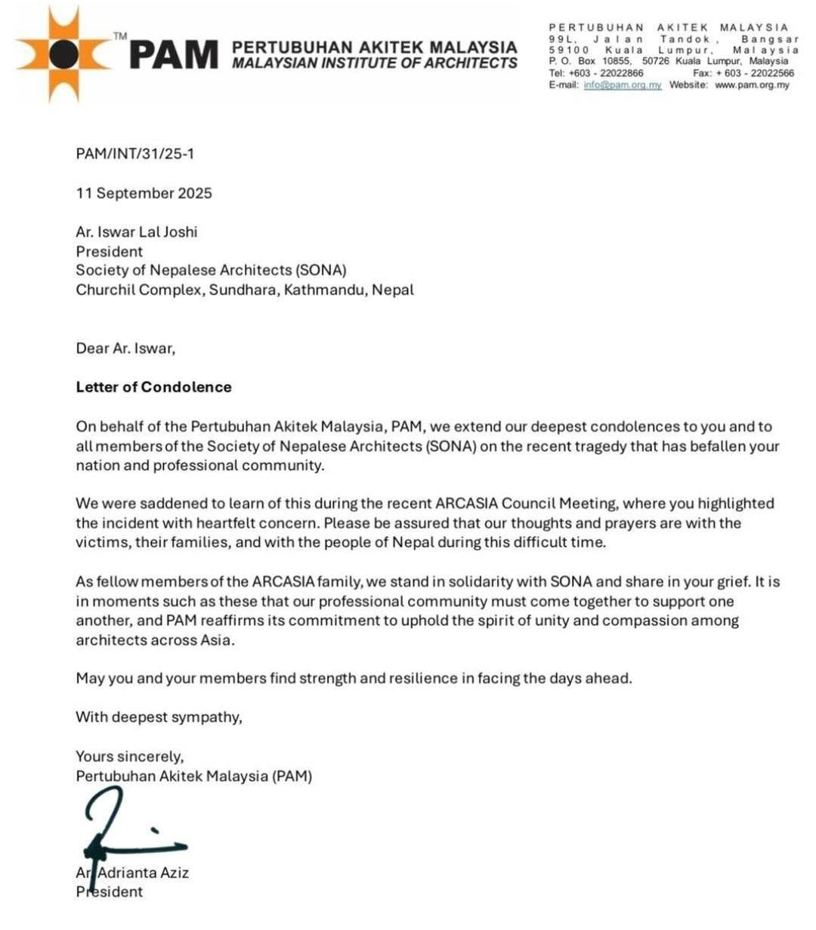
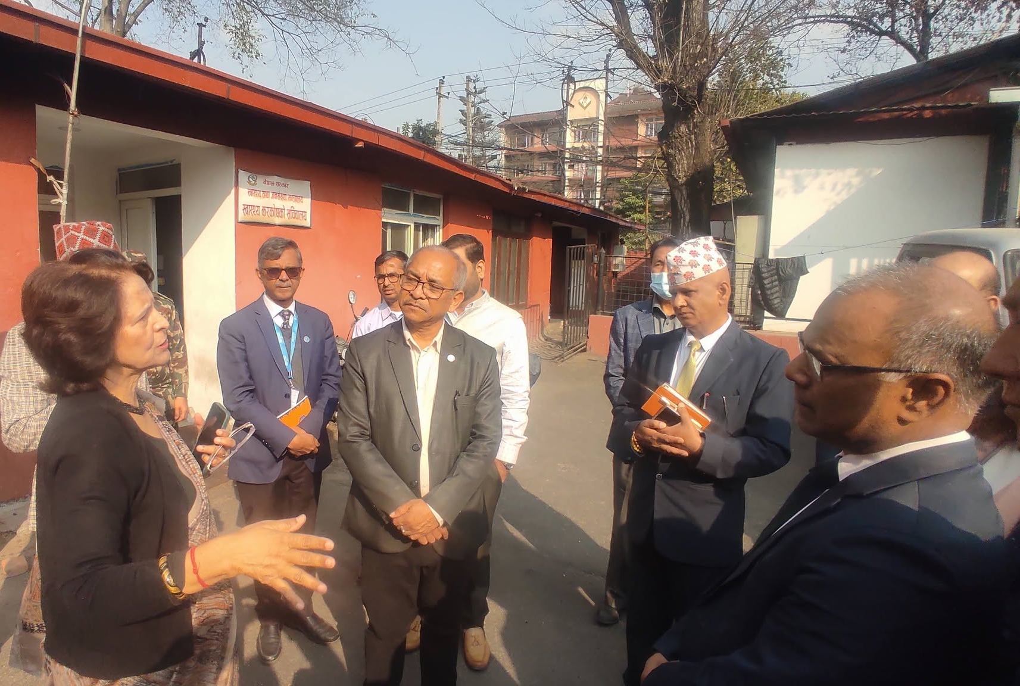
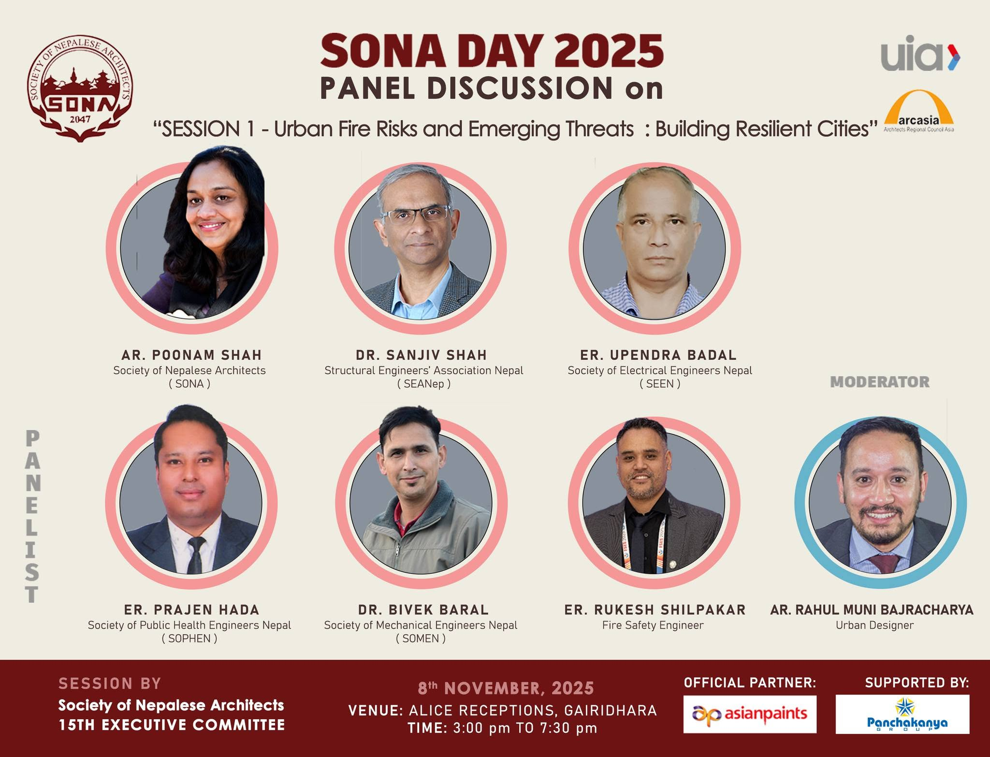
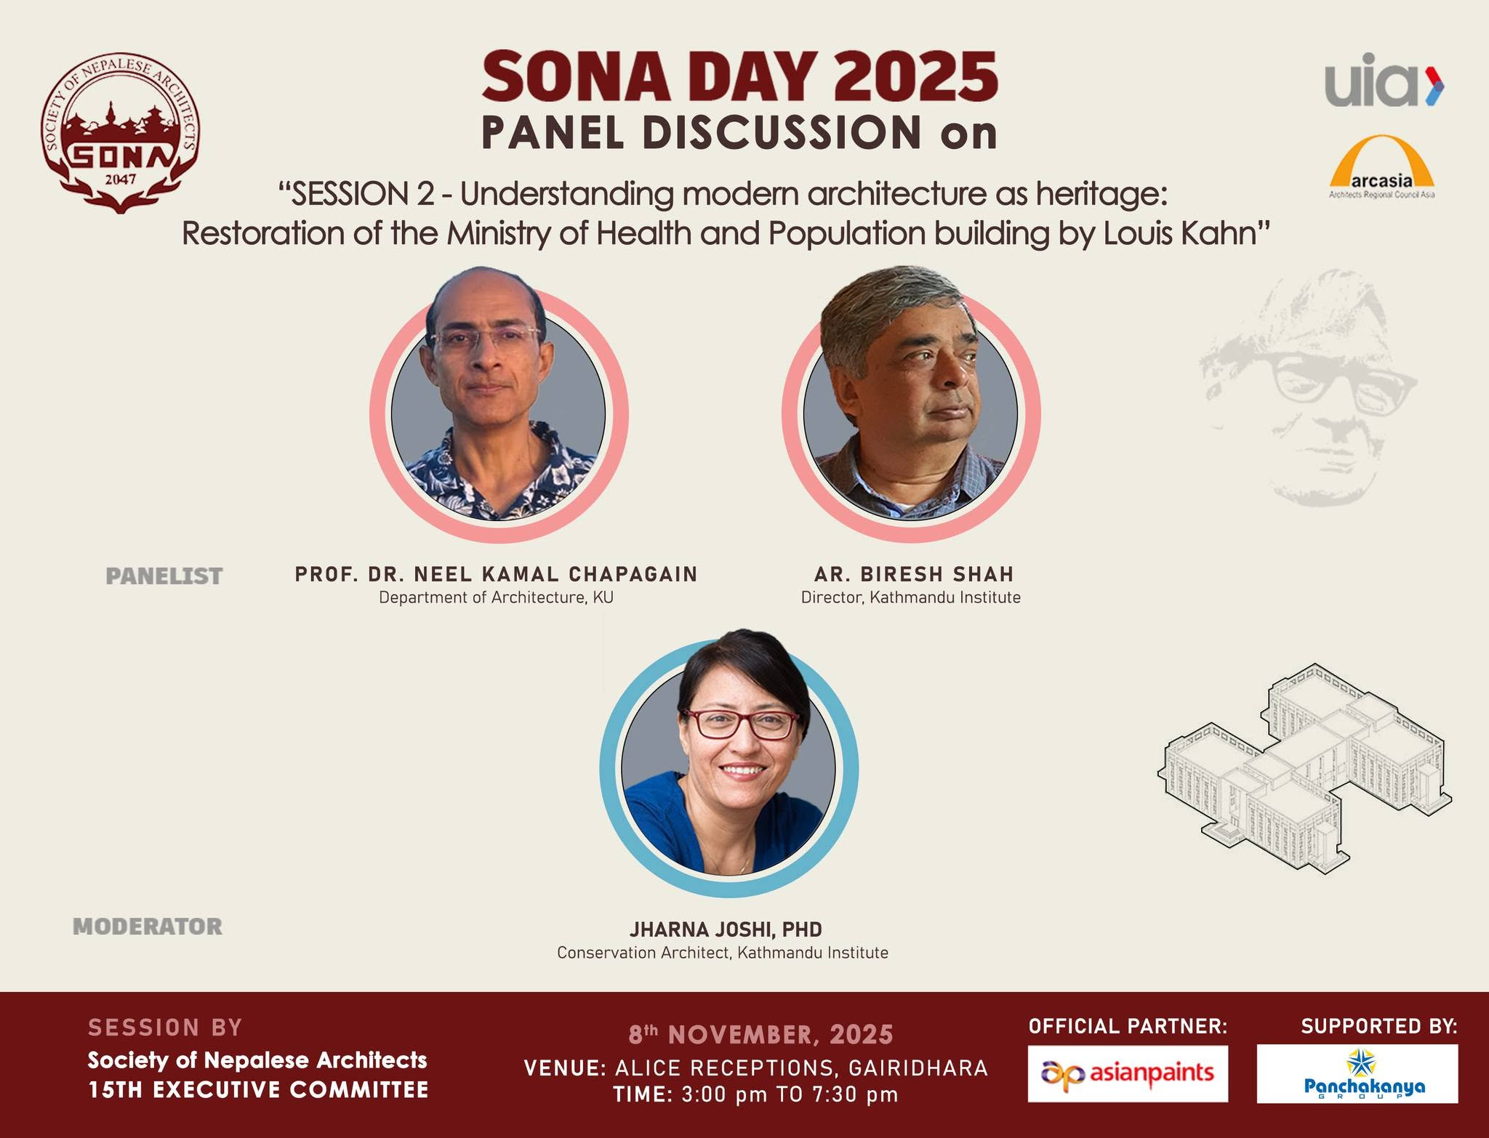
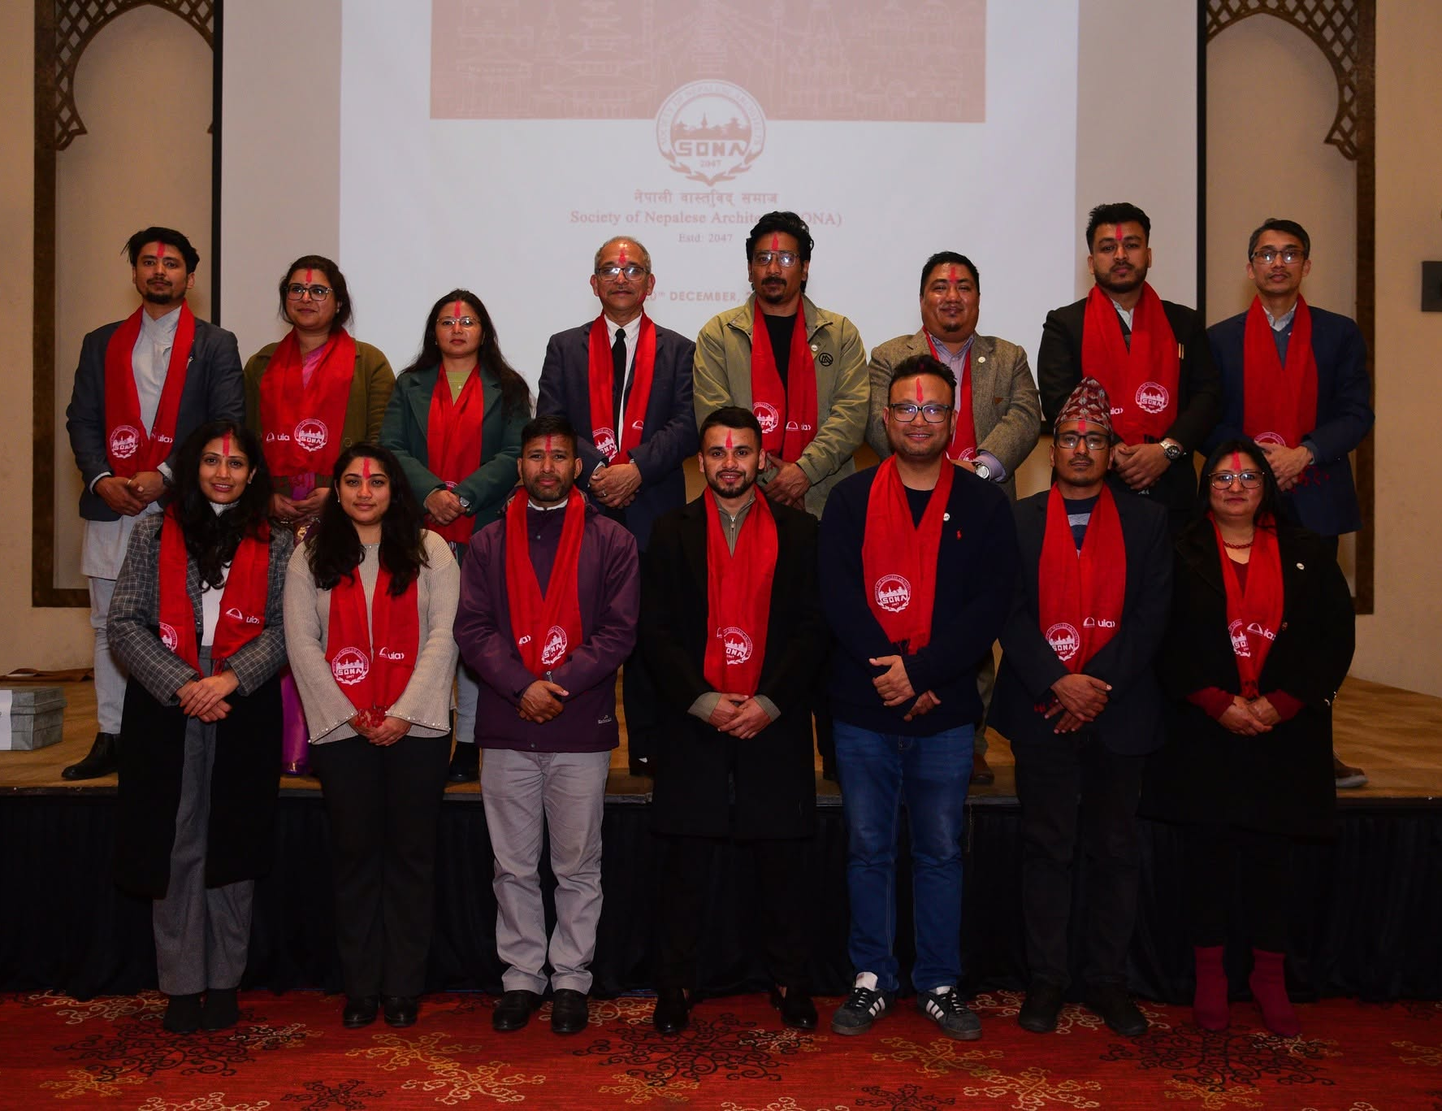
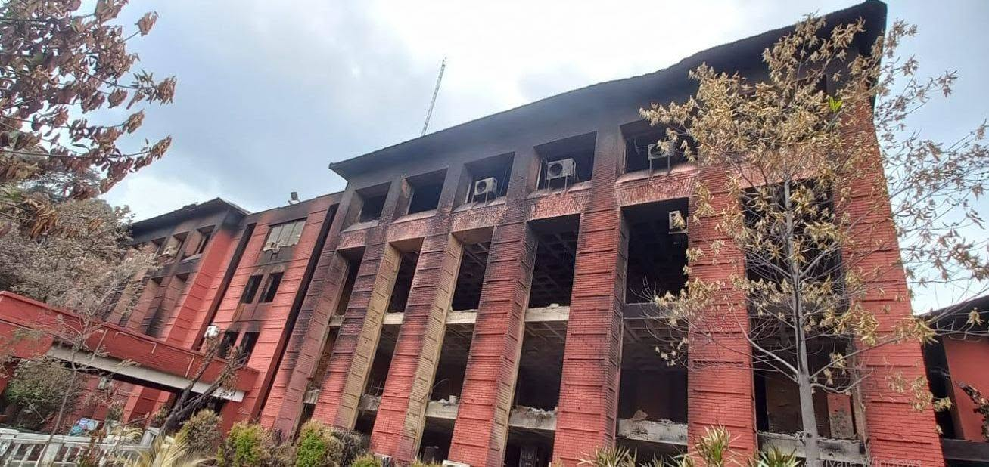
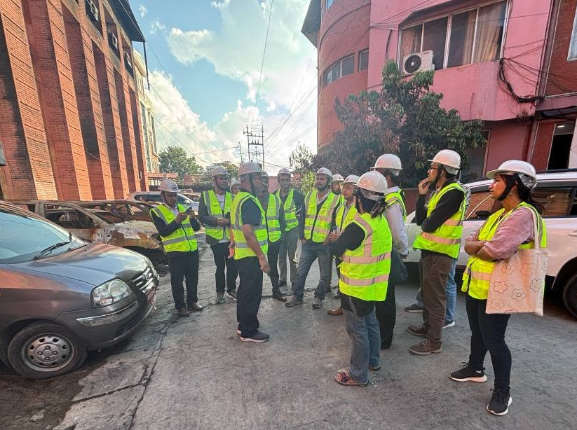
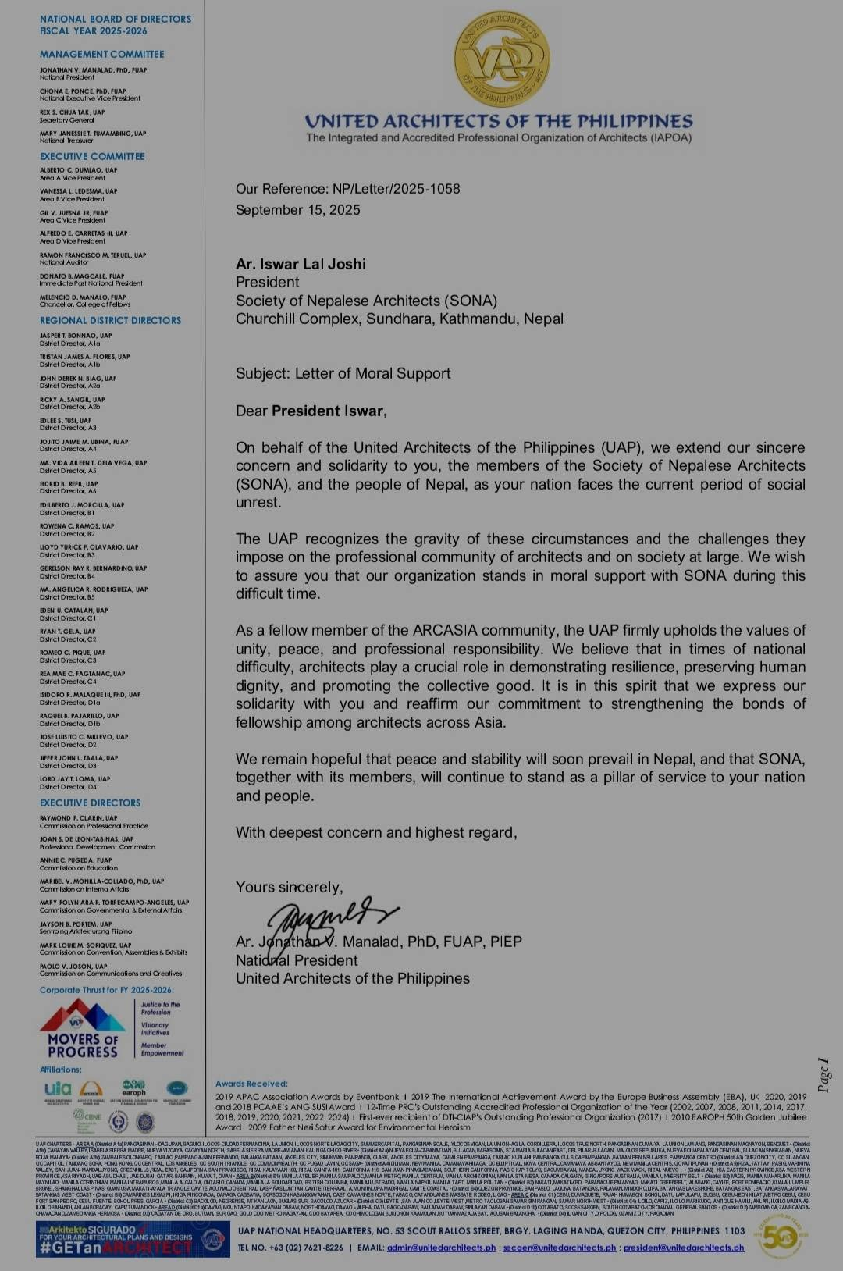
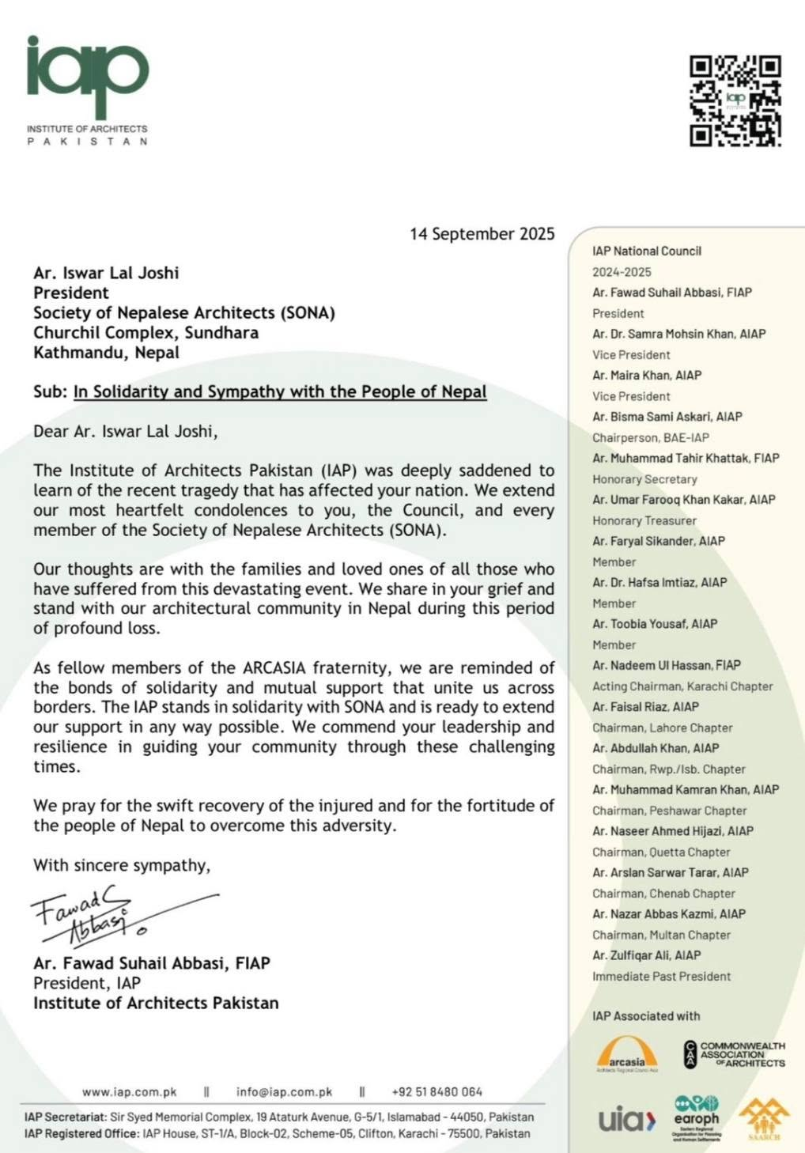
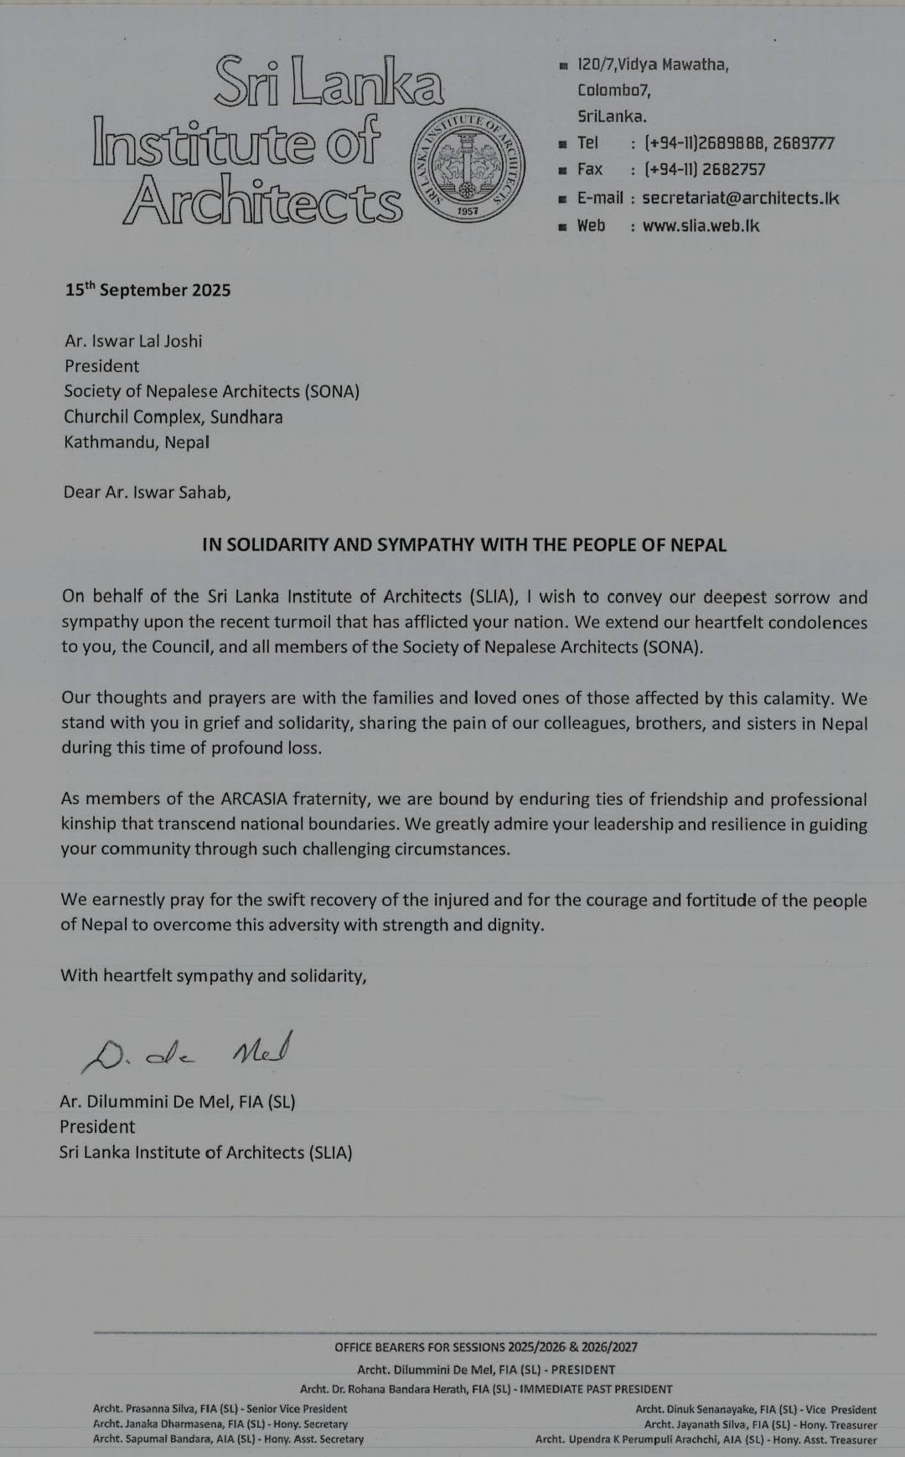
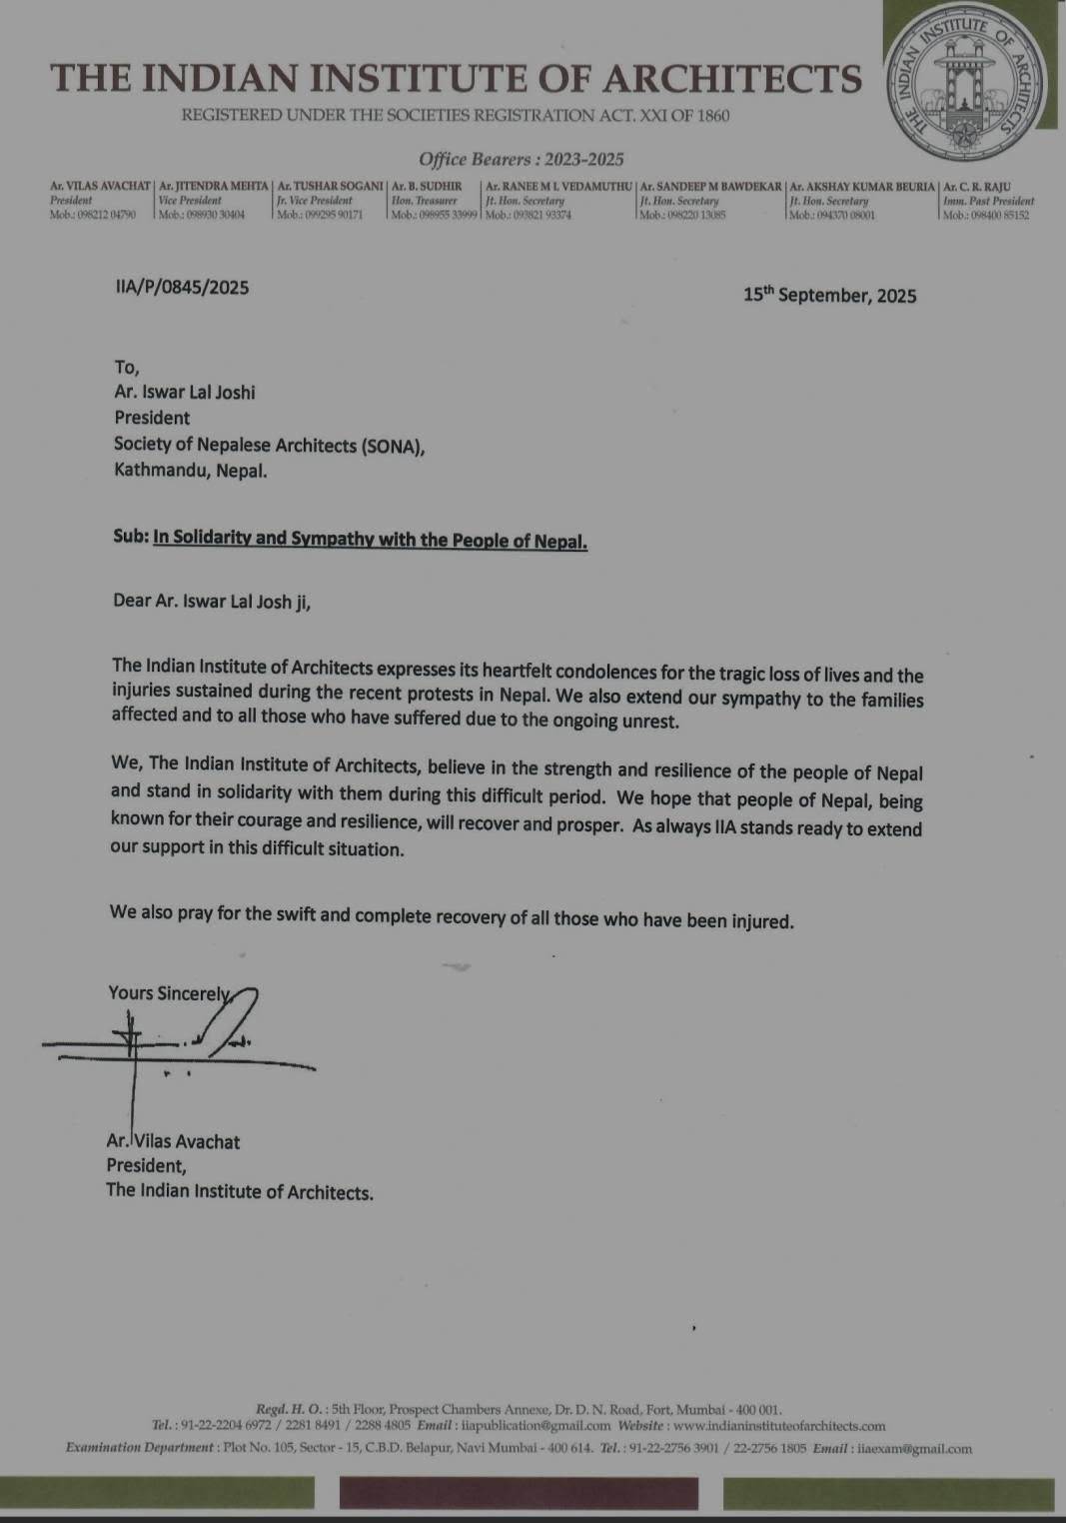
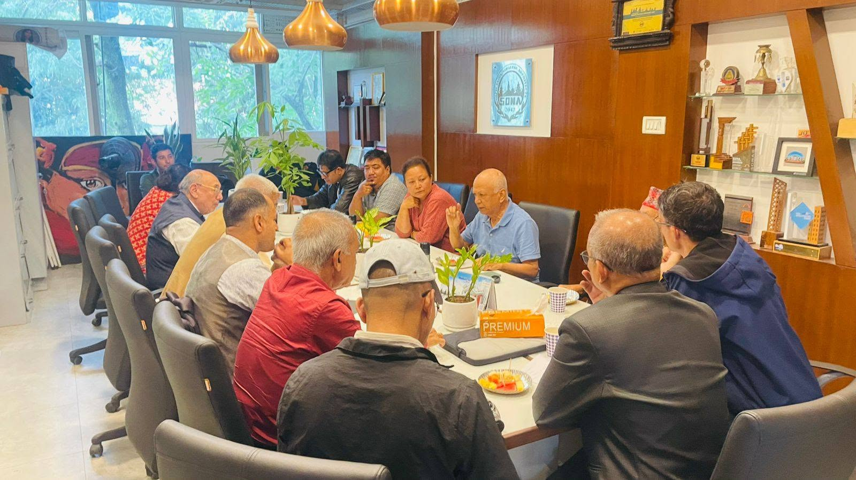
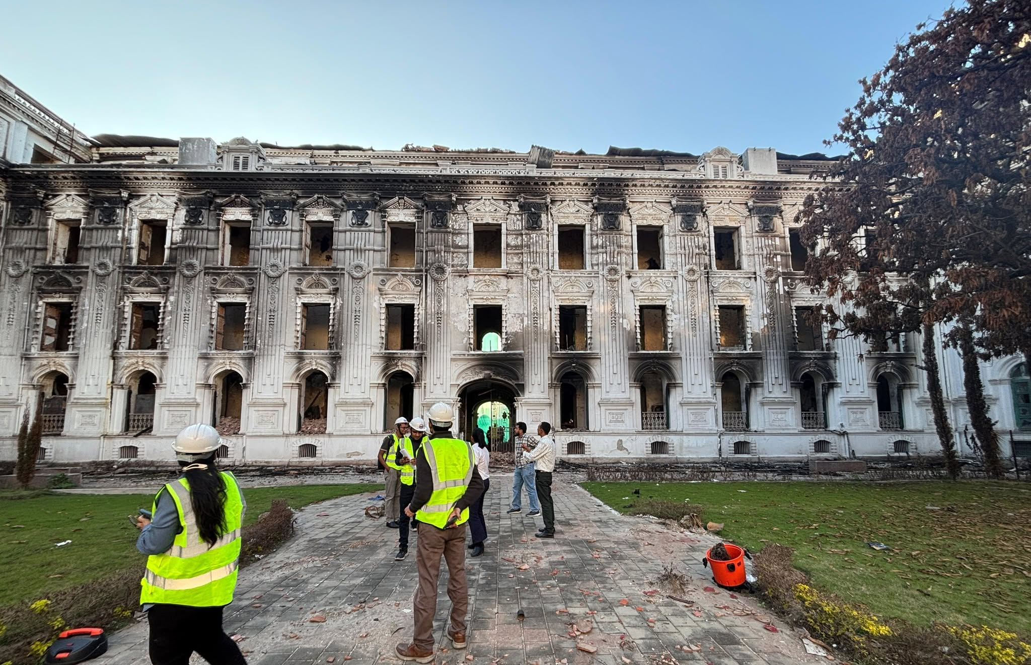


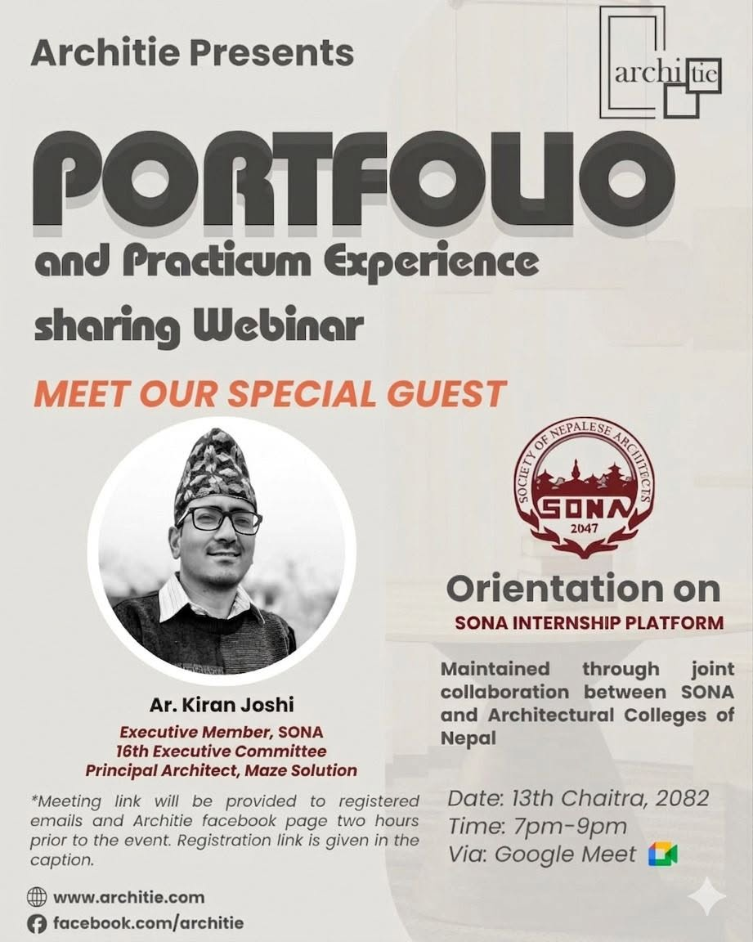


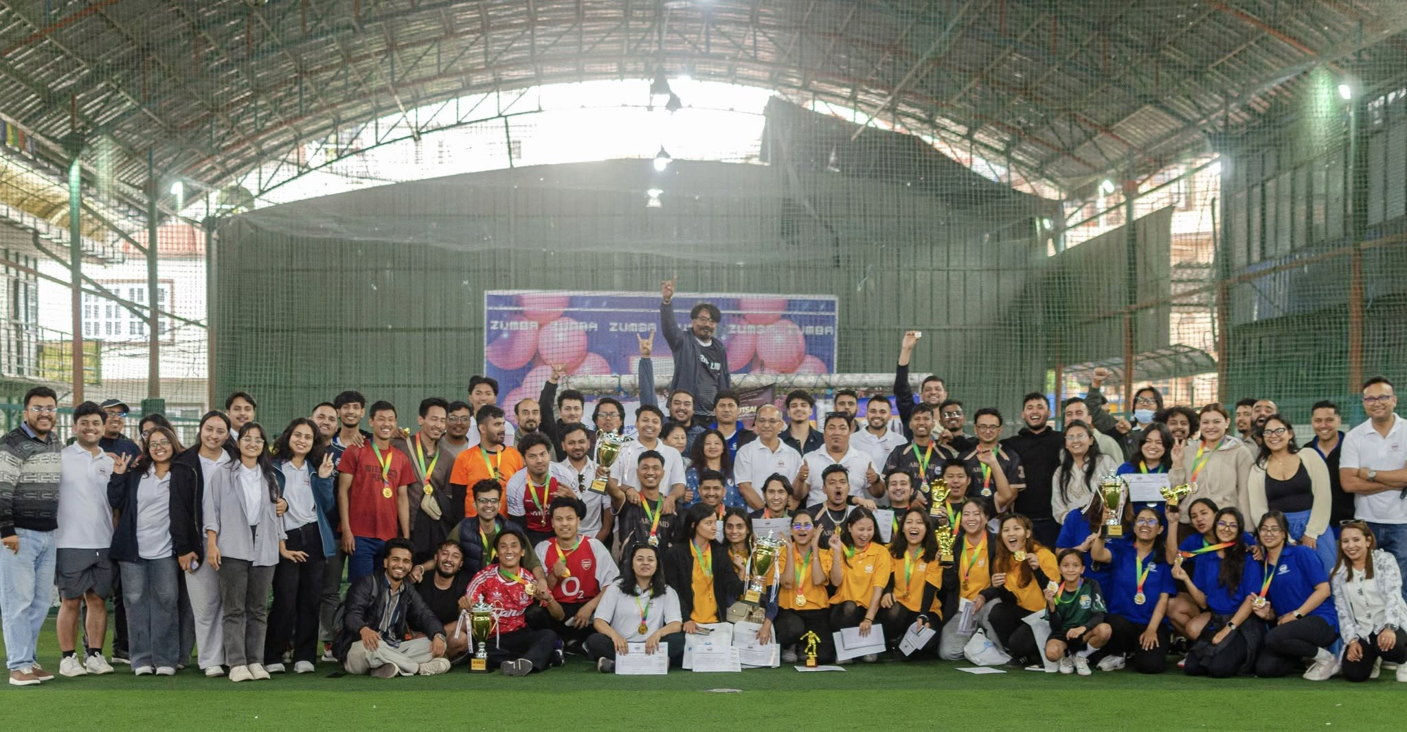
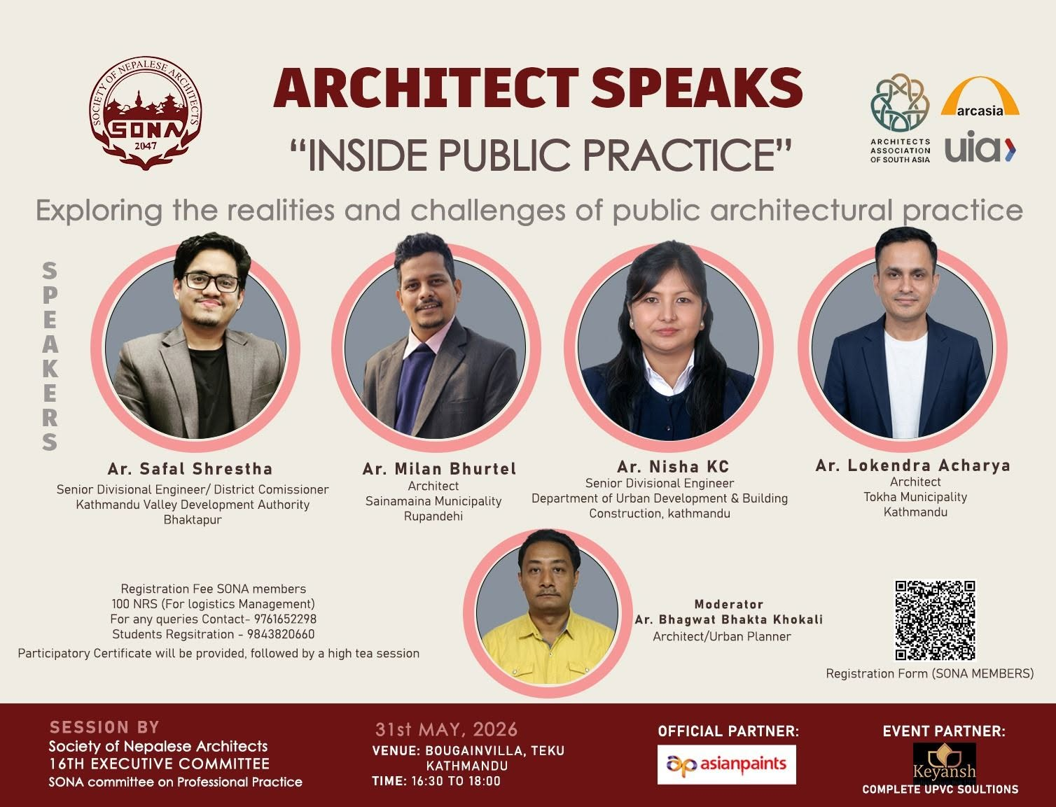
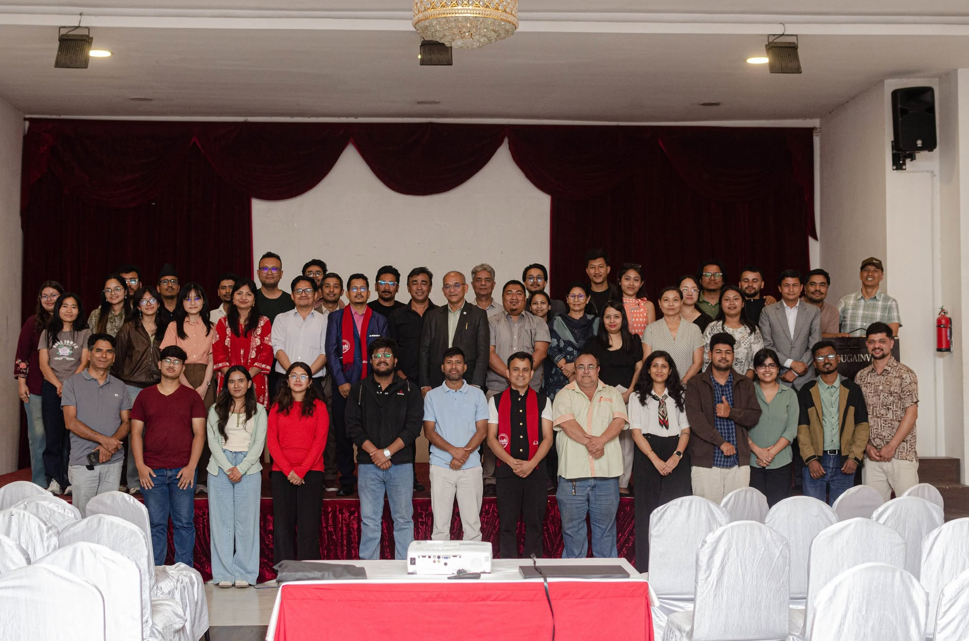

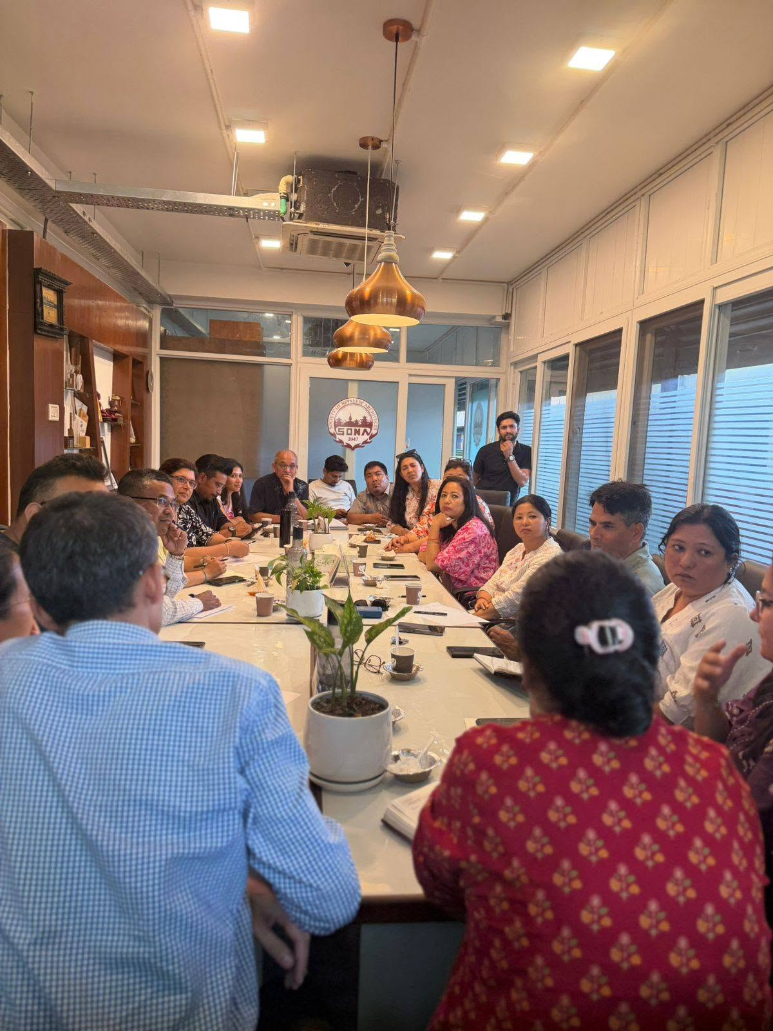
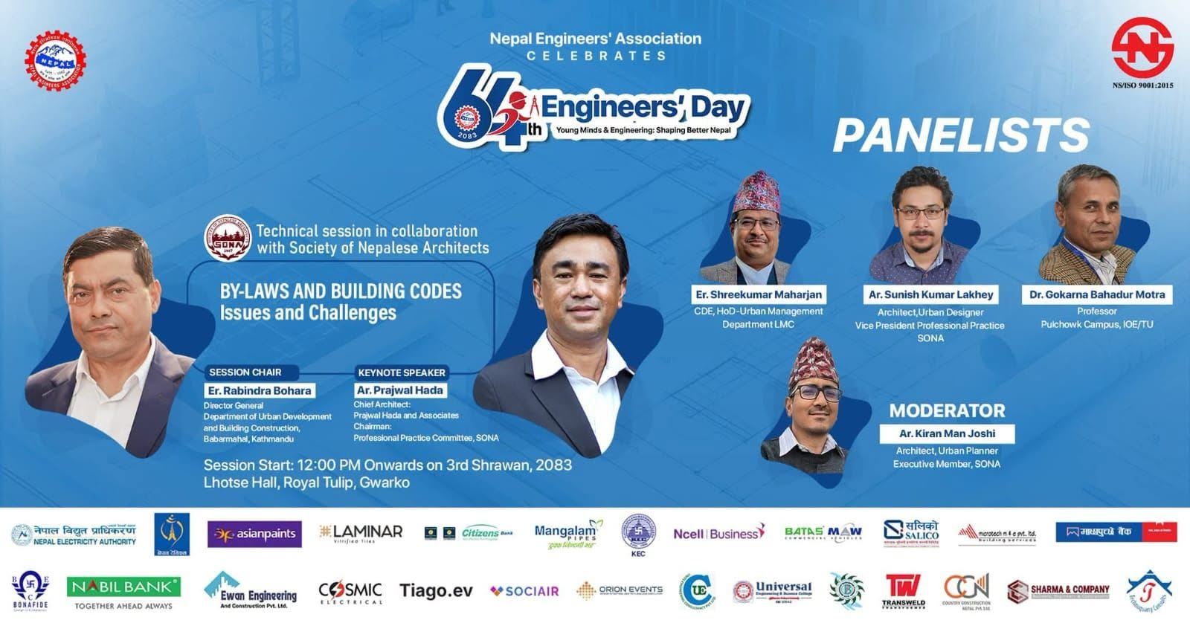
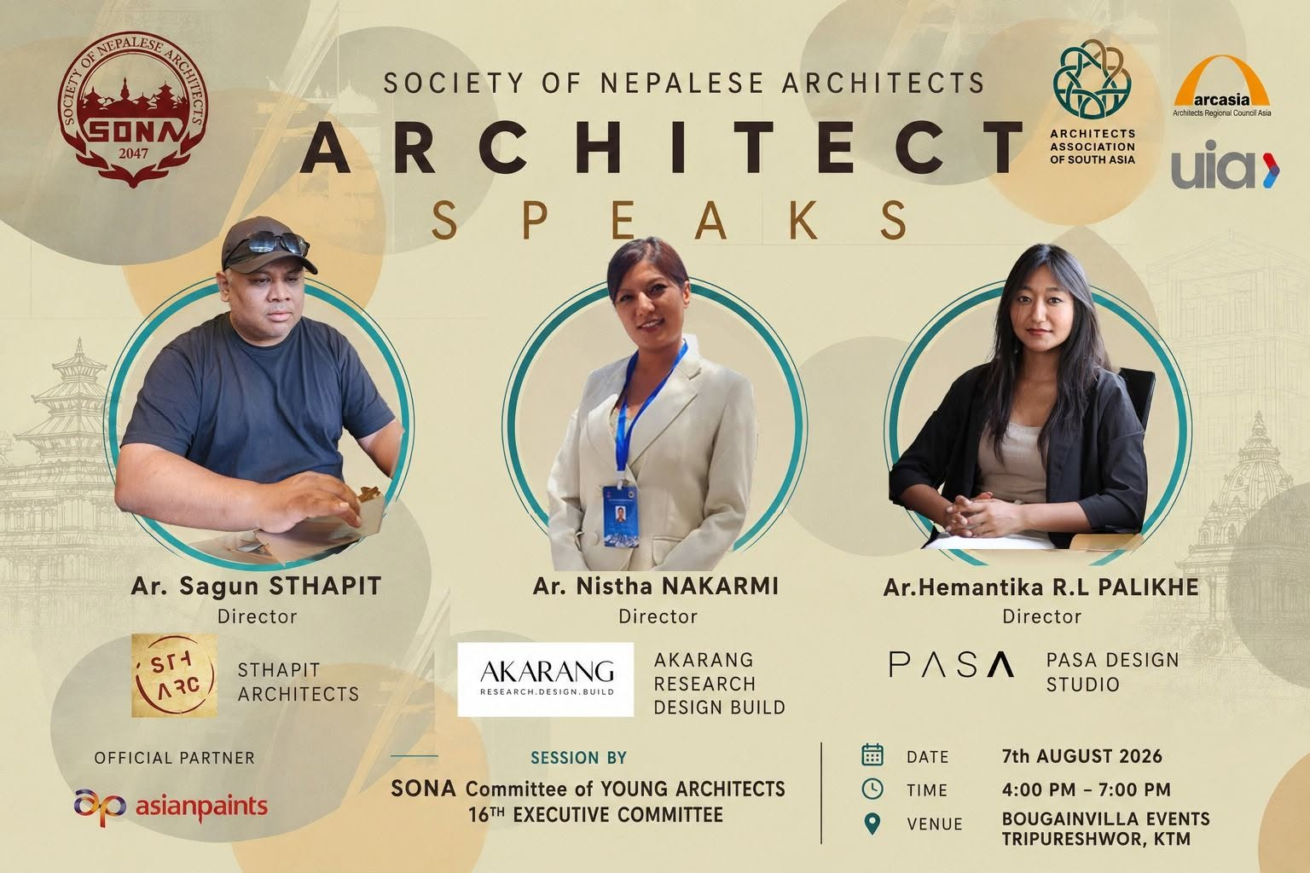
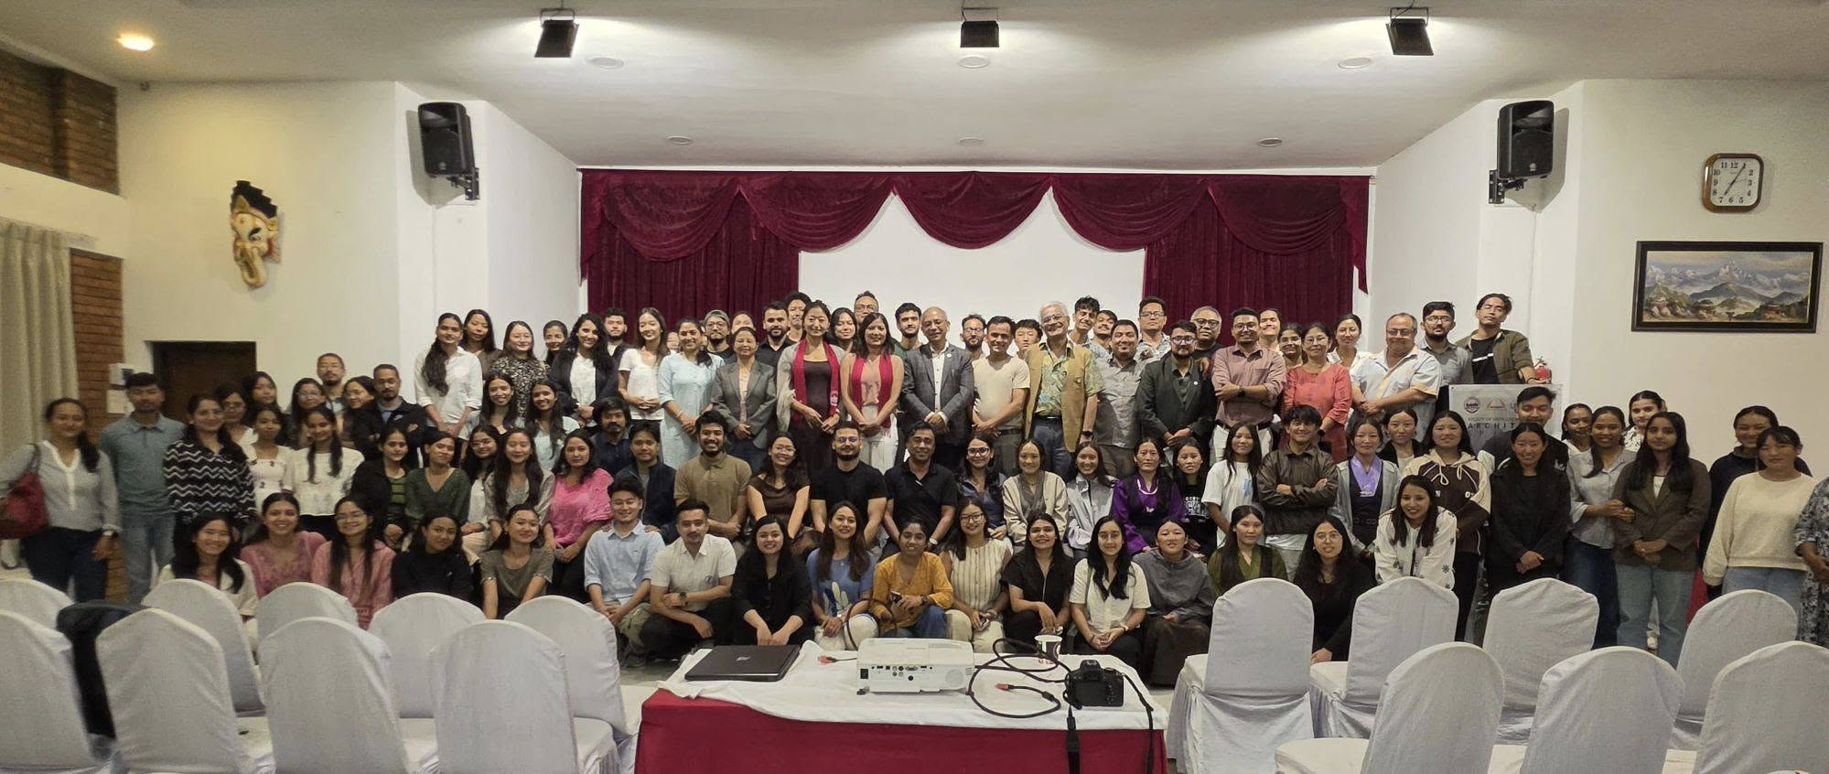
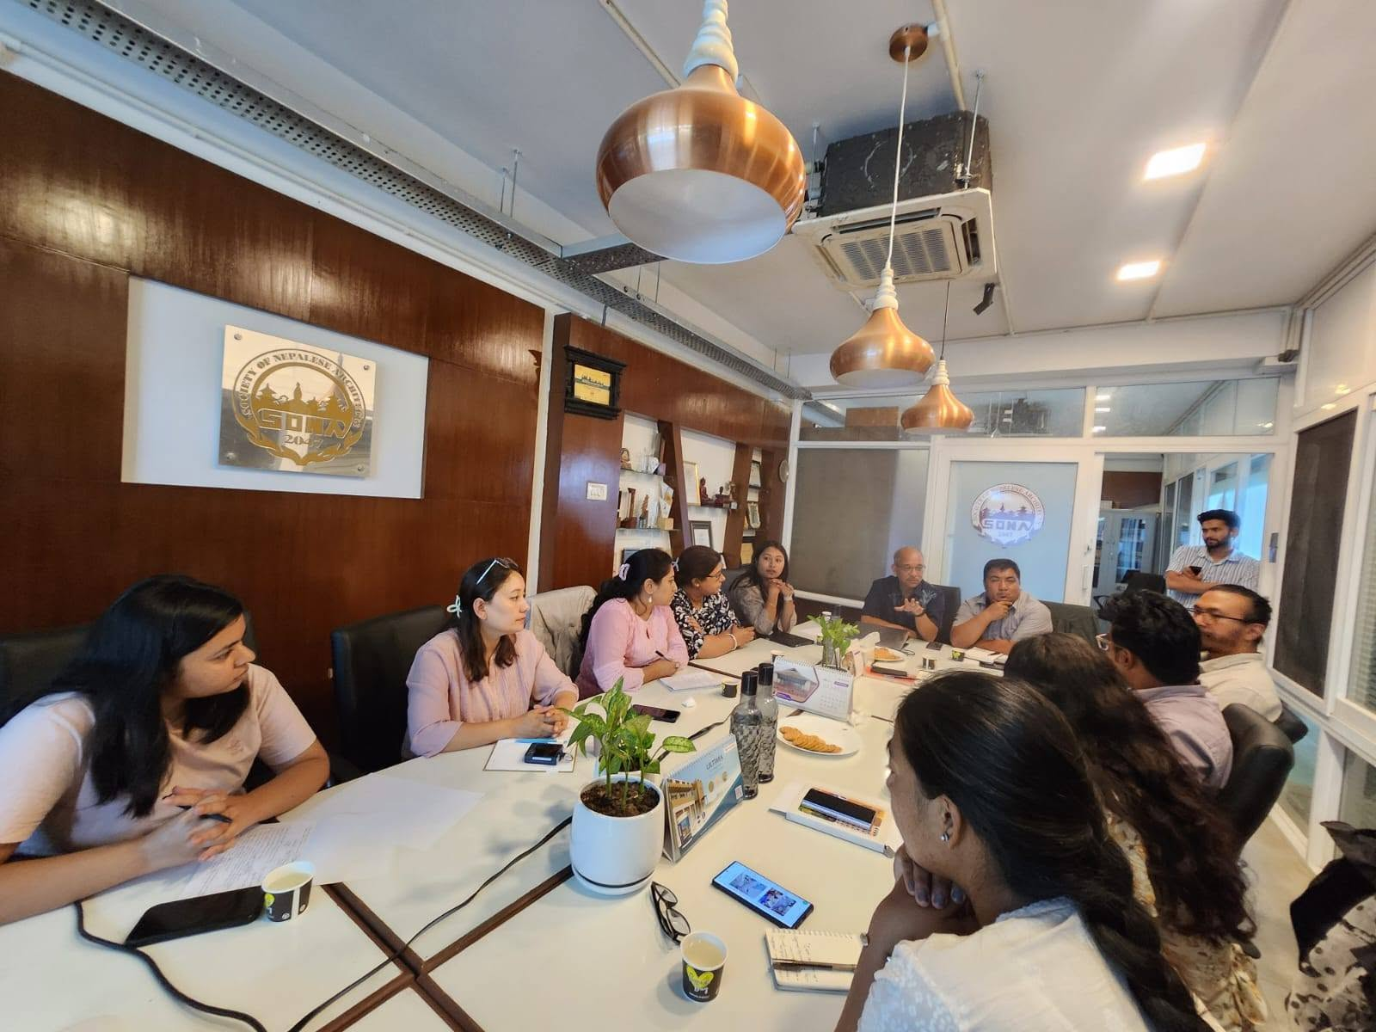
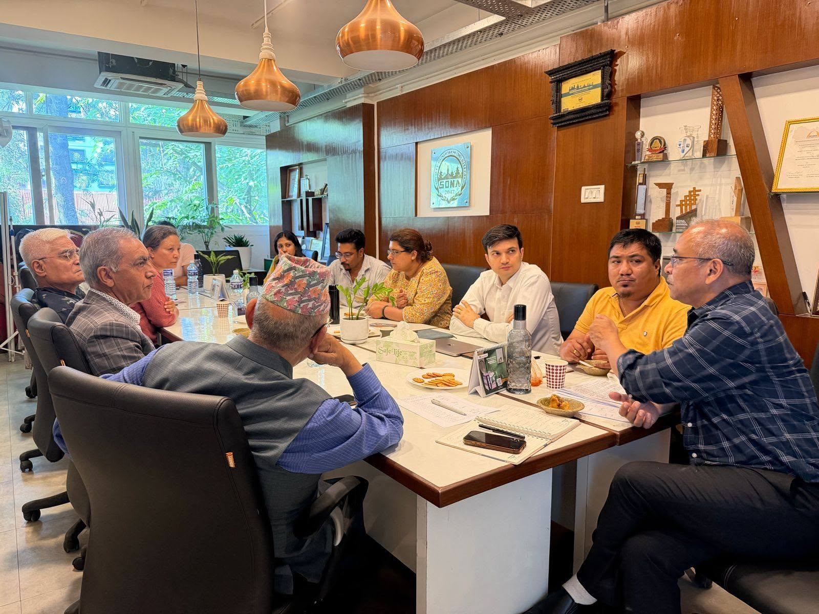
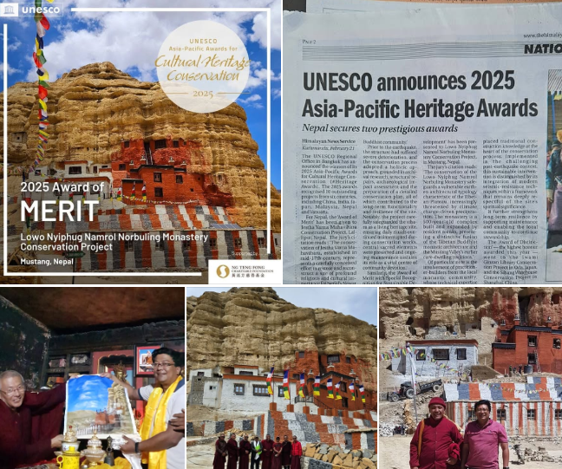
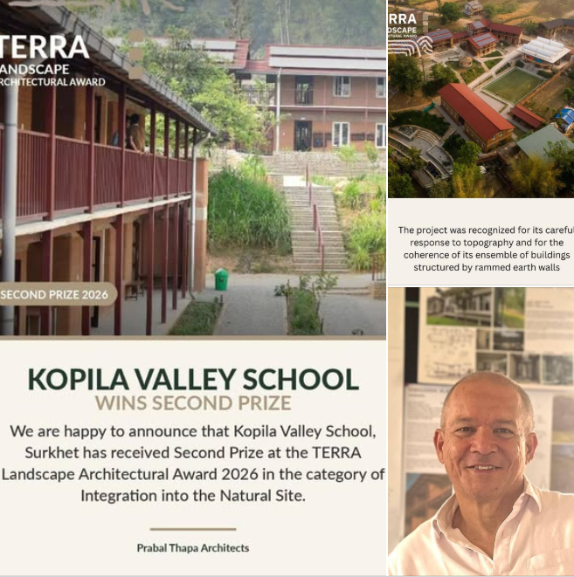
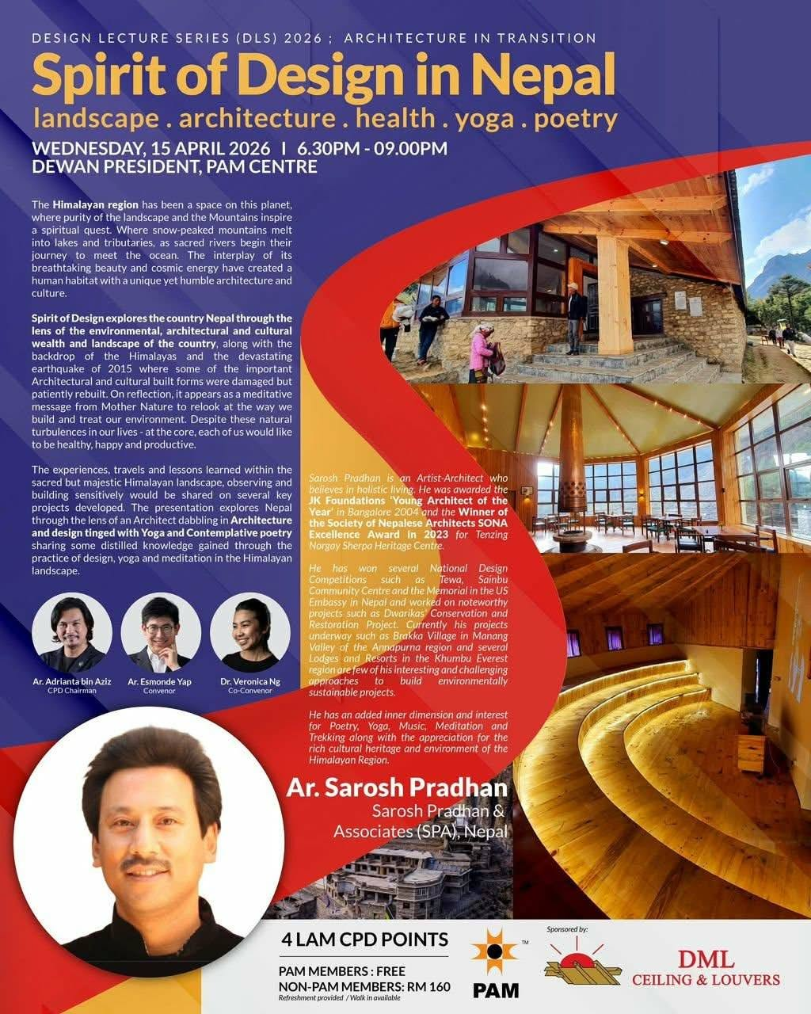
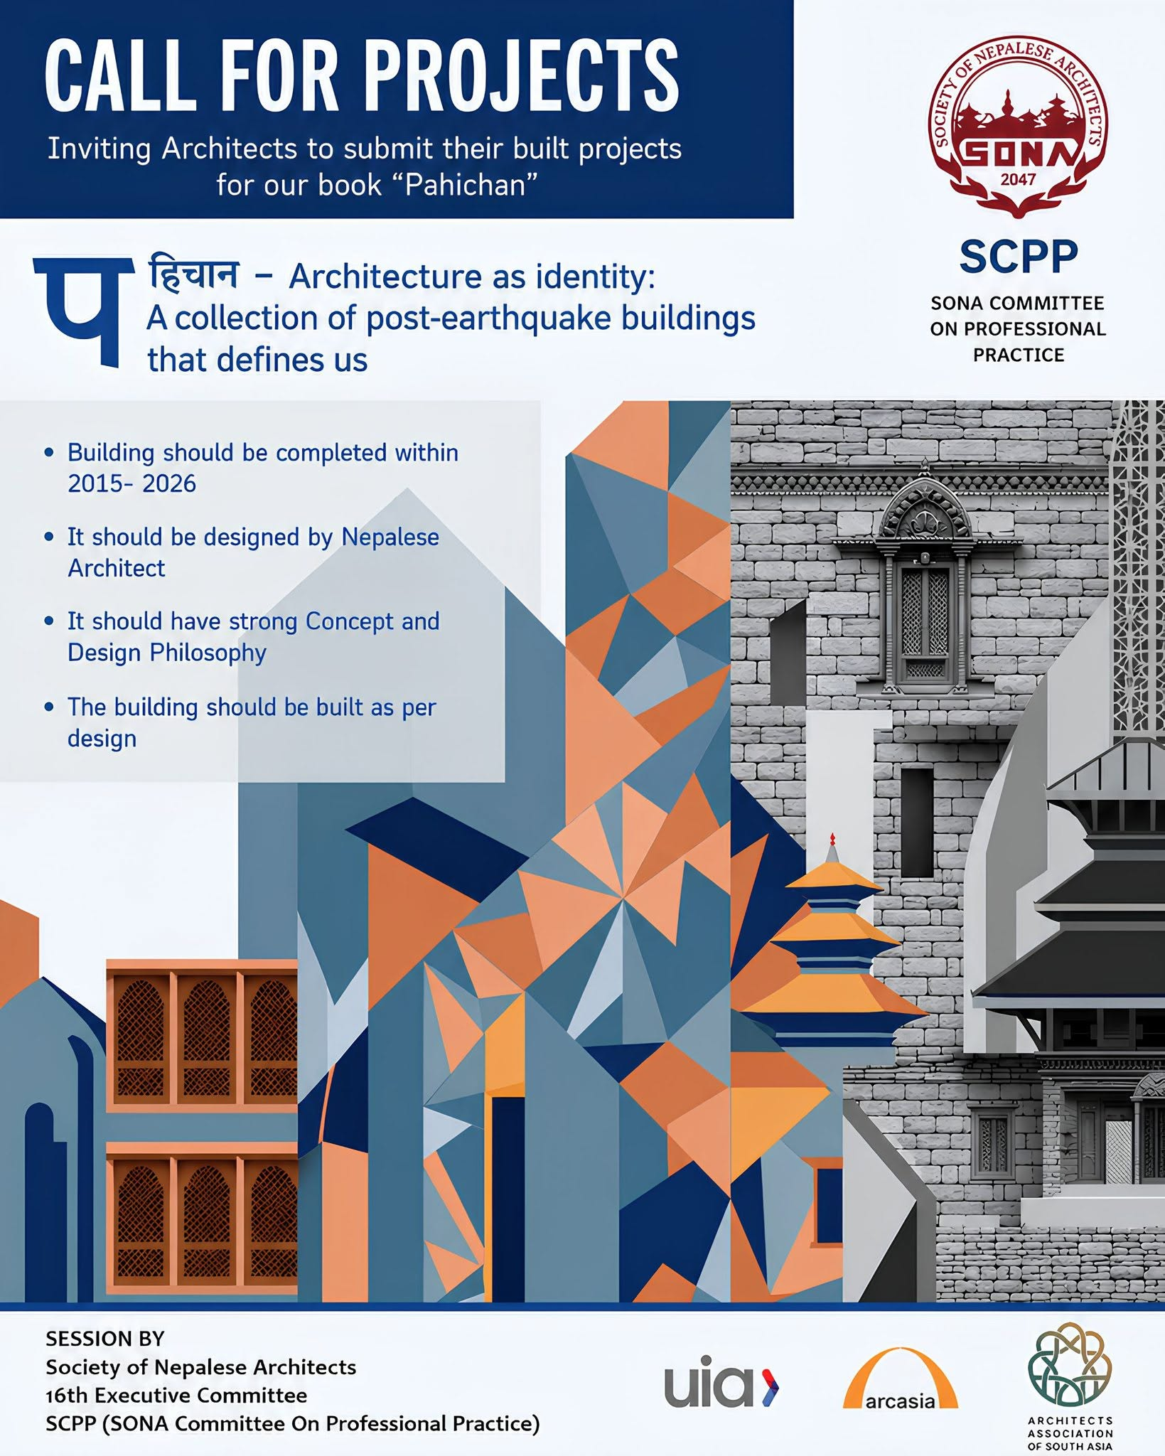
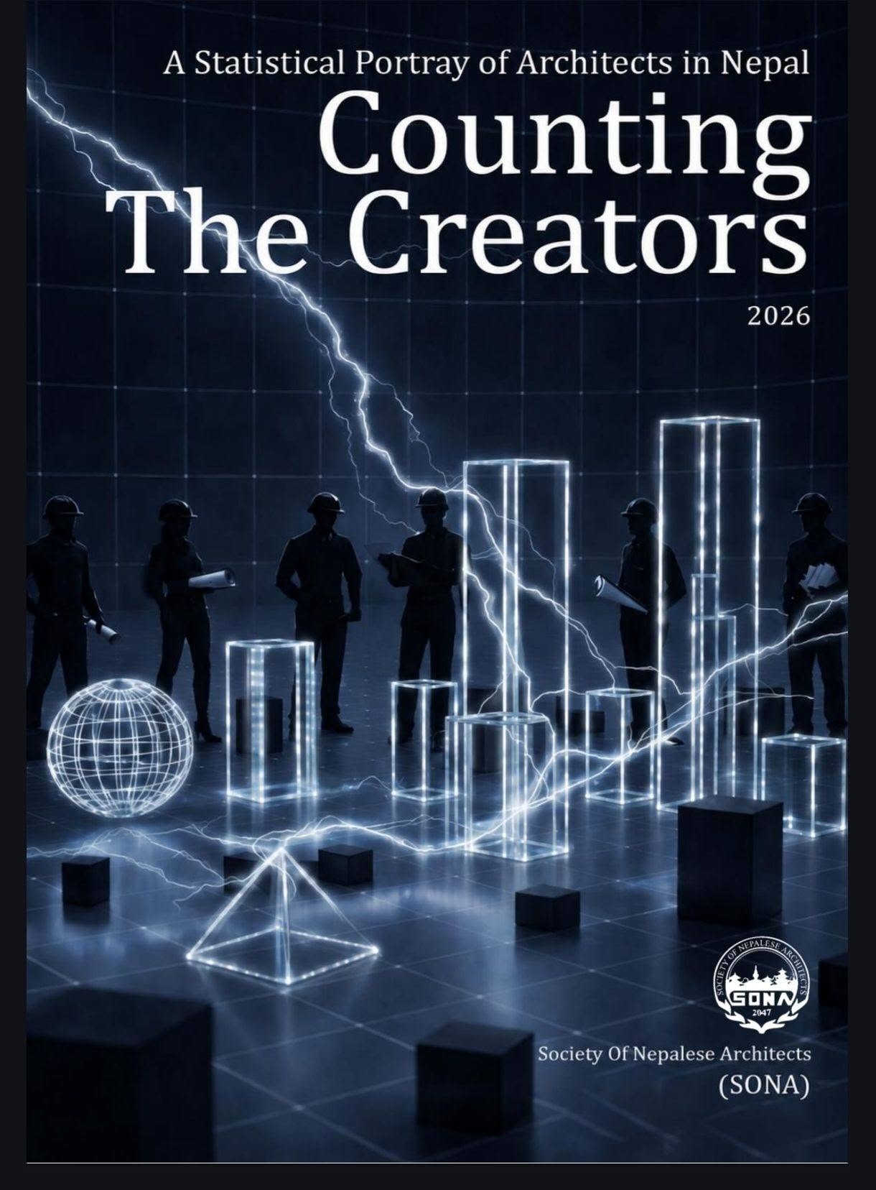
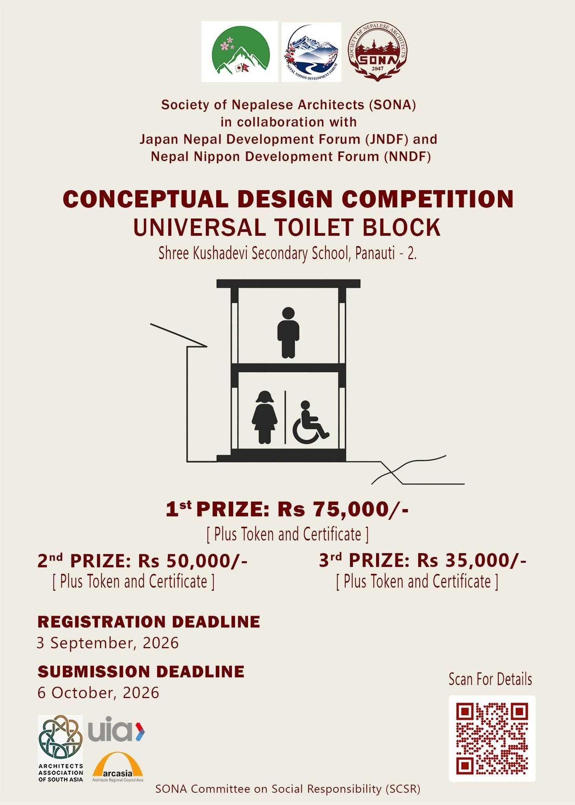
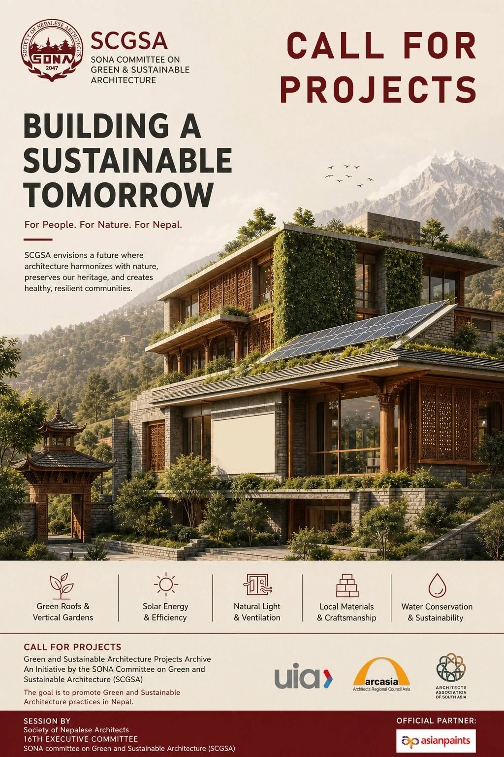
SOCIETY OF NEPALESE ARCHITECTS (SONA)
November, 2026: SONA organized panel sessions on 35th SONA Day; (a) Fire Safety parameters in Building Design with multidisciplinary professions and (b) Understanding modern architecture as Heritage: Restoration of the Ministry of Health and Population Building by Louis I Kahn. The sessions were attended by number of concerned Government officials which helped them to understand the importance of the MOHP building.
December, 2026: New 16th SONA Executive Committee was formed through the election. It is now led by Ar. Iswor Lal Joshi as the President along with 14 other executive members. This is Ar. Joshi’s second term as the President.
February, 2026: Logo Design Competition was announced for the newly formed Architects Association of South Asia (AASA) which includes Maldives, Bhutan, Bangladesh, Pakistan, India, Sri Lanka and Nepal. About 53 entries were received from the member nations. The winner of the logo design competition was Ar. Kabindra Shrestha from SONA.
September 2025-March 2026: During the 21st Asian Congress of Architects in Incheon, South Korea, Genz Protest sparked the whole Nepal where many lives were lost and important buildings were badly burnt down. SONA is very grateful to receive a number of concerned letters from ARCASIA and ARCASIA nations. Immediately after we got back, after a series of meetings with Government officials, our advisory panels, and heritage experts, SONA mobilized volunteers for the inventories of the damaged buildings. One of the buildings was iconic Ministry of Health and Population (MOHP), designed by Master Architect Louis I Kahn in 1960s. With SONA’s continuous and dedicated effort, the Government agreed to preserve it with required interventions and technology. A complete restoration project document has been submitted to the Government for the implementation which was done by Center for Urban Planning Studies (CUPS) under SONA’s guidance.
March, 2026: SONA in collaboration with Architie organized a Portfolio and Practicum Experience sharing webinar with young student of architecture.
April, 2026: SONA invited interested architecture students to be on the list of Volunteer roster for the future SONA events. Interestingly 300 entries were received.
May, 2026: Annual SONA Futsal Competition was organized by SONA Committee on Young Architects (SCYA).
May, 2026: SONA Committee on Professional Practice (SCPP) organized an Architect Speaks Series on Inside Public Practice.
July, 2026: SONA in collaboration with Nepal Engineering Association (NEA) organized a session regarding the By-laws and Building Codes-Issues and Challenges. The discussion brought together a diverse panel of experts, including private practitioners, municipal engineers, and academic professionals, to share their experiences, perspectives, and recommendations on the practical challenges of implementing building codes and bylaws inn Nepal.
June, 2026: SONA revised its Code of Ethics which was formalized in 2016 to Code of Conduct which included all the parameters with legal definitions for professional ethics and harassments in work space, educational institutions etc. It was vigorously discussed with Advisory group, Architecture schools and concerned SONA members in presence of Legal Advisor.
August, 2026: SCYA organized an Architect Speaks Series on Aspiring Young Architects of the fraternity. The session was attended by 150 audiences.
June, 2026: SONA Committee on Professional Practice (SCPP) called for projects from its members for the Pahichan for the publication.
The Society of Nepalese Architects (SONA) is the National professional body that represents architects across Nepal. It was founded in 1990 by a group of architects from different sectors—academia, government, and private practice—with the aim of safeguarding and promoting the architectural profession in the country. Since then, SONA has played a vital role in ensuring that architecture in Nepal develops in harmony with the nation’s geography, culture, climate, and modern aspirations. Today, SONA has grown into an organization with over 2000 members nationwide. It is led by an Executive Committee, elected for two years, and supported by nine thematic sub-committees that focus on areas such as education, sustainable architecture, heritage conservation, and women in architecture.
February, 2026: SONA Life member Ar. Alex Shrestha, won the prestigious UNESCO 2025 Asia-Pacific Heritage Awards for his conservation project of Lowo Nyiphug Namrol Norbuling Monastery in Mustang.
July, 2026: SONA Life member Ar. Prabal Thapa won the Second prize at the Terra Landscape Architectural Award 2026 in the category of integration into the natural site for his project Kopila Valley School in Surkhet.
April, 2026: SONA Life member Ar. Sarosh Pradhan was invited as speaker in the Design Lecture Series (DLS) 2026: Architecture in Transition, organized by PAM Pertubuhan Akitek Malaysia (PAM) at PAM Centre, Kuala Lumpur.
May 2026: SONA Committee on Green and Sustainable Architecture (SCGSA) called for green building projects from its members.
August, 2026: SONA published the Counting The Creators- the report about the Architects data of Nepal.
August, 2026: SONA Committee on Social Responsibility (SCSR) called for a Universal Toilet design competition.

