Slide 1

ALACE
2021 Report
To council committee meeting
Date 30-31 October 2021

Slide 2
Contents
Current Office Bearers of Institute
Current Membership Strength
2020-2021 ALACE Activities
2021-2022 Plan

Slide 3
1. Current Office Bearers of Institute
President : Ar. Phonexay Southiphong
Vice presidents 1 : Ar. Khamthavy Thayphachanh
Vice presidents 2 : Ar. Manokham Vongxay
Committee Board : Assoc. Prof. Manoloth Phinith
Auditor : Assoc.Dr. Aphisayadeth Insisiengmay
Honorary Secretary : Ar. Phatthana Simmalavong
Honorary Treasurer : Ar. Sounantha Kanlaya
Social and Communication : Ar. Sounantha Kanlaya
Professional Practice : Ar. Phatthana Simmalavong
Education Committee : Assoc.Prof. Dr. Khampaseuth Thepvongsa
External Relation Committee: Ar.Saykham Thammanosouth

Slide 4
2. Current membership Strength
ALACE Membership: 1,205
Regular Member 1,045
Associate Member 158
Honorary Member 2
Asian Architect’s 9

Slide 5
3. 2020-2021 ALACE Activities Implemented and Challenges

Slide 6
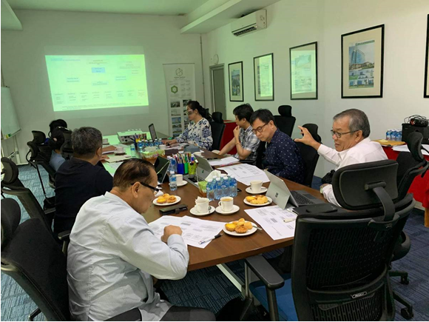
ALACE Congress preparation in 2020 to elect a new term of Office Bearers

Slide 7

Video Conference with ASA ESAN, “Dinner Talk at Thailand

Slide 8
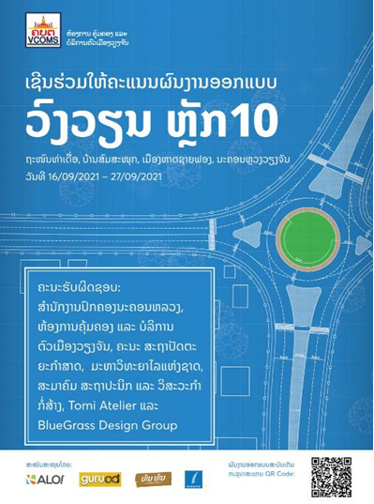
Competition Awards by ALACE and National University and Art and Culture School

Slide 9
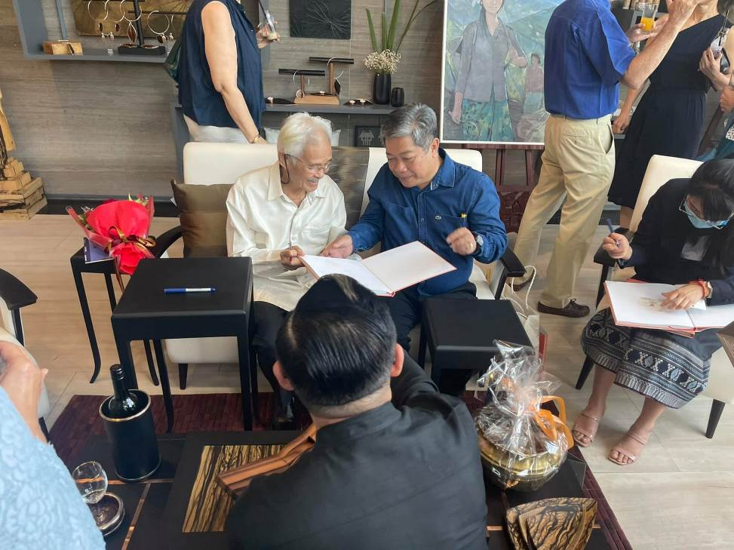
PRESS CONFERENCE - National Artist Awards WITH ART & CULTURE SCHOOL

Slide 10
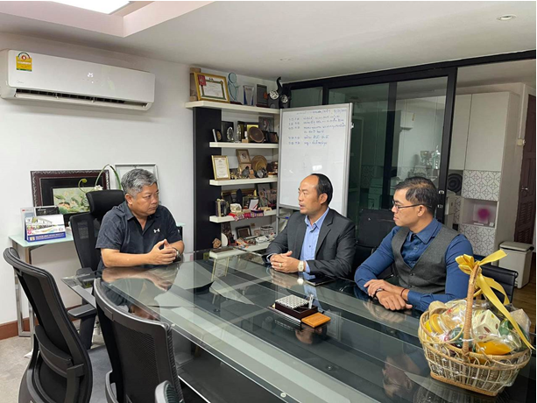
Outreach and Publication Program between
ALACE and TOYO Factory (ALACE Member)

Slide 11
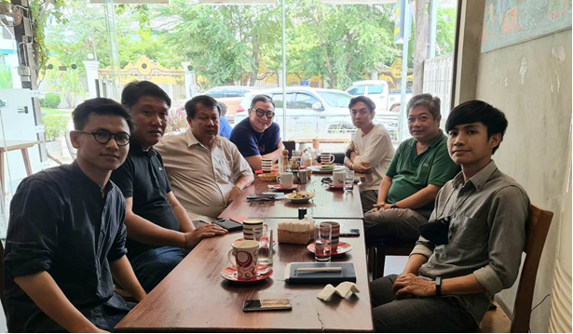
Breakfast Talk with Faculty of Architecture (Professor of National University and Designers from Art and Culture School)

Slide 12
Challenges
  Due to COVID-19 pandemic in 2019 up until now, many ALACE activities were cancelled and postponed:
  LAOS Build 2020
  Annual Conference
  Architects Dinner Talk
  No financial support from foreign sponsors / donors
  Postpone the election of the new Office Bearers

Slide 13
4. 2021-2022 Plan
ALACE Fair 2021 and Annual Forum on November 2021
Improving of ALACE organization
The preservation and management of profession in terms of legislation
Improvement of the association’s works
Enhancing financial status to be stable and permanent
The development of communication and advertisement to ALACE members
Assist and support young architects
Educate and research on the Lao Architecture identity
Contributing the challenge of auction particular in the government’s construction projects which using the state budget
Improving the commission to strengthen international relationship
Helping organizations in producing human resources to be strengthened
Improving social and profession relation.

Slide 14
Thank you for your attention

