Slide 1

KIRA Korea Institute of Registered Architects
41st ARCASIA Council Meeting

Slide 2
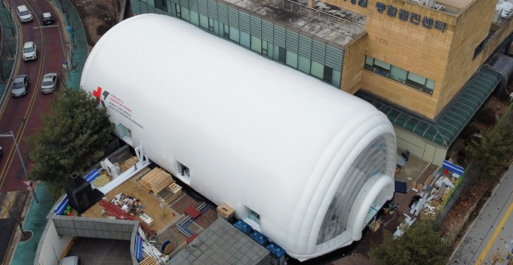
COVID 19 and
KAIST’s Mobile Clinic Modules(MCM)
Exterior of the MCM installed in Nowon District, northern Seoul. [KAIST]
Specifically built to treat patients with infectious diseases, these units prevent the escape of viruses.
14 days to built, 5 days to set up, 15 minutes to assemble one negative pressure room
About 15 meters (49 feet) wide and 30 meters long
with four negative pressure isolation rooms, bathrooms attached to each of them, two offices for medical staff and a corridor.

Slide 3
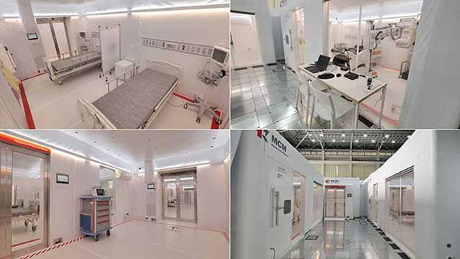
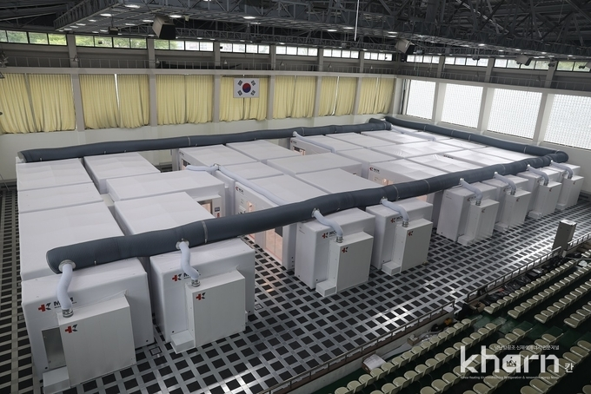
COVID 19 and
KAIST’s Mobile Clinic Modules(MCM)
The MCM installed in Indoor Gymnasium, Gyeonggi Human Resources Development Institute. [KAIST]
It won the Reddot Design Award in Germany.
It has been installed and tested in Korea Atomic Energy Research Institute, Jeju Vaccination Center.
ShinsungE&G participated in development and commercialization of MCM with KAIST
It has been installed and utilized in Emergency room of Konyang University Hospital and Indoor Gymnasium of Gyeonggi Human Resources Development Institute.

Slide 4
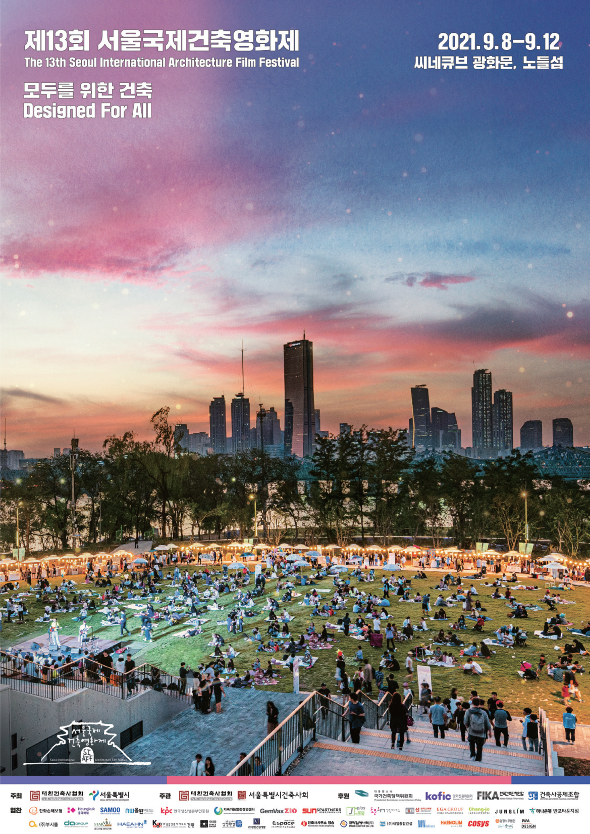
The 13th
Seoul International
Architecture Film Festival
Asia’s only architectural film festival
22 Films from 14 countries
24,301 audiences
Organized by
KIRA & Seoul City
Hosted by
KIRA & KIRA Seoul

Slide 5
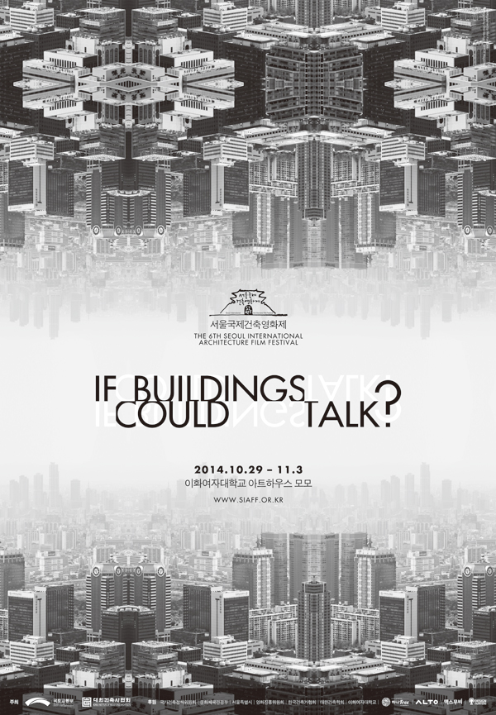
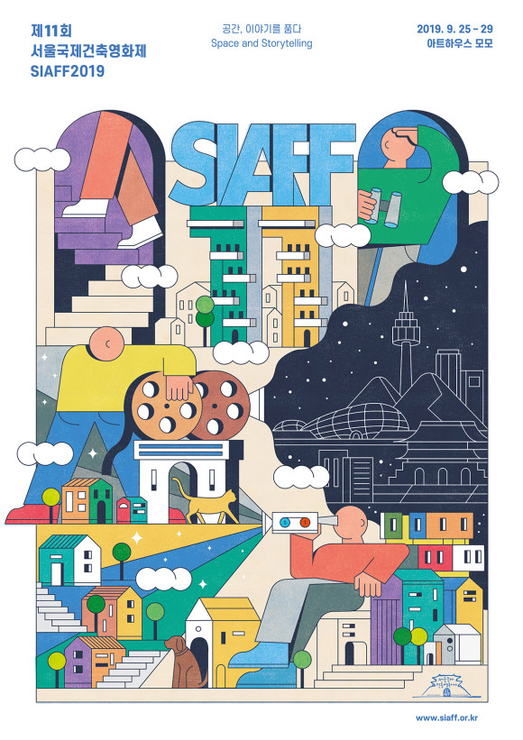
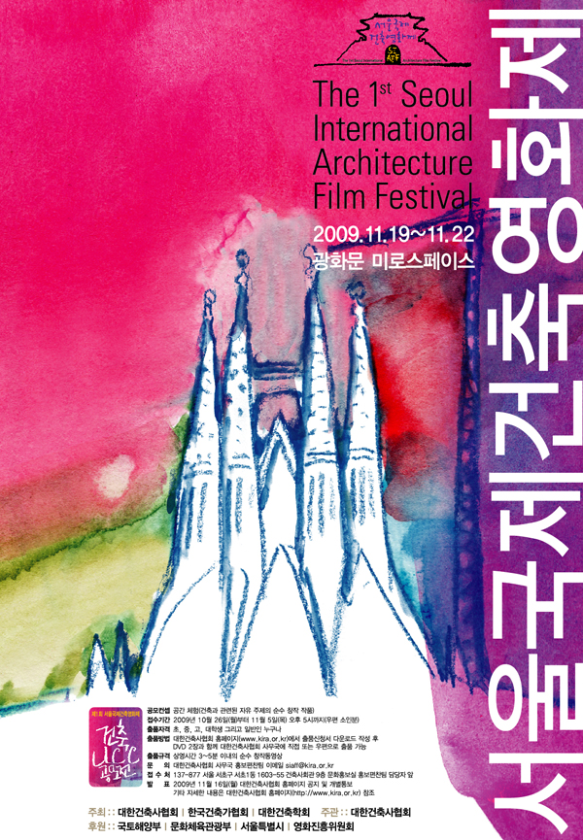
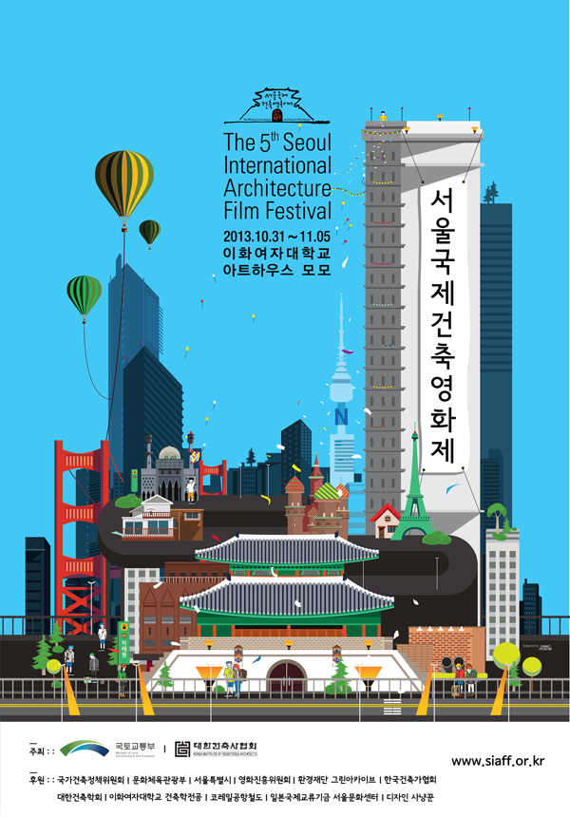
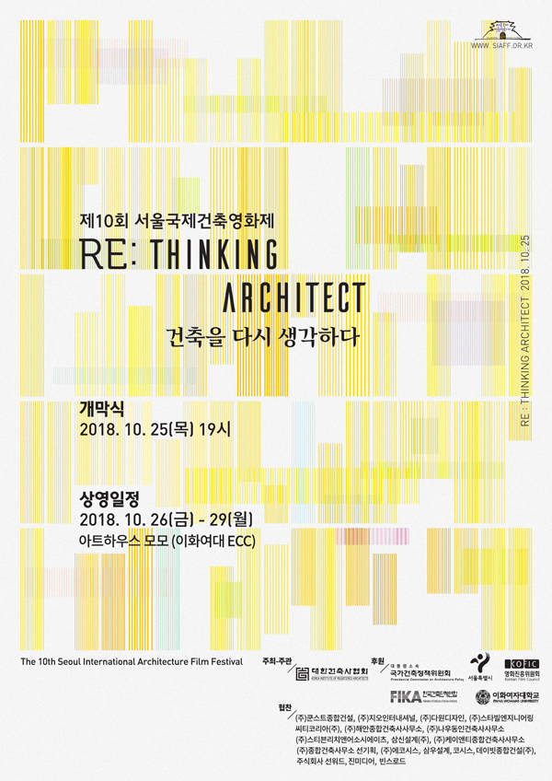
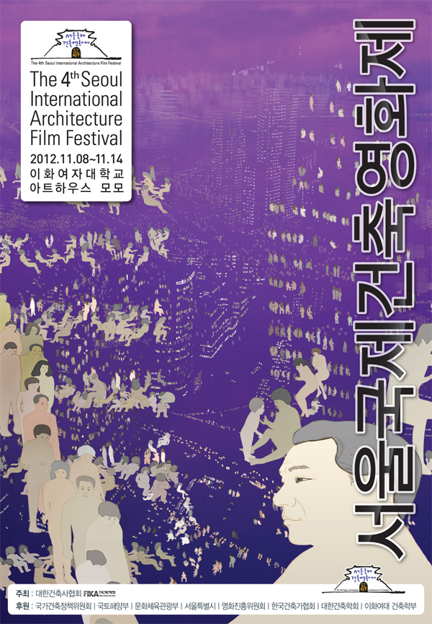
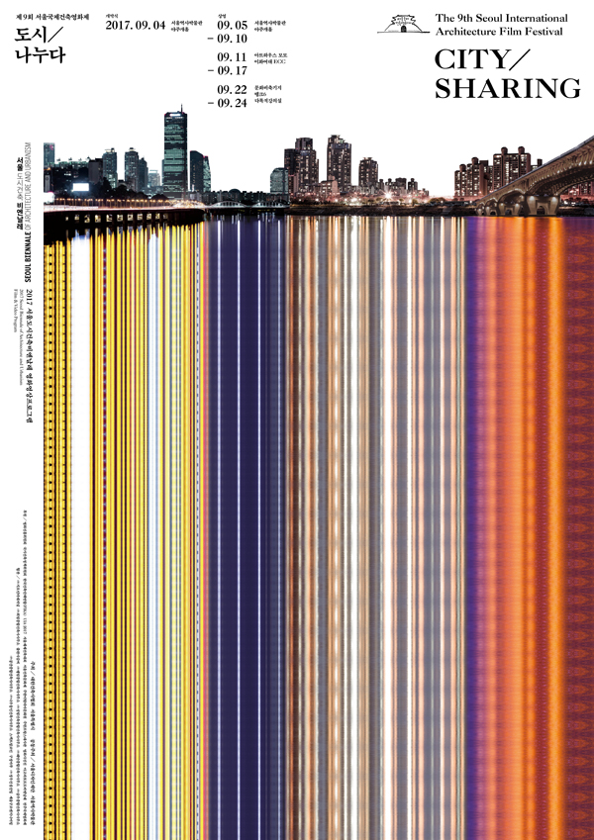
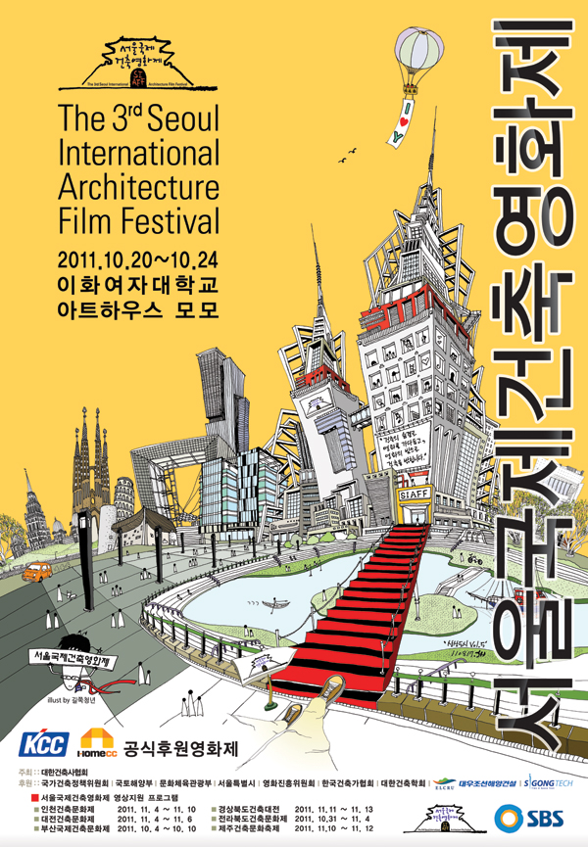
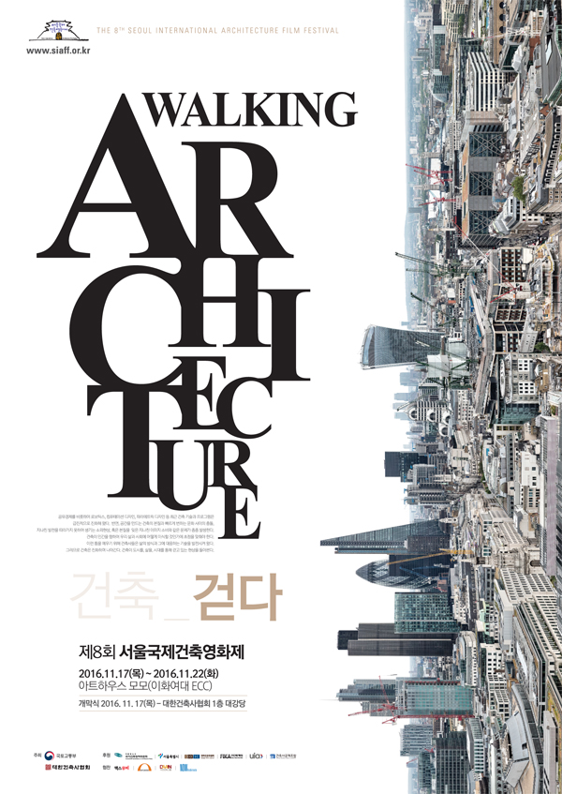
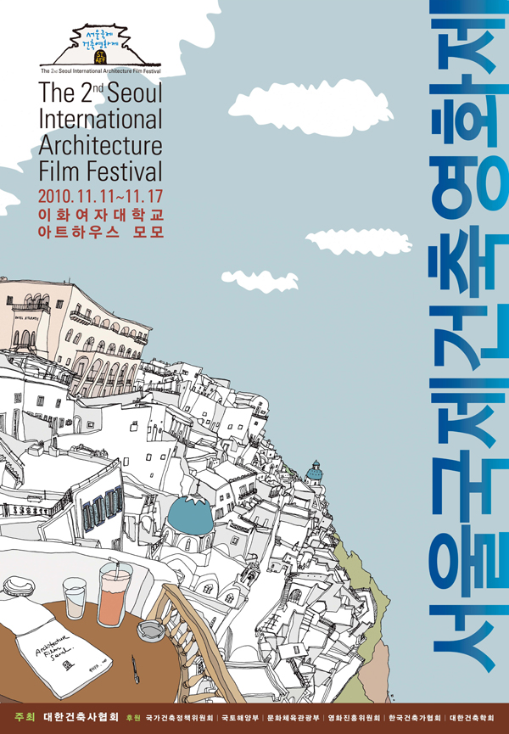
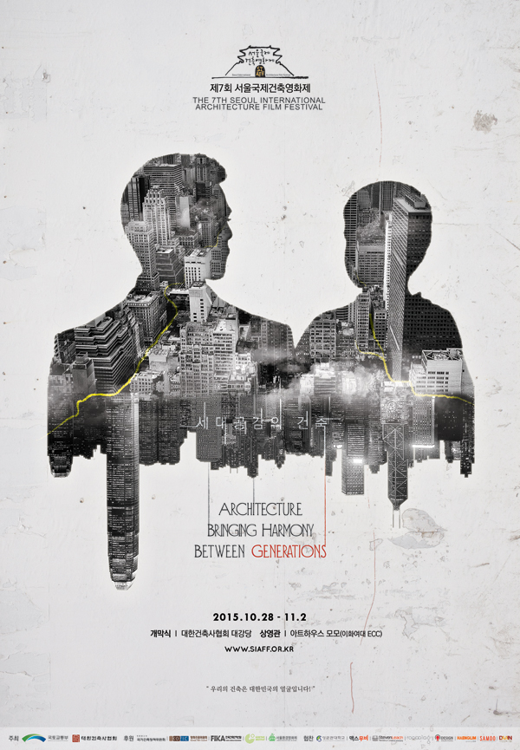
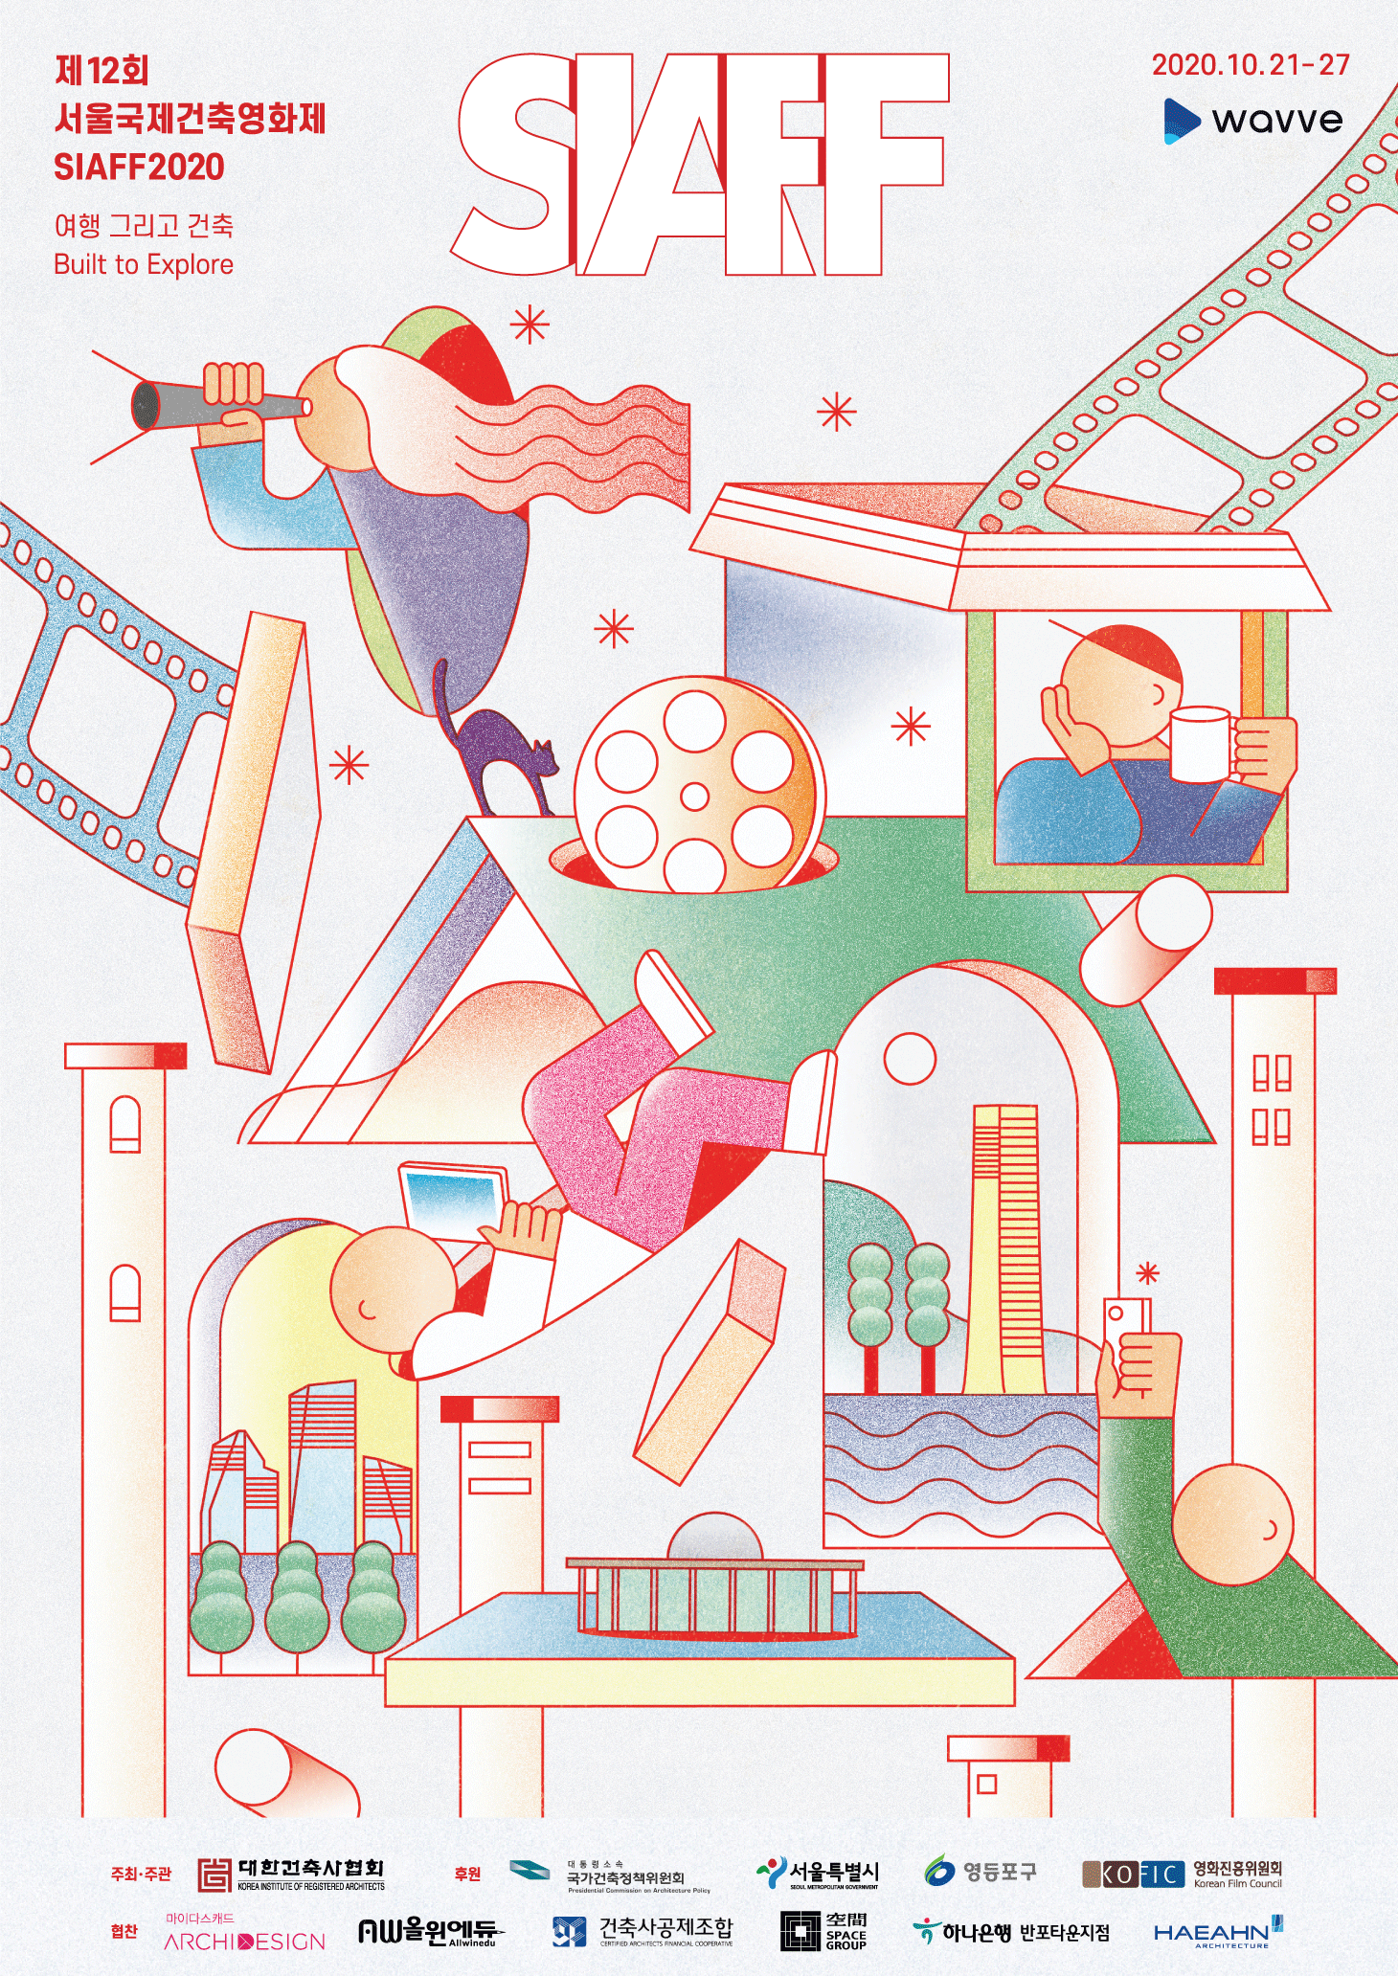
History of
Seoul International
Architecture Film Festival
The Architects | Link | Between | City | House | Buildings
Architecture Bringing Harmony Between Generations | Walking Architecture | City/Sharing | RE: Thinking Architect | Space and Storytelling | Built to Explore
Notes:
Opening Film
빔스의 아이들 Kids of the Bims
Dir. AM HERE
2021 | 34' | Netherlands |
Color/B&W | G | Asian Premiere

Slide 6
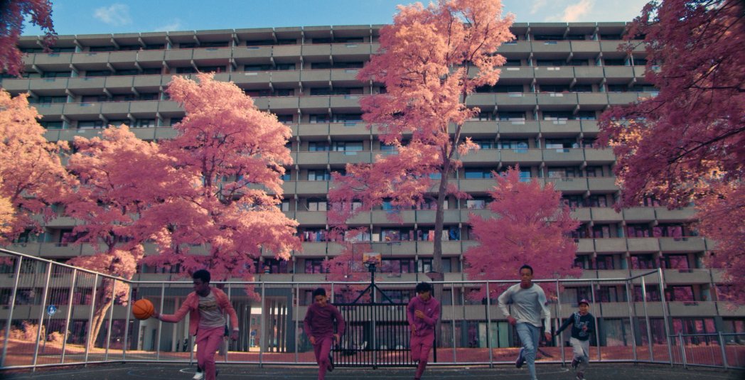
The 13th
Seoul International
Architecture Film Festival
Opening Film
Kids of the Bims
Dir. AM HERE
2021 | 34' | Netherlands |
Color/B&W | G | Asian Premiere
Notes:
Opening Film
빔스의 아이들 Kids of the Bims
Dir. AM HERE
2021 | 34' | Netherlands |
Color/B&W | G | Asian Premiere

Slide 7
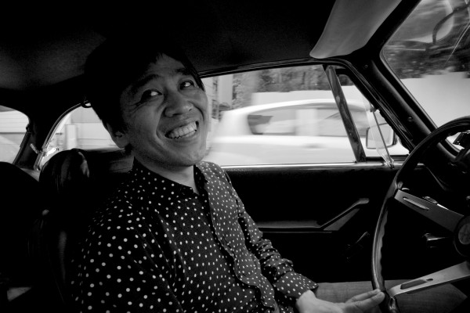
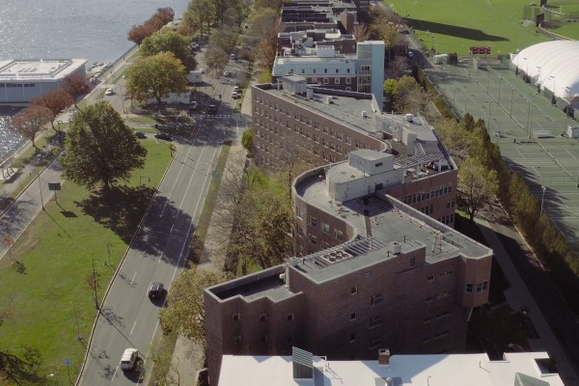
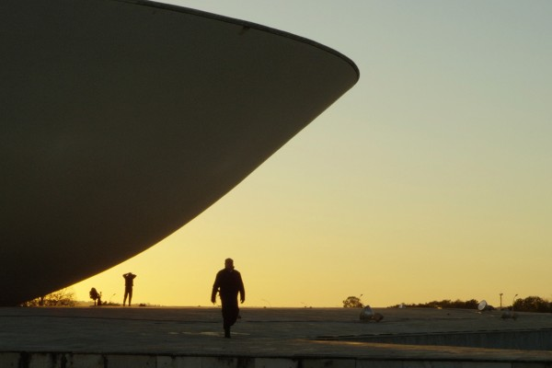
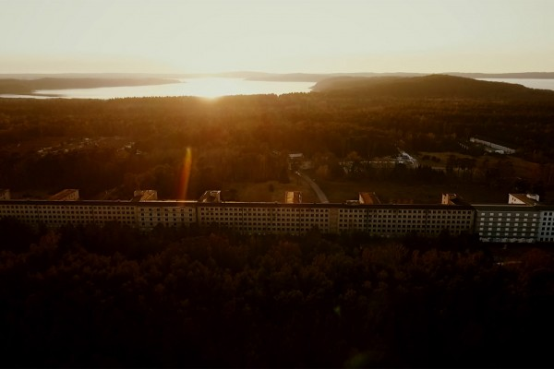
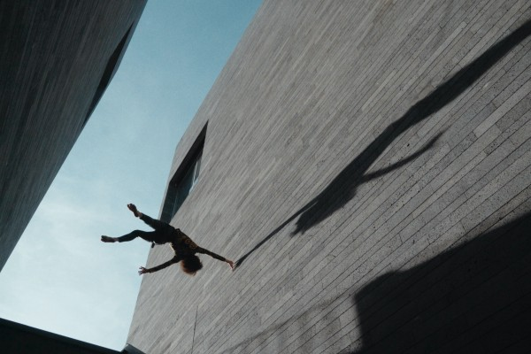
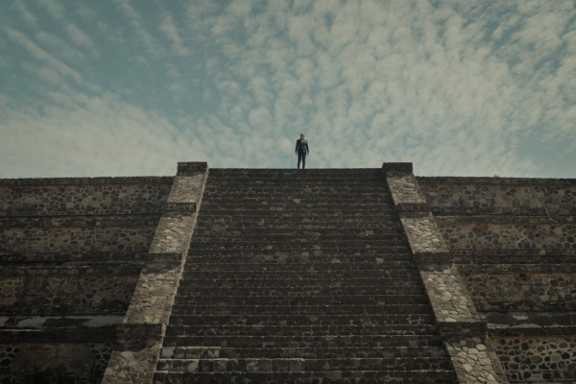
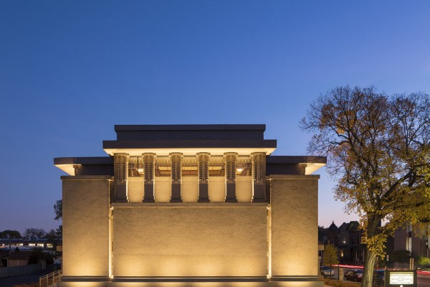
Masters & Masterpieces
 | Aalto Dir. Virpi Suutari 2020 | 103' | Finland | Color/B&W | 12
 | The Arch Dir. Alessandra Stefani 2020 | 104' | Italy | Color | 12 | Asian Premiere
 | Body-Buildings Dir. Henrique Pina 2021 | 50' | Portugal | Color | 18 | Asian Premiere
 | Inside Prora Dir. Nico Weber 2020 | 100' | Germany | Color/B&W | 12 | Korean Premiere
 | A Machine to Live in Dir. Yoni Goldstein, Meredith Zielke 2020 | 88' | USA | Color | 15 | Korean Premiere
 | Tokyo Ride Dir. Ila Bêka & Louise Lemoine 2020 | 90' | France, Japan | B&W | G | Korean Premiere
 | Unity Temple: Frank Lloyd Wright’s Modern Masterpiece Dir. Lauren Levine 2020 | 55' | USA | Color | G | Korean Premiere
Notes:
알토 Aalto
Dir. Virpi Suutari
2020 | 103' | Finland | Color/B&W | 12

Slide 8
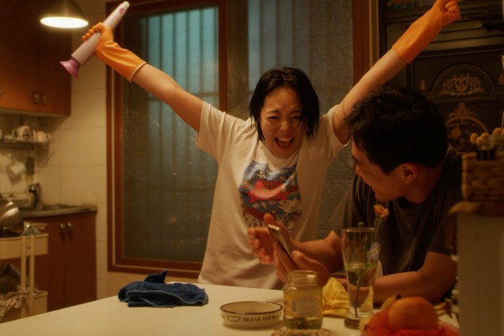
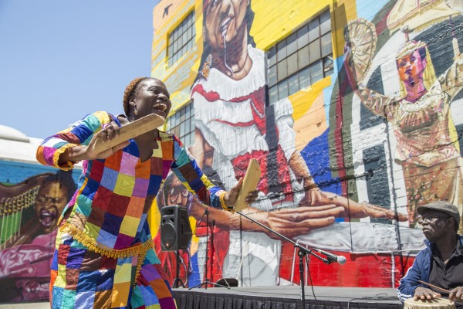
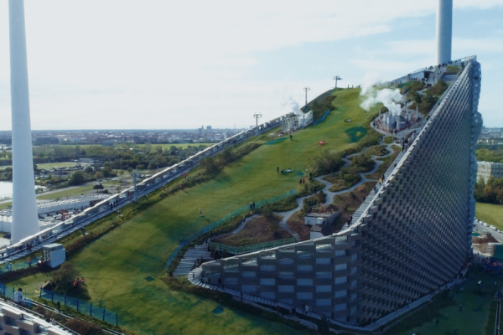
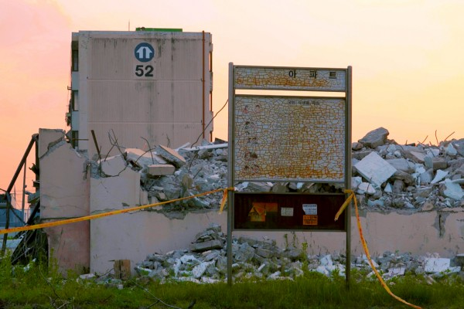
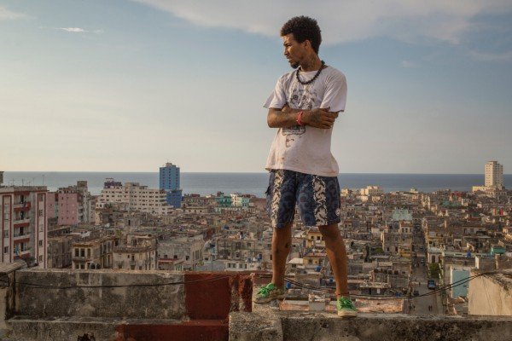
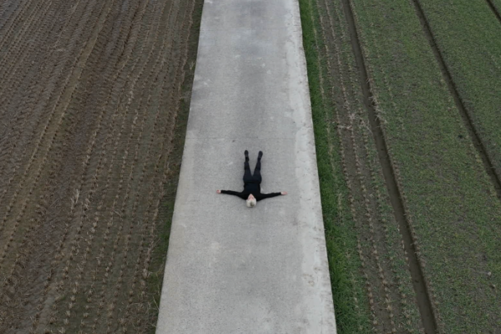
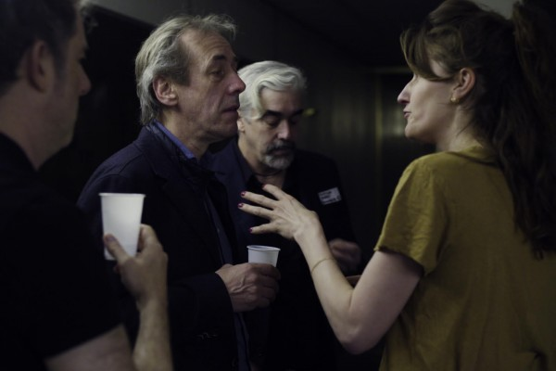
Urbanscape
 | Alice Street Dir. Spencer Wilkinson 2020 | 69' | USA | Color | G | Asian Premiere
 | The City of Emigrants Dir. Moon Seung-Wook, Yu Yejin 2020 | 61' | Korea | Color/B&W | 12
 | Havana, from on High Dir. Pedro Ruiz 2019 | 80' | Canada, Cuba | Color | 15 | Korean Premiere
 | Land and Housing Dir. Kim Kiseong 2020 | 83' | Korea | Color | G
 | Making a Mountain Dir. Kaspar Astrup Schröder, Rikke Selin 2020 | 51' | Denmark | Color | G | Korean Premiere
 | Schrodinger's Kitties Dir. Seo Yun-su 2021 | 23' | Korea | Color | 12
 | WTC a Love Story Dir. Wouter De Raeve, Lietje Bauwens 2020 | 62' | Netherlands, Belgium | Color | 12 | Asian Premiere
Notes:
알토 Aalto
Dir. Virpi Suutari
2020 | 103' | Finland | Color/B&W | 12

Slide 9
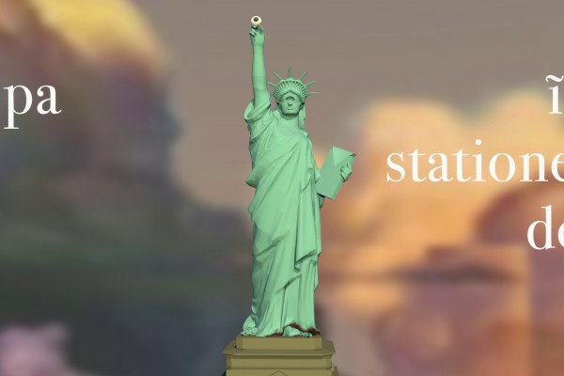
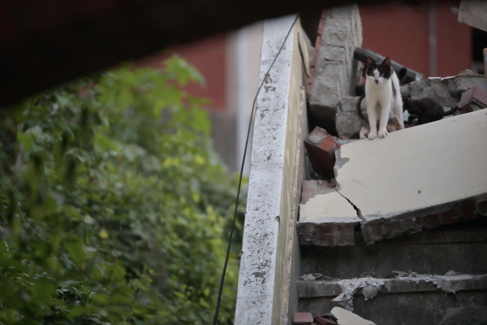
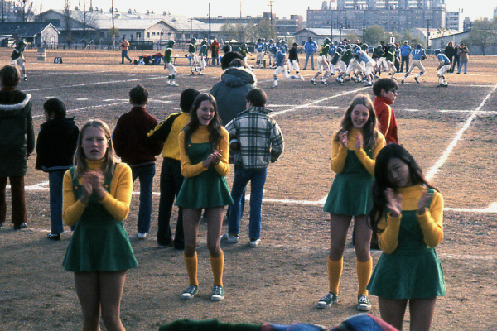
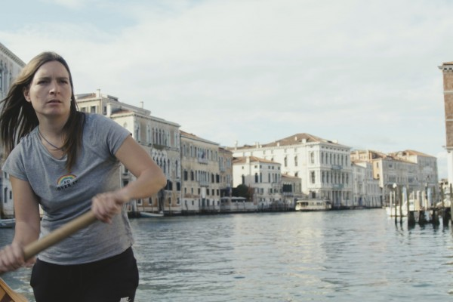
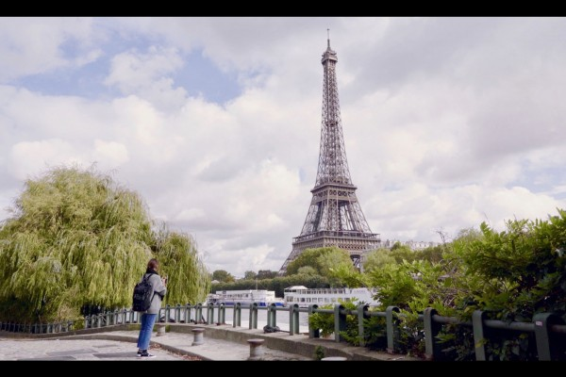
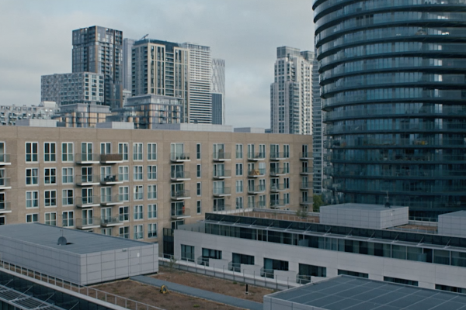
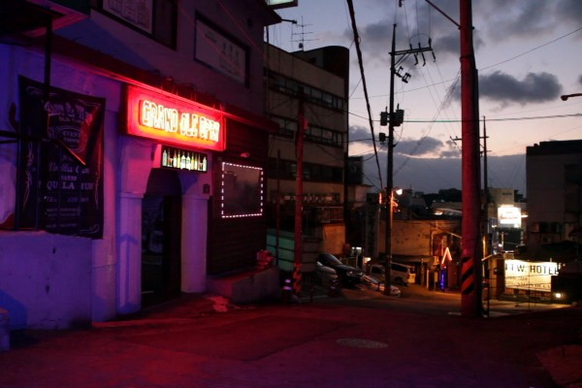
Beyond - Where We Go from Here
Special Section - Yongsan, Returned
 | Dreaming Cat Dir. Kang Min Hyun, Ji Won 2020 | 74' | Korea | Color | G
 | E14 Dir. Peiman Zekavat 2021 | 19' | UK | Color | 15
 | A Letter Dir. Hwang Ji-eun 2021 | 14' | Korea | Color | 12 | World Premiere
 | Molecules Dir. Andrea Segre 2020 | 68' | Italy | Color/B&W | 12 | Korean Premiere
 | Our Journey Home 2006 | 90' | USA | Color/B&W | 15 | Asian Premiere
 | Graeae: A Stationed Idea Dir. Jeong Yeoreum 2020 | 33' | Korea | Color/B&W | G
 | Itaewon Dir. Kangyu Garam 2016 | 94' | Korea | Color | 15
Notes:
알토 Aalto
Dir. Virpi Suutari
2020 | 103' | Finland | Color/B&W | 12

Slide 10
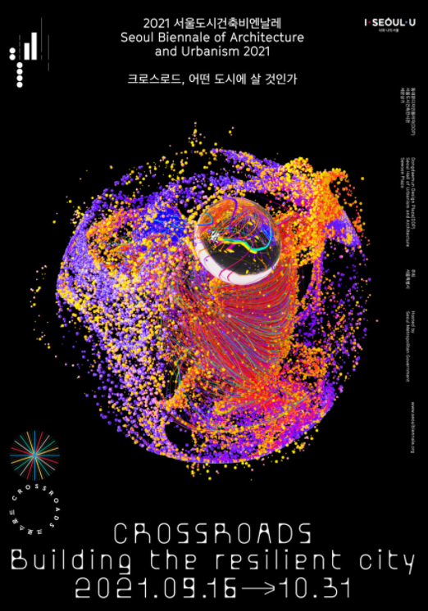
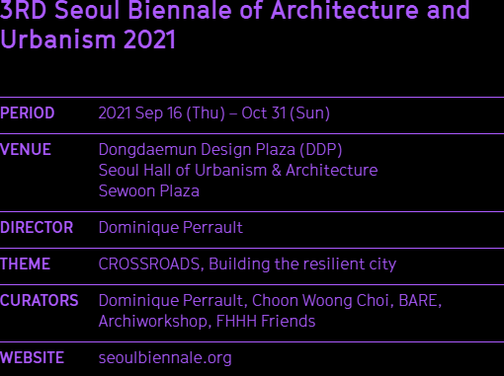

Slide 11
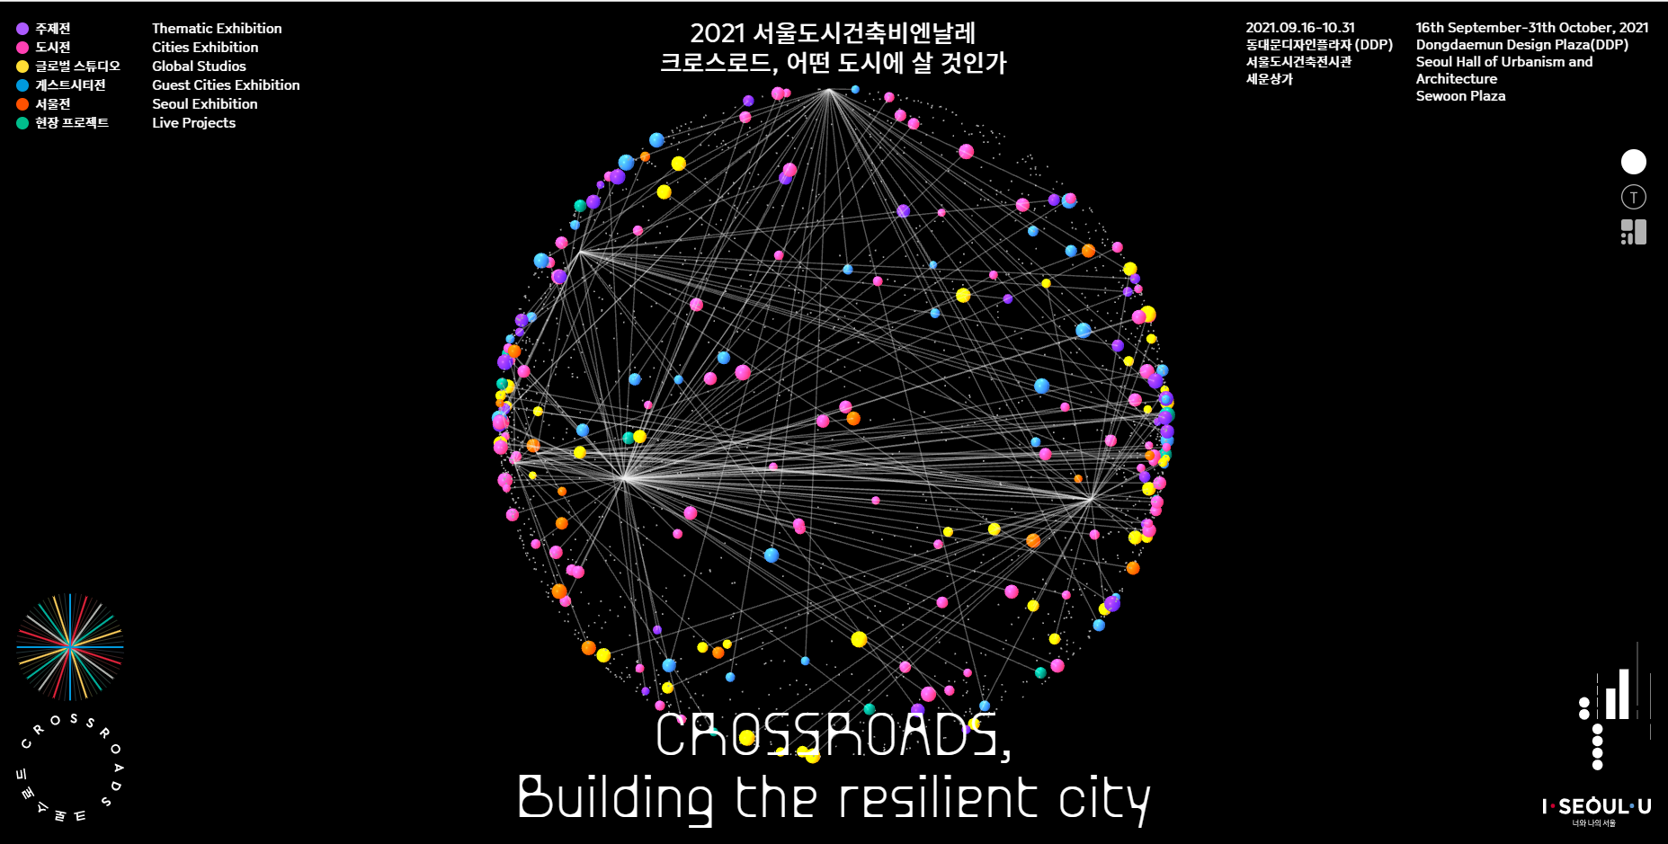

Slide 12
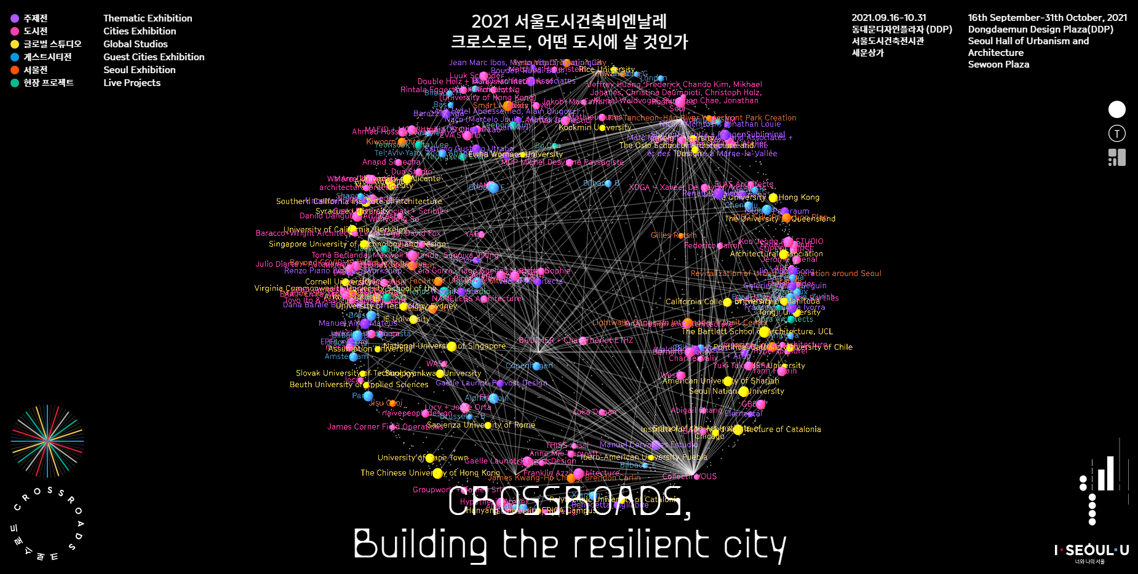

Slide 13
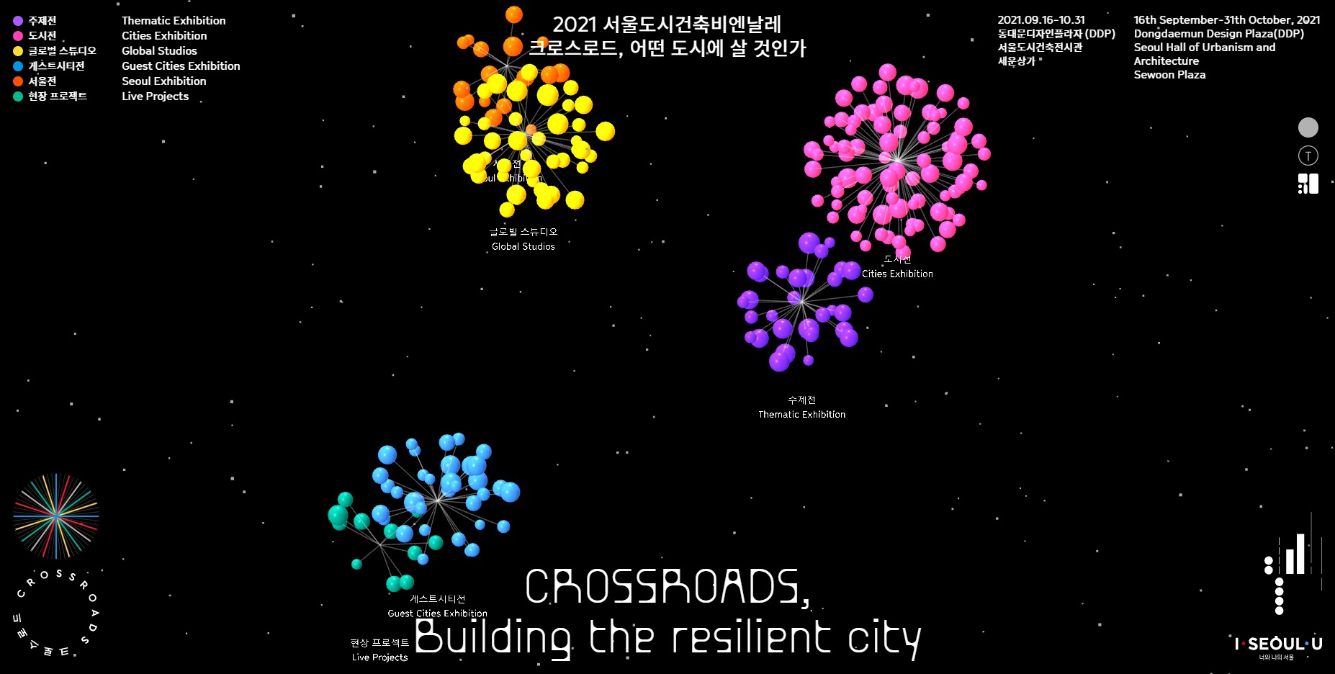

Slide 14



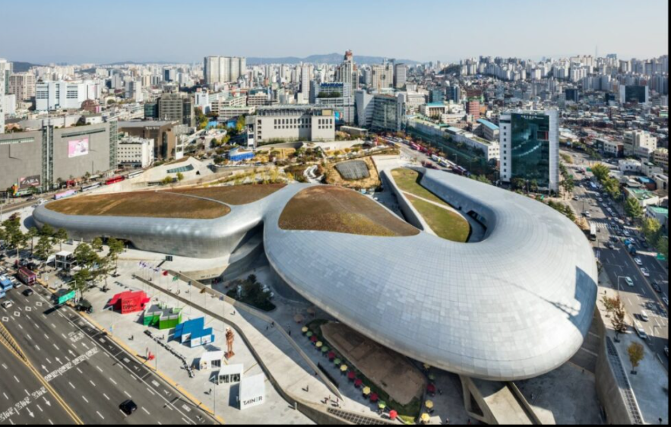
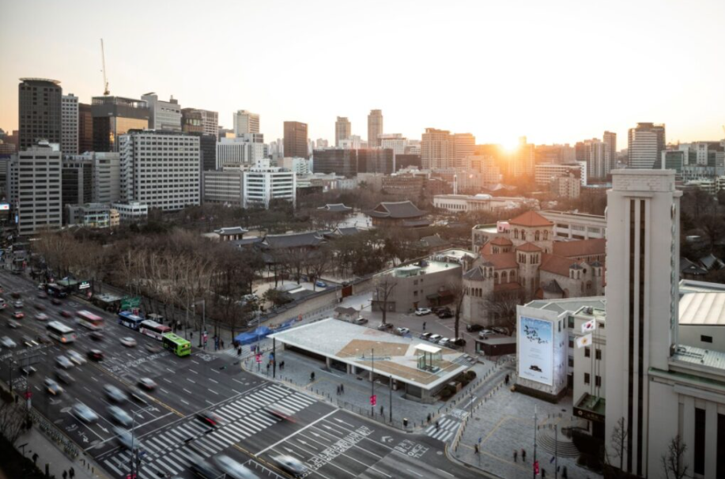
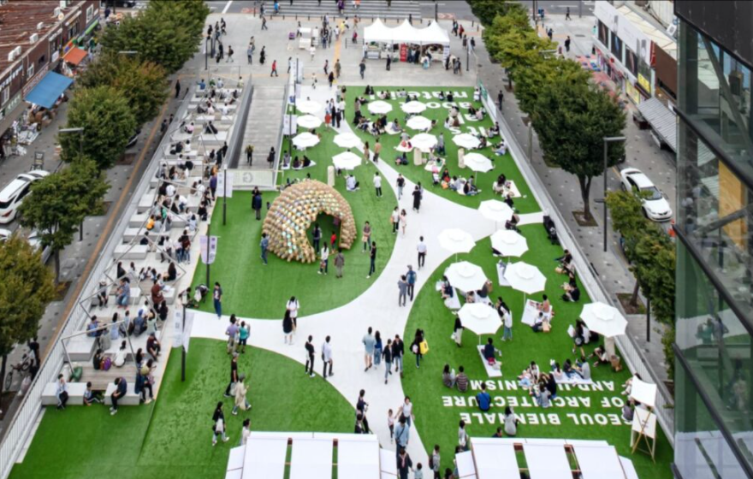



Introduction of Venues

Slide 15
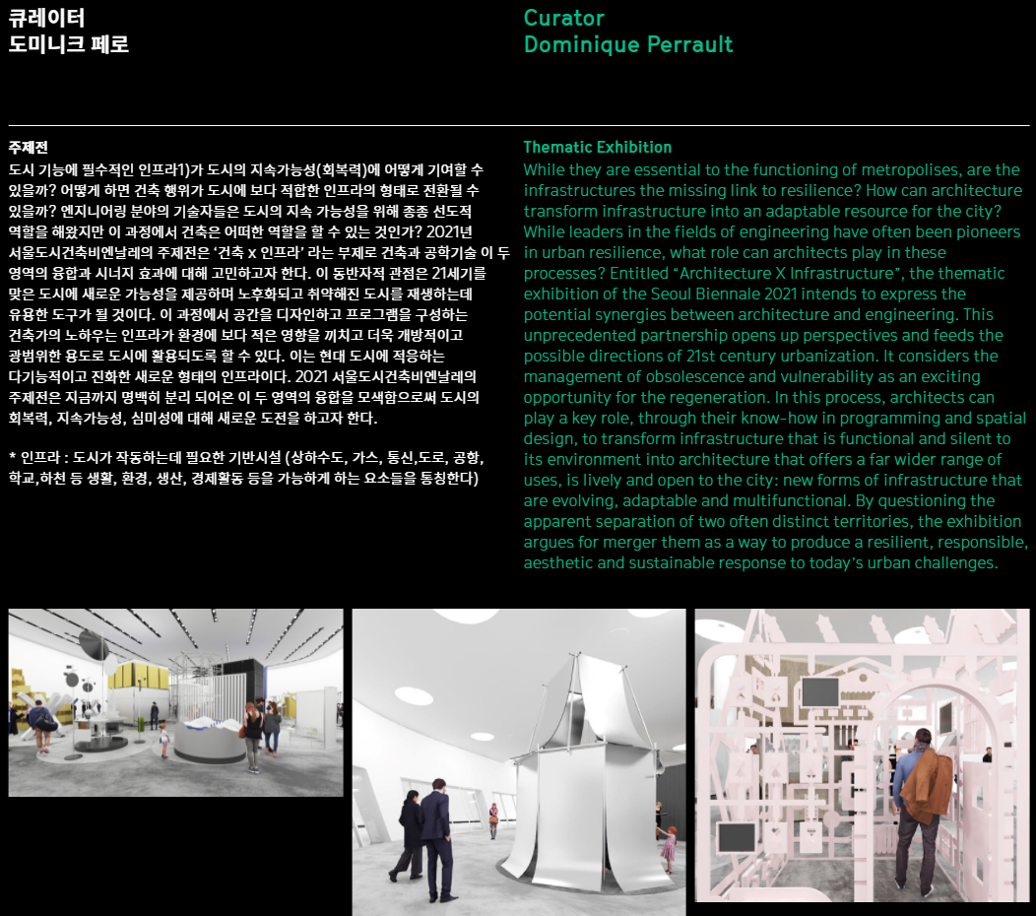

Slide 16
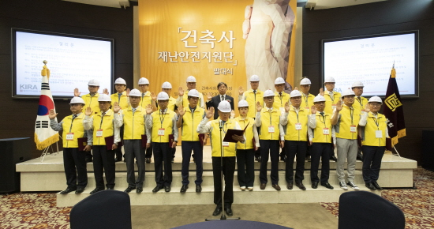
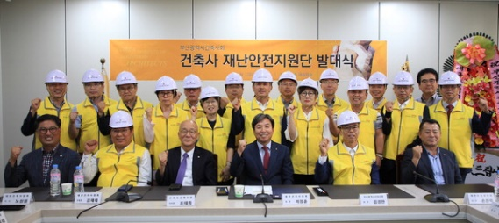
KIRA’s Architects’ Disaster Management Support Group
* Purpose : Support Public Safety from Disaster
* The 1st Term Support Group Started in May 2019
The 2nd Term Support Group Started in July 2021
* Activities
- Support Groups from KIRA HQ, 17 Chapters and 135 Regional Offices (332 Architects) have Participated in Disaster Management, Building Safety Evaluation + Community Service.

Slide 17
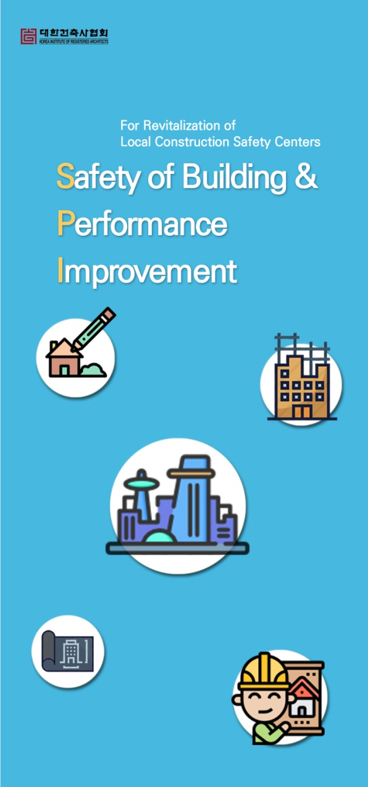

Korean Local Construction Safety Centers
Purpose : To Provide Technical Support for Building Safety Related Works
Legal Status : Established Per Korean Building Act (Article 87-2) in 2017
► Mandatory Installation Required for Cities with Population of 500,000 and Over

Slide 18

Korean Local Construction Safety Centers
Center’s Tasks:
On Behalf of Local Authority with Jurisdiction
- Reporting, Verification, Review, Inspection of Technical Works Related to Building Permit and Certificate of Occupancy
Administrative Works for Building Permit
Management and Control of Construction Supervision (CS)

Slide 19

Korean Local Construction Safety Centers
Test Run in Metropolitan Cities – Seoul and In Gyeonggi, Chungchung, Yongnam and Honam Provinces
Establishment of Building Safety and Performance System

Slide 20


3. KIRA’s Social Participation
New Construction of Public Community Children Center
In Collaboration with SBS (A Korean Broadcasting Company) and NGO’s, KIRA has Built Public Regional Children’s Centers.
On June 3, 2020, the Fourth Center in Okchun Opened (Left) and On July 24, 2020 the Fifth Center in Yeongyang was Completed (Right).

Slide 21
3. KIRA’s Social Participation
Workshop Programs for Students in Disaster Area
With the Collaboration with the City of Sokcho and ChildFund Korea, KIRA built and Provided Programs for Students in Disaster Area.
This Project is to Promote Healthy Psychological Development for the Children and Teenagers Who were Exposed to the Regional Forest Fire in 2019.
KIRA held Hope Architecture School for Them and Provided Pro-bono Design Service.

