Slide 1
THE HONG KONG INSTITUTE OF ARCHITECTS
COUNTRY REPORT 2015
36th ARCASIA COUNCIL MEETING
In Ayutthaya, Thailand
12-13Nov 2015

Slide 2
Brief History of the Institute
Set up in 1956
2016 : 60th Anniversary
Beijing Representative Office since 2006

Slide 3
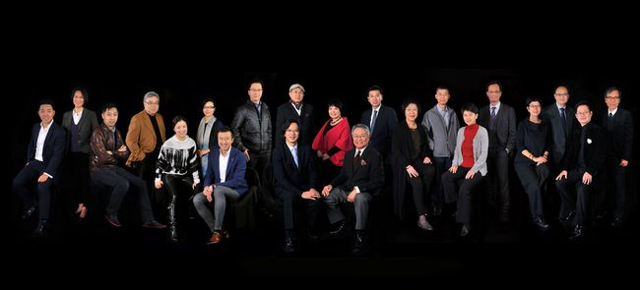
Office Bearers of the Institute 2015-2016
Mr. Vincent NG JP (President)
Mr. William TSENG (Vice President)
Dr. Rosman WAI (Vice President)
Mr. Daniel CHI (Honorary Secretary)
Mr. Paul CHU (Honorary Treasurer)

Slide 4
HKIA Council 2015-2016
The Institute is governed by a Council consisting of:
5 Office Bearers and
8 Ordinary Members of the Council
1 Immediate Past President (ex-officio member)
6 Chairmen of the Boards

Slide 5
HKIA Council 2015-2016
Six Boards are formed to deal with specific areas in the objectives of the Institute :-.
The Board of Educational Affairs
The Board of External Affairs
The Board of Internal Affairs
The Board of Local Affairs
The Board of Mainland Affairs
The Board of Practices

Slide 6
Current Membership Strength
Registered Practices | Number
w/ 1-9 HKIA members | 153
w/ 10-19 HKIA members | 17
w/ 20-29 HKIA members | 3
w/ 30-39 HKIA members | 2
w/ 40 or more HKIA members | 8
Total: | 183
(Statistics as of 20 Oct 2015)
Types | Number
Member | 3186
Graduate Member | 592
Non-Resident Member | 88
Fellow | 183
Associate | 35
Affiliate | 15
Student Member | 44
Retired Member | 35
Retired Fellow | 4
Honorary Fellow | 1
Honorary Member | 11
Total: | 4194
^{[1]} Based on the exchange rate of HK$7.8 = USD$1

Slide 7
Current Membership Strength
HKIA List of Registered Practices
HKIA Directory of Architectural Practices
Architectural and Associated Consultants Selection Board (AACSB) List of Consultants in Architectural Category - Band 1 and 2
List of HKIA Band 3 Architectural Consultants

Slide 8
Budget of the Institute
Funds are largely raised through membership annual subscription.
Budget is approved by the Council and audited accounts would be presented to the General Membership in the Annual General Meeting.
Office Bearers are empowered to execute payment of Institute’s expenses.

Slide 9
Annual General Meeting of the Institute
There are four Quarterly General Meetings per year for collective decision making. Annual election is held in the Third Quarterly General Meeting in September.

Slide 10
Legal Status of the Institute
Recognized by the HKSAR Government as the representative professional body of the Architects in Hong Kong.
Enacted under the Hong Kong Institute of Architects Incorporation Ordinance (CAP 1147) of the Laws of Hong Kong.
The only professional body offering professional accreditation of Architects in Hong Kong for admission to be Registered Architects under the Architects Registration Ordinance (CAP 408).

Slide 11
Legal Status of the Architect in Hong Kong
The title “Architect” is protected under the Architects Registration Ordinance (CAP 408)

Slide 12
Architects Registration Authority in Hong Kong
Architects Registration Board (ARB), HKSAR registration body for the Architects in Hong Kong.
Applicants satisfying the qualifications for registration as stipulated under Section 13 of the Ordinance are eligible to apply. There is a total of 3202Registered Architects.
Under the Architects Registration Ordinance, ten Members of the Architects Registration Board are appointed by the Council of the Hong Kong Institute of Architects plus one Member appointed by the Hong Kong SAR Government.

Slide 13
International Affiliations of the Institute
Architects Regional Council of Asia (ARCASIA)
Commonwealth Association of Architects (CAA)
The International Union of Architects (UIA)
APEC Architect Project

Slide 14
International Affiliations of the Institute
Mainland
HKIA has been working closely with the Government and Mainland counterparts to facilitate and equip members to obtain registration and practice in Mainland China.
Since 2005, 412 members gained PRC Class I Architect Qualification. Since 2011, a total of 249 HKIA members who had attained PRC Class I Architect Qualification have taken the CEPA legal examinations organized by the Department of Housing and Urban-Rural Development of Guangdong Province and all of them passed the exams.

Slide 15
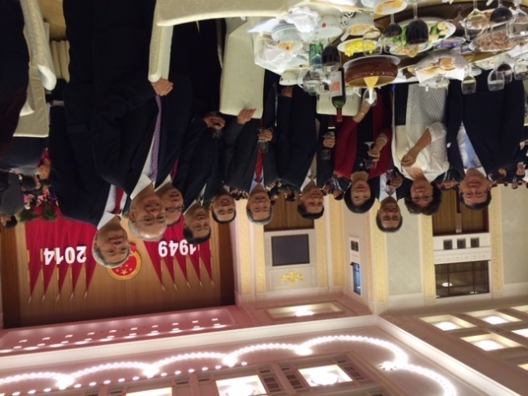
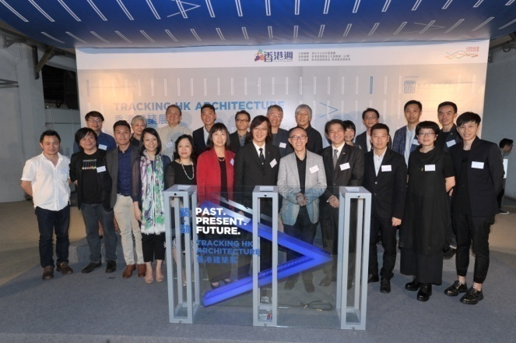
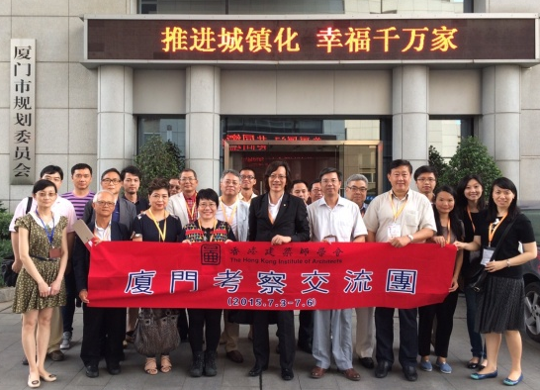
International Affiliations of the Institute

Slide 16
International Affiliations of the Institute
Meeting with the Director of Department of Housing and Urban-Rural Development of Guangdong Province, Guangdong | 26May 2014
Meeting with AAM President, Macau | 30May2014
Visit for Accreditation of Macau Architectural Programs, Macau | 31 May 2014
ARCASIA Annual Meetings and ACA-16, Kuala Lumpur, Malaysia | 23-29 Jun 2014
The 26th UIA General Assembly, Durban, South Africa | 3-10 Aug 2014
HKIA-HKIE Delegation Visit to Inner Mongolia, Inner Mongolia | 6-11 Sept 2014
2014 Shanghai Tower Visit, Shanghai | 13 Sept 2014
2014 National Day Celebration Dinner in Beijing, China | 27-30 Sept 2014
6th APEC Architect Project Central Council Meeting, Vancouver, Canada | 6-7 Oct 2014
10th Pan-Pearl River Delta Region Co-operation and Development Forum , Guangzhou, China | 12 Oct 2014
World SB14 Barcelona Conference, Barcelona | 28-30 Oct 2014
HKIA Annual Awards 50th Anniversary Exhibition London, UK | 30 Oct –26 Nov 2014
2014 Mainland-Hong Kong Construction Industry Forum, Nanning, China | 9-11 Nov 2014

Slide 17
International Affiliations of the Institute
Yangcheng Design Alliance 2015 Annual Ceremony | 12 Jan 2015
2015 HKIA Council Courtesy Visit in Beijing, China | 29-30 Jan 2015
5th General Meeting of the Canberra Accord on Architectural Education, Boston, USA | 3-5 May 2015
Site Visit to Beijing Projects 2015, Beijing, China | 23 May 2015
SmartHK Exhibition, Jinan, Shandong, China | 27-28 May 2015
2015 CAA General Assembly, London, UK | 15-18 June 2015
CLO-HKIA Delegation Visit to Xiamen, Fujian, China | 3-6 Jul 2015
HKIA Taiwan Exhibition and HK Week in Taiwan 2015 Opening Ceremony, Taipei | 9-12 Sept 2015
Past. Present. Future - Tracking Hong Kong Architecture, Taiwan | 10-25 Sept 2015
2015 National Day Celebration Dinner, Beijing | 29 Sept 2015
ARCASIA Forum 18 and Annual Meetings, Ayutthaya, Thailand | 11-16 Nov 2015

Slide 18
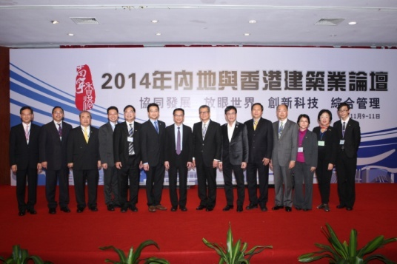
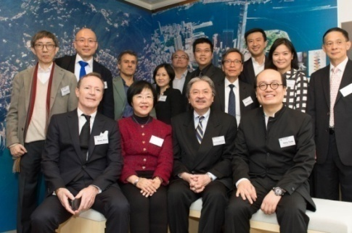
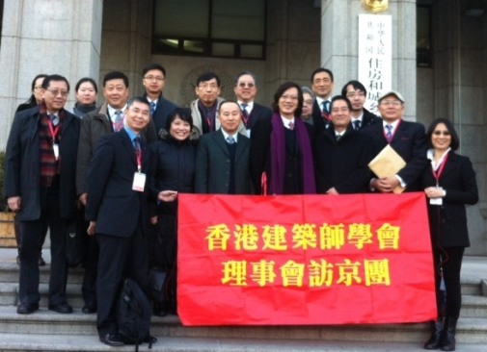
International Affiliations of the Institute

Slide 19
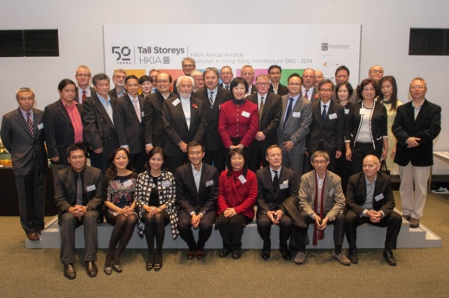
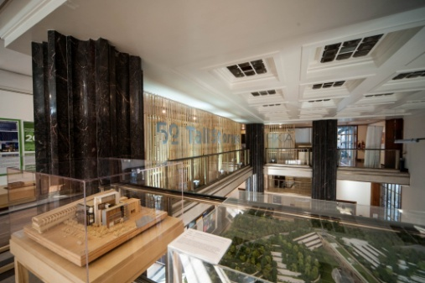
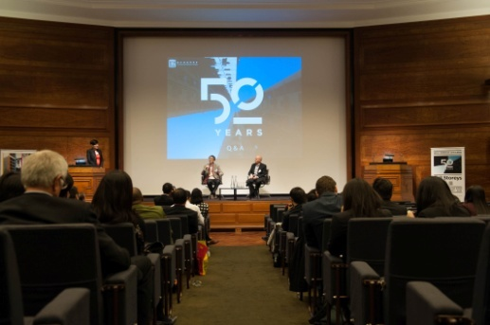
Major Programmes and Activities of the Institute
30 Oct 2014 Exhibition, Opening Ceremony & Forum for 50 years Tall Storeys Evolution in Hong Kong Architecture 1965-2014

Slide 20
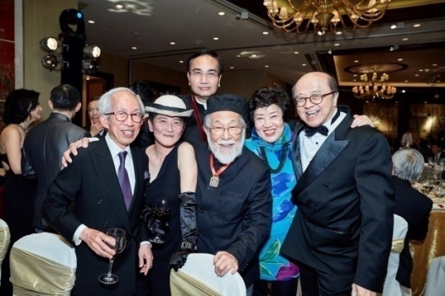
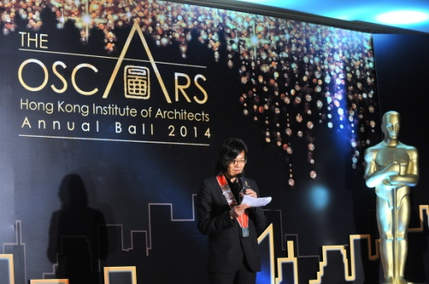
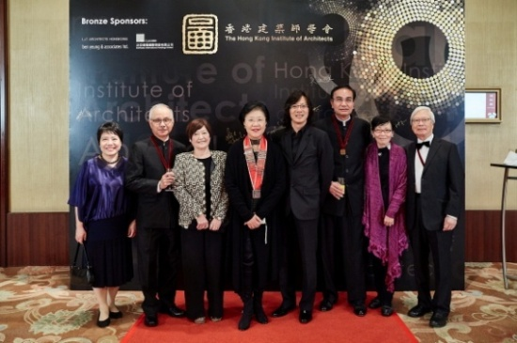
Major Programmes and Activities of the Institute
8 Nov 2014 HKIA Annual Ball 2014

Slide 21
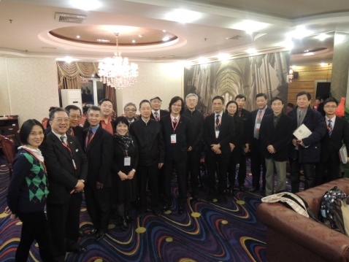
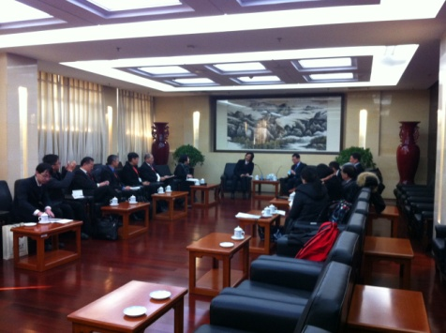
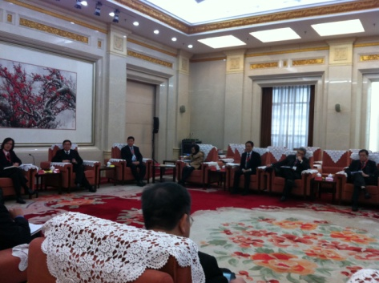
Major Programmes and Activities of the Institute
29-30 Jan 2015 2015 HKIA Council Courtesy Visit in Beijing, China

Slide 22
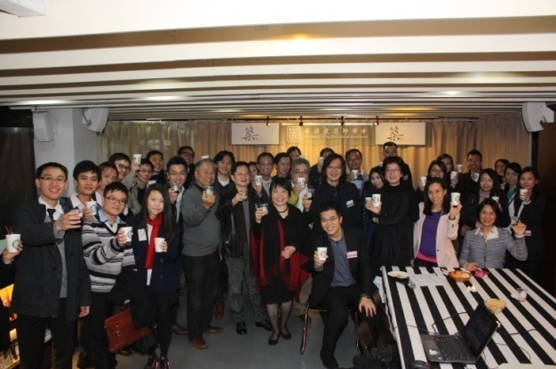
Major Programmes and Activities of the Institute
9 Jan 2015 HKIA Young Members Committee New Year 2015 Drink Party and HKIA CaféLaunching

Slide 23
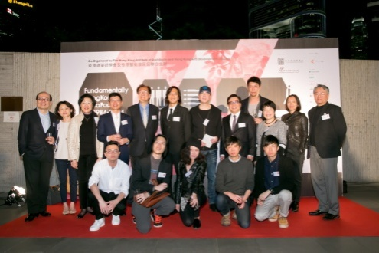
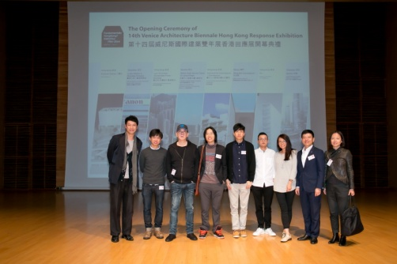
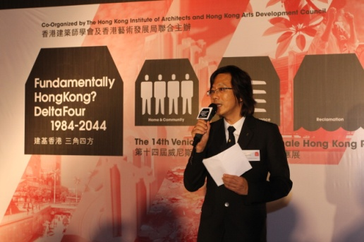
Major Programmes and Activities of the Institute
9 March 2015 VB2014 Response Exhibition Opening Ceremony

Slide 24
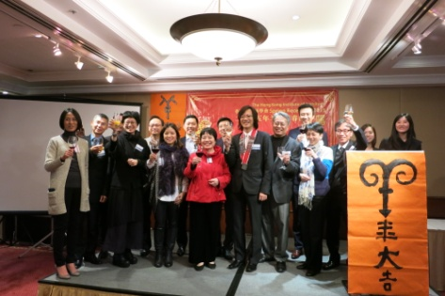
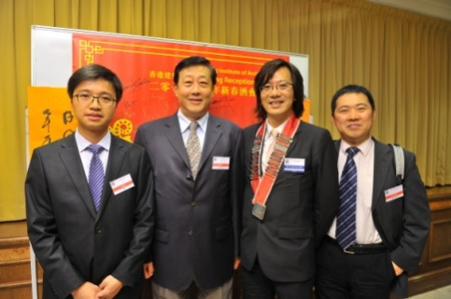
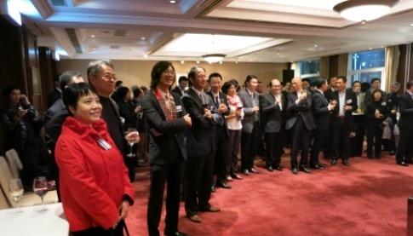
Major Programmes and Activities of the Institute
10 Mar 2015 HKIA Spring Reception

Slide 25
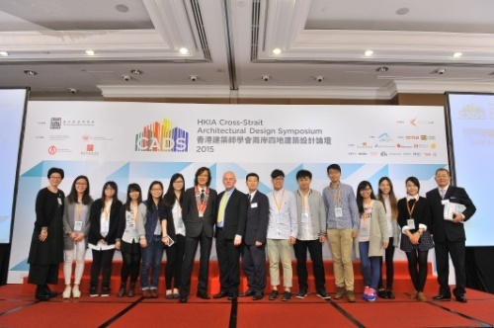
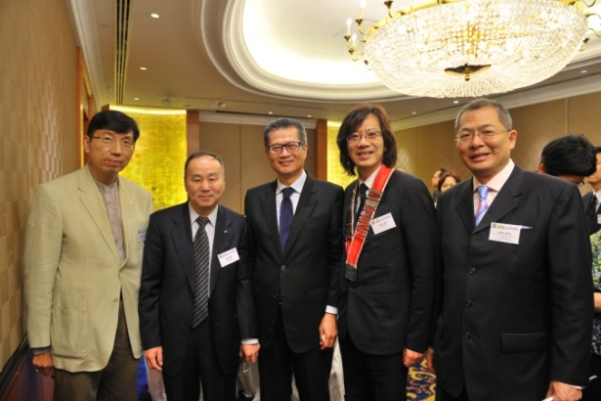
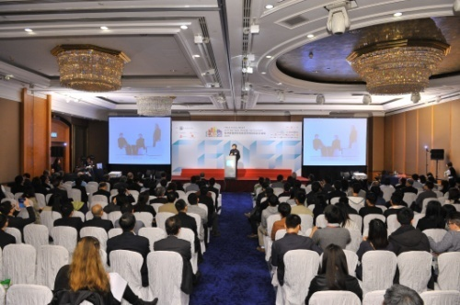
Major Programmes and Activities of the Institute
28 Mar 2015 HKIA Cross-Strait Architectural Design Symposium and Awards 2015

Slide 26
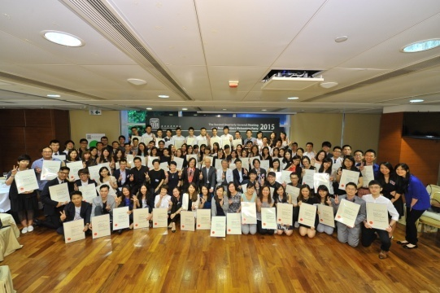
Major Programmes and Activities of the Institute
11 Jun 2015
New Members Welcoming Party at 2nd Quarterly General Meeting

Slide 27
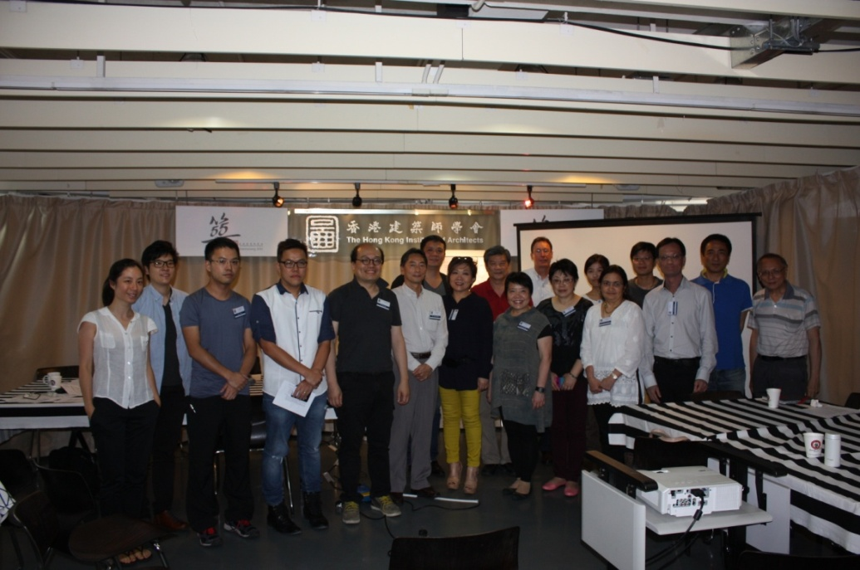
Major Programmes and Activities of the Institute
27 Jun 2015 EARTHquake Nepal Workshop

Slide 28
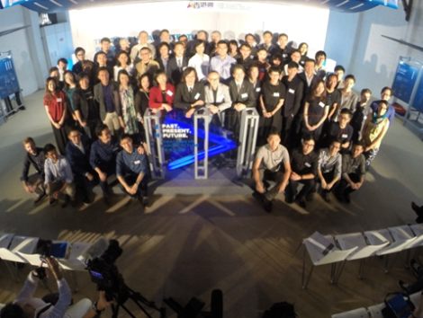
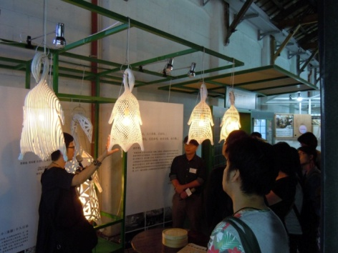
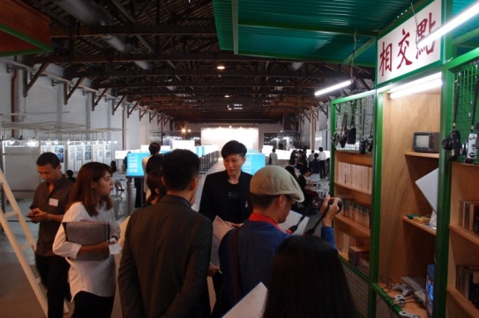
Major Programmes and Activities of the Institute
10-25 Sept 2015
Past. Present. Future - Tracking Hong Kong Architecture

Slide 29
Continuing Professional Development
To ensure that professionals meet up-to-date requirements and catch up with the latest news, ideas and technological advancements through ongoing education and training.
Members are required to comply with the mandatory CPD requirements for renewal and reinstatement of HKIA membership since 1 January 2003.
Throughout the year, the Institute organizes various CPD activities for members to participate.

Slide 30

Architectural Competitions/Awards Organized by the Institute
HKIA Annual Awards 2014
Organized every year to give recognition to outstanding architecture designed by our members.
Established since 1965 and well recognized as the most important architectural award in Hong Kong.
To give professional recognition and to increase public awareness to outstanding achievements in architecture.
To foster an appreciation for
buildings designed by members
of HKIA with architectural
excellence that deserve
professional acknowledgement
and public attention.

Slide 31
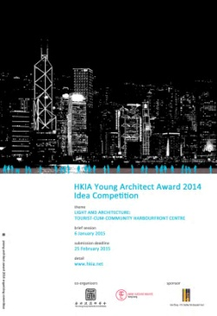
Architectural Competitions/Awards Organized by the Institute
HKIA Young Architect Award 2014
HKIA encourages young architects
to contribute their talent
pro-actively in upholding
the professional, art and
cultural developments of
Hong Kong.

Slide 32
Key Issues Facing the Architects/Architectural Profession/ Institute in Hong Kong
Proposed Security of Payment Legislation for the Construction Industry in Hong Kong
Global Trend of Adopting Building Information Modelling (BIM)

Slide 33
Resources of the Institute
Full calendar of events : Biennale Exhibitions, Continuing Professional Development seminars, HKIA Annual Awards, competitions, architectural walks, joint-institutes forums and symposia at all levels of society to cross-boundaries architectural biennales beyond Hong Kong.

Slide 34

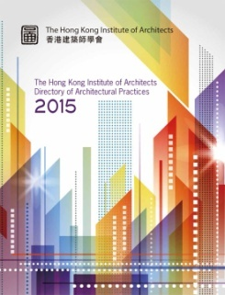
Resources of the Institute
Publications :
HKIA Daily
HKIA Directory of Architects Practices (Annual Publication)
HKIA Journal (2 issues per year)
Annual Report (Annual Publication)
Annual Awards Special Issue (Annual Publication)

Slide 35
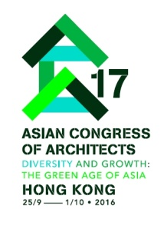
Plans for the Future
HKIA 60th Anniversary in 2016
17th Asian Congress of Architects
REVEAL 2016
2015 Bi-City Biennale or Urbanism\
Architecture (Hong Kong)
2016 Venice Biennale International
Architecture Exhibition (Hong Kong)

