Slide 1
WEBSITE REVAMP UPDATE
NOV 2019

Slide 2
Reasons and objectives of Website Revamp
Update to latest web technology
Archival of Arcasia records
Facilitation of primary platform for OB handover management
Portals for Committees to operate from
Potential to centralise and integrate AA Awards Submission

Slide 3
Concept Mockup

Slide 4
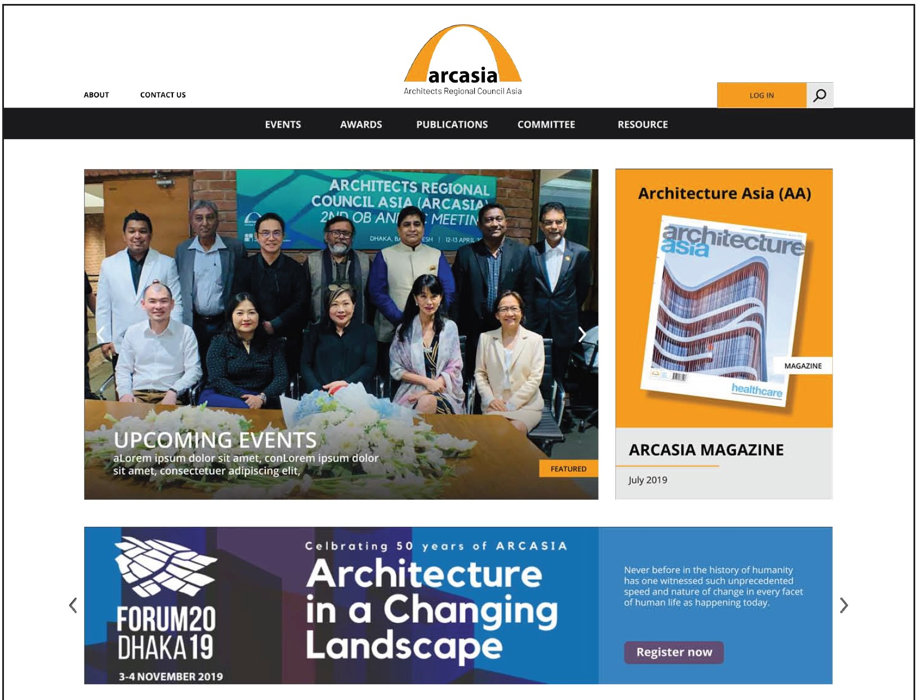

Slide 5


Slide 6
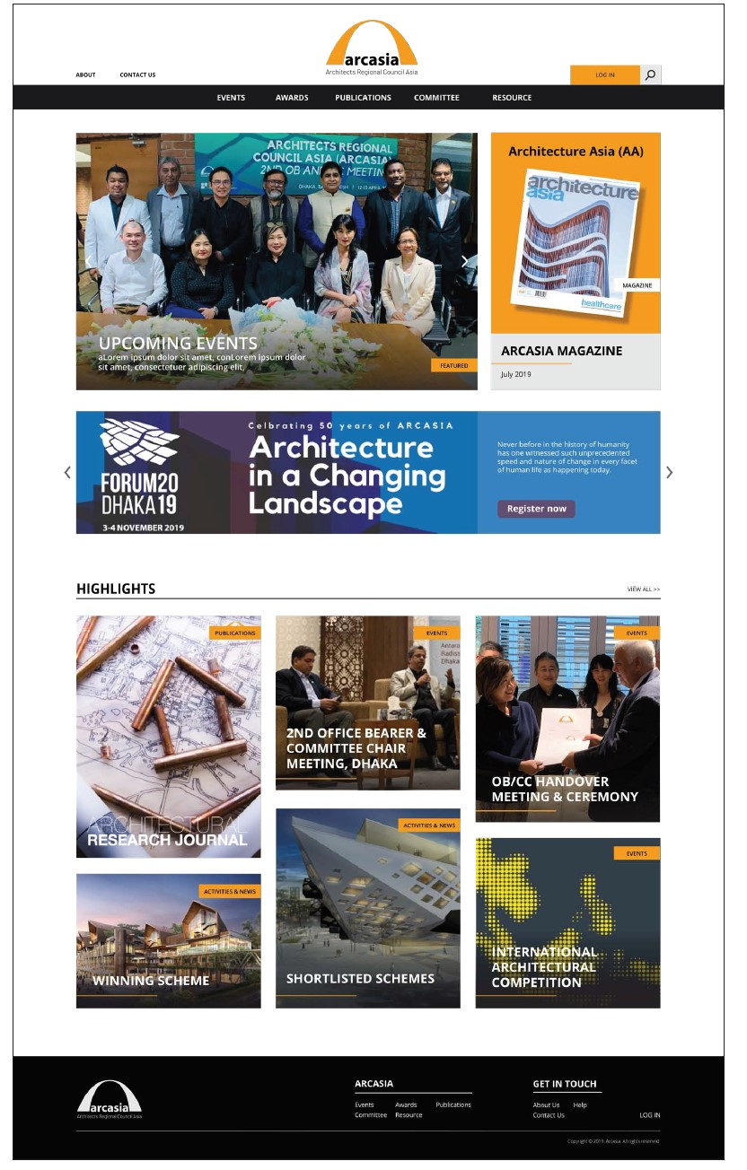
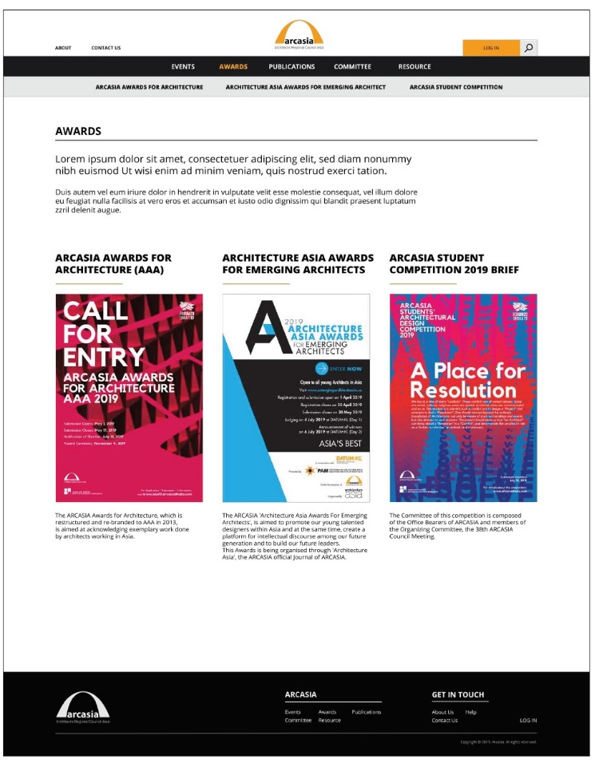
Award submission portal

