Slide 1

ACPP 2018-2019
ARCASIA COMMITTEE FOR PROFESSIONAL PRACTICE
CHAIRMAN REPORT

Slide 2
ACPP Activites from last ARCASIA 2018
Roundtable Meeting in Tokyo - 10th Sept. 2018
Roundtable Meeting in Manila – 15th March 2019
Workship in Jaipur – 27th July 2019

Slide 3
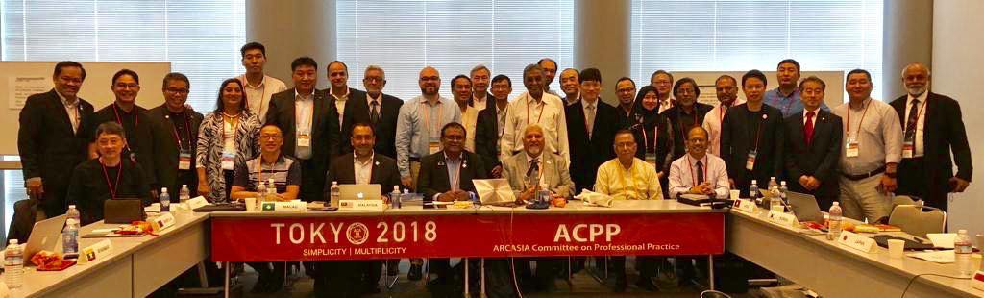
Tokyo – Arcasia ACPP Round table
10th Sept. 2018
All countries presented their country reports
The data was collected and filled up in a set format
This was then submitted in the data bank of ACPP
HOST : JIA

Slide 4
Country Report Data Collected
SECTION 1 : COUNTRY INFORMATION AND ECONOMIC INDICATOR
SECTION 2 : NO.OF REGISTERED ARCHITECTS
SECTION 3 : ARCHITECTURAL PRACTICE / FIRM DATA
SECTION 4 : PROFESSIONAL / REGISTERED/ LICENSED ARCHITECTS
SECTION 5 : ARCHITECTS FEES AND REMUNERATION
SECTION 6 : ARCHITECTURAL SCHOOLS AND EDUCATION
SECTION 7 : CPD PROGRAM
SECTION 8 : LEGISLATIONS, REGULATIONS, STANDARDS RELATED TO ARCHITECTS
AND PROFESSION
SECTION 9 : CROSS BORDER PRACTICES
SECTION 10 : ISSUES AND CHALLENGES FACED BY ARCHITECTS AND PROFESSIONAL
ORGANISATIONS

Slide 5
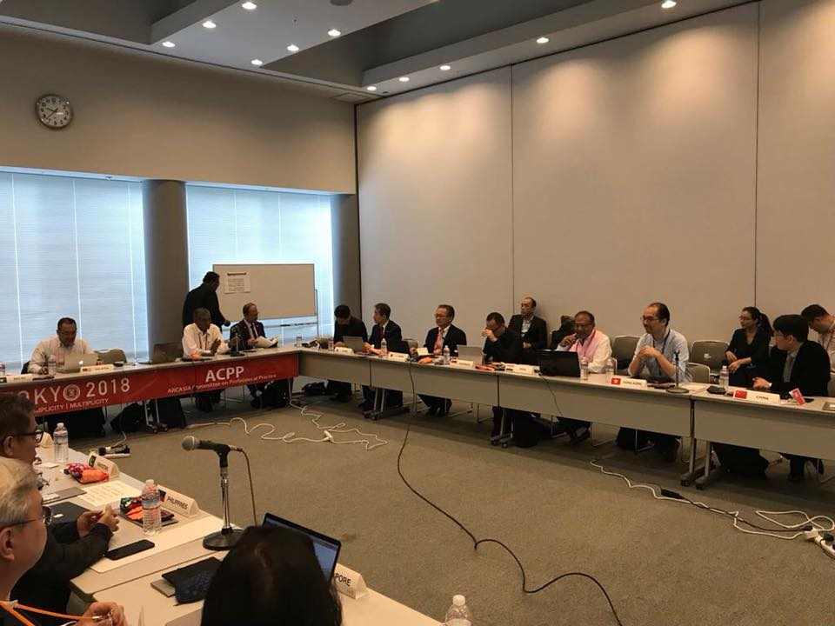
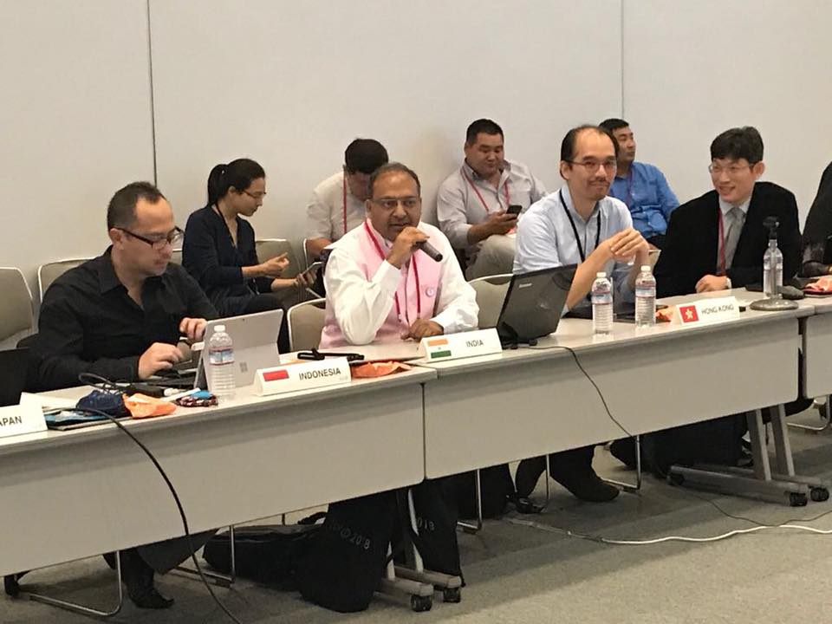
ACPP Tokyo Glimpses

Slide 6
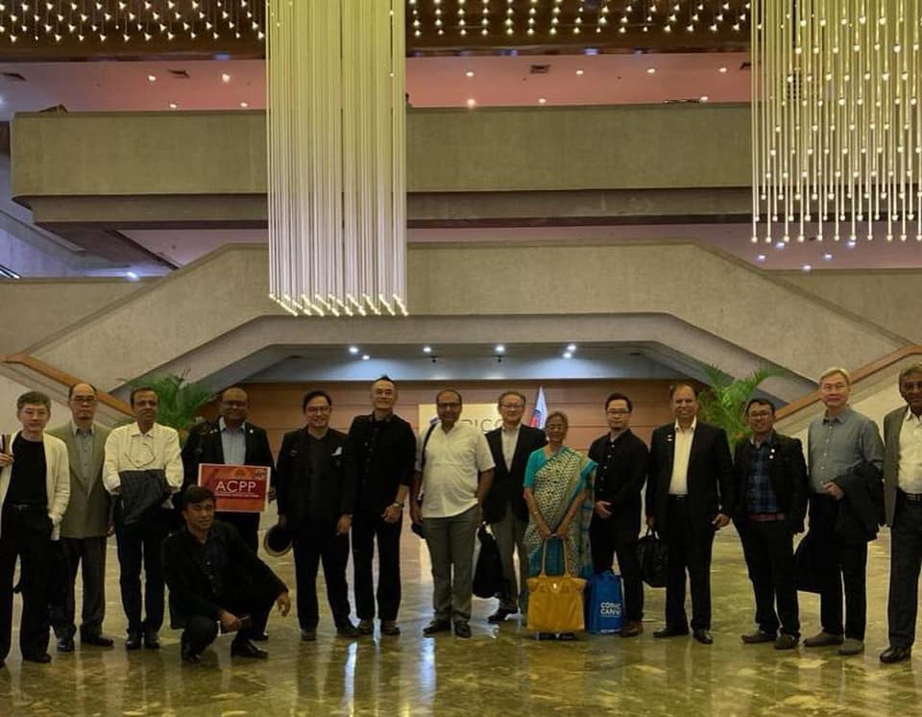
Manila ACPP Roundtable
15th March 2019
HOST : UAP

Slide 7
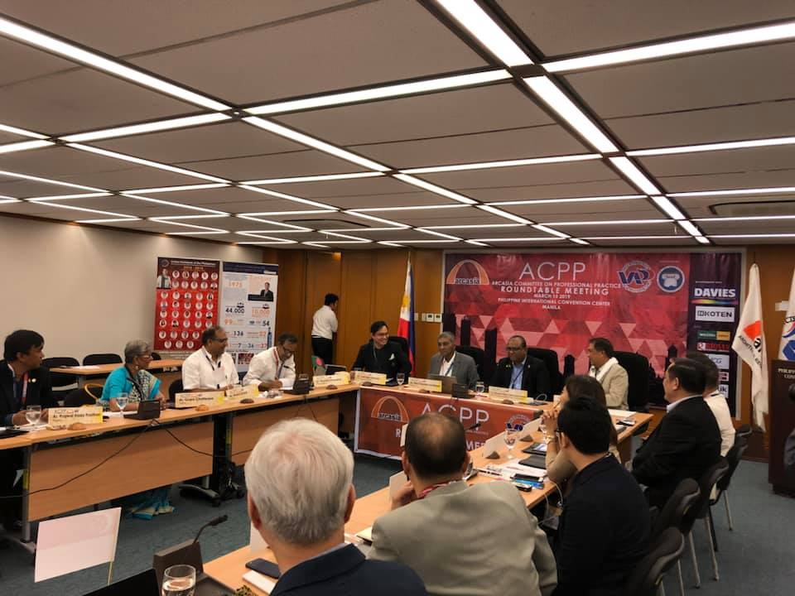
Procurement Strategies & Policies
Take away :
Understanding the Strategies of Procurement across Asia and recording the Policies for the ACPP records

Slide 8
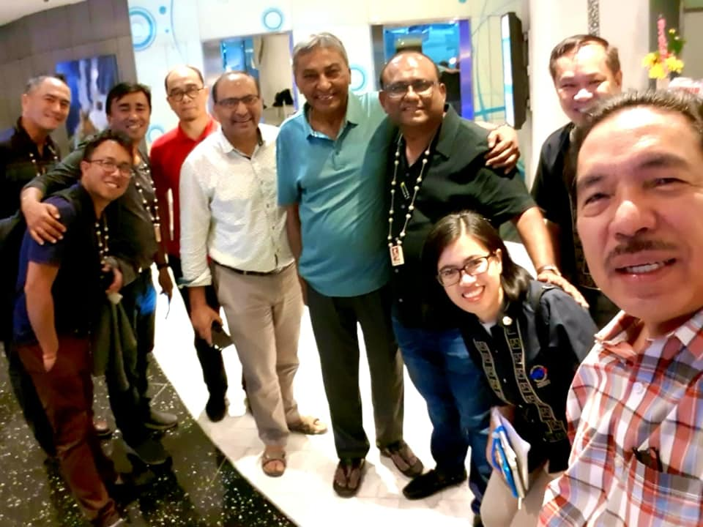
Conclusion 1
“Cross Border Practice” has not been very prevalent amongst Asian Countries but a clear understanding of Project Procurement Strategies of various countries is necessary for an Architect or Architectural Firm to bid for a project. Especially in perspective to its Culture, demography and Education base.

Slide 9
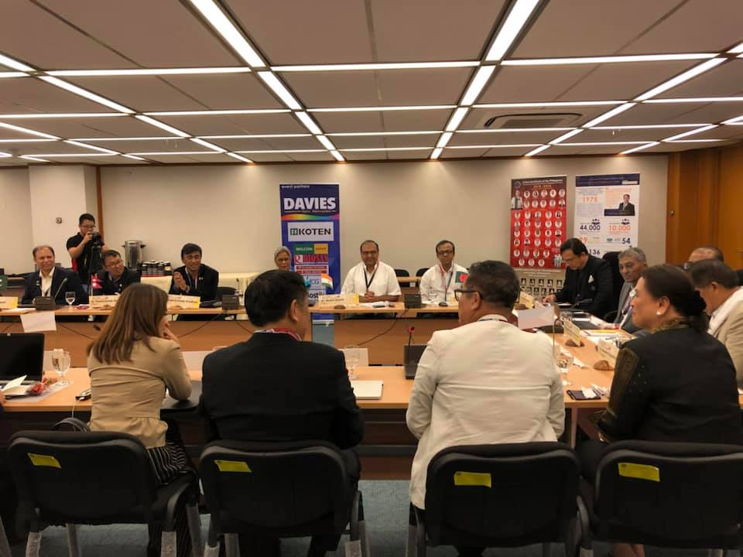
Conclusion 2
Our countries can benefit from one another by understanding the salient practices of Project Procurement in any particular country. Documentation of the same will help all practicing architects in the future.

Slide 10
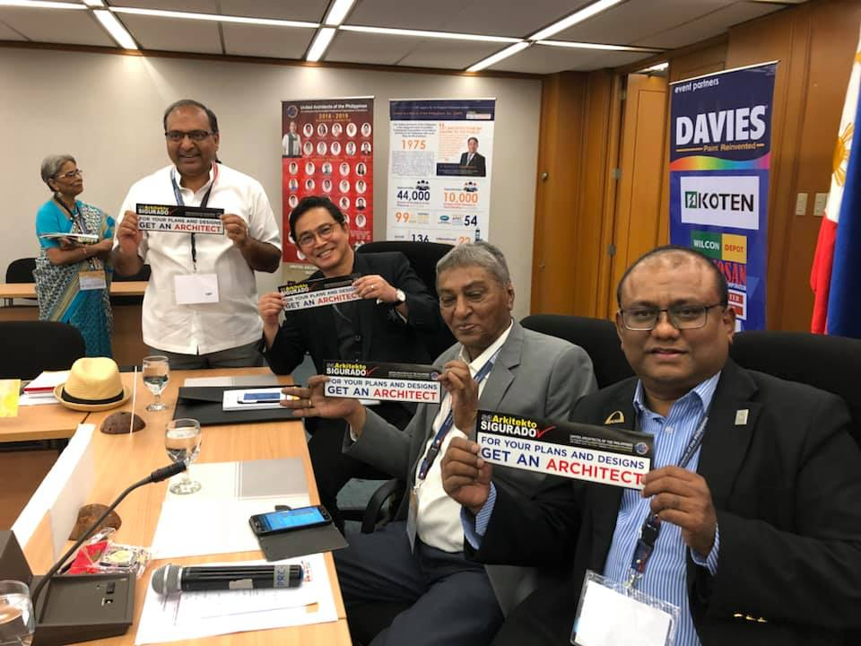
Conclusion 3
Another major issue in Procurement is the unspoken subject of Permissible Advertising as in many countries Non-architects are advertising for commissions openly as they are not covered under the laws of the land. Whereas Registered Architects are pushed into oblivion due to the legal framework around the clause of advertising by their Board/Council.

Slide 11
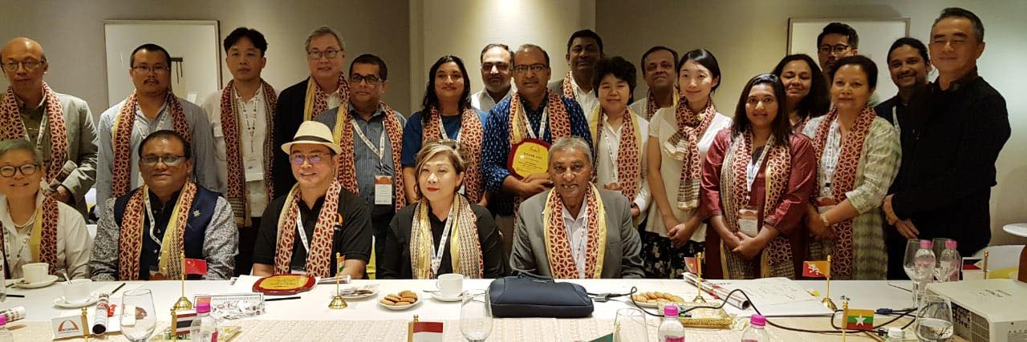
JAIPUR – ACPP WORKSHOP
27 JULY 2019
HERITAGE WALK
SEMINAR
WORKSHOP
HOST : IIA
COMPONENTS :

Slide 12
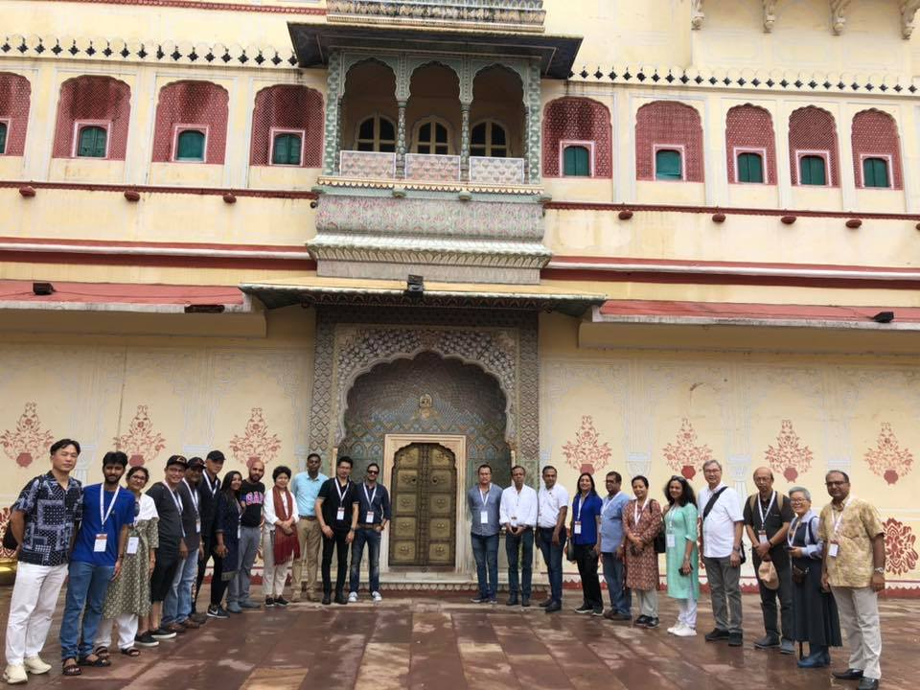
ADAPTIVE REUSE OF HERITAGE FOR TOURISM
HERITAGE WALK : City Palace (Kings res.)
Outcome : Delegates absorbed and carried back with them the techniques and low cost methodology adopted in the Indian scenario by local traditional village artisans to preserve and convert Heritage structures into useful contemporary spaces.

Slide 13
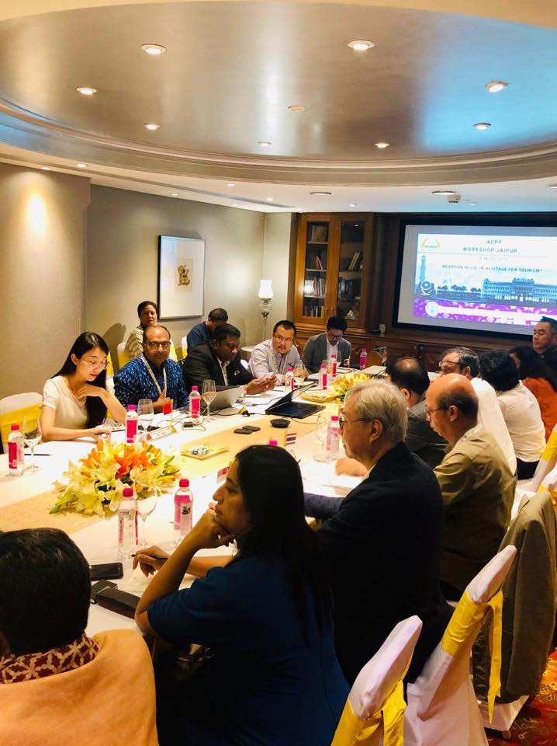
ADAPTIVE REUSE OF HERITAGE FOR TOURISM
Workshop by
Ar Ravi Gupta , Ar In Souk and Ar Kavita Jain
Outcome: Delegates got to hear first hand as to how in Professional Practice, live Heritage projects have been dealt with and how numerous challenges were overcome. Delegates made their own notes with respect to their country and cleared all doubts.

Slide 14
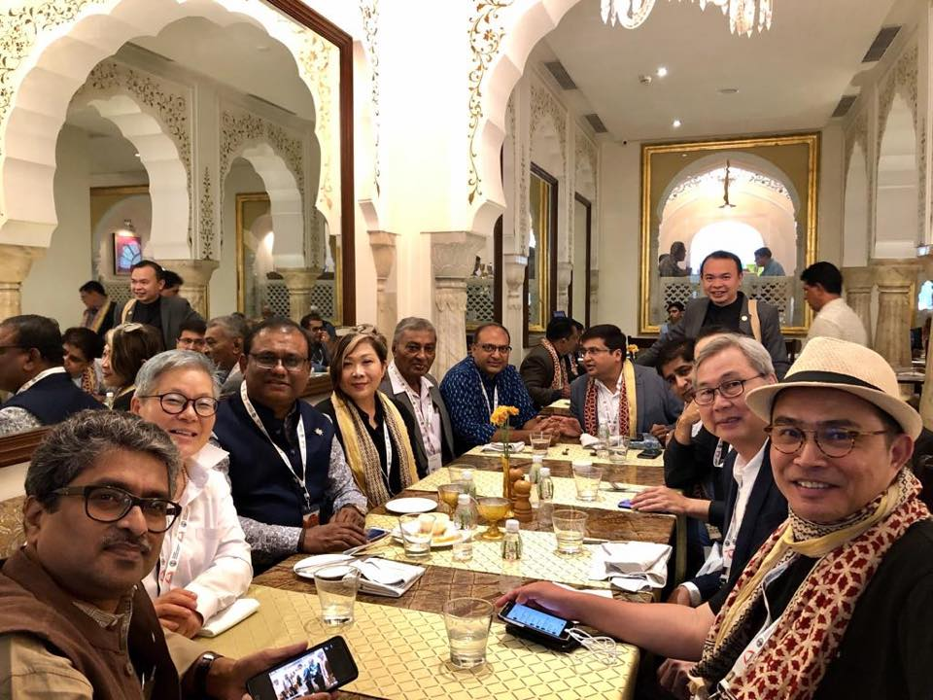
ADAPTIVE REUSE OF HERITAGE FOR TOURISM
Seminar from each Zone
Zone 1 – Pakistan
Nepal
Zone 2 - Myanamar
Zone 3 - Hongkong
Outcome : Heritage Architecture is different everywhere but the underlying need to preserve and reuse the structures is common. This session helped Delegates to understand what other countries across asia are doing in Adaptive reuse of Heritage for Tourism.

Slide 15
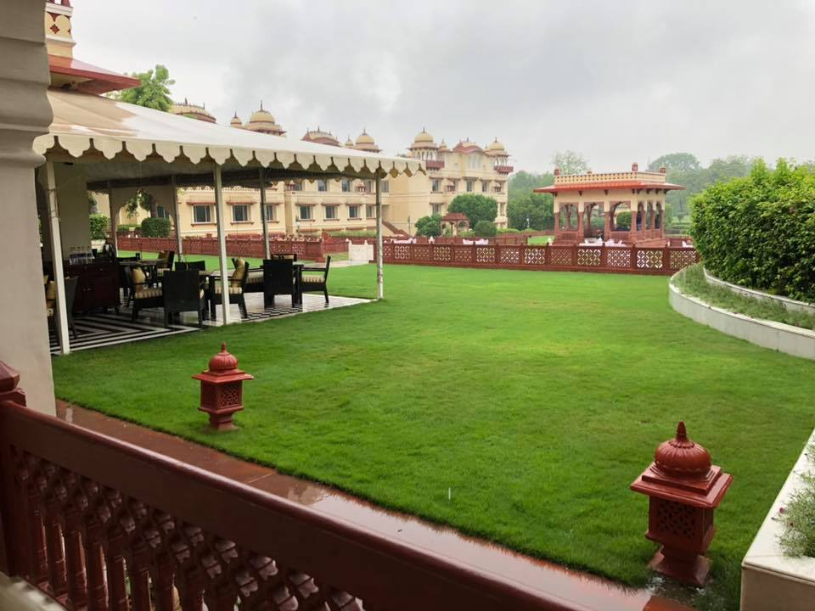
Inter Committee Panel Discussion
# Inter committee panel Discussion :
In this unique situation we had Chairman of all Six ARCASIA committees including Fellowship, in this forum.
Each committee has an important role to play in conserving and restructuring our Heritage Building Policy today.
Each member of each committee came forward to put up their point of view and how each architect can contribute in his daily professional life to achieving and saving this national treasure all over Asia.

Slide 16
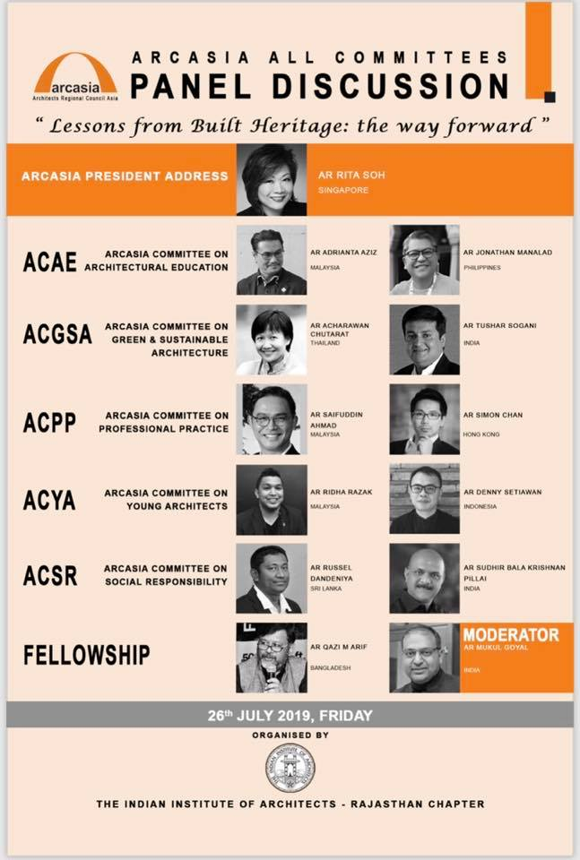
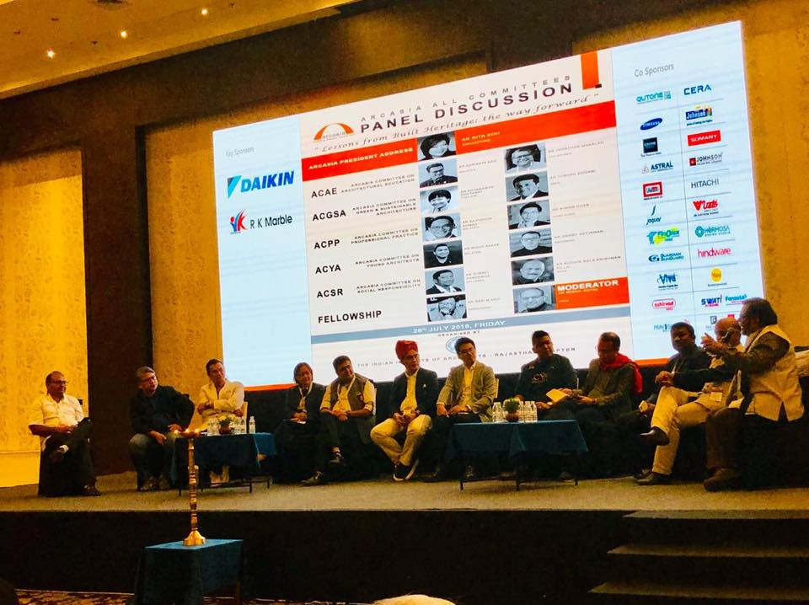
ALL COMMITTEES
PANEL DISCUSSION

Slide 17
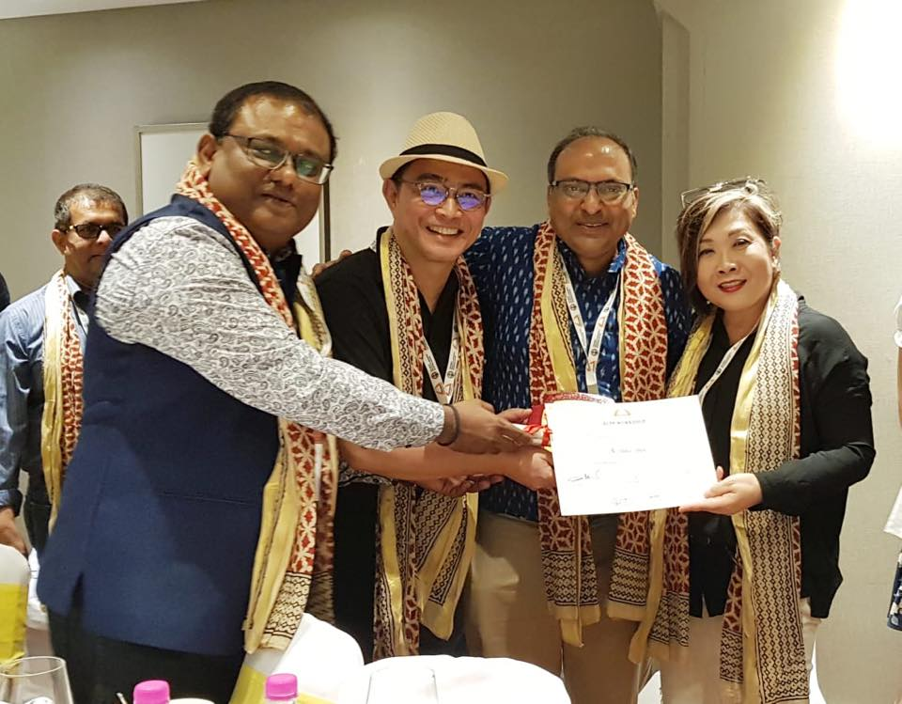
Certificates were given to members

Slide 18
Jaipur Declaration
ACPP, Jaipur 2019
“Adaptive Reuse of Heritage for Tourism”
Outcomes of the Workshop
1. Heritage structures are reservoirs of knowledge as they contain the history of architectural aspects, social aspects and technological aspects of that region. It is our duty as Architects to preserve them.
2. Architects shall be well aware of the Heritage of their region and shall promote and employ the craftsmen who are well versed with the traditional methods of construction.
3. Architects shall encourage and promote the Traditional Local Artists and their artworks in all their projects, irrespective of the nature of project.
4. Architects shall teach their staff and send them for Heritage Workshops so as to sensitise them about the traditional methods of construction.
5. Architects shall encourage clients to preserve and rejuvenate their heritage properties and help them to become sustainable entities.
6. Architects shall discourage any form of demolition of respectable Built Heritage and devise methods of its adaptable reuse so as to encourage the Government or Private client to preserve and reuse the built form.
ACPP
ARCASIA COMMITTEE
ON PROFESSIONAL PRACTICE

Slide 19
Jaipur Declaration (page 2)
7. Architects shall come up with innovative structural systems to preserve the older heritage and increase it’s build able capacity.
8. Architects shall share their traditional knowledge with colleagues across borders to propagate good construction practices within the Arcasia region.
9. Architects shall write and Document their experiences with Traditional methods of Architecture and Heritage structures. This documentation can thus be shared on a single portal of Arcasia.
10. Architects shall report to relevant authorities about disregard and misuse of various Built Heritage across their region and suggest methods for their rejuvenation.
11. Arcasia to create its own ‘Heritage Charter’ on the basis of various European charters to help architects to follow a set guidelines which are conducive to our region.
12. Architects to identify the various Heritage communities living around them and work towards the preservation of not just the buildings but of the cultural and social parameters which build the community.

Slide 20
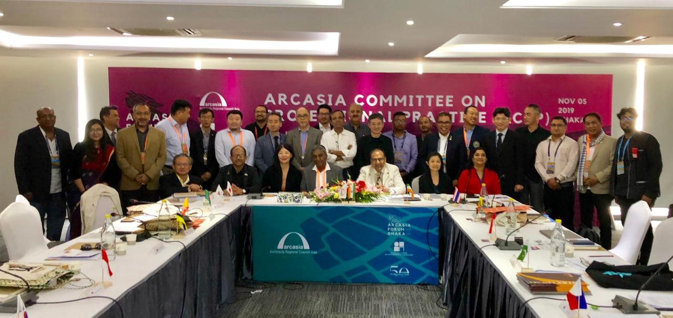
ARCASIA DHAKA ROUND TABLE
5^{th November 2019}

Slide 21
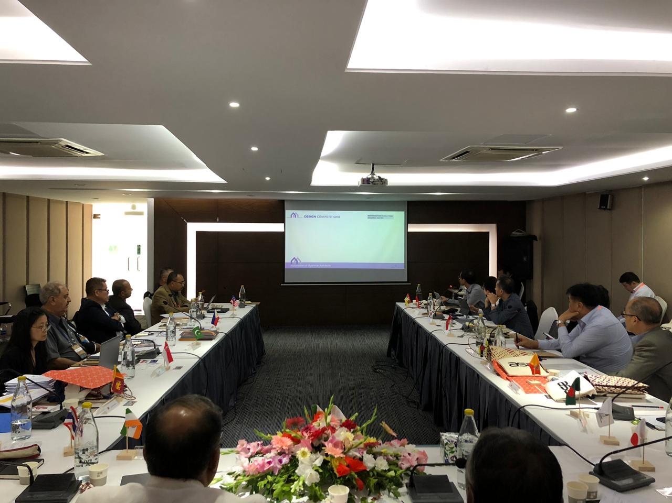
Cross Border Practice
Presentations made by
Zone 1 : IIA
Zone 2 : UAP and SIA
Zone 3 : JIA
2. It was discussed that CBP was happening unofficially or partially officially in every country. And it was agreed that certain parameters and norms have to be enlisted under which CBP can take place seamlessly throughout Asia. The modalities shall be taken up in the future meetings.

Slide 22
Future Programs
February 2020 – CPD Workshop in Colombo
May 2020 – Roundtable in Mynamar

Slide 23
Thank you
Thank you to all Member Countries and Participants for their continued support and good wishes

