Slide 1

40th Council Meeting
Report: Committee on green and sustainable architecture
Acgsa
Acharawan chutarat, Chairman

Slide 2
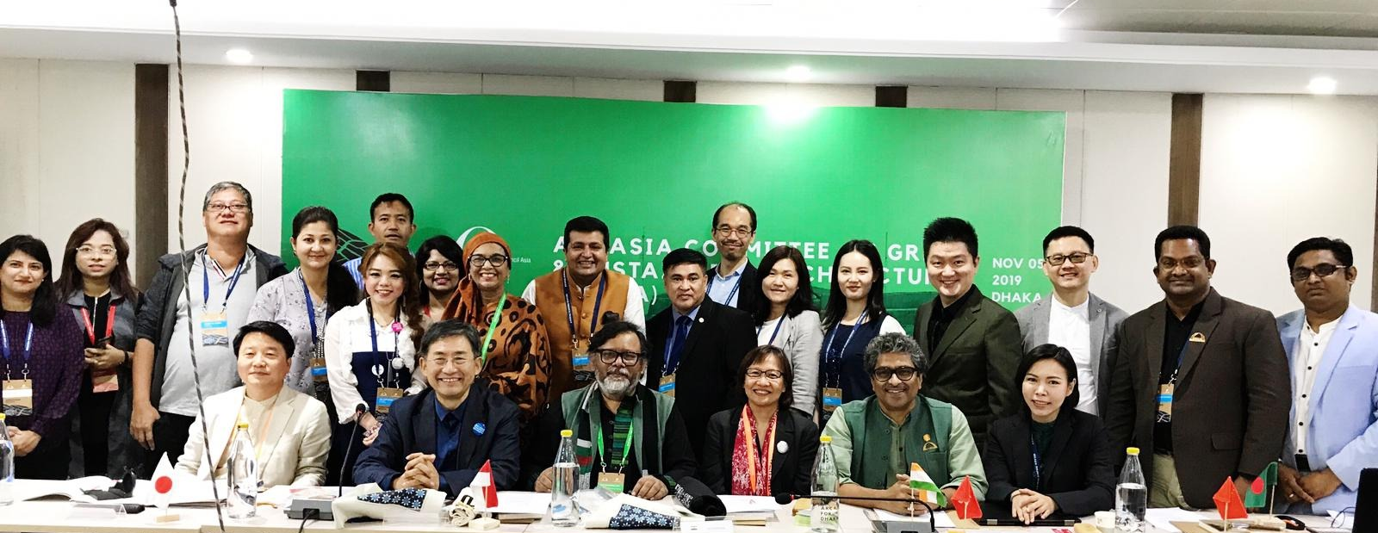
ACGSA Team
Chairman Ar.Acharawan Chutarat
Imm. Past Chairman Ar.Debatosh Sahu
Past Chairman Ar.Qazi Arif
Zone A rep Ar.Tushar Sogani
Zone B rep Ar.Alice Leong
Zone C rep Ar.Terukazu Nii
Zone B rep
Zone A rep
Zone C rep
past chair
Chair
Imm. past chair

Slide 3
Agenda
Vision-Directions
Past and ongoing
  11th Roundtable in Jaipur, July 2019: Built and Natural Heritage: The Sustainable Face of Architecture
  Declarations: 2017: Vernacular, 2018: Water, 2019: Heritage
  Green Building Rating Tools Comparative Study, To be harmonized, refined
  ACGSA E Newsletter, 1st Launch in 2018 in Semarang, then Jaipur, Tokyo and Dhaka, Bi-Annual
  Vernacular Wisdom Book, initiated in 2016, finished 2019
  GreenAsiArch 1st Launch in 2016 in HK then Jaipur, Tokyo and Dhaka, Annual exhibition
Future Green and Sustainable Architecture 3 Pillars:
  Heritage/Future Vernacular/Adaptive Reuse → Further development towards today and future context
  New Urban Agenda: Awareness, Waste, Community, Professionalism → Green Book Principles / Rating Tools
  Resilience: Earthquake, Flood, Water Scarcity → Best Practices and Techniques Sharing / Adopting

Slide 4
Vision-Direction + Activities
Stewardship in use of all resources
Learning from the past for ways forward
Sustainability through working among crossed disciplines with respect to resilient using technology towards innovation
Integrate in Practice, Design and Education, through social outreach
Education + Life-long Learning
Environmental Sustainability
Vernacular Wisdom Book
ACGSA’s
Green AsiArc
Green Building Rating Tools
E-Newsletter
Crossed disciplines
Workshop
Training
Design Excellence + Empathy
Social Awareness+Responsibility

Slide 5
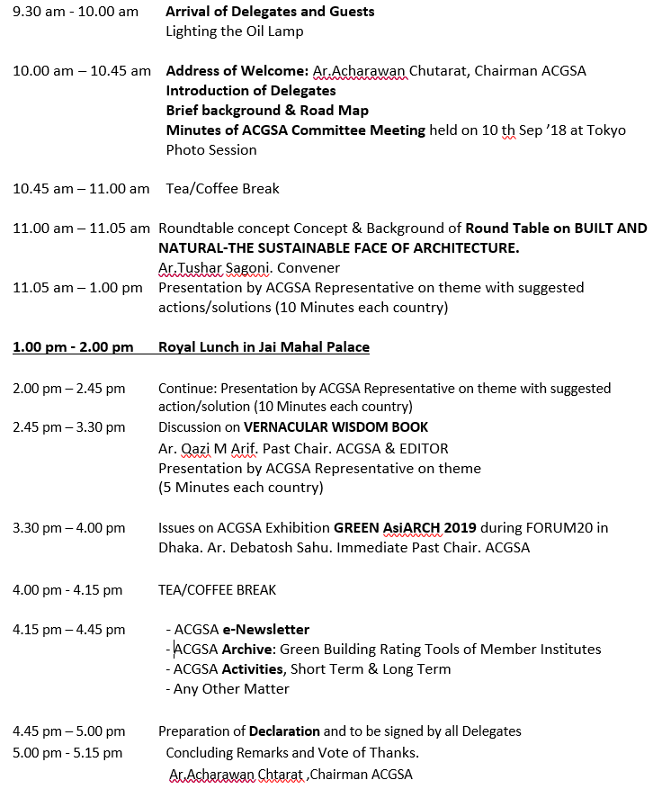
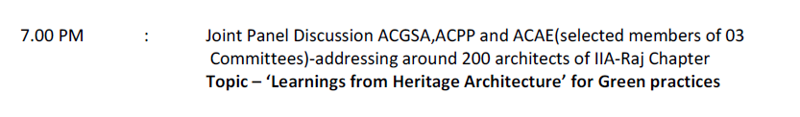
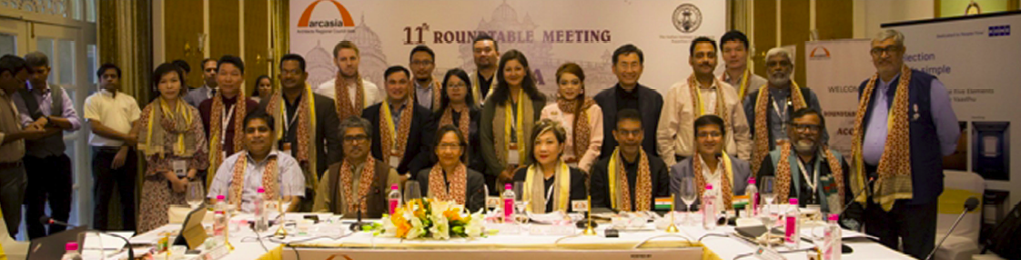
11th Roundtable Meeting: ACGSA, Jaipur ACGSA+ACAE+ACPP
27 July 2019
26 July 2019

Slide 6

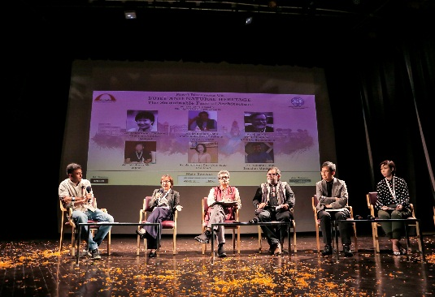
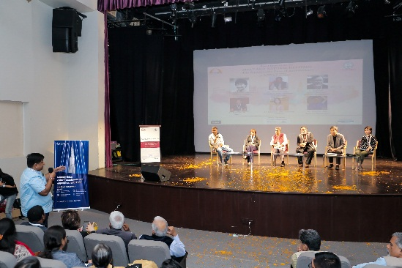
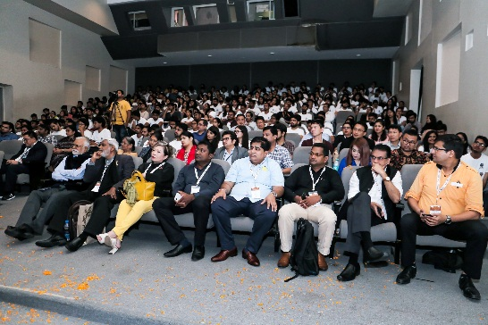
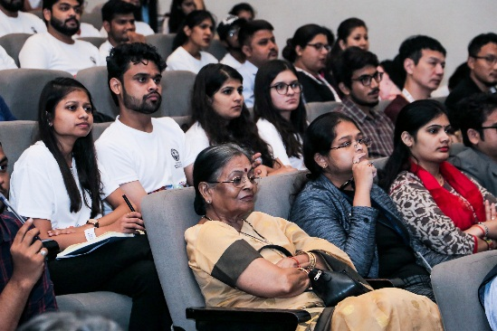
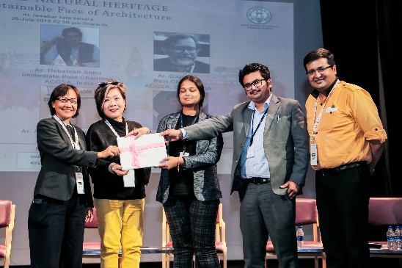
Panel discussion on Built and Natural Heritage addressing architecture students and faculty at JKK, Jaipur RT, July 2019
Involved
8 local universities
200+ students
For training and workshop
ACGSA+ACAE+ACPP
Ganesh Vandana in the Event
Panel Discussion on Built and
Natural Heritage
Panelists addressing the students
and Faculty
The students and Faculty from
Architecture colleges
The students and Faculty from
Architecture colleges
The Faculty of colleges receiving
certificates

Slide 7
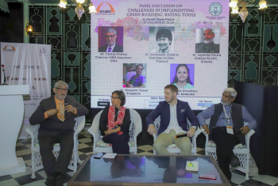
Panel discussion on Challenges in Implementing Green Building Rating Tools, Jaipur RT, July 2019
Speakers
Ar.Jayantha Perera, Former ACGSA from SLIA
Mr.Pankaj Dharkar, Chairman Assocham Gem India
Ar.Benjamin Towell, ACGSA from SIA
Ar.Dr.Acharawan Chutarat, ACGSA Chairman

Slide 8
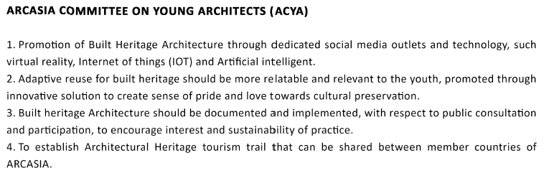
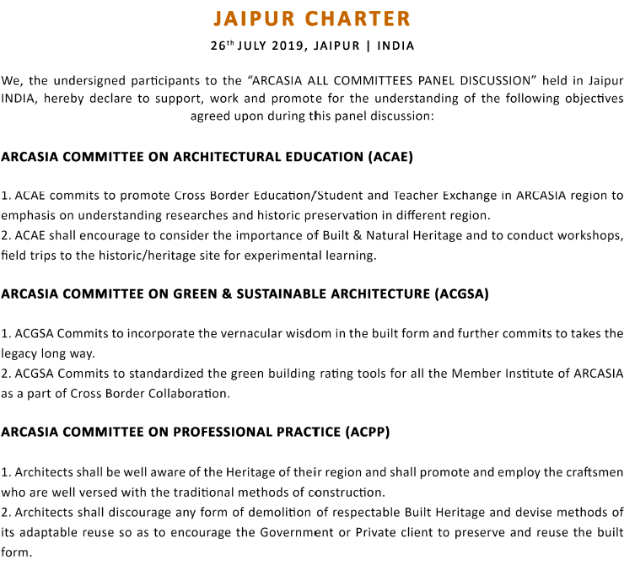
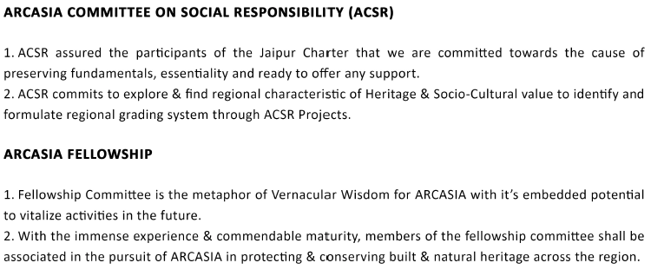
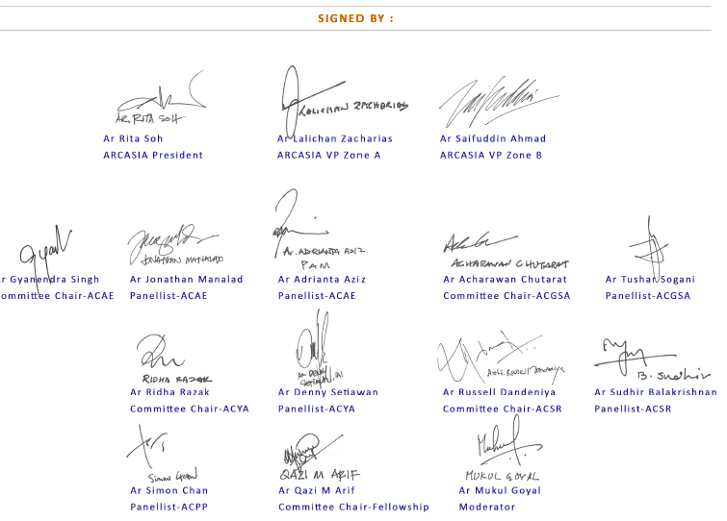
ARCASIA All Committees Panel Discussion: Lessons from Built Heritage The Way Forward, July 2019

Slide 9
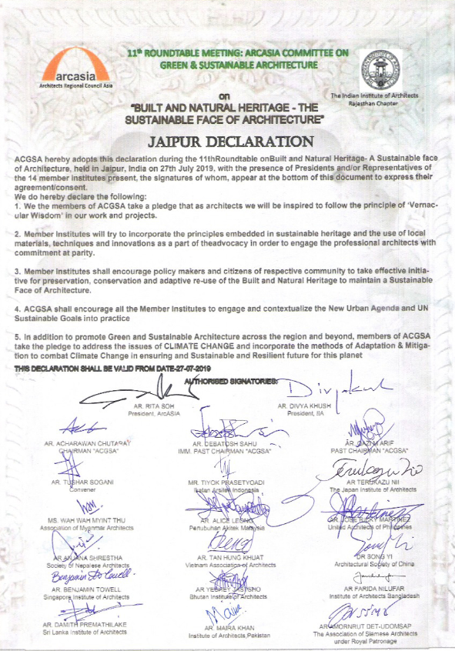
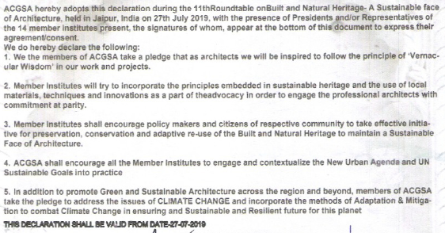
Jaipur Declaration

Slide 10
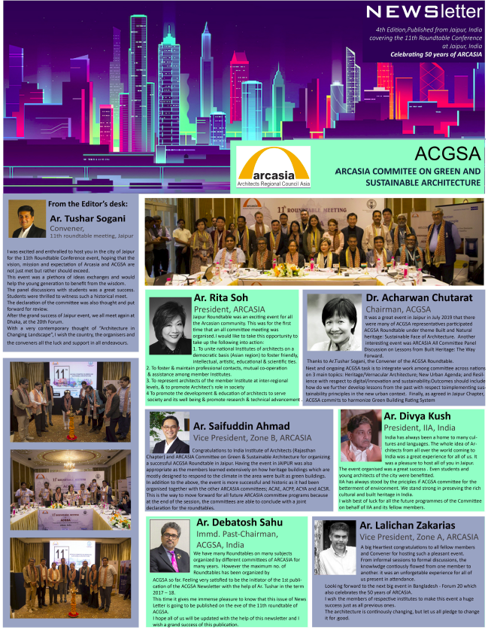
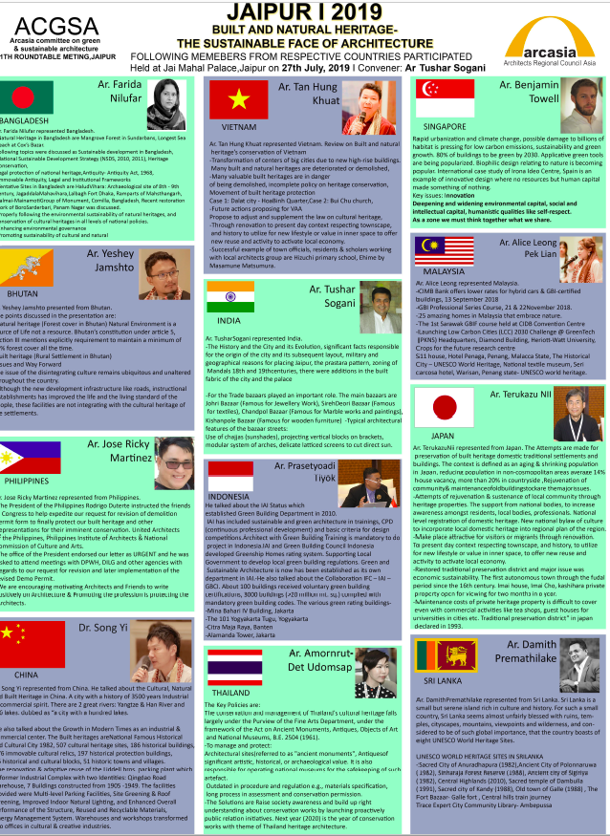
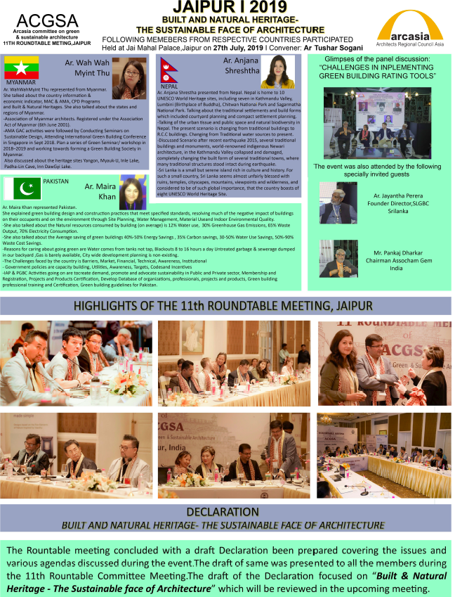
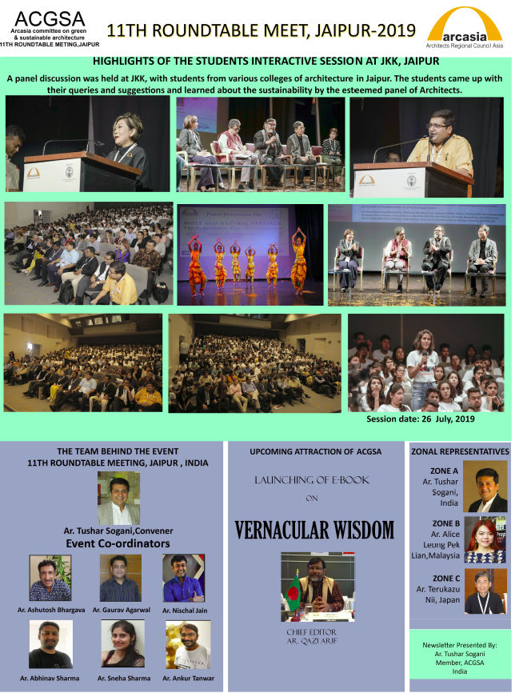
ACGSA Newsletter, 4th Edition

Slide 11
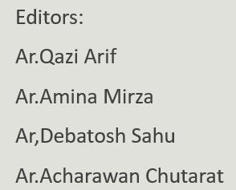

Vernacular Wisdom Book
Launch November the 7th, 2019
Editors:
Ar.Qazi Arif
Ar.Amina Mirza
Ar,Debatosh Sahu
Ar.Acharawan Chutarat
BANGLADESH. Institute of Architects Bangladesh (IAB)
BHUTAN. Bhutan Institute of Architects (BIA)
CHINA. Architectural Society of China(ASC)
HONGKONG. Hong Kong Institute of Architects (HKIA)
INDIA. Indian Institute of Architects (IIA)
INDONESIA. Indonesian Institute of Architects (IAI)
JAPAN. Japan Institute of Architects (JIA)
KOREA. Korean Institute of Registered Architects (KIRA)
MALAYSIA. Malaysian Institute of Architects (PAM)
MYANMAR. Association of Myanmar Architects
NEPAL. Society of Nepalese Architects (SONA)
PAKISTAN. Institute of Architects Pakistan (IAP)
PHILIPPINES. United Architects of the Philippines (UAP)
SRI LANKA. Sri Lanka Institute of Architects (SLIA)
THAILAND. Association of Siamese Architects (ASA)
VIETNAM. Vietnam Association of Architects (VAA)

Slide 12
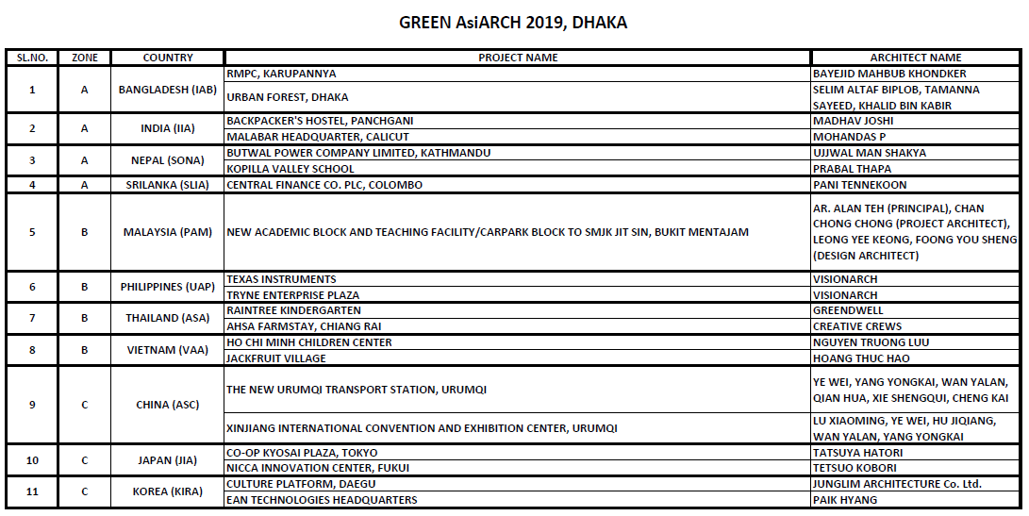
GreenAsiArch2019, Dhaka
best green building practices

Slide 13
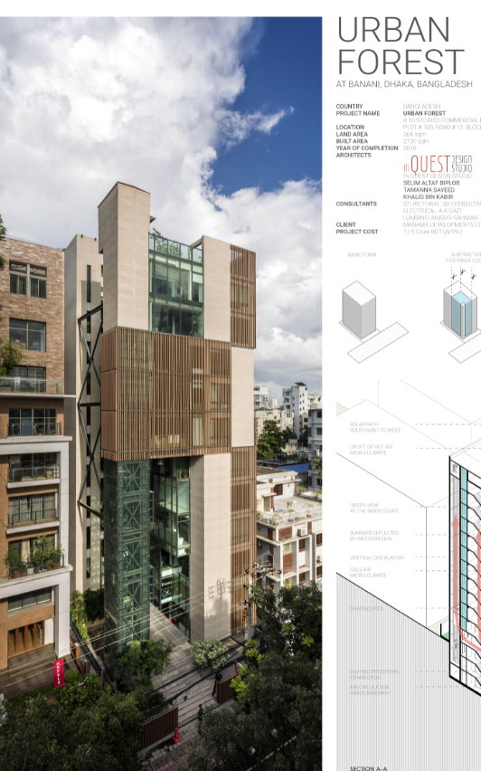
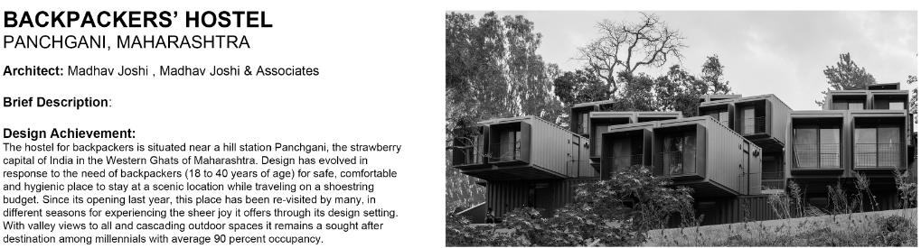
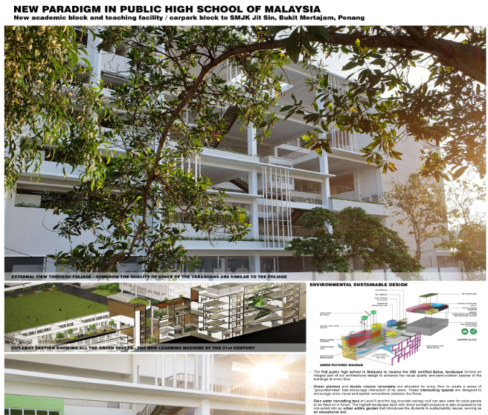
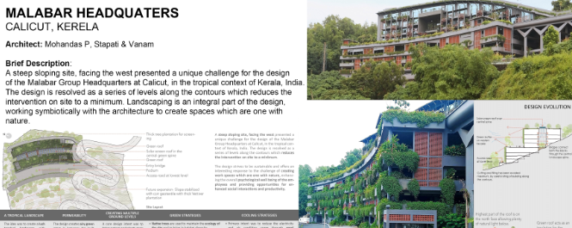
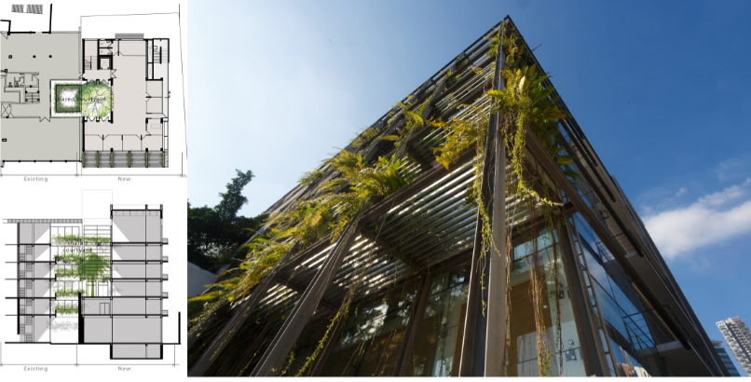
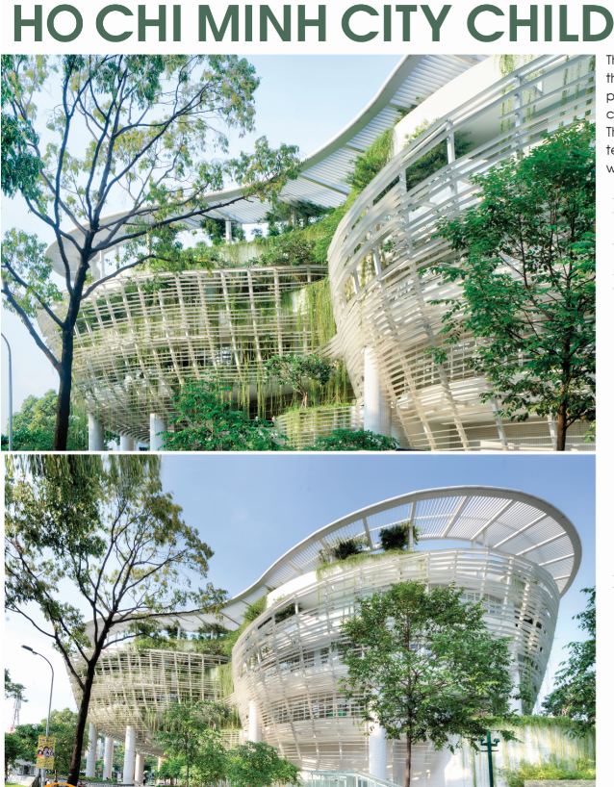
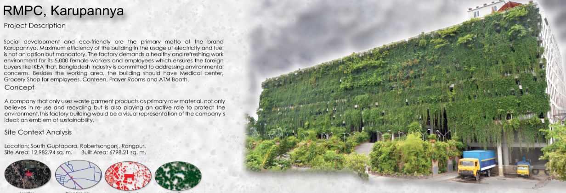
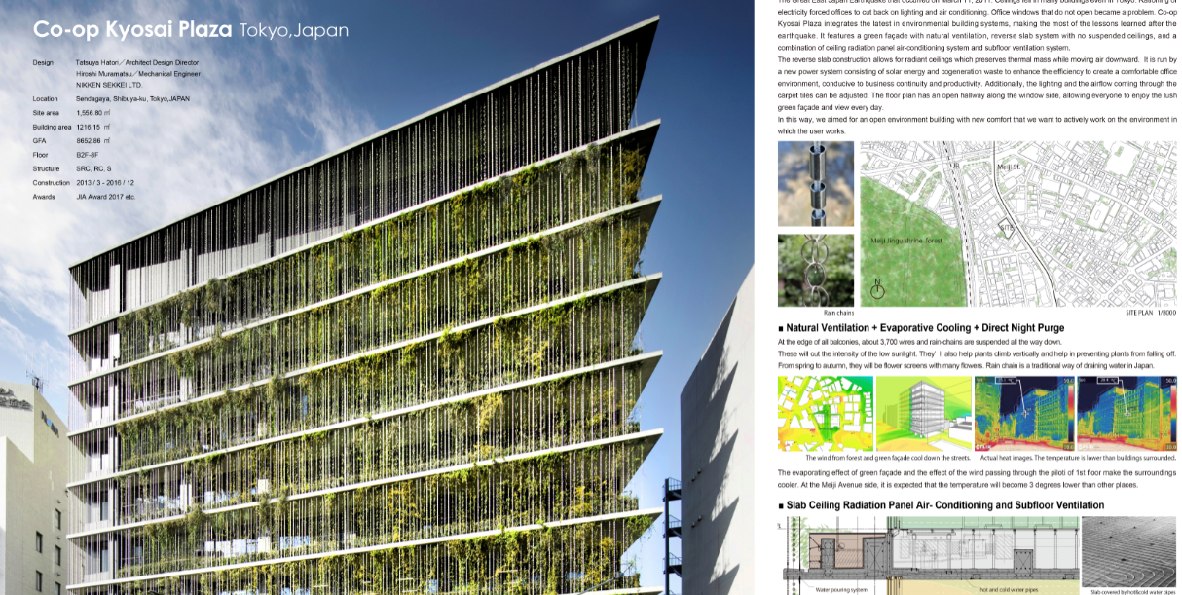
New Urban Green Typologies

Slide 14
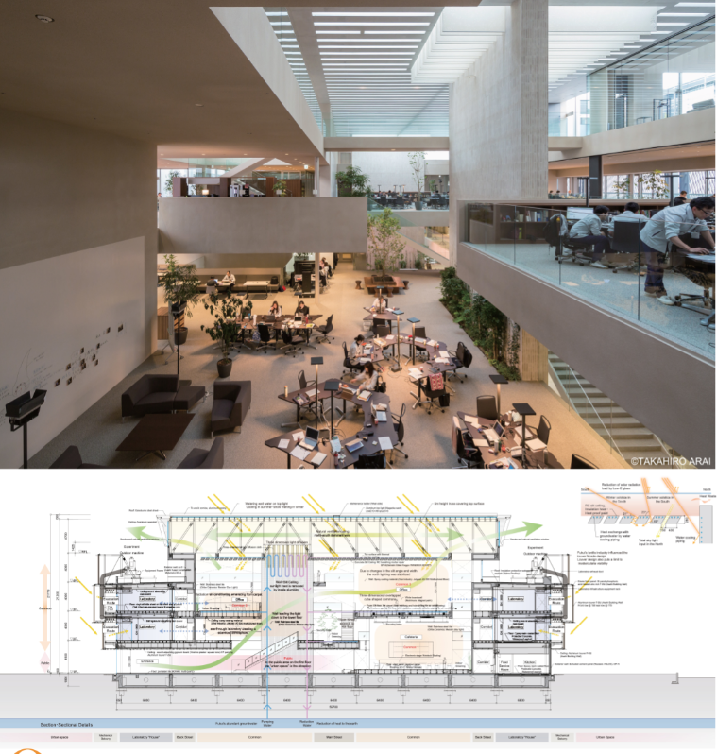
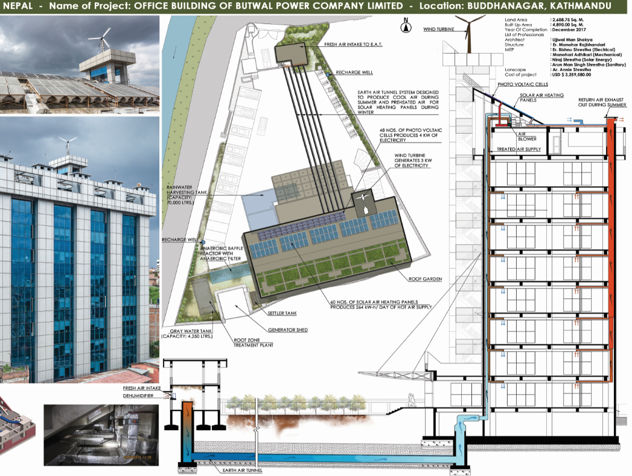
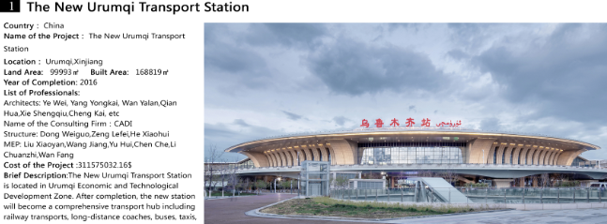
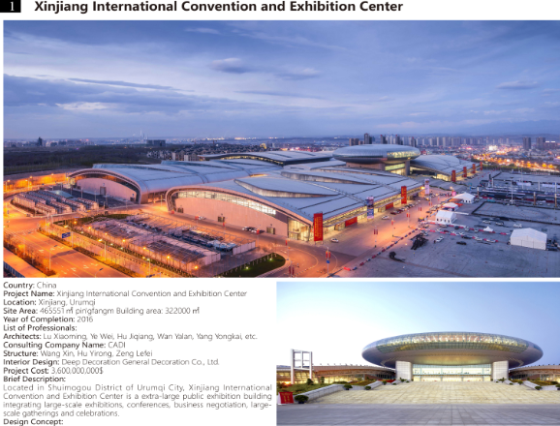

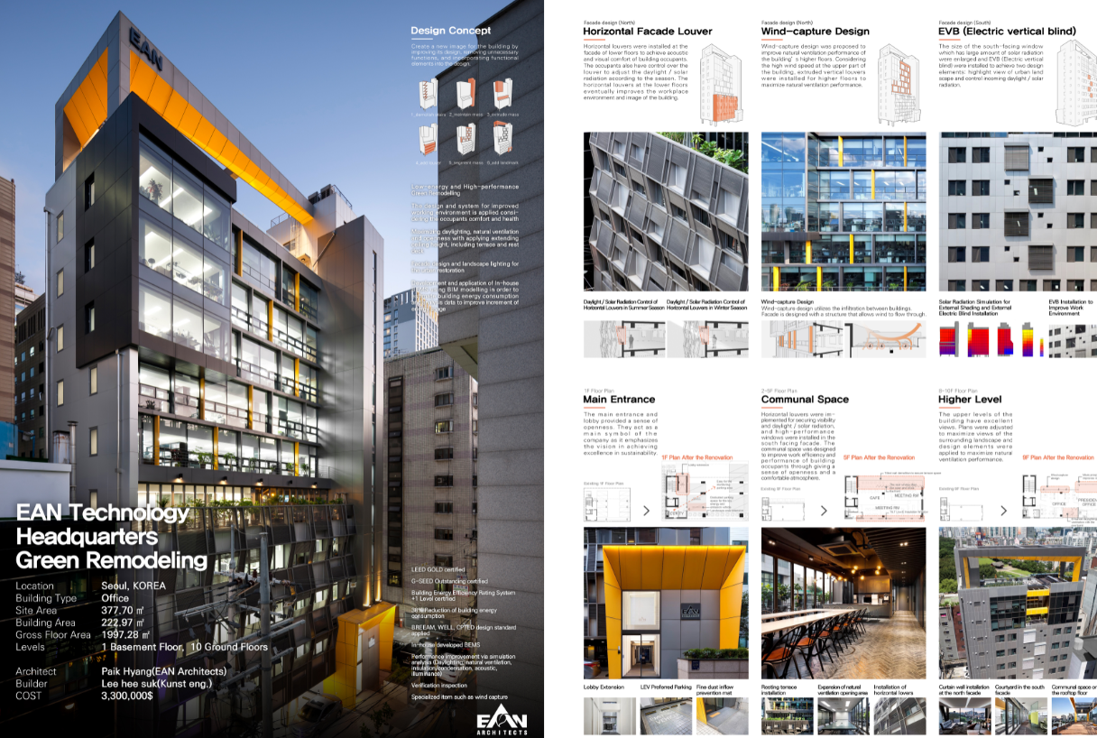
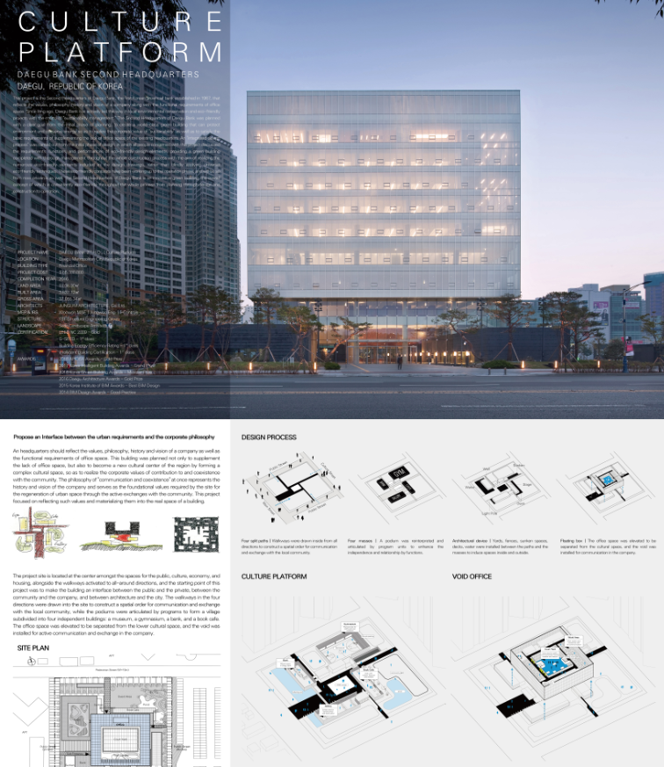
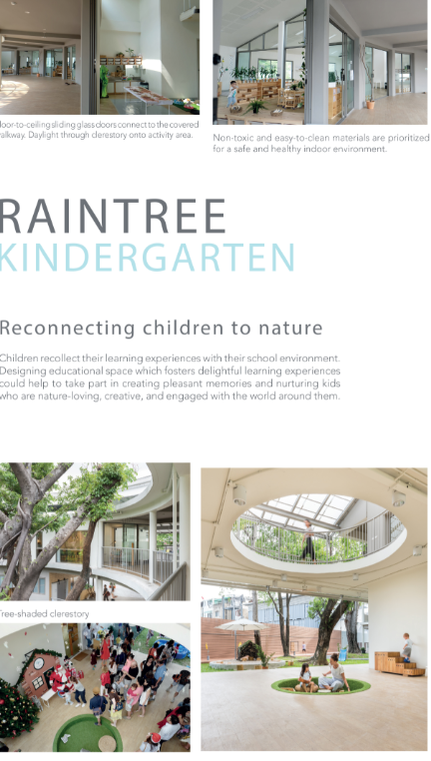

Contemporary Sustainable Integrated Design + Innovation

Slide 15
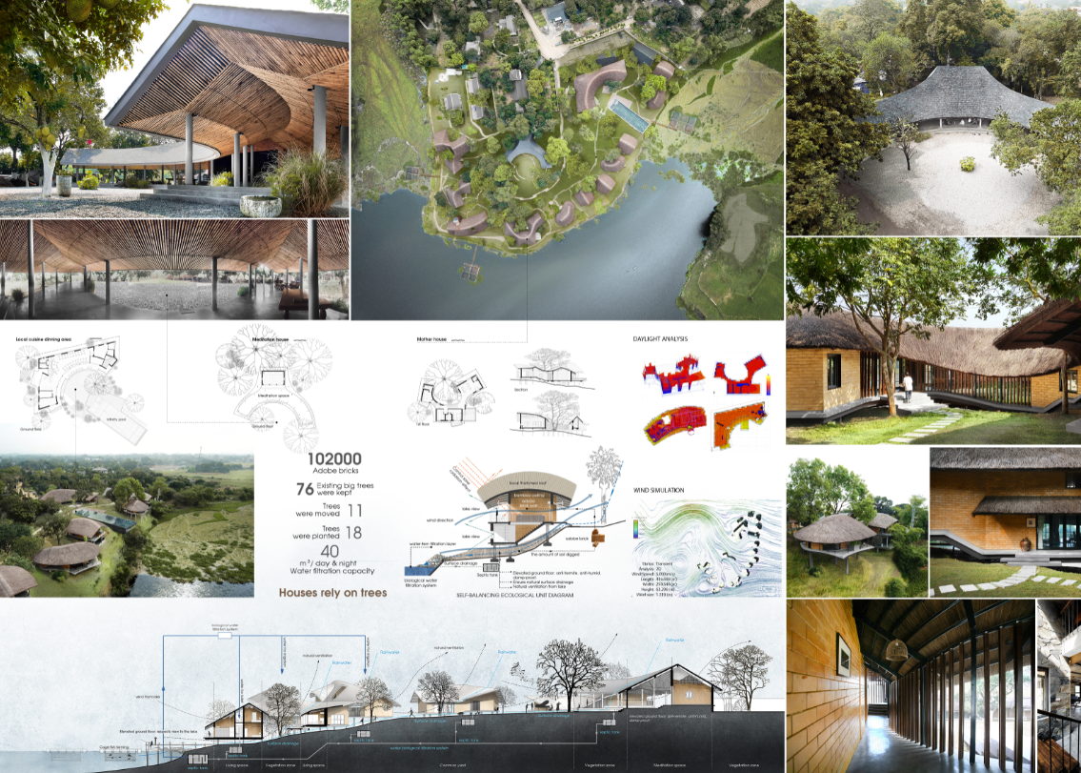
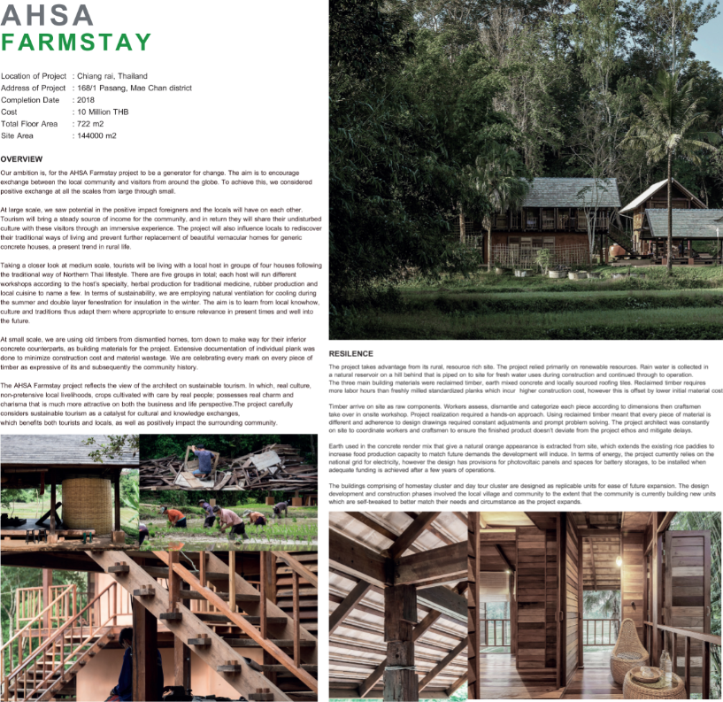
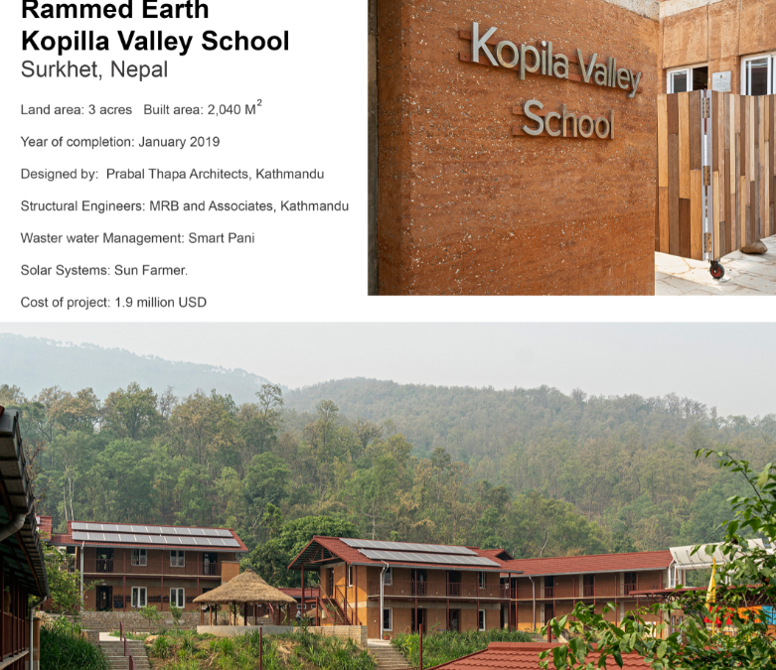
New Vernacular / Sharing / Community

Slide 16
Country Reports, Nov 5th, 2019
Heritage/Vernacular
  Sustainable tourism, eco village
  Renovation and Construction method: Modern architecture based on traditional wisdom and local culture responding to local climate
  Adopt in Green design criteria
  Increase participation, co-create, especially for youth

Slide 17
Country Reports, Nov 5th, 2019
New Urban Agenda
  Strengthen building codes to reduce CO2 emission (EE, RE)
  New guides/regulations for climate changes, smart cities, net zero energy buildings
  Incentives in tax exemption on targeted industries, equipment supporting green, smart
  Promote design technique/approach with renewable energies, bioclimatic design, eco house
  New design paradigm for urban forest, urban green, green roof, edible garden
  Promote design with waste / circular economy
  Design with high density with green integration
  SDGs adoption
  Improve awareness in adopting green criteria for awards, activities, new working group (such as simulation, resilience), training for several sectors—education, design, industry

Slide 18
Country Reports, Nov 5th, 2019
Resilience
  Design method for Tsunami , Coastal resilience
  Design for climate changes
  Seismic in design consideration
  Sponge City and building design for water shortage

Slide 19
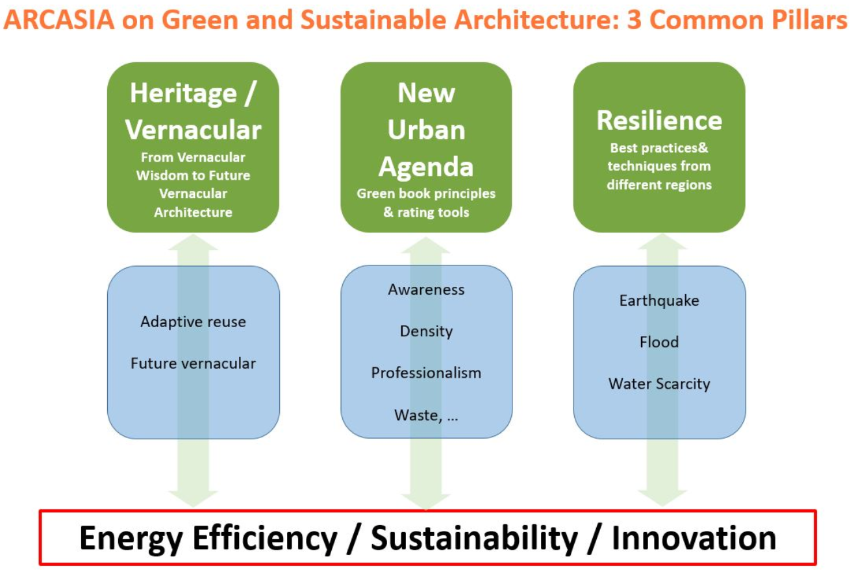
Discussions—3 Pillars
Stewardship in use of all resources
Education + Life-long Learning
Crossed disciplines
Workshop
Training
Environmental Sustainability
Design Excellence + Empathy
Social Awareness+Responsibility

Slide 20
Progress for subcommittee meeting
Pillar 1: working group ASC, ASA, HKIA, VAA, SONA, IIA, AMA
Pillar 2: working group SIA, PAM, IAB, HKIA, SONA, IAP, SLIA, AMA
Pillar 3: working group JIA, UAP, SONA, IAI, AMA
Proposed time frame
March 2020 work progress 1 (online or face to face meeting) and workshop in Wuhan
May 2020 RT and work progress 2 for all in Myanmar proposed with ACSR/ACPP workshop
July/Aug 2020 work progress 3 (online or face to face meeting)
Nov 2020 ACA in Shanghai, final delivery

Slide 21
12th Roundtable Proposals
AMA→ Confirmed to host the 12th Roundtable collaborate with other committee
ASC
IAB

Slide 22
Summary + Suggested Work
  Collaborate and support AEA by Pillar 3 sub-committee working group
  GreenAsiArch can be featured in Architecture Asia Magazine
  Initiate Sustainable + Innovation in AAA Award
Learning from the past for ways forward
Sustainability through working among crossed disciplines with respect to resilient using technology towards innovation
Integrate in Practice, Design and Education, through social outreach
Vernacular Wisdom Book
ACGSA’s
Green AsiArc
Green Building Rating Tools
E-Newsletter
Crossed disciplines
Workshop
Training
Future Vernacular/ Adaptive Reuse
ACGSA’s
Green AsiArc + AA
Harmonize GB Rating Tools, NUA, SDGS

Slide 23
Thank you

