Slide 1
Activity Report of Zone A
Vice President

Slide 2
Vice – President Zone – A Report
Congratulation to President ARCASIA, Ar. George Kunihiro for the AIA Presidential Medal awarded to him by the President AIA at their Annual Convention.
The American Institute of Architects held the AIA 2011, National Convention and Exposition in New Orleans, Louisiana May, 12-14, 2011
I must thank George Kunihiro for inviting me to attend the AIA convention as a representative of ARCASIA. It was a great opportunity for us to project ARCASIA at the AIA Forum with a strong presence of members from our region. The Office Bearers who attended the AIA Convention were Ar. George Kunihiro, Ar. Yolanda Reyes, Ar. Nela Dzousa and Ar. Kalim A. Siddiqui. Besides the above others from the region were Ar. Shahab Ghani Khan President IAP and a very strong delegation from Korea as well.

Slide 3
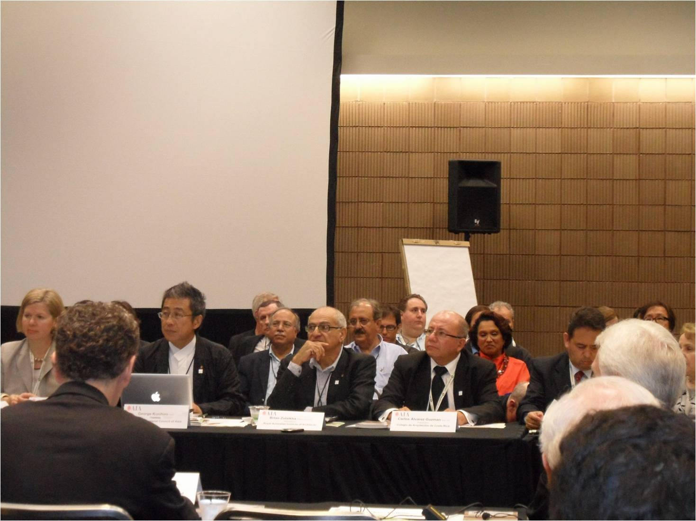

Slide 4
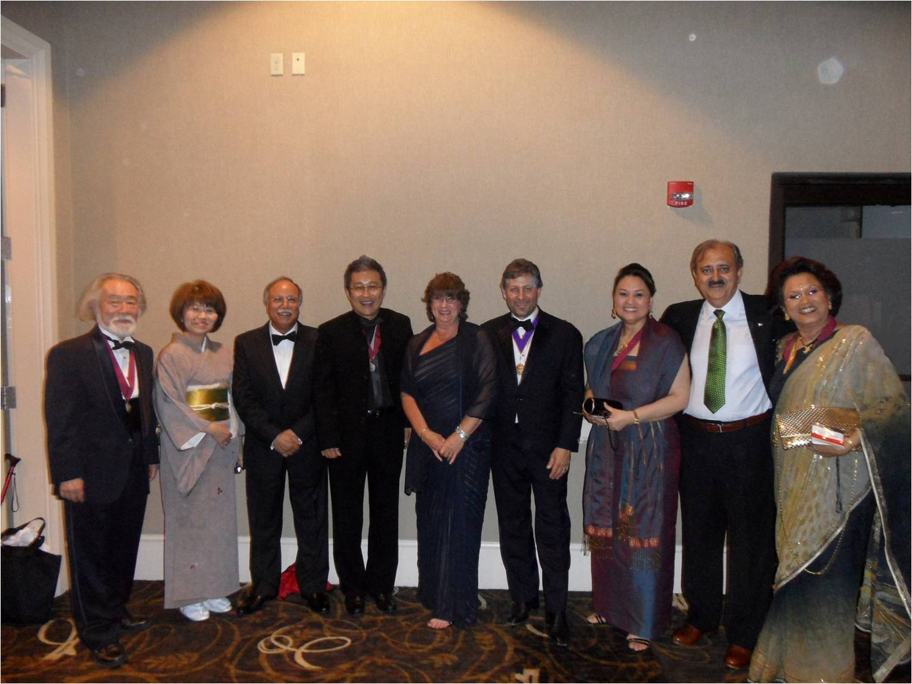

Slide 5
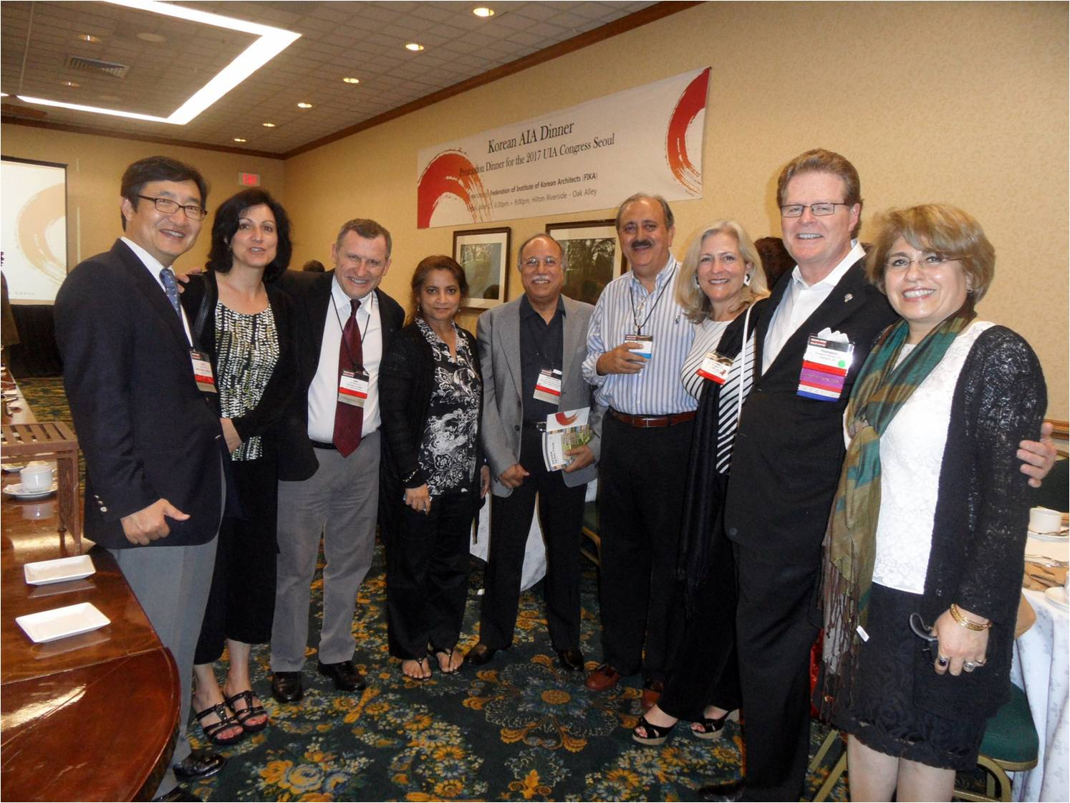

Slide 6
Vice president zone-A was also invited by the Association of Siamese Architects to attend the Annual National Convention and International Forum 2011 which was held from 8th – 13th February 2011, at Challenger Hall, Impact Convention, Maun Thong, Thani, Bangkok Thailand. This year it featured the theme “Bottom up”, a vision to address the foundation that will have an affect all the way to the top.

Slide 7
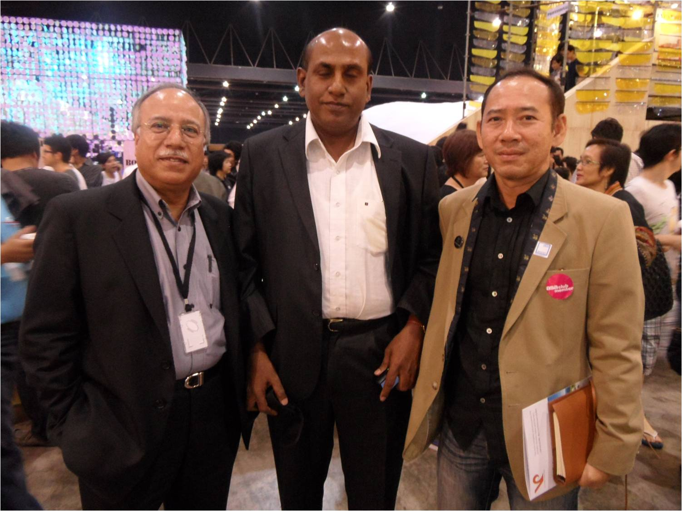

Slide 8
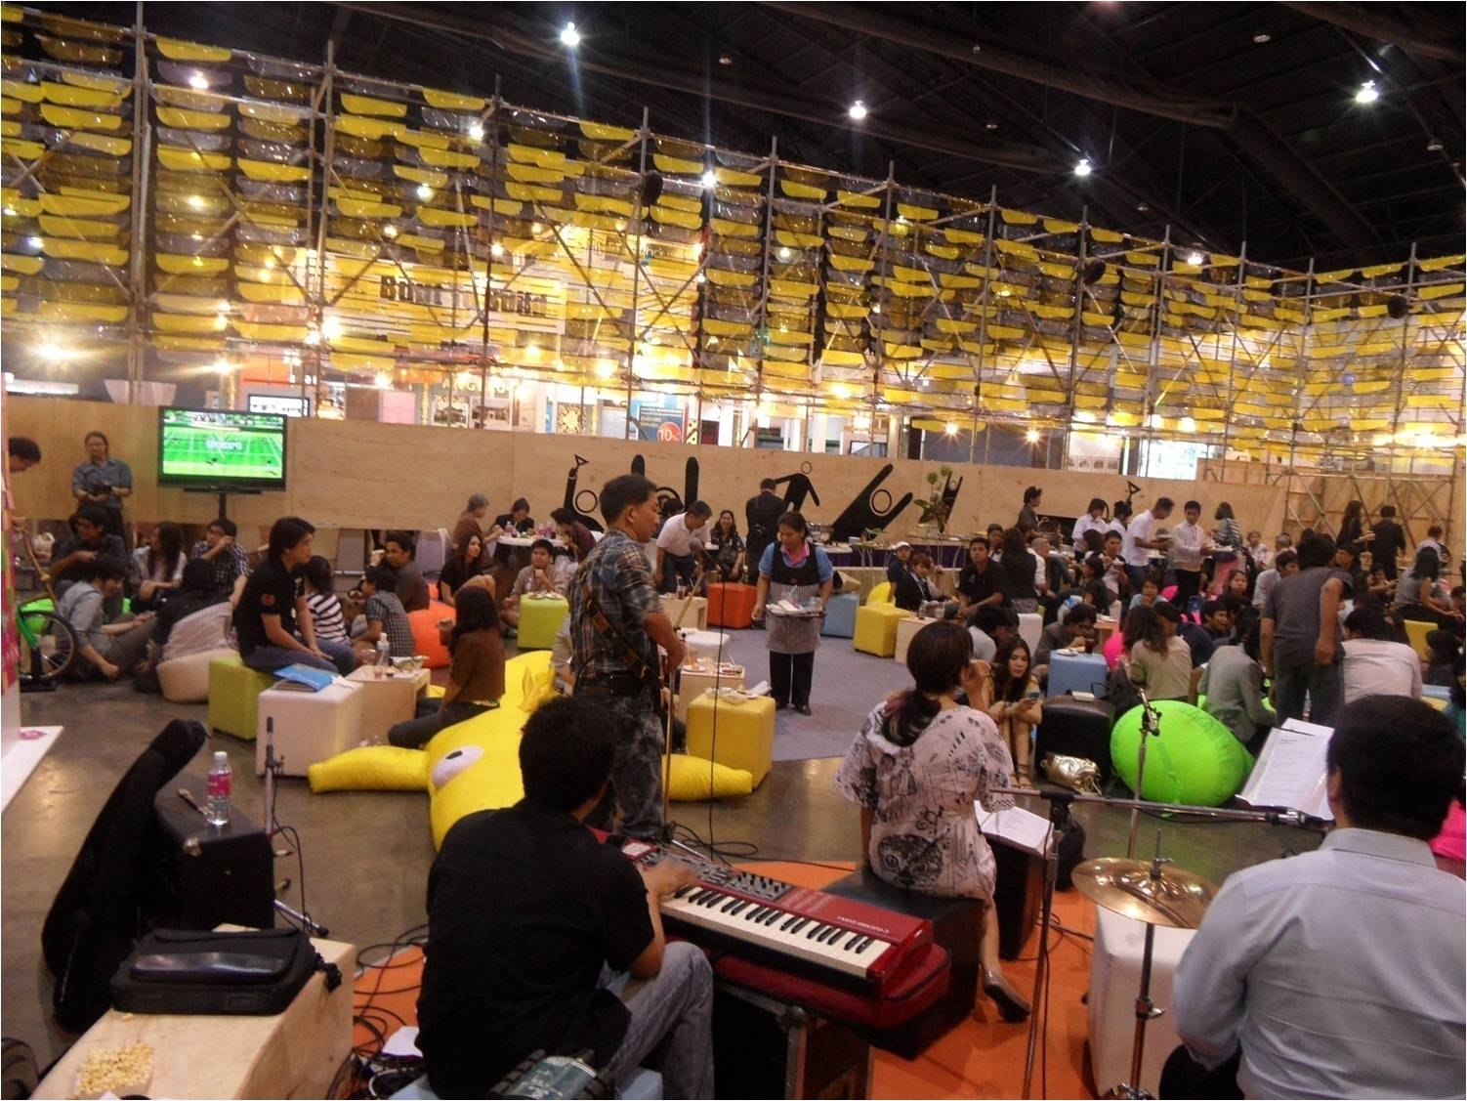

Slide 9
Flood relief for Pakistan
I would like to extend my thanks and gratitude to all those who donated generously in the IAP flood relief fund and extended their assistance and support.
Thailand $2000/- donation received on 9th February, 2011
Srilanka $1000/- donation received in February 2011
Ar. Bashir ul Haq from Bangladesh donated $ 607/- received in October 2011.
Ms. Louise Cox from Australia donation $ 1400/- received on 16th November, 2011

Slide 10
OFFICE BEARERS MEETING IN KUALA LUMPUR
July 1-2, 2011
DATUM : KL
Kuala Lumpur Architecture Festival 2011
1st and 2nd July 2011

Slide 11


Slide 12
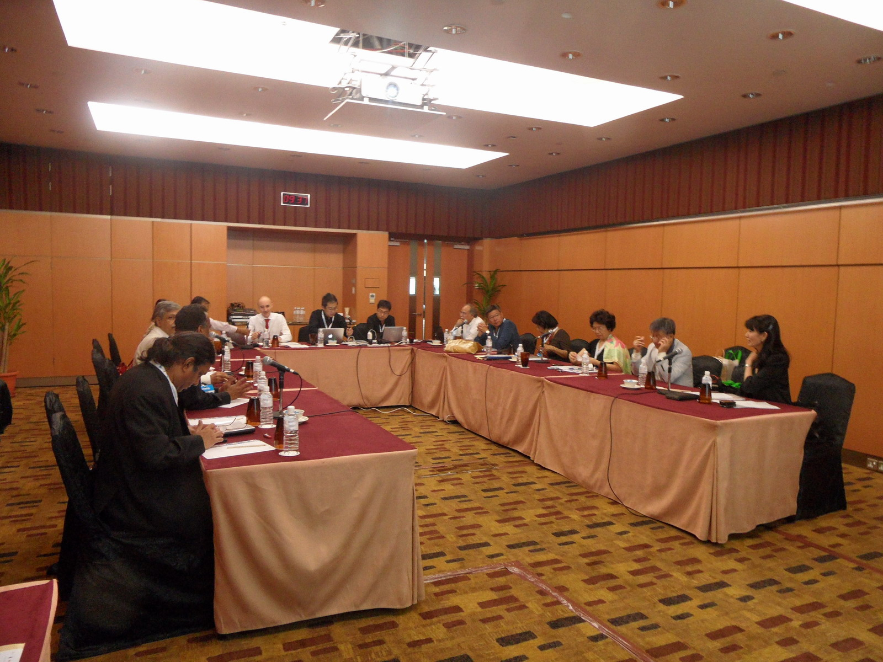

Slide 13
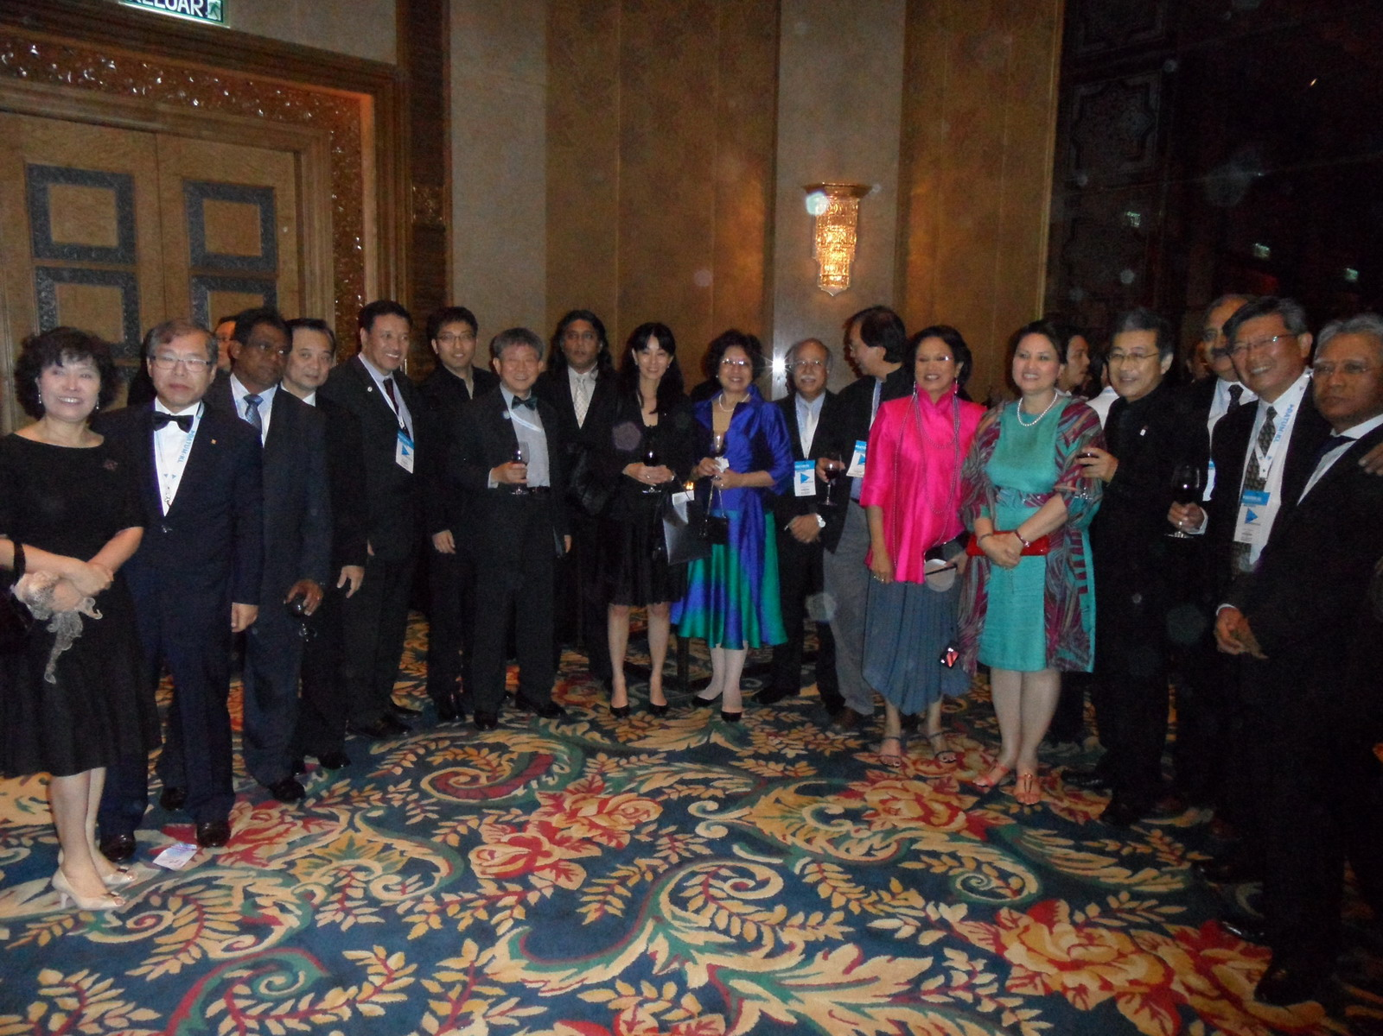

Slide 14
Various Activities in Zone A

Slide 15
BANGLADESH
IAB
INSTITUTE OF ARCHITECTS BANGLADESH

Slide 16
MEMBERSHIP CATEGORIES
There are four types:
1) Honorary Member
2) Member
3) Candidate Member
4) Student Member
LEGAL STATUS
Registered with the Government as a society.
Last annual general meeting was held on 7 April 2011.

Slide 17
REGULAR PROGRAMS
IAB organizes CPD program for it members. It will be mandatory to have minimum no. of credits for all members soon.
IAB Organized the following seminars:
Exhibition on ARCASIA heritage on 16th July, 2011
Diplomats of 17 countries and Bangladesh foreign minister inaugurated this occasion at the National Museum Dhaka.

Slide 18
ARCHITECTURE SCHOOLS & REGISTRATION
At present there are five (5) IAB recognized architectural schools in Bangladesh.
IAB has just recently passed the accreditation procedures and formed the accreditation committee to ensure the minimum standards of architectural education.
All the architectural schools are gradually applying for IAB accreditation. Eventually without IAB accreditation, it will not allow any person to become IAB members.
At present there is no registration body. However, it is mandatory to be a member of IAB to submit building plans in the major cities including the capital Dhaka.

Slide 19
INDIA
IIA
INSTITUTE OF INDIAN ARCHITECTS

Slide 20
MEMBERSHIP CATEGORIES
MEMBERSHIP CATEGORY NUMBERS
Fellow Architects 1619 Nos
Associate Architect 12616 Nos
Licentiate Architect 43 Nos
REGIONAL CHAPTERS
17 Chapters all over India.

Slide 21
LEGAL STATUS
Registration Under the Societies Registration Act, XXI of 1860.
The last annual general Meeting was held on 5th December, 2010 at Lucknow, UP.
PROGRAMS
IIA organises CPD programs such as seminars, workshops and guest lectures etc. For the benifit of members through chapters and centres.Besides there are two national events namely
1) Young architects festival.
2) conferences and seminars on Green Architecture & Sustainable Energy.

Slide 22
Young Architects Festival will be held Chandigarh, Punjab from 14th to 16th October, 2011.
The theme of the Festival is
“Contemporary Architecture – Beyond Corbusierism”
National Convention 2011 will be held at Hyderabad, Andhra Pradesh on the Theme
“Emerging Trends and issues in Indian Architecture.”
ARCHITECT’S REGISTRATION BOARD
Council of architecture, under provisions of ARCHITECTS REGISTRATION ACT, does the registration of Architects. Five representatives are on the council of architecture.

Slide 23
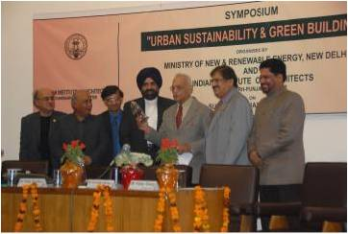

Slide 24
NEPAL
SONA
SOCIETY OF NEPALIAN ARCHITECTS

Slide 25
MEMBERSHIP CATEGORIES
MEMBERSHIP CATEGORY NUMBER
Ordinary Member 447
Life Member 115
Institutional 0
Honorary 0
LEGAL STATUS
Registered as an NGO in Kathmandu district office, Kathmandu, Nepal.
The last annual general Meeting was held on 2011.03.04

Slide 26
INSTITUTE’S ROLE
There are seven institutions that have 5 years B. Arch education, all in Kathmandu.
There is no registration process for architects.
REPRESENTATION IN THE GOVERNMENT
Government of Nepal regularly gets suggestions and views of SONA in formulation and review of different regulation and policies related to Architecture, building construction and urban planning. SONA is given responsibilities to conduct design competition by some government departments.

Slide 27
PAKISTAN
IAP
INSTITUTE OF ARCHITECTS PAKISTAN

Slide 28
MEMBERSHIP CATEGORIES
MEMBERSHIP CATEGORY NUMBERS
Fellows 45
Associates 1171
Affiliates 269

Slide 29
ORGANIZATIONAL STRUCTURE
IAP has a National Council consisting of 13 members, nine of whom are directly elected, comprising a President, two Vice Presidents, Honorary Secretary, Honorary Treasurer, Chairmen of all the four chapters and four executive members.
LEGAL STATUS
IAP is a non- profit organization registered under company ordinance 1984 with status of “Company” with Securities & Exchange Commission of Pakistan (SECP)
The last annual general Meeting was held on 26th November 2010 at Karachi.

Slide 30
INSTITUTE’S ROLE
There are currently 12 recognized Architectural schools in Pakistan, and IAP does have a significant role in the architectural education of the country. It is one of the objectives of IAP to improve and elevate the technical and general knowledge of professional architects who are engaged in the teaching process and also awards scholarships, grants, rewards and other benefactions to outstanding students and graduates.
ACCREDITATION PROCESS
IAP is not directly involved in the accreditation process. Accreditation of Architectural schools is done by Pakistan Council of Architects and town Planners (PCATP) under the law. IAP members are part of the accreditation teams.

Slide 31
ARCHITECT’S REGISTRATION BOARD
There is a registration process,Architects are not allowed to practice unless registered with Pakistan Council of Architects and Town Planners (PCATP). And likewise no Architect can be an IAP member unless registered with PCATP.
REPRESENTATION IN THE GOVERNMENT
The Pakistan Council of Architects & Town Planners (PCATP), the regulatory statutory body established by the Government, recognizes IAP as the sole representative body of professionally qualified architects of the country and as its ‘executive arm’.

Slide 32
KARACHI
10th-12th May
IAPEX Karachi 2011 was held at Expo Centre, Karachi, on theme “Generation Next” .

Slide 33
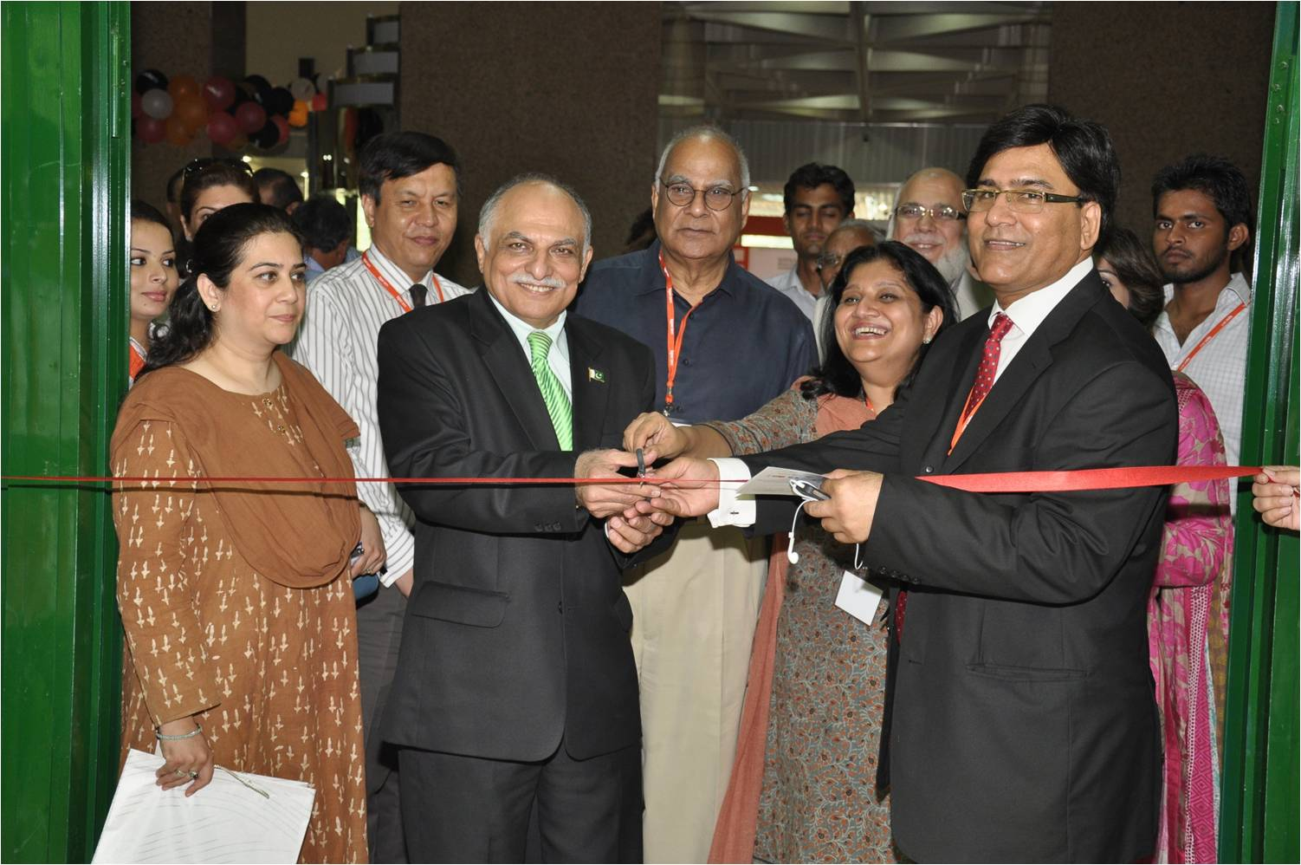

Slide 34
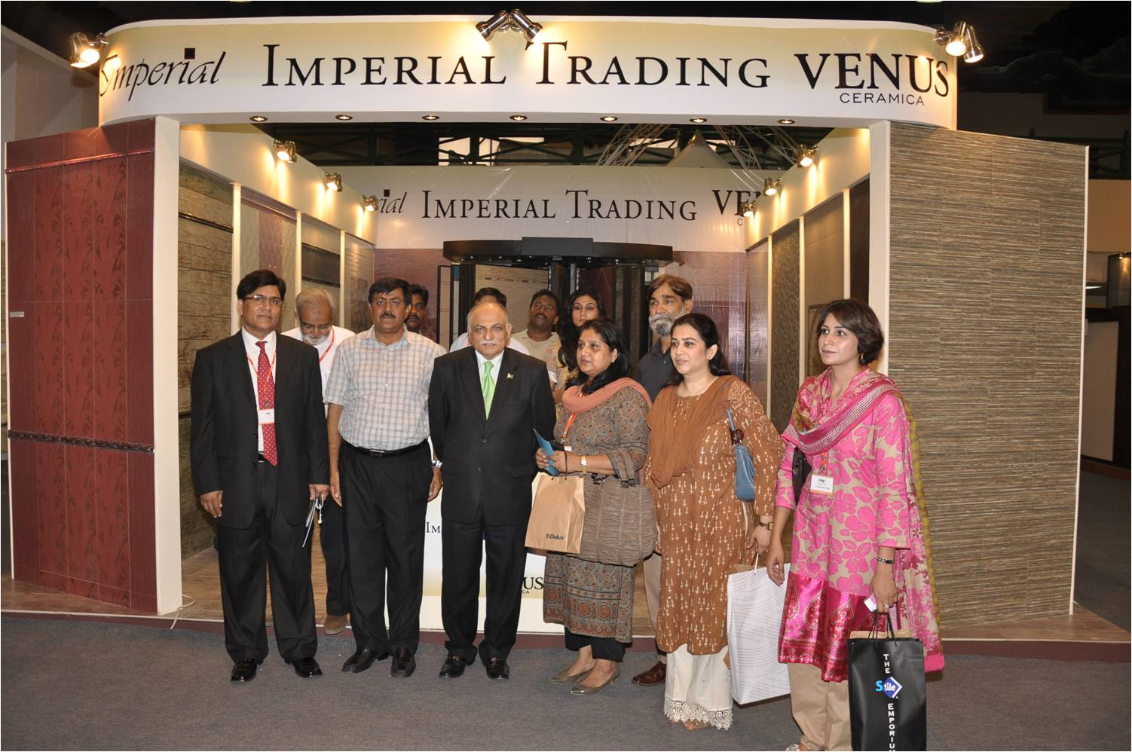

Slide 35
LAHORE
3rd- 5th June, 2011
IAPEX Lahore 2011 was held at the Expo and Convention Centre, Lahore, on the theme “Architecture as an expression of poetic spaces”.

Slide 36
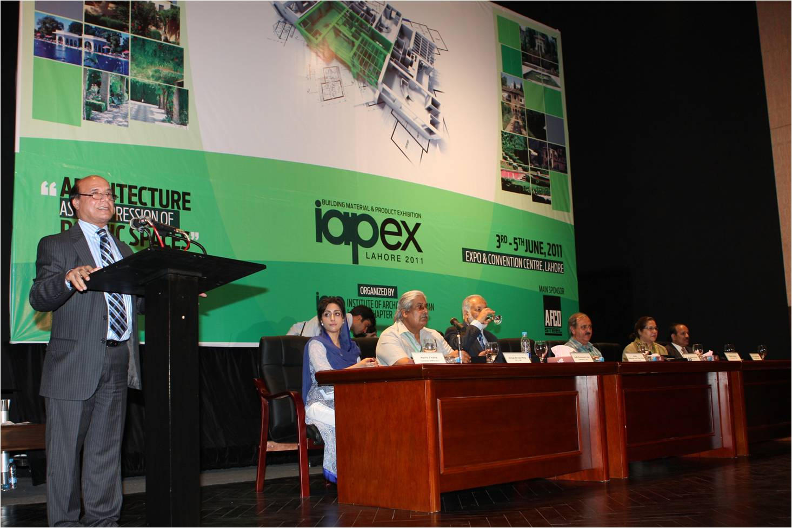

Slide 37
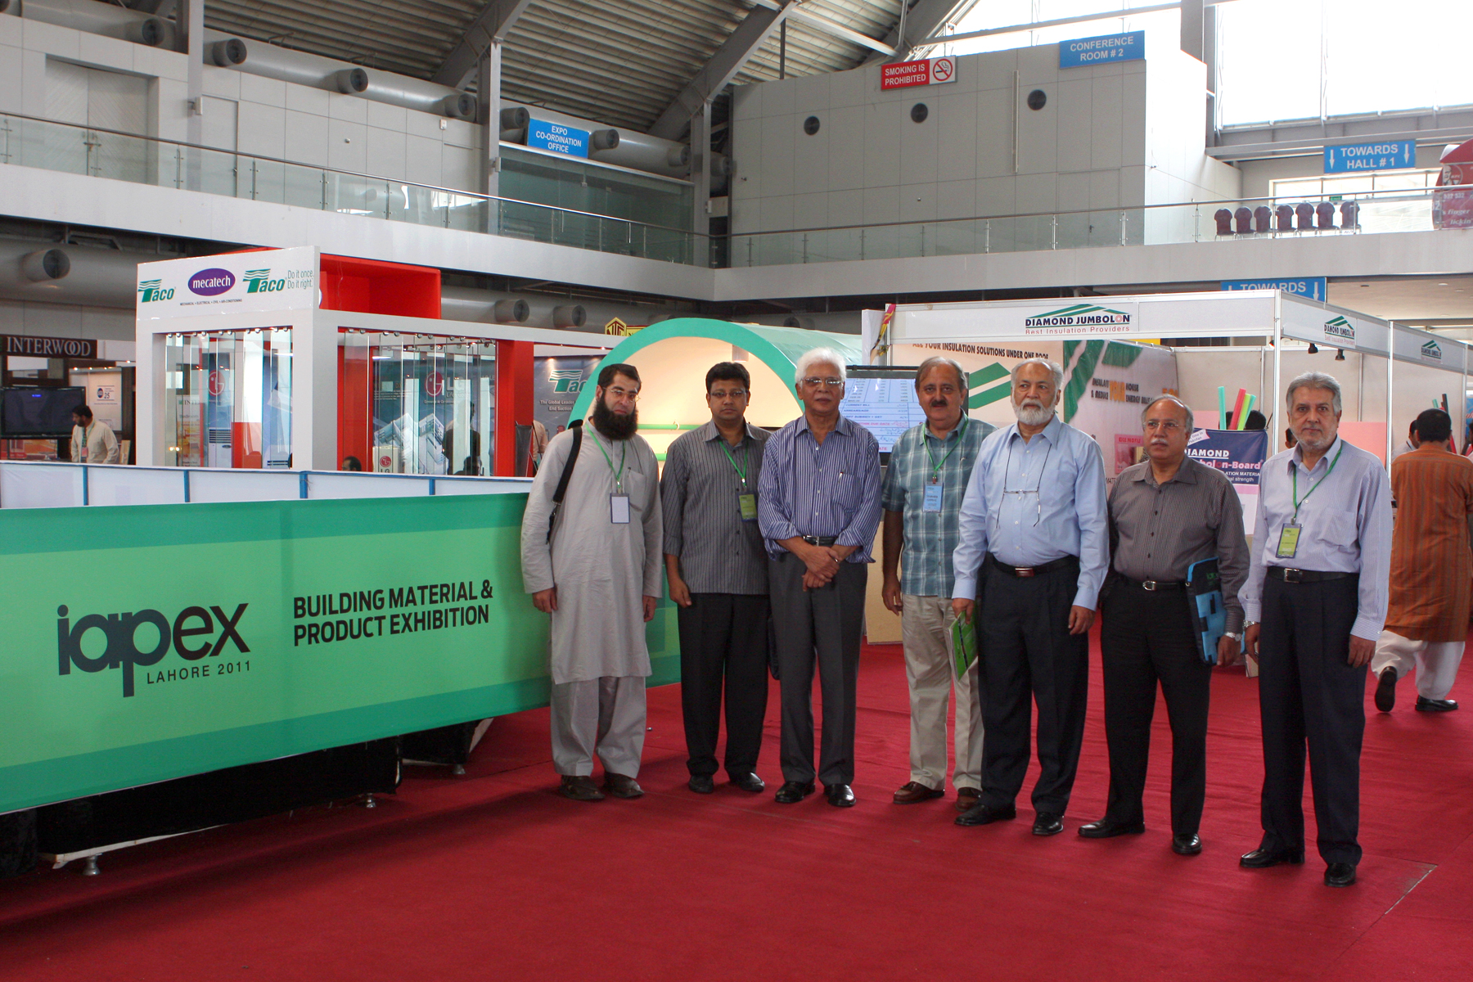

Slide 38
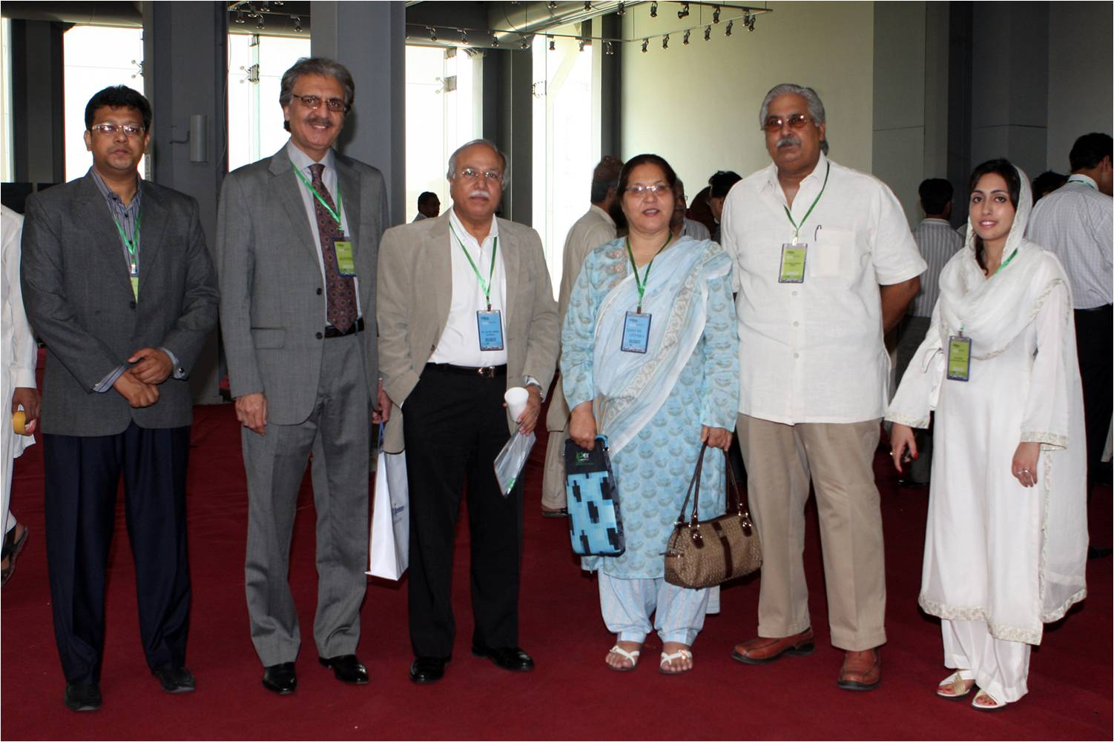

Slide 39
ISLAMABAD
22nd – 24th April, 2011
IAPEX Islamabad 2011 was held at Pearl Continental Hotel, Rawalpindi, on the theme
“50 years of Islamabad architecture: honoring our heritage.”

Slide 40
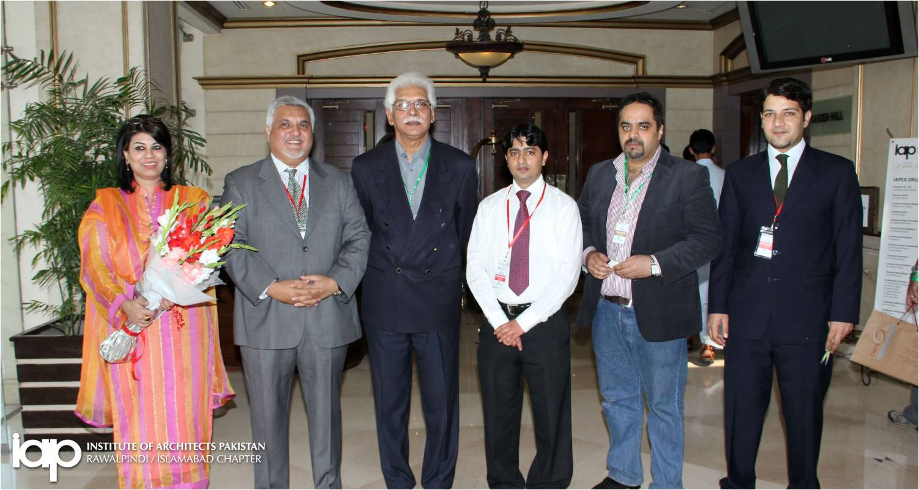

Slide 41
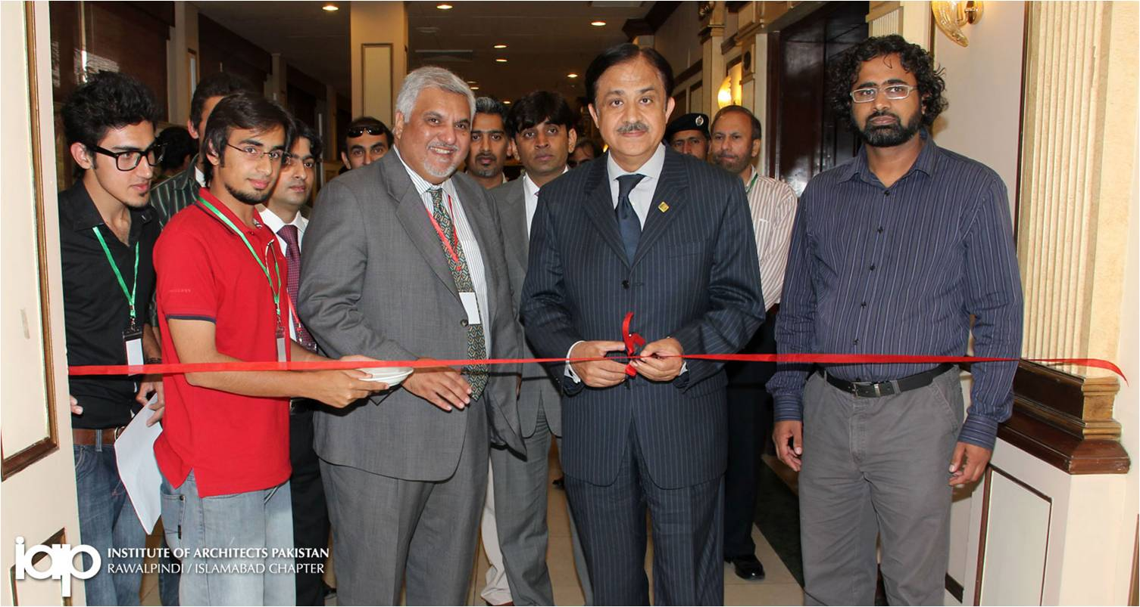

Slide 42
SRILANKA
SLIA
SRILANKAN INSTITUTE OF ARCHITECTS

Slide 43
MEMBERSHIP CATEGORIES
MEMBERSHIP CATEGORY NUMBERS
Hony.Fellow members 07
Fellow Members 94
Associate Members 777
Registered Members 02
Graduate Members 124
Student Members 65

Slide 44
The institute has three/Four CPD’s a year.
The topic of the last CPD event was “Transmission of knowledge Vs Progresses”
LEGAL STATUS OF THE INSTITUTE
Incorporated by Act. of Parliament.
No. 1 of 1976 and as amended by Act. No.14 of 1996.
The last annual general meeting was held on 26th of february 2011.

Slide 45
INSTITUTE’S ROLE
City School of Architecture (Colombo) Ltd and the faculty of architecture of the university of Moratuwa.
Mechanism for accreditation of architectural schools:
By the BAE of SLIA, once in Five(5) Years.
There are two recognized architecture schools functioning in the country.
REGISTRATION BOARD
The architects registration board established by an act of Parliament. Two council members represent the council on the board.

Slide 46
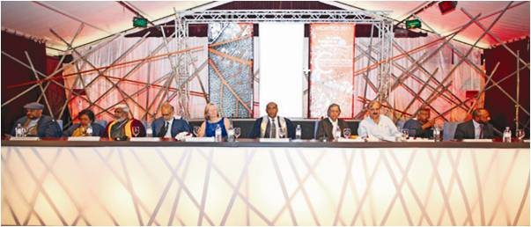

Slide 47
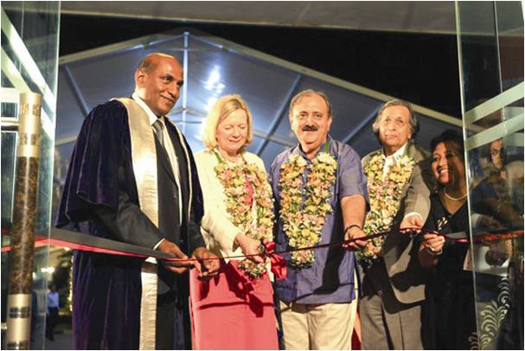

Slide 48
THANKYOU!!

