Slide 1

IMPORTANT ACTIVITIES OF ZONE A
Ar. Lalichan Zacharias , Vice President, Zone- A

Slide 2
INSTITUTES IN ZONE A
THE INDIAN INSTITUTE OF ARCHITECTS- IIA
INSTITUTE OF ARCHITECTS PAKISTAN- IAP
INSTITUTE OF ARCHITECTS BANGLADESH- IAB
SRILANKAN INSTITUTE OF ARCHITECTS- SLIA
SOCIETY OF NEPALIESE ARCHITECTS- ZONA
BUTENIESE INSTITUTE OF ARCHITECTS- BIA

Slide 3

ARCASIA FORUM – 20 ,2019 AND ARCASIA AWARDS, DHAKA
HOSTED BY IAB
The ARCASIA FORUM organized by IAB
DHAKA. From 3rd to 7th Nov. 2019.
The ARCASIA AWARDS also organised as
a part of the Forum by IAB.

Slide 4
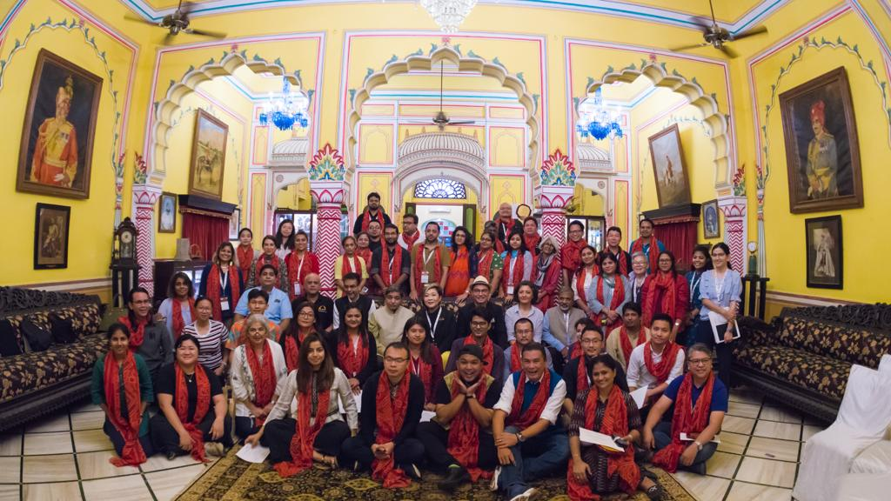
The Heritage Workshop Tour, IIA Rajasthan Chapter
For teachers of the Architecture schools of the
Member Institutes from 22nd to 26th July 2019
Jaipur

Slide 5
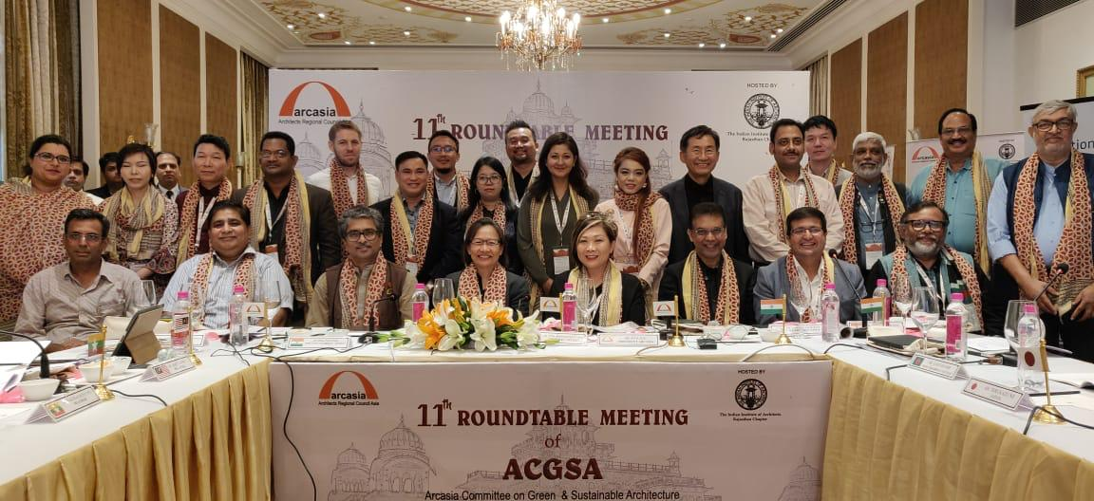
AGCSA Round Table, 2019 Jaipur
11th Round table on ‘Built and NATURAL HERITAGE-
The sustainable Face of Architecture.’ – 26th July
2019.

Slide 6
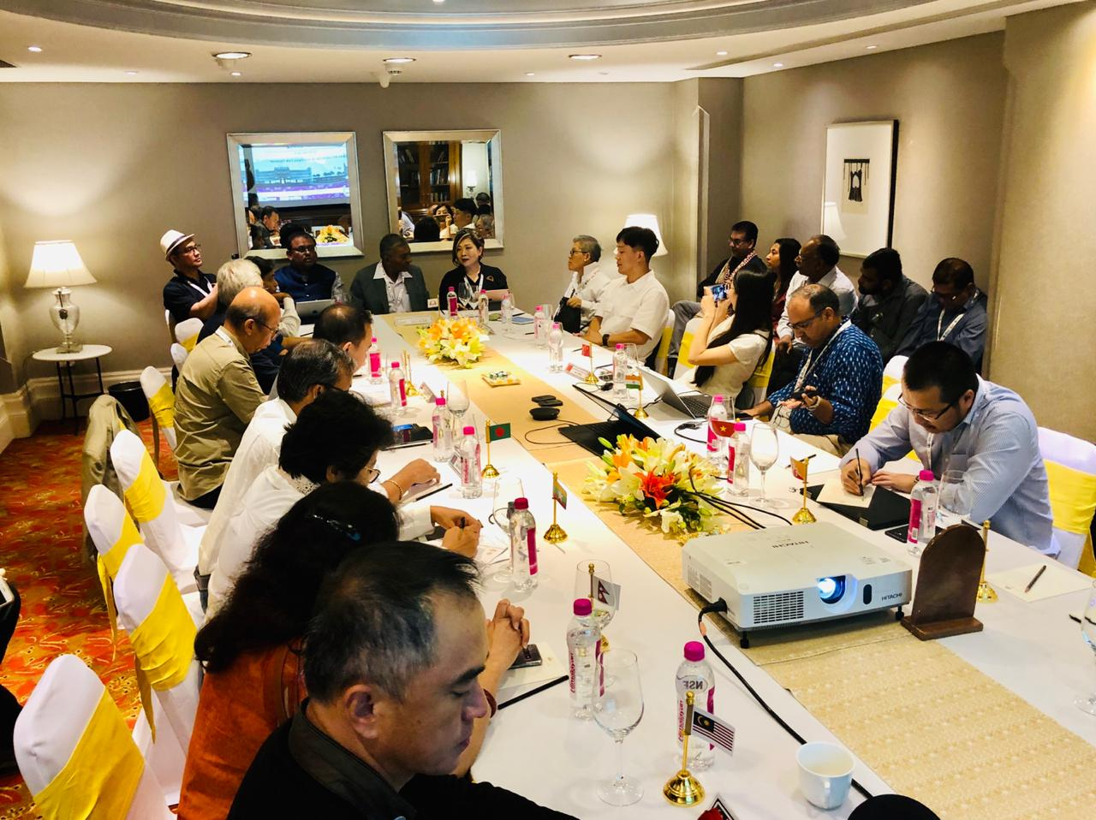
ACPP meeting at Jaipur
26th July 2019

Slide 7
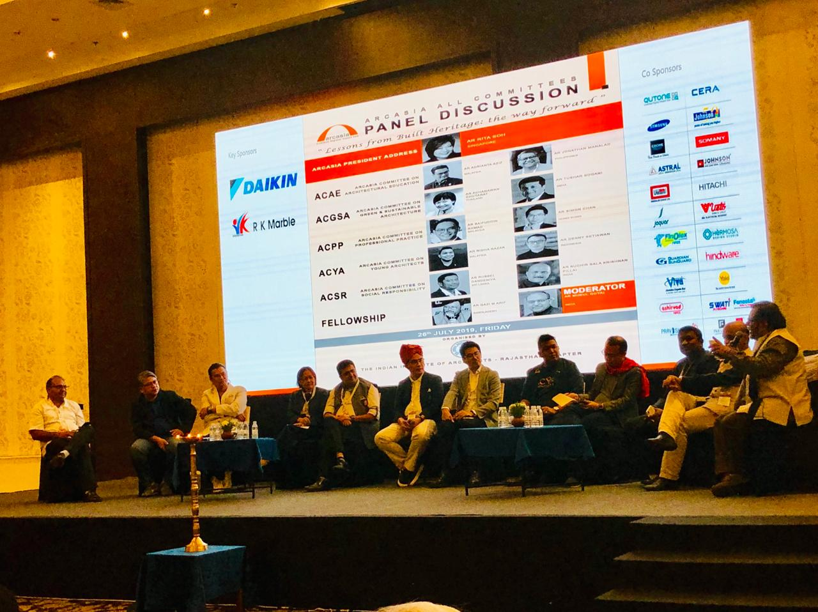
ARCASIA ALL COMMITTEE PANEL DISCUSSION
ON
‘LESSONS FROM BUILT HERITAGE-
THE WAY FORWARD”.
conducted on
26th July 2019 at Jaipur

Slide 8
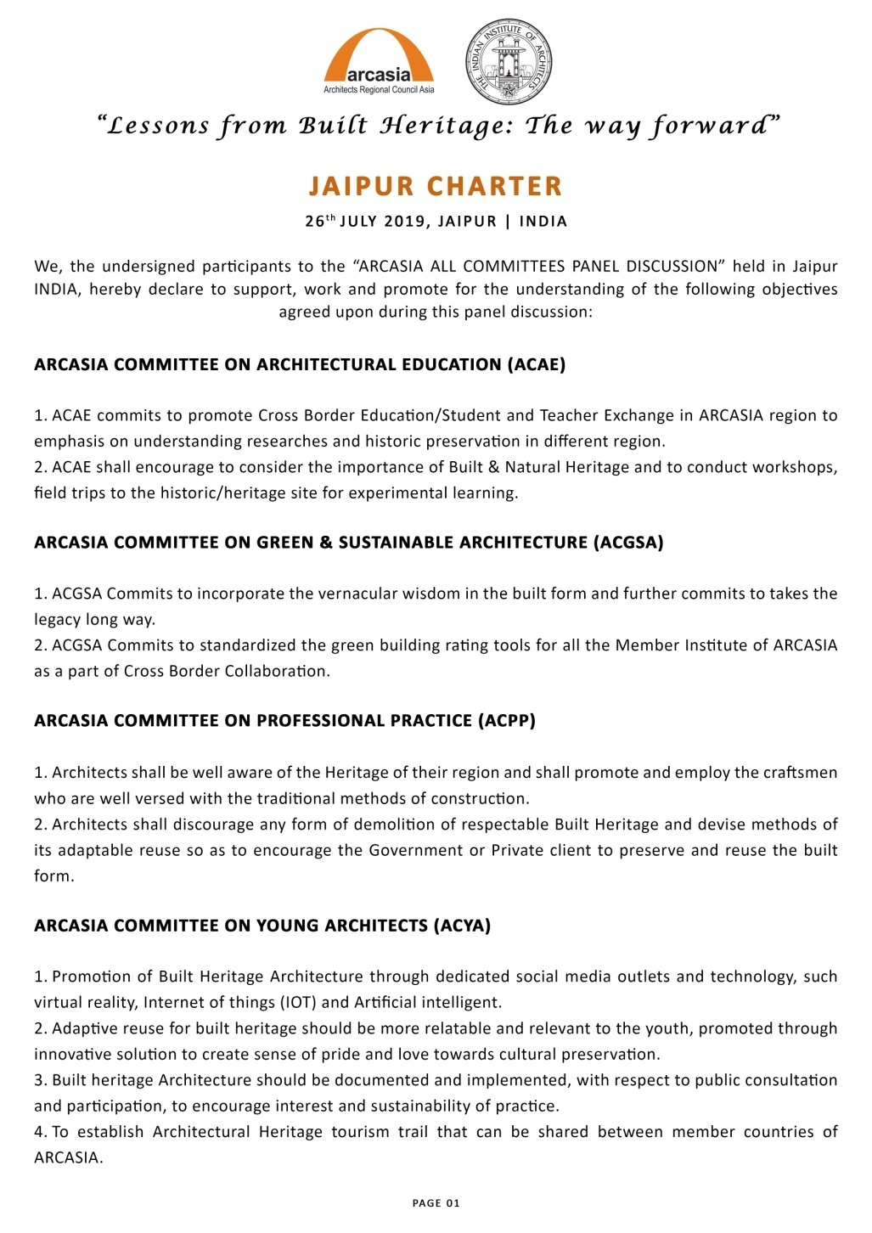

Slide 9
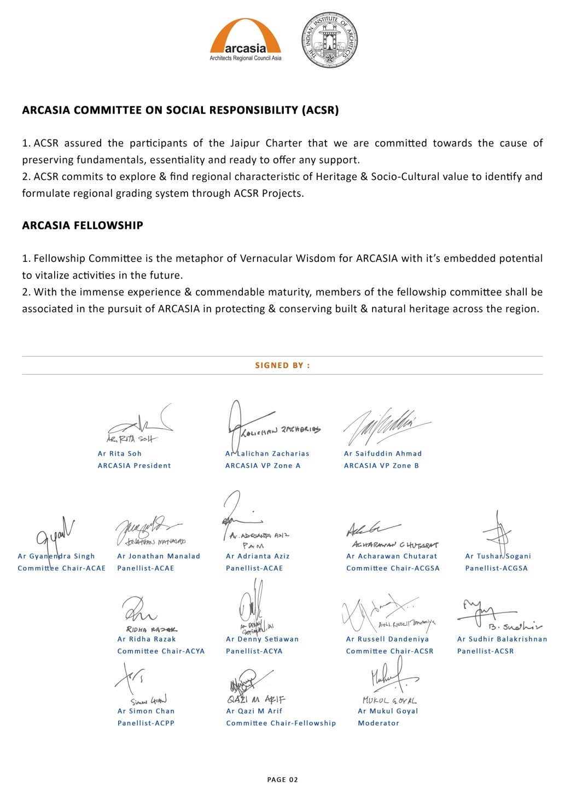

Slide 10
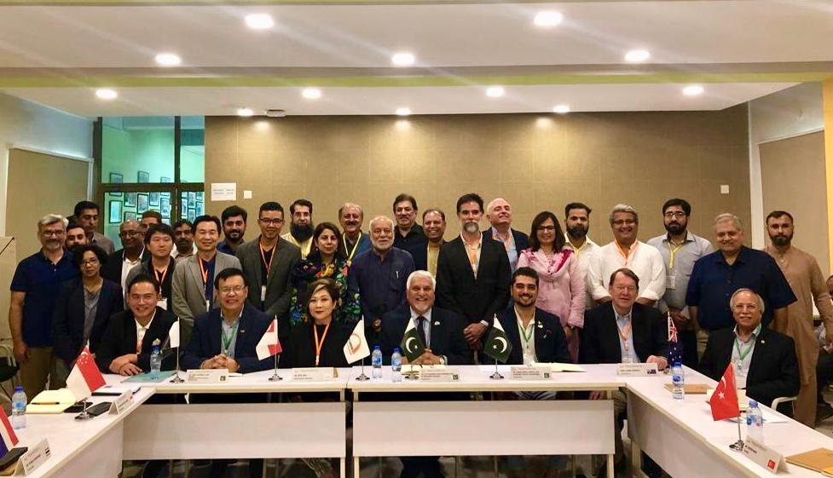
SECOND ARCASIA- URBANISM FORUM
URBANISM DIALOGUE Was conducted on 5th to 6th of September 2019 at
Islamabad on the theme- ‘Capital cities: New Cities/
Visionary Master Plans.’ Hosted by IAP

Slide 11
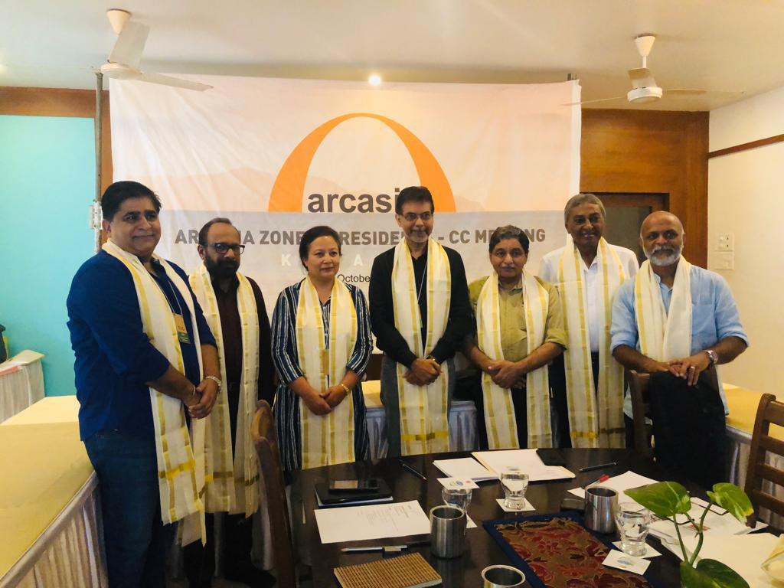
ZONE –A PRESIDENTS MEET
3rd OCTOBER 2019, KOVALAM.
To Discuss And Identify Issues
Faced by member Institutes/ARCHITECTS
To be discussed during the council meeting at
Dhaka

Slide 12

ARCASIA SPORTS FIESTA
SLIA proposes ARCHITECTS CRICKET,Badminton
And Golf tournaments at SRI LANKA from
13th to 18th Fenruary 2020.

Slide 13
ACAE Announces Two winter programs
On-’ Interpreting Built Heritage- A workshop
tour- From 2nd to 10th Dec 2019- at AAYOJAN
Schoolof Architecture and Design,Pune.
2. ON-’Environment and Architecture-
‘A workshop tour’- from 2nd to 8th December
2019 at Saveetha college of architecture and design, Chennai.

Slide 14
THANK YOU

