Slide 1
ZONE B
Report from ARCASIA Zone B 2013-2014
ARCASIA 2nd O.B. MEETING
SMX Convention Center, Pasay City, Philippines
April 19, 2013, Friday
Association of Lao Architects and Civil Engineers (ALACE)
Association of Siamese Architects (ASA)
Ikatan Arsitek Indonesia (IAI)
Pertubuhan Akitek Malaysia (PAM)
Singapore Institute of Architects (SIA)
United Architects of the Philippines (UAP)
Vietnam Architects Association (VAA)

Slide 2
OBJECTIVE:
To maximize the involvement and participation of all member-institutes under Zone B on all ARCASIA’s activities, projects and endeavors.
To invite other surrounding architectural institutes to get into the fold of ARCASIA.

Slide 3
FOCUS PROJECTS
1. Communications:
2. Commission Base Projects:
3. Participation:
4. Growth:

Slide 4
STATUS REPORT:
1. Communications:
  Dissemination of information and updates on all of activities of ARCASIA. Status Report: I gathered the official email addresses of each member institutes and its President. I disseminated a number of information regarding official information, announcements and activities to all the Presidents of member institutes under Zone B, such as the ARCASIA websites, Arcasia Awards for Architecture (AAA) and other announcements.
  VP's visitation to all member institutes under Zone B within this administration. Status Report: Arranging schedule for my visitation to member institutes.
  Conduct Zone B meetings in countries under Zone B for maximum participation. Status Report: Conduct the 1st ARCASIA Zone B Meeting in Manila, Philippines on April 19, 2013 hosted by the United Architects of the Philippines.

Slide 5
STATUS REPORT:
2. Committee Base Projects:
  Exhort and encourage member-institutes to conduct projects under the various ARCASIA committees, namely, Architectural Education, Professional Practice, Green and Sustainable Architecture, and Responsible Architecture. Status Report: Awaiting for ARCASIA Zone B member institutes reports.

Slide 6
STATUS REPORT:
3. Participation:
  Exhort a maximum participation by Zone B Member-institutes to attend ACA & Forum. Status Report: I have forwarded announcements in regards to this event.

Slide 7
STATUS REPORT:
4. Growth:
  Invite potential Member-Institutes for Zone B, such as Brunei, Myanmar, Cambodia, and other architectural institutes in the borders of Zone B. Status report: On-going strategic approaches in accomplishing this Focus Project.

Slide 8
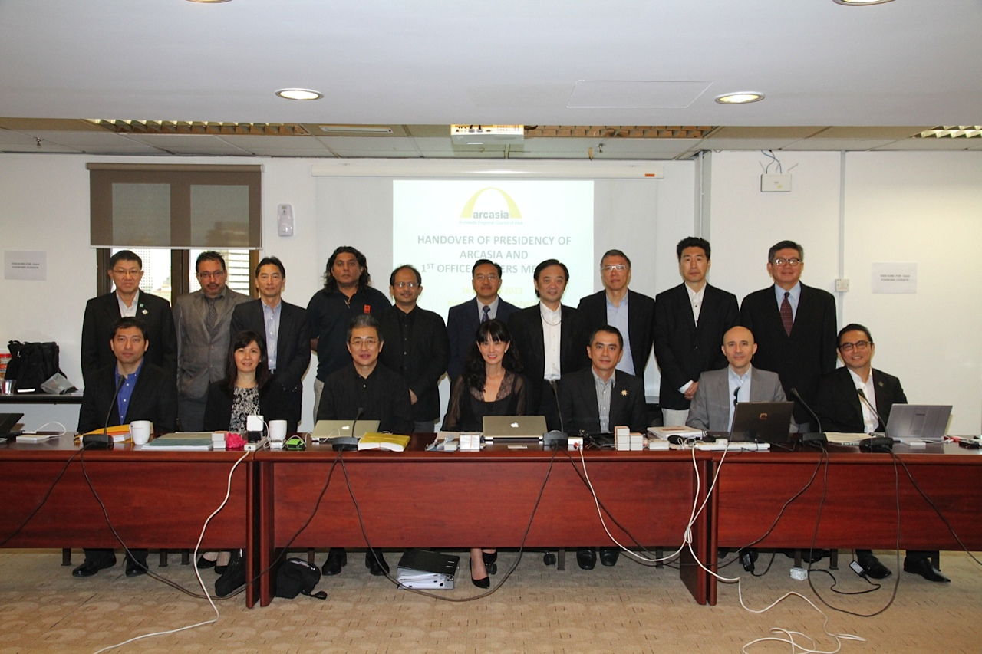
REPORT:
I attended and participated in the 1st ARCASIA Office Bearers Meeting and the ARCASIA Leader’s Handover Ceremony at PAM Building, Kuala Lumpur, Malaysia on January 18, 2013.

