Slide 1


ACYA REPORT 2017/2018
PREPARED BY : AR RIDHA RAZAK

Slide 2
THE YOUTH OF TODAY ARE THE LEADERS OF TOMORROW
JOSE RIZAL

Slide 3

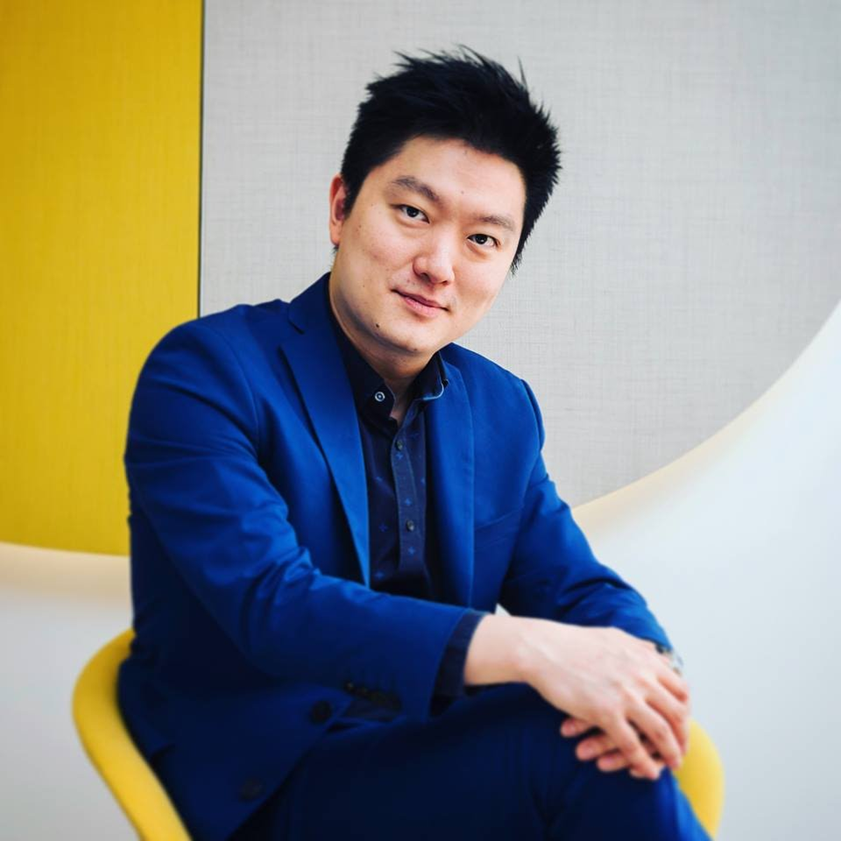
ACYA CHAIRMAN 2017-2018
AR. TAN SZUE HANN
It has been a great 2 years serving the young architects’ fraternity in Asia as ACYA (ARCASIA Committee on Young Architects) Chairman. I have seen some amazing energy from my fellow young architect leaders, and in the course of two years, we have identified key issues that young architects in Asia face. The Committee continues to look at modes of collaboration and the exchange of ideas and solutions, that could alleviate some of these issues, and bring the profession of Architecture in Asia into further excellence and esteem.

Slide 4
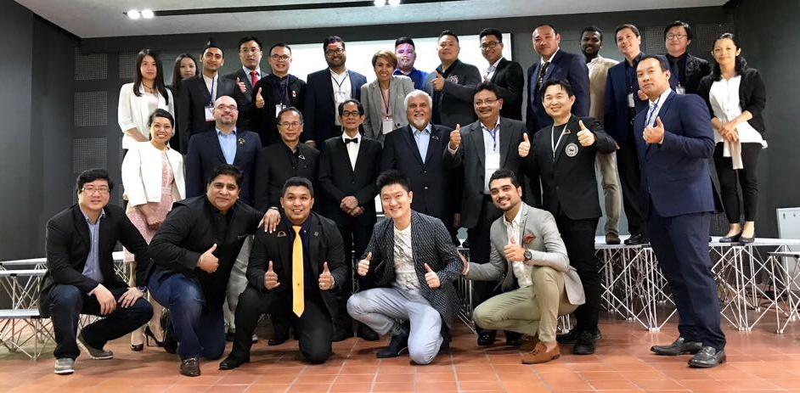
ACYA COMMITTEE MEMBERS 2017
Official representative | REPRESENTATIVE OF |  | Role
 | COUNTRY | INSTITUTE
Ar Tan Szue Hann | Singapore | SIA | Chairman
Ar Mikako Oshima | Japan | JIA | Representative / Acting Chair*
Ar Rattapong Angkasith | Thailand | ASA | Representative
Ar Cho Younkyoung | Korea | KIRA | Representative
Ar Asif M Ahsanul Haq | Bangladesh | IAB | Representative
Ar Denny Setiawan | Indonesia | IAI | Representative
Ar Gyanendra Singh Shekhawat | India | IIA | Representative
Ar Ahmad Ridha Abdul Razak | Malaysia | PAM | Representative
Ar Sudeep Sharma Paudyal | Nepal | SONA | Representative
* For roundtable in Jaipur
Skype Call : Ar Tan Szue Hann(SIA, Singapore/ 2017-18 ACYA Chair)
Observer : Ar Divya Kush (IIA_President/ARCASIA Office Bearer), Ar Abu Sayeed (IAB, ARCASIA Office Bearer) , Ar Md Rakibuzzaman (IBA), Mr. (KIRA), Ms Sojeong Kwon (KIRA), Ar Pankaj Sharma(IIA), Ar Navpreet Kaur(IIA)
Absent with Apologies : BIA, IAP, SLIA, ALACE, SIA, UAP, VAA, PUJA, AMA, AAM, HKIA, UMA

Slide 5
ACYA COMMITTEE MEMBERS
2018
Official representative | REPRESENTATIVE OF |  | Role
 | COUNTRY | INSTITUTE
Ar. Szue Hann Tan | Singapore | SIA | Chair of ACYA
Ar. Ahmad Ridha | Malaysia | PAM | Deputy Chair of ACYA
Ar. Fawad Suhail Abbasi | Pakistan | IAP | IP Chairman
Ar Bisma Askari | Pakistan | IAP | Representative
Ar. Aohana Ferdaus | Bangladesh | IAB | Representative
Ar. Antony Morais | India | IIA | Representative
Ar. Nandaka Jayasingme | Sri Lanka | SLIA | Representative
Ar.Susan Vaidya | Nepal | SONA | Representative
Nil | Bhutan | BIA | Representative
Ar. Pouy Phanphengdy | Laos | ALACE | Representative
Ar. Denny Setiawan | Indonesia | IAI | Representative
Ar. Becca Rellosa | Philippines | UAP | Representative
Ar. Nataporn Meksawasd (Bell) | Thailand | ASA | Representative
Nil | Vietnam | VAA | Representative
Ar. Aung Kaung | Myanmar | AMA | Representative
Ar. Afifah Abdullah | Brunei | PUJA | Representative
Ar. Shinichi Saitoh | Japan | JIA | Representative
Ar. Ni Ding | China | ASC | Representative
Ar. Simon Hui | Hong Kong | HKIA | Representative
Ar. Jeong Taek,Lim | Korea | KIRA | Representative
Nil | Macau | AAM | Representative
Nil | Mongolia | UMA | Representative

Slide 6
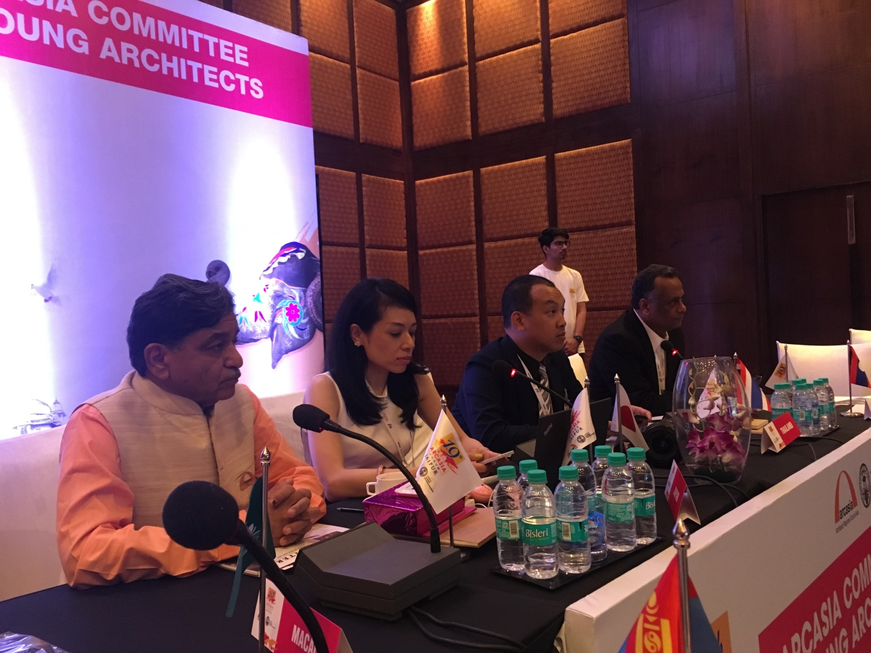
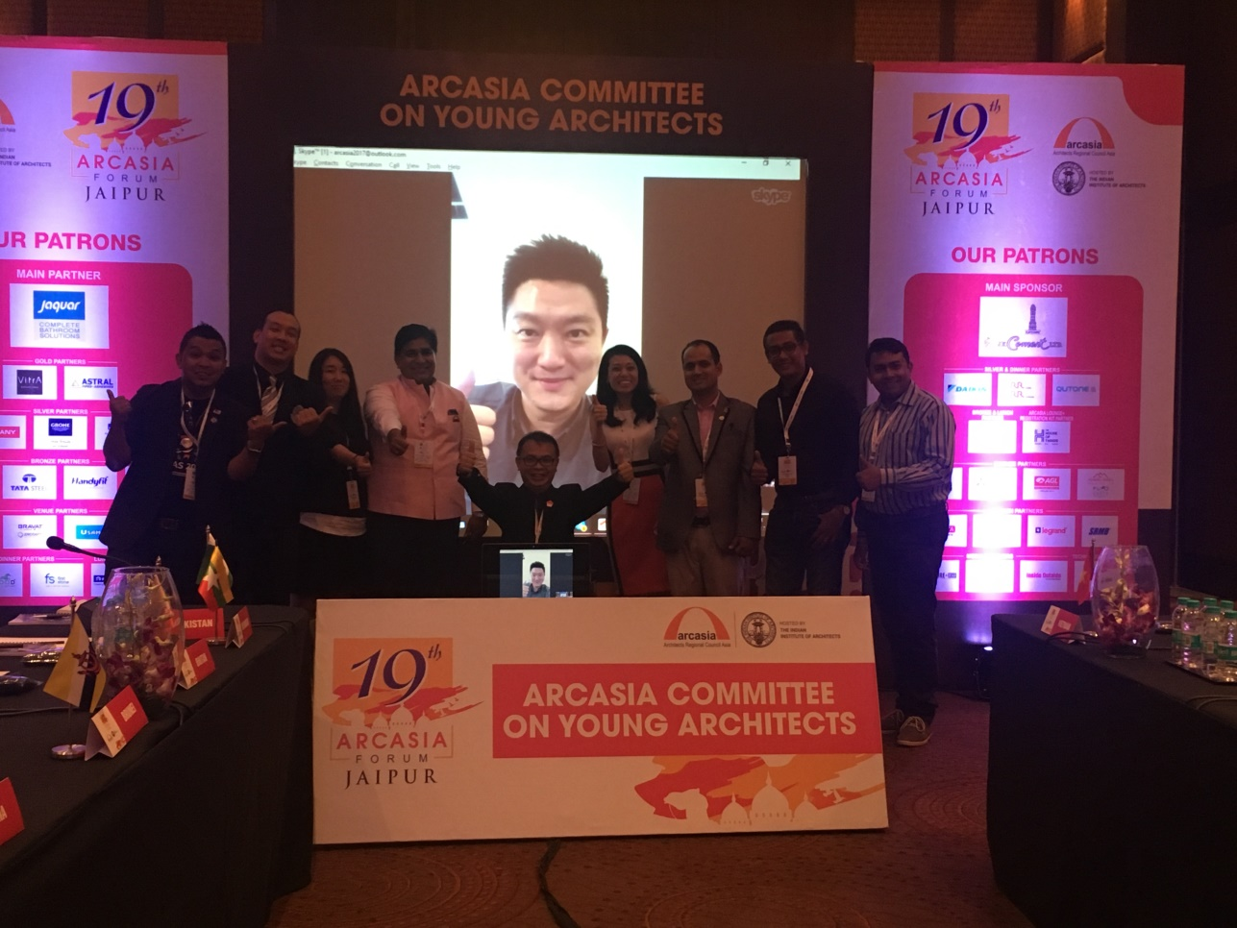
ACYA MEETING ACA17 JAIPUR

Slide 7
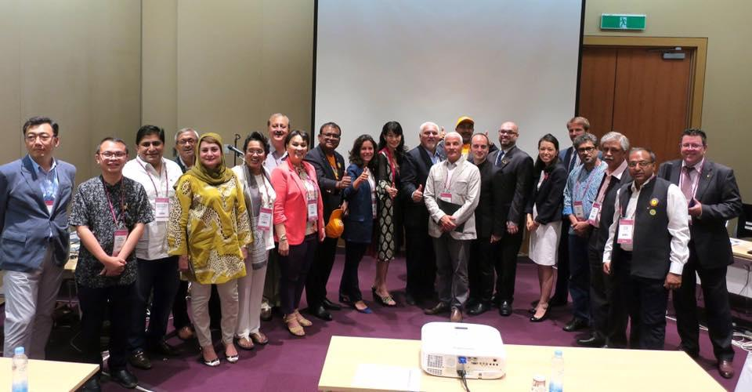
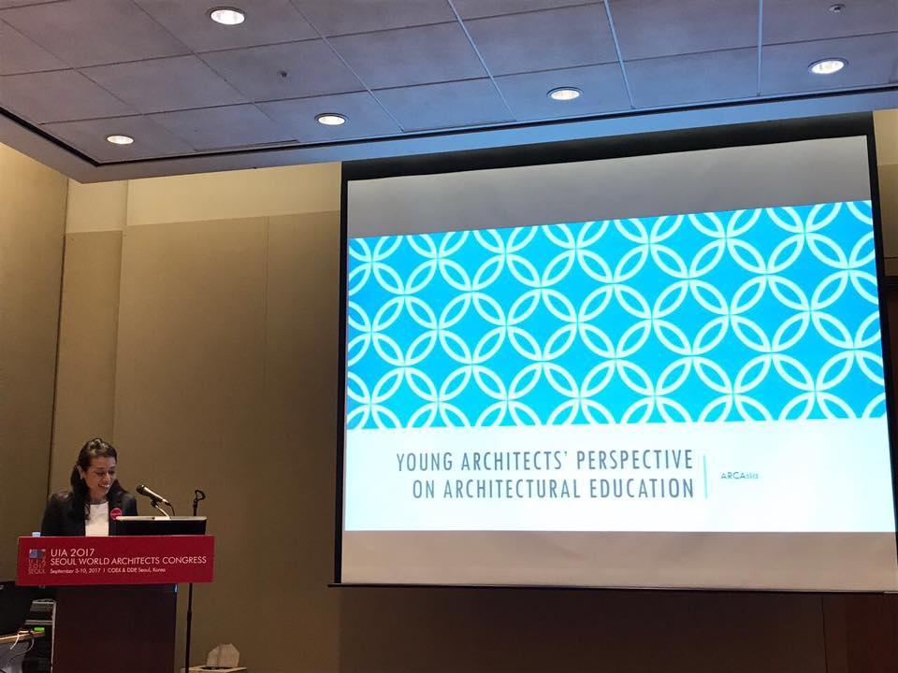
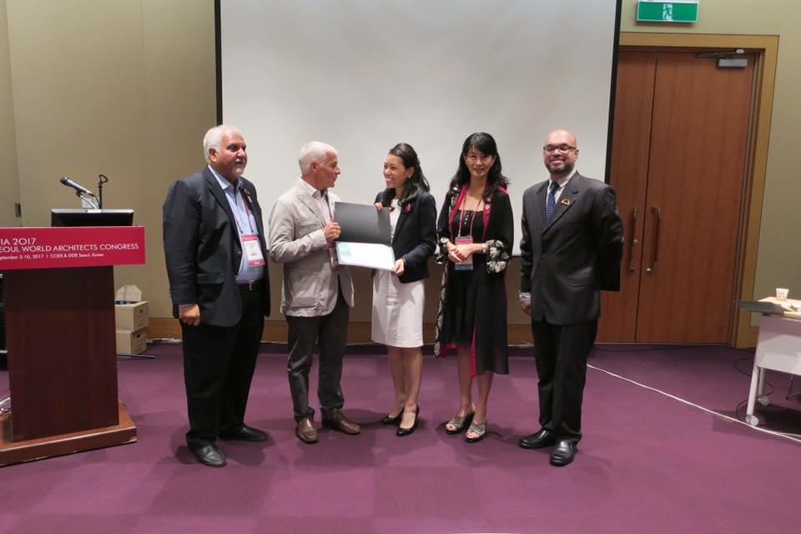
ACYA SHARING SESSION
AT UIA SEOUL
SHARING SESSION
ACYA was represented by Ar Mikako Oshima on behalf of ACYA Chairman, due to visa delay issues.
ACYA view on Architecture Education in Asia.
ACYA observation in Europe - Given the wealth of heritage and culture in Asia, this should be learned and appropriated – instead of demolishing and rebuilding.
Tools and techniques, both craft-wise and digital, can be shared and exchanged.
PROPOSED COLLABORATION
Architectural Competition / Exchange Program / Inspirelli Awards

Slide 8
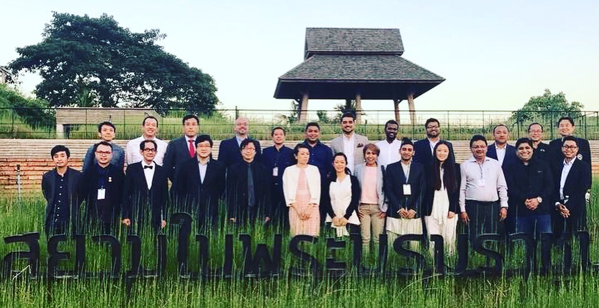
STORMATHON 2.0 CHIANG MAI
MORNING: MEETING SESSION
Chairman Ar Tan Szue Hann Chaired the meeting with assistance from Deputy Ar Ridha Razak.
Ar Jahangir shared the direction of ARCASIA.
All Country representatives presented and shared their youth Initiative.
AFTERNOON: WORKSHOP SESSION
MATTERS DISCUSSED | COMMITTEE DECISSION
Whether ACYA should be open below 45 | All committee agree to maintain 40 and below.
constant change of ACYA representative | Committee agree that this is something that cannot be control and it is up to country to select its representative. However, mechanism to update new committee member must be formed.
Strategic Plan ACYA | Ar Hann and Ar Ridha presented the strategic plan for ACYA covering scope of Promotion, Develop of youth and Exchange of ideas.
ACYA infrastructure : | Ar Ridha inform that various communication platform has been set up such as ACYA email (ACYAMAILER@gmail.com, ACYA Drop Box (Contains ACYA info, meeting reports, proforma, country reports, practice sharing and etc,), ACYA Whatsapp, future ACYA public FB and instagram/ Telegram/We chat
ACYA Branding | All committee agreed that Ar Aung from Myanmar has agreed to host an ACYA logo competition in Myanmar.

Slide 9
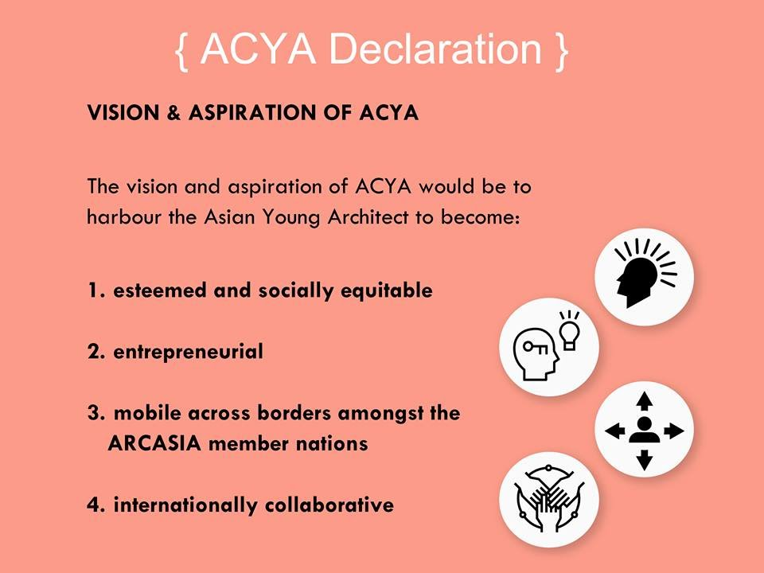
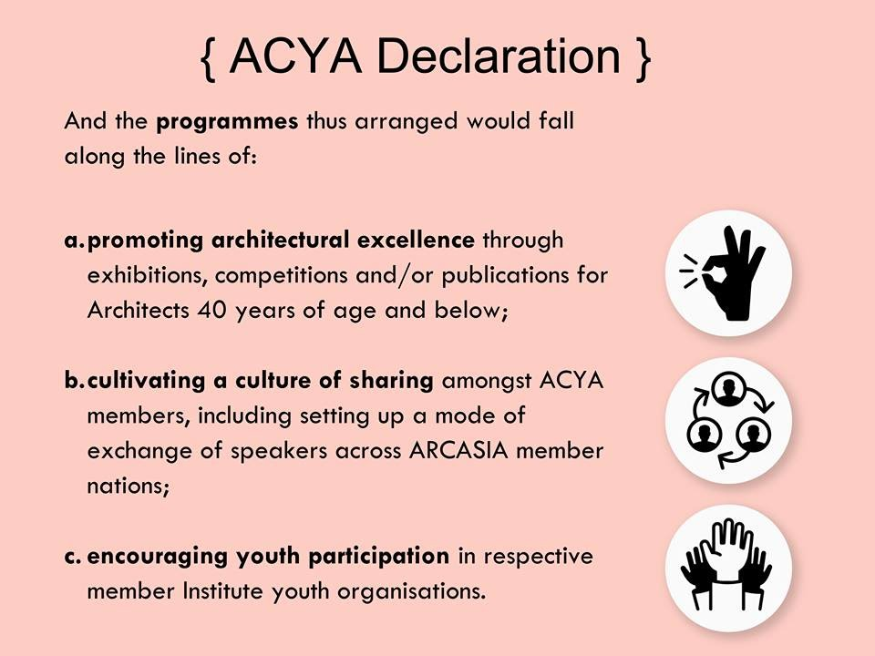

Slide 10


ACYA EXCHANGE SPEAKERS
MARCH 2018
INDONESIA
MAY 2018
PHILIPPINES

Slide 11
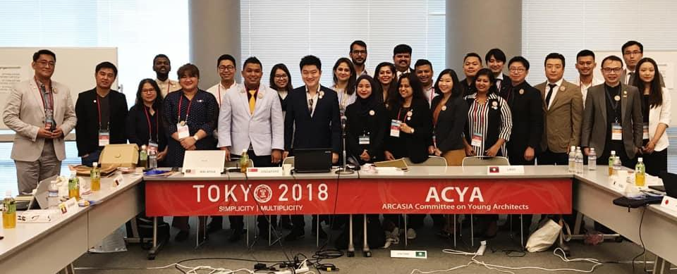
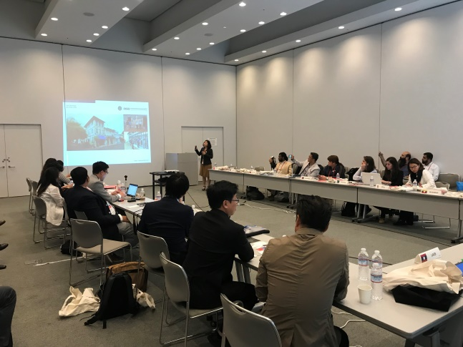
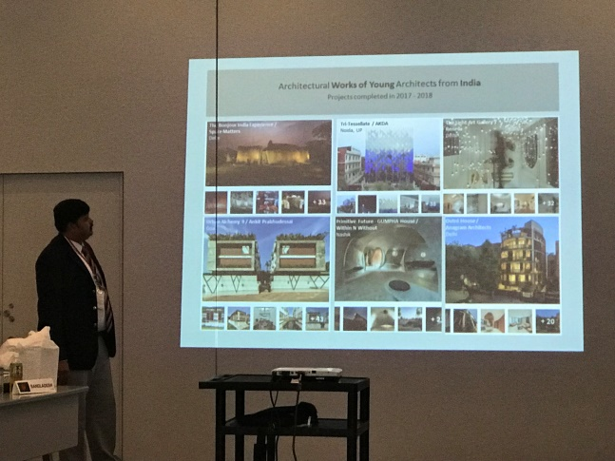
ACYA MEETING ACA18 TOKYO
The ACYA Meeting 2018 was held at Meiji University. The meeting was attended by 17 countries with Brunei making its debut.
Among the agenda of the meeting was:
Educating new members on ARCASIA Constitution and relevant clauses to ACYA
Enhancing ACYA digital infrastructure and line of communication
Various sharing of Country Presentation youth activity best practices and youth structure.
Online survey analysis on issues pertaining Young Architects and does not encroach territory of students.
Workshop on issues and solutions

Slide 12
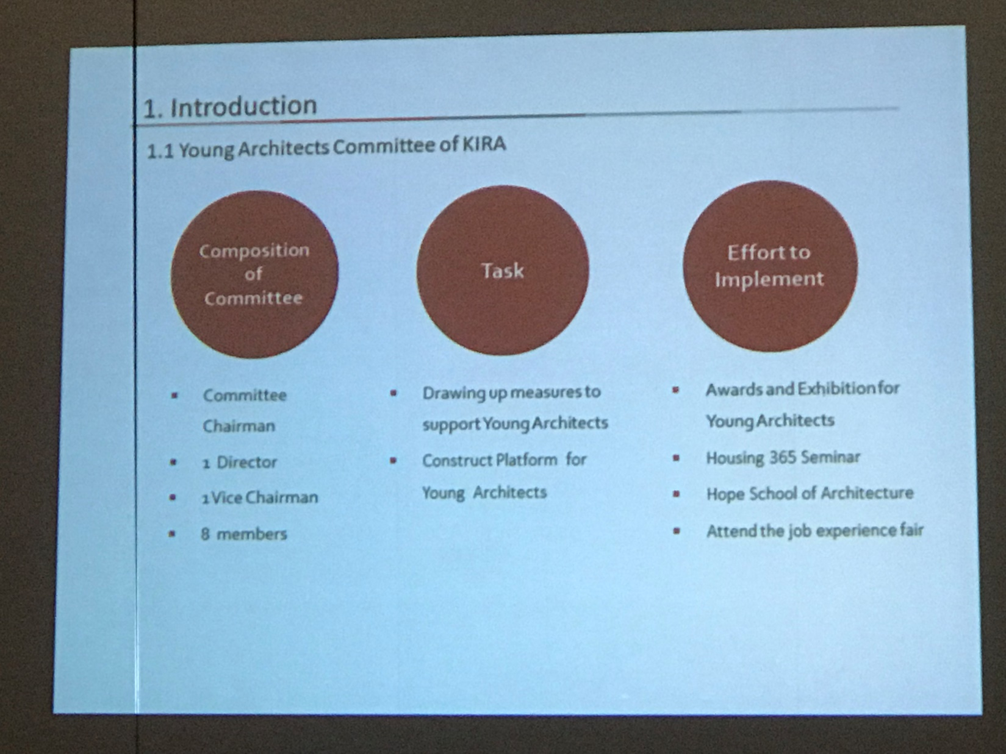
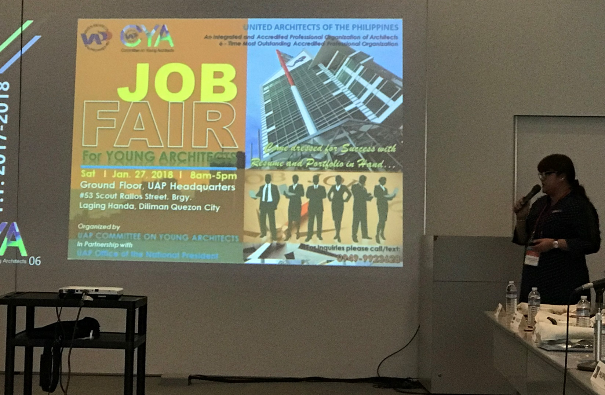
SHARING SESSION BY AR LIM JEONG TAEK (KIRA)
SHARING BY REBECCA RELLOSA (UAP)

Slide 13
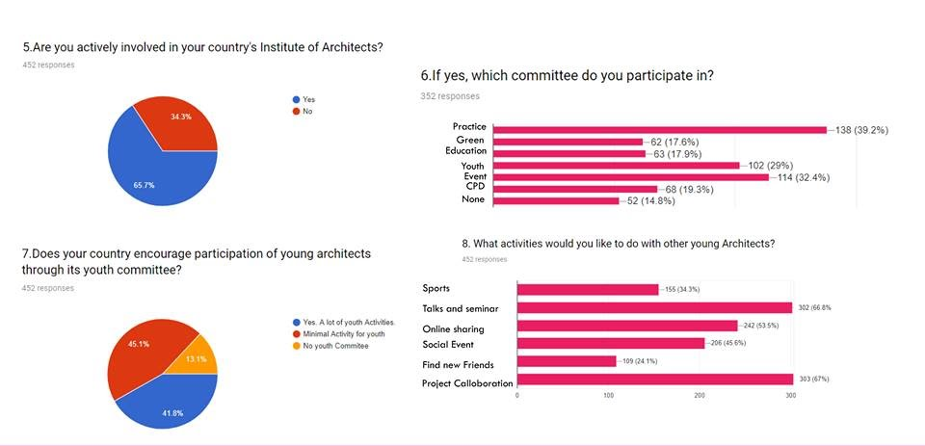
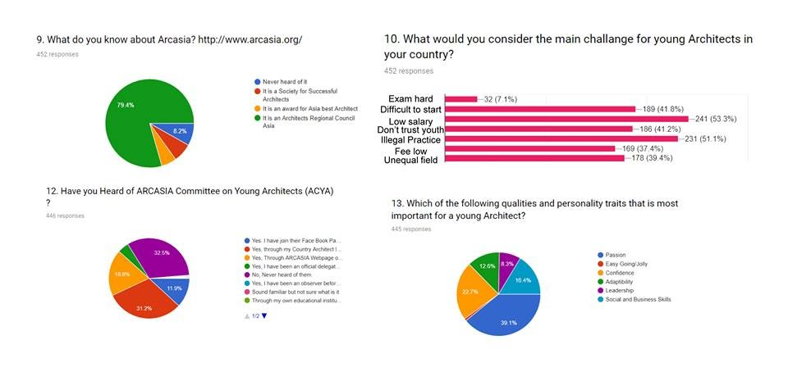
ACYA SURVEY 2018
The ACYA Google survey on young Architects was distributed to Young Architects all over Asia through the Google survey link. About 500 young Architects responded to the survey and have given their thoughts and suggestions to the state of young Architects in their Country.
Some of the results are as follows:

Slide 14
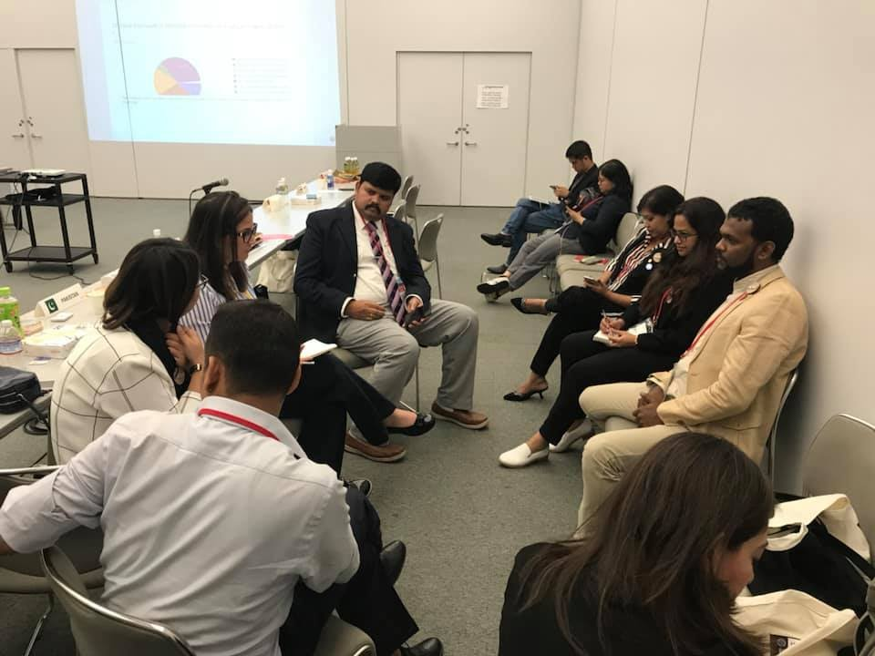
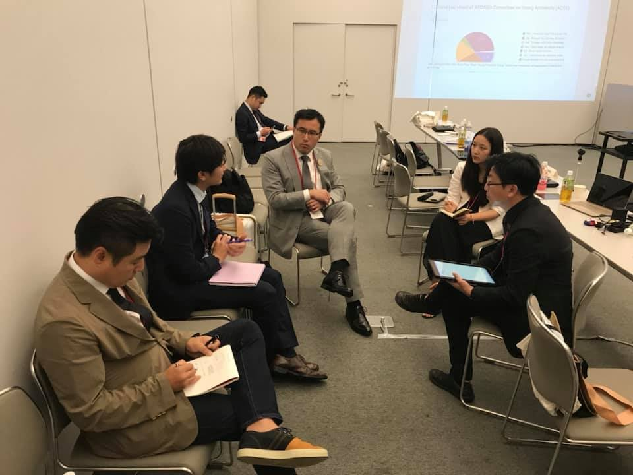
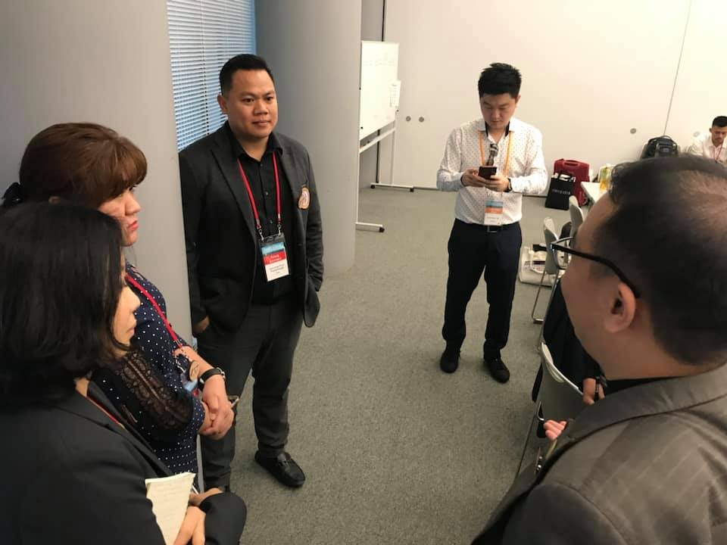
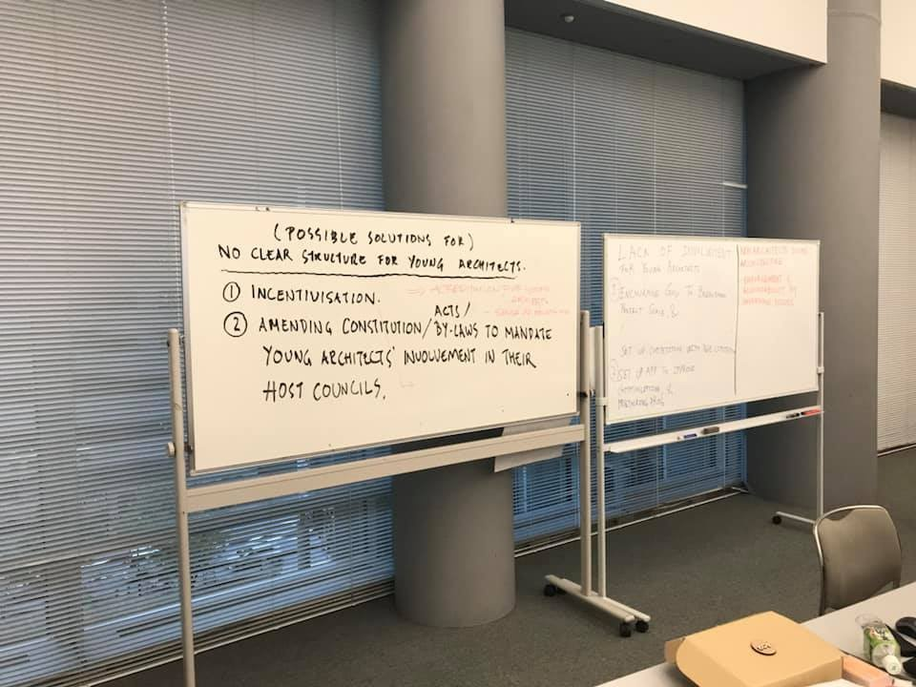
ACYA WORKSHOP 2018
The results of the ACYA survey was announce.
7 Issues was identified from the survey ( Low salary, Behind in technology, lack of active involvement/empowerment of youth, no clear structure of youth in institute, long working hours, non Architect doing Architecture, Devaluation of design)
Discussion was done in 3 zones. ( Zone A- Non Architects doing Architecture, Zone B- No clear Structure, Zone C- Lack of Active involvement/ Empowerment)
Proposals
Zon A- Encourage government to breakdown project and scale, set up competition with age limit, set up Apps to improve communication , mentoring program.
Zone B- Incentivize youth, look into law amendments
Zone C- Enforcement, accountability and governing bodies
Item discussed to be summarized and to be brought to OB meeting.

Slide 15
WE CANNOT ALWAYS BUILD THE FUTURE FOR OUR YOUTH, BUT WE CAN BUILD OUR YOUTH FOR THE FUTURE
FRANKLIN ROOSEVELT

Slide 16

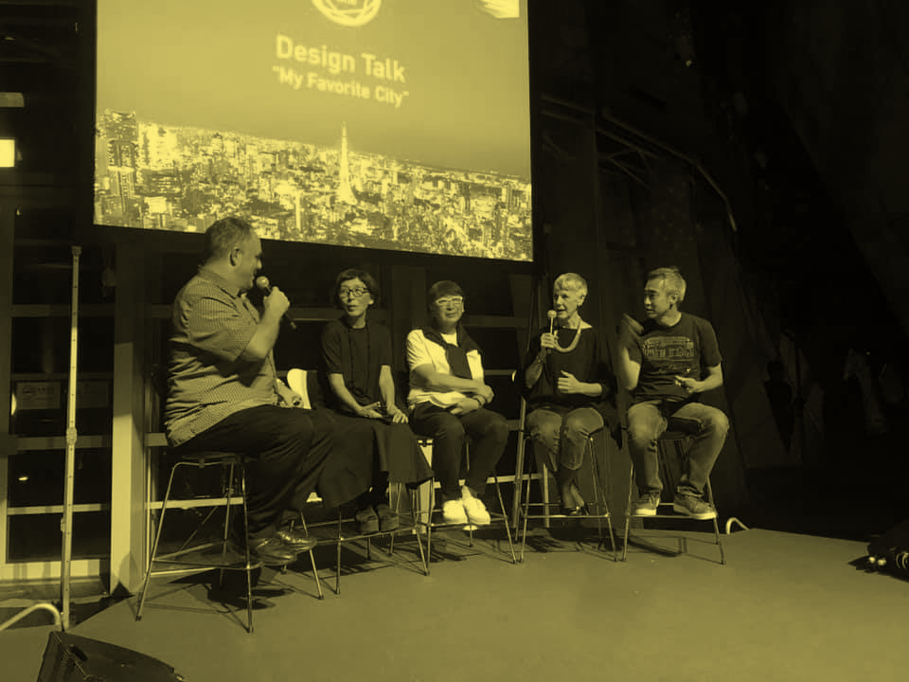
PECHA KUCHA : MY FAVOURITE CITY

Slide 17
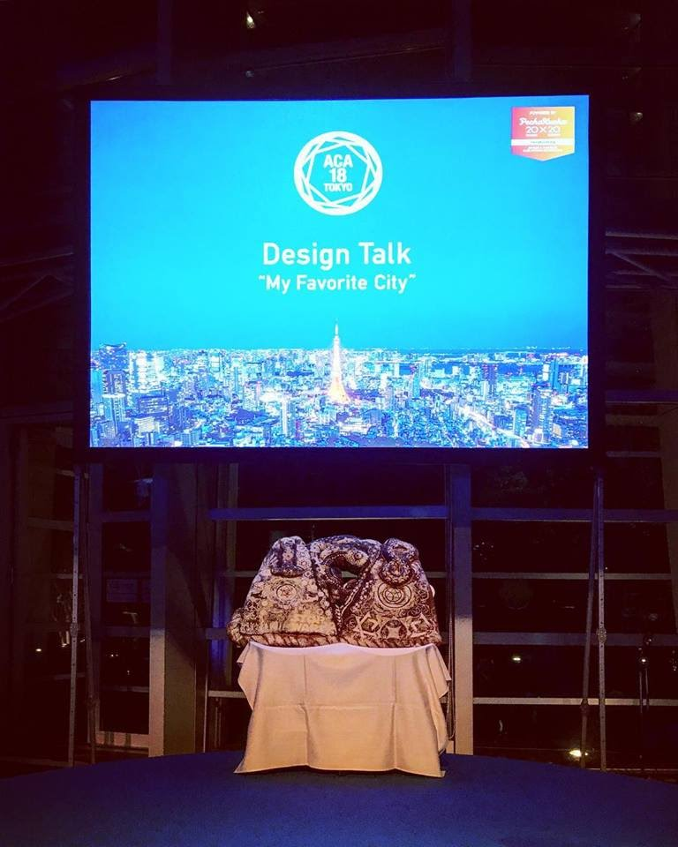
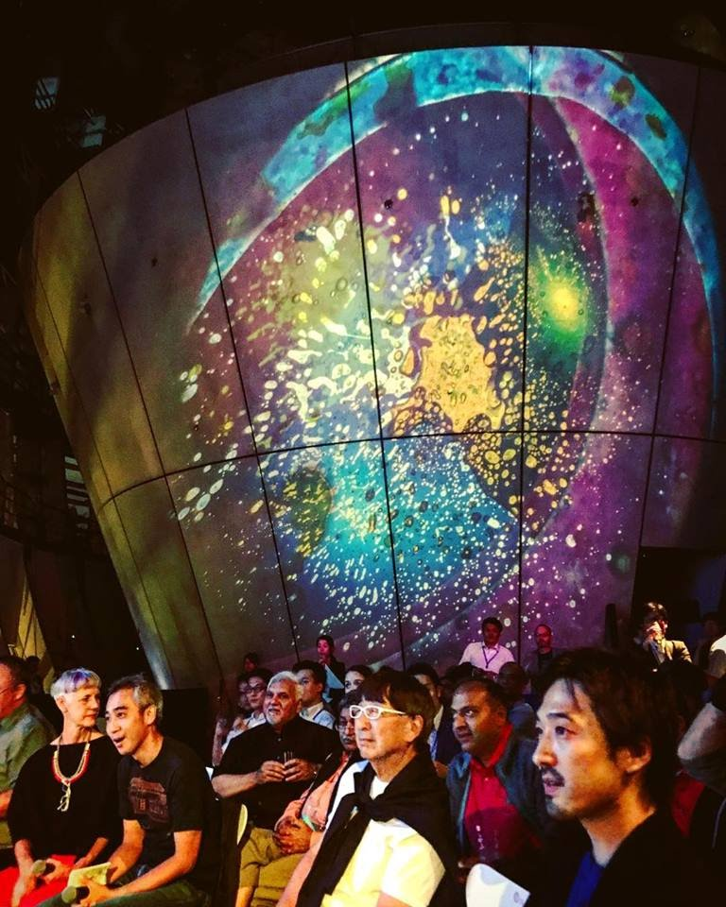
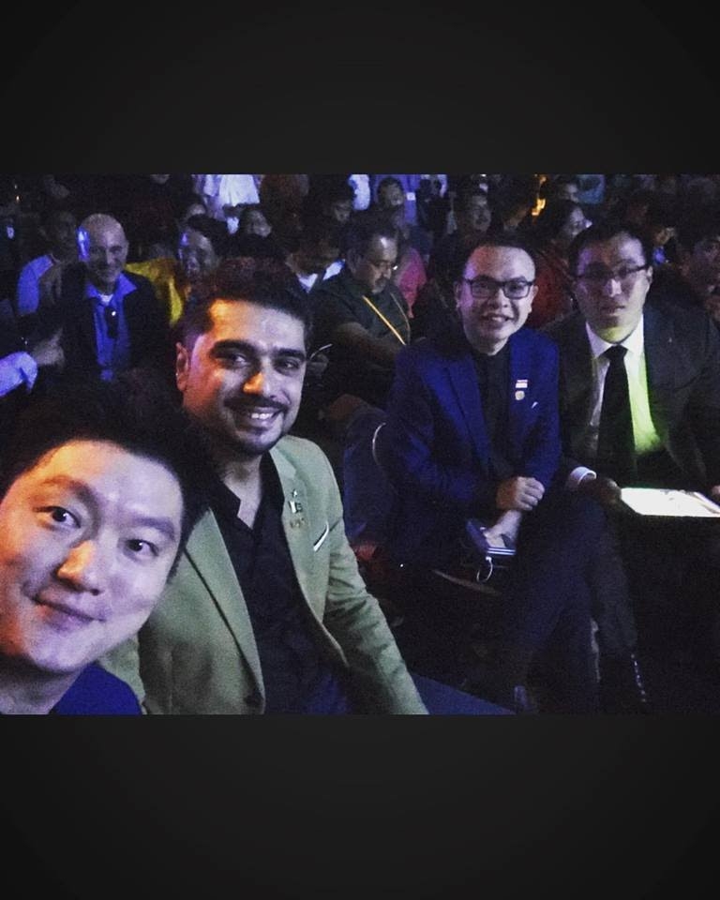
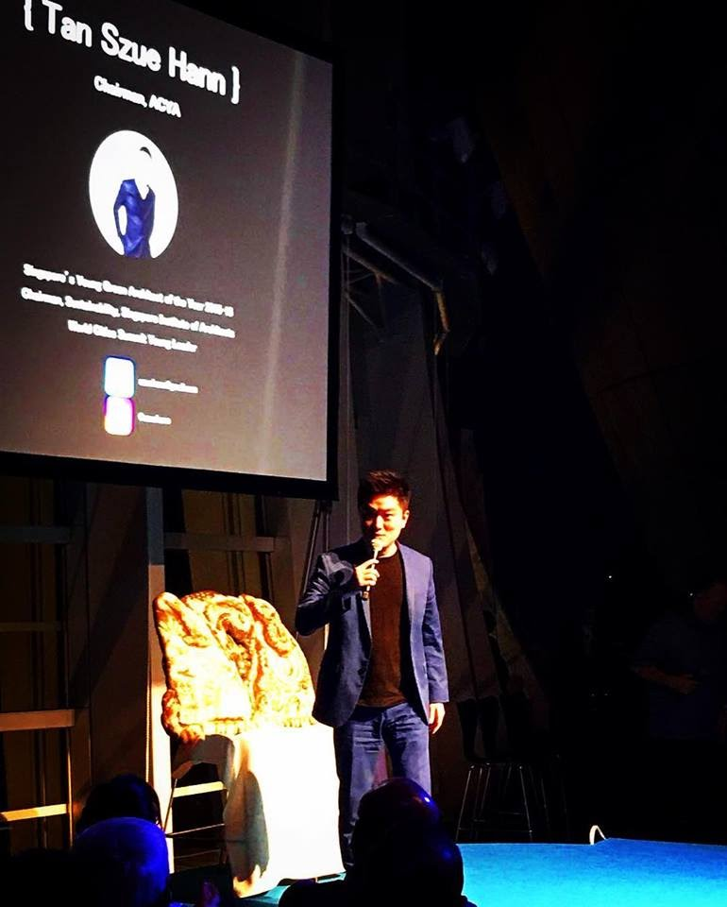
PECHA KUCHA : MY FAVOURITE CITY
An amazing opportunity to 4 ACYA members to share their perspective of their favourite city along side seasoned speakers such as Caroline Bos (UN Studio), Pritzker Prize laureates Toyo Ito and Kazuyo Sejima (SANAA) at the beautiful National Art Centre in Tokyo by Kurokawa .
The speakers representing ACYA was Ar Tan Szue Hann ( Singapore) , Ar Fawad ( Pakistan), Ar Denny (Indonesia) & Ar Simon ( Hong Kong)

Slide 18

ACYA IN ACTION

Slide 19
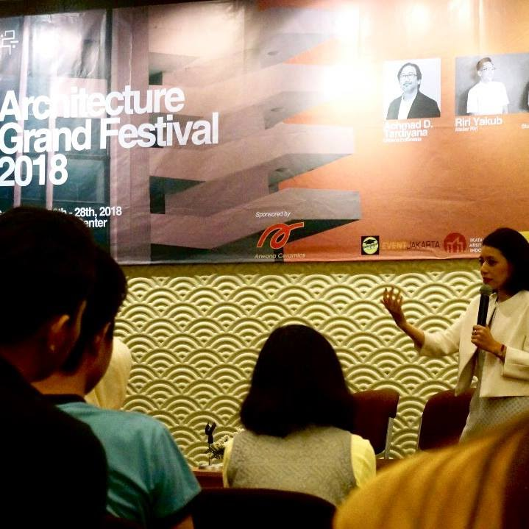
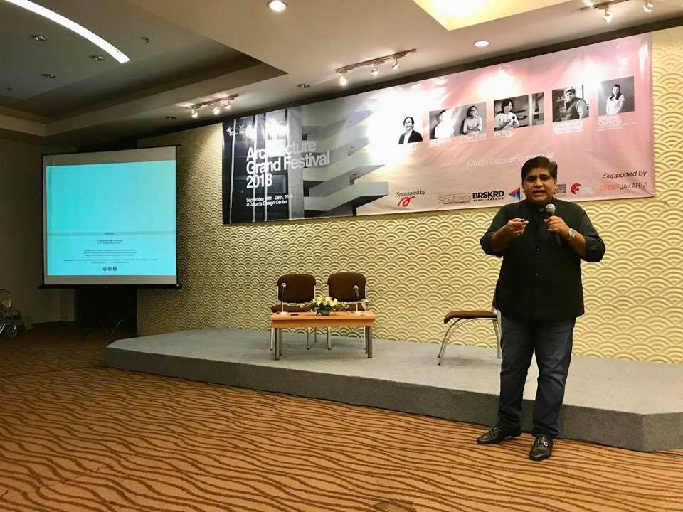
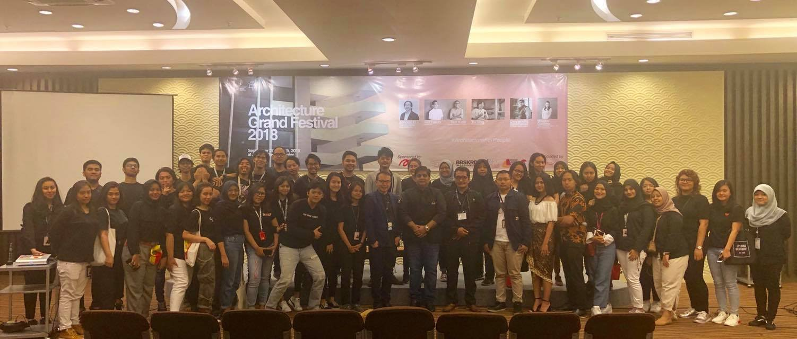
ACYA ALUMNI IN ACTION
Mikako Oshima
‘Modernization of Tokyo’
Gyanendra Singh
‘Evolution & Growth of Jaipur, blending modernity with heritage’

Slide 20



CONTACT OR VISIT US
ACYAMAILER@GMAIL.COM
ASIAN YOUNG ARCHITECTS GROUP

Slide 21

ACYA CHAIRMAN 2019-2020
AR RIDHA RAZAK ( MALAYSIA)
‘LETS BE CREATIVE IN MAKING ARCHITECTURAL PRACTICE CURRENT TO THE WORLD’

Slide 22
ACYA REPORT 2017/2018
PREPARED BY : AR RIDHA RAZAK

