Slide 1
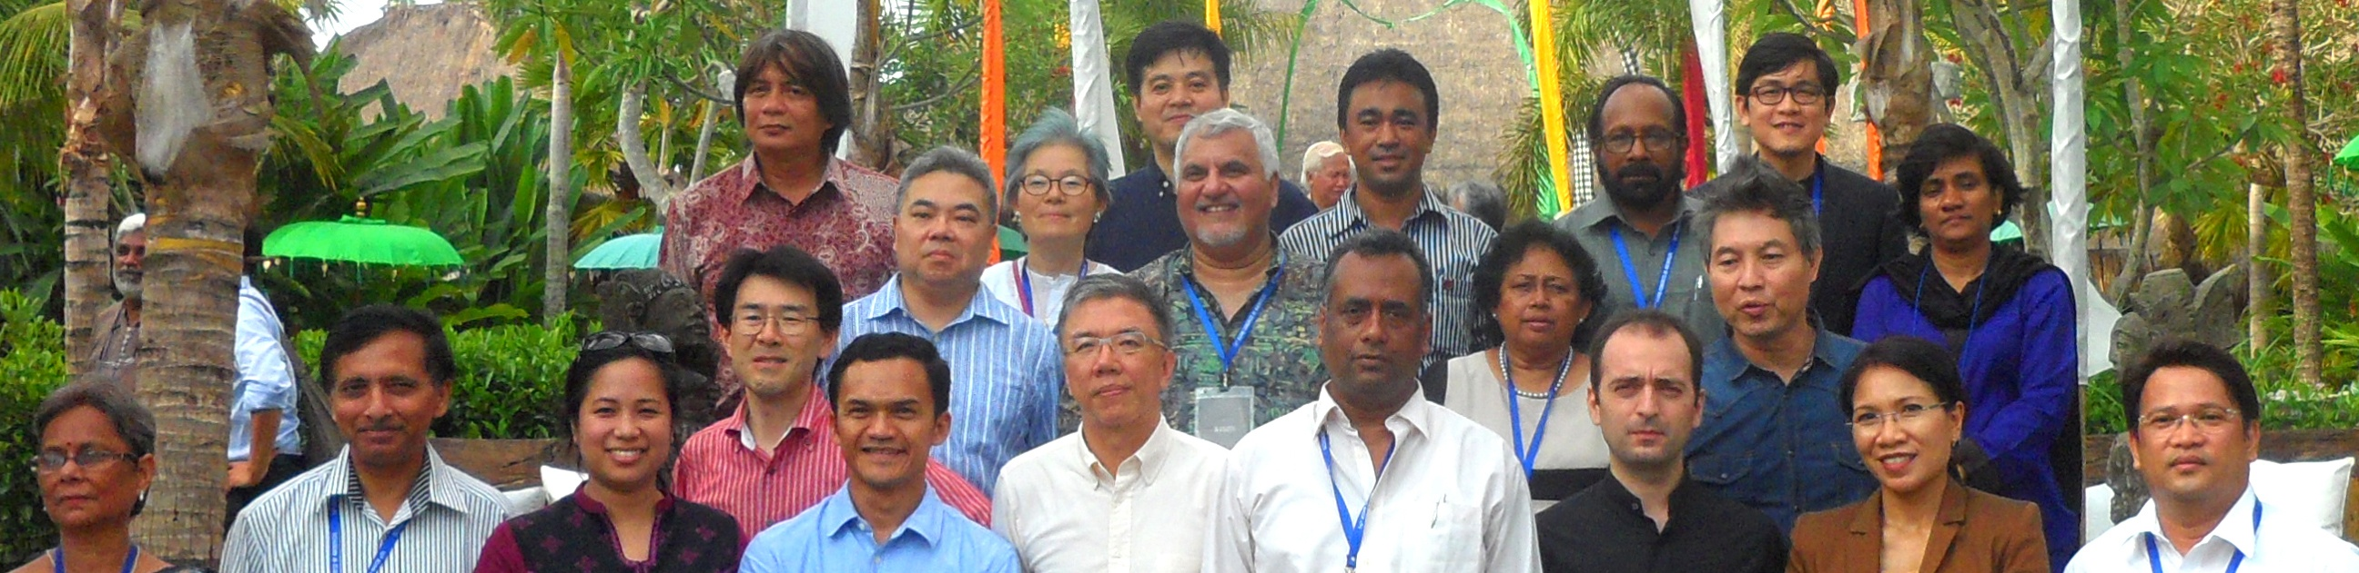
33rd Meeting of
ARCASIA COMMITTEE FOR
ARCHITECTURAL EDUCATION (ACAE)
October 31st, 2012, Venue: The Mansion Resort – Ubud, Bali, Indonesia

Slide 2
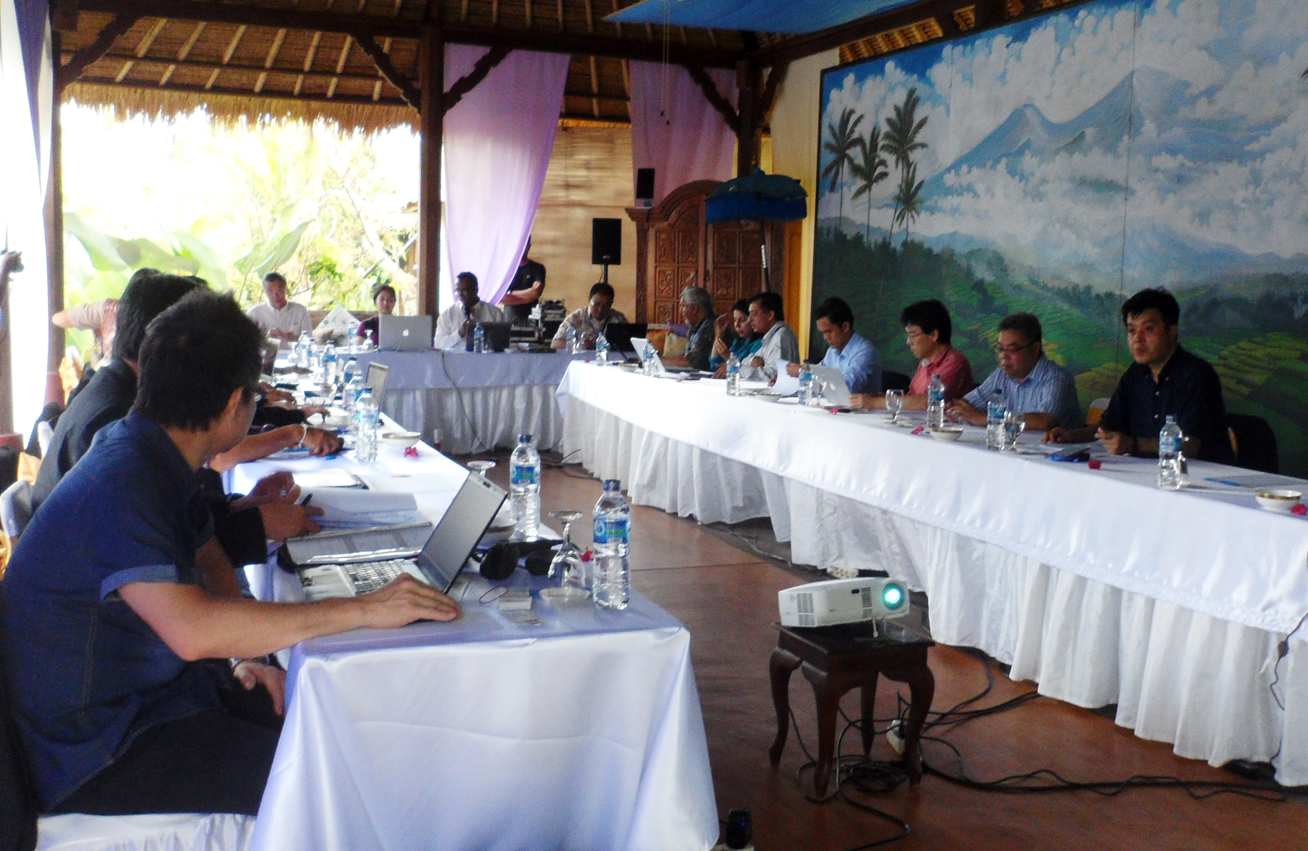
Quorum
26 delegates from15 countries (missing China, Laos, Vietnam)

Slide 3
Country Report
No Hard Copy Submission
Uploaded in Google Spreadsheet
Notable issues : Introduced recently CPD in three Institutions, Organizing workshop for upgrading Architectural aptitude & awareness to school students, paradigm shifting of national education system, scarcity of faculty, looking for exchange program etc

Slide 4
ARCASIA Students Jamboree Manual
DAY 1: SESSION 1 (2:00 PM – 7:00 PM)
ARCASIA Students Jamboree Manual, drafted by Ar. Akeel Bilgrami (IAP) & presented by Ar. Jahangir Khan.
Written feedback will be given within February 2013. After revision and Review will finalized during the Forum in Nepal (2013).

Slide 5
ARCASIA Students Jamboree 2012 in Bali,Indonesia
Report of the status of ongoing student Jamboree 2012 in Bali, Indonesia presented by Prof. Dewi Jayanti (Convener of the Student Jamboree, Udayana University),
All students must be selected through their respective institute => refer to Jamboree manual.

Slide 6


















ARCASIA
STUDENT
JAMBOREE 2012

Slide 7
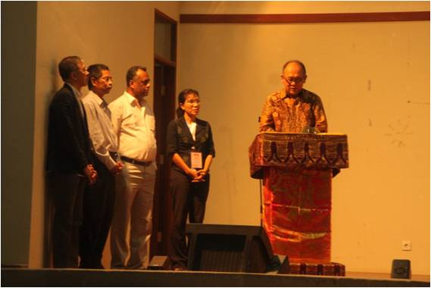
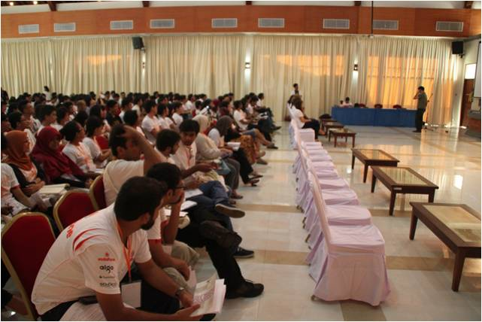
INAGURATION CEREMONY

Slide 8
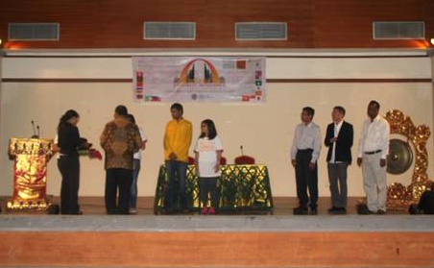
INAGURATION CEREMONY

Slide 9
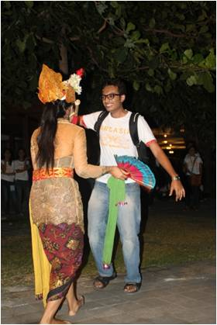
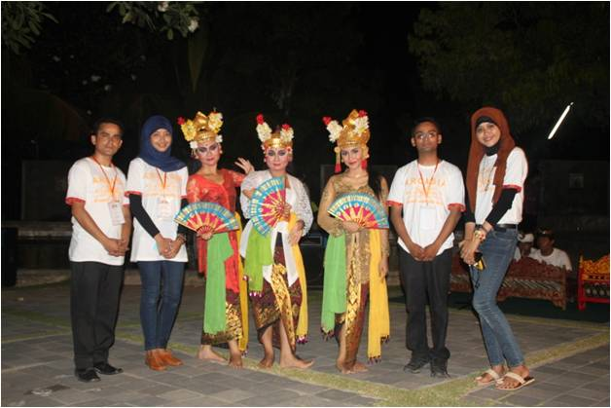
WELCOMING DINNER

Slide 10
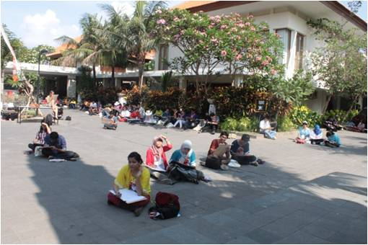
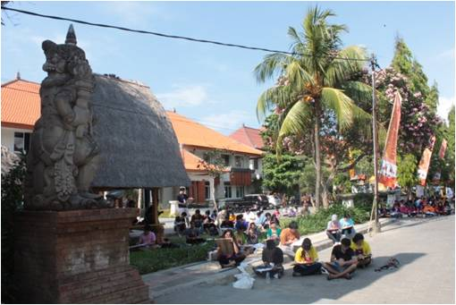
QUICK SKETCHING COMPETITION

Slide 11
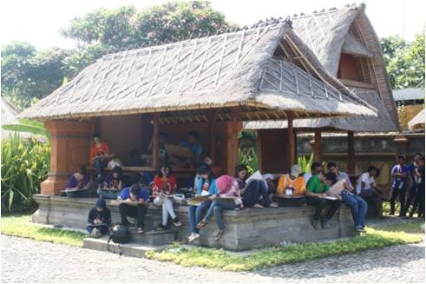
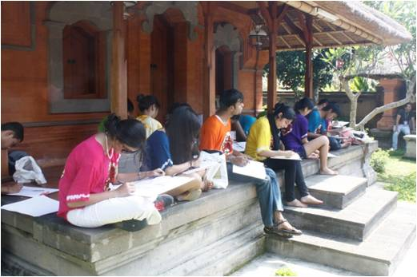
QUICK SKETCHING COMPETITION

Slide 12
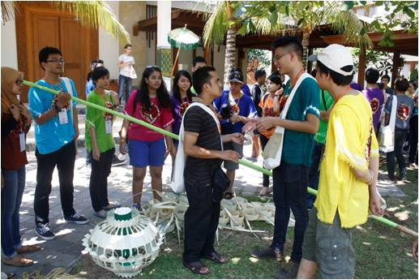
BAMBOO WORKSHOP

Slide 13
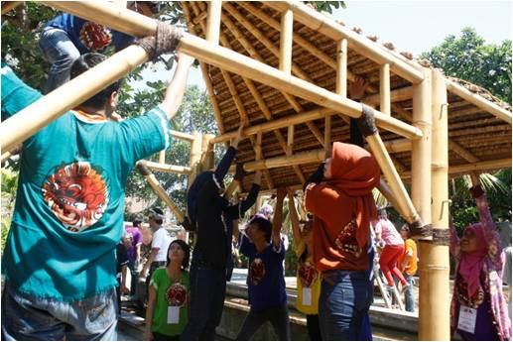
BAMBOO
WORKSHOP

Slide 14
The way forward
Short term agenda (one year)
Electronic publication of TLC
Compilation of the Handbook of Asian Architectural Schools
Organizing regularly ARCASIA Student design Competition during Jamboree.
Introducing a new category for academic or professional research in the existing ARCASIA AWARD.
Paperless ACAE meeting (country report in Matrix format)

Slide 15
Mid-term agenda (five year)
Cross Border Internship program among member institutes.
To promote students interaction within ARCASIA region an Interactive Web site for students of ARCASIA region may be created.
Publishing quarterly on line ARCASIA E-journal

Slide 16
Long-term Agenda (within ten years)
a. Accreditation council leading to the title “ARCASIA Architect”
b. Virtual Asian School of Architecture

Slide 17
Status of the ongoing Projects of ACAE

Slide 18

Handbook of Asian Architectural Schools
about700 schools updated from 16 countries (India coming up, not yet from Laos, Vietnam)
no need for hard copies

Slide 19

ARCASIA Time Line Chart: Web version
Project carried out by IAB,
web version of the ARCASIA Time line Chart available,
next step is to draft a criteria to enrich TLC by extending time span up to 2012.

Slide 20
Launching of online ARCASIA research E-journal
Concept paper presented by Dr. Chalay Kunawong (ASA), Deputy Chair, ACAE,
Journal will be called “ARCASIA e-Journal”,
Special task-force will be leaded by Prof. John Fernandez (UAP),
Review panel will be formed jointly by IIA, AAM, IAB, UAP,
First issues will come from ACA and Forum’s technical session, peer reviewed before next Forums

Slide 21
Virtual Asian School of Architecture
Dr.Kemas (IAI) proposed a draft concept paper consisting of How to establish VASA:
  Technical part,
  Accreditation board.
  Possibilities of Pilot virtual workshop will be done by Ar. Nuno Saures (AAM).

Slide 22
ACAE Board for School of Architecture in Asia
Dr. Kemas (IAI) presented the idea of Accreditation Board
Prof. John Fernandez (UAP) will lead the special task force.

Slide 23
Chairperson : Dr. Chaley Kunawong (ASA)
Deputy Chair: Dr. Kemas Ridwan Kurnawan (IAI)
Hon. Secretary: Dr. Walaiporn Nakapan (ASA)
Recomendation for Chair and Deputy-ACAE (2013-1414)

