Slide 1
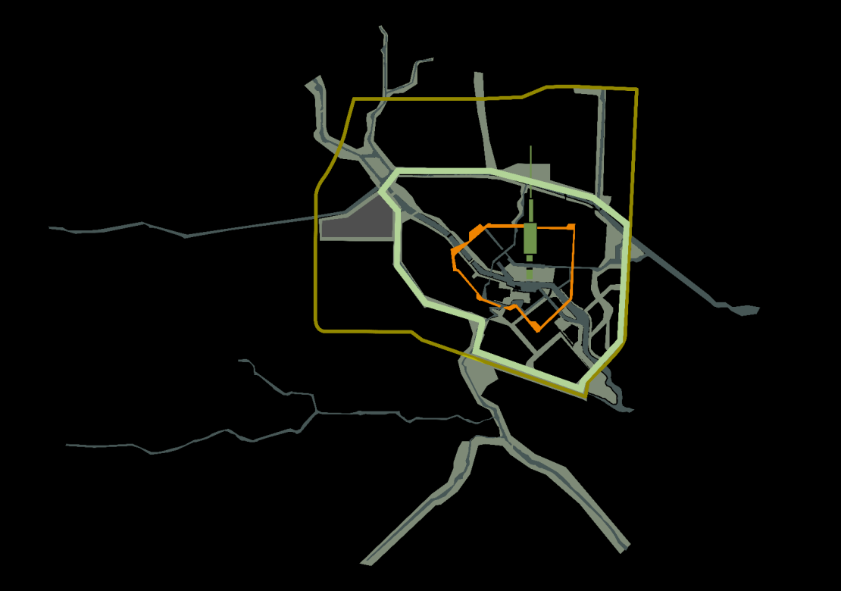
中国建筑职业实践概述
ARCHITECTURAL PROFESSIONAL PRACTICE
IN CHINA
张维 ZHANG WEI
2017.05.20

Slide 2
目录
Contents
01
建筑教育和认证
Architectural Education and Accreditation System
02
建筑师职业实践
Professional Practice
03
建筑市场
Statues of Market

Slide 3

01
建筑教育和认证
Architectural Education and Accreditation System

Slide 4
EUROPE
32
NORTH AMERICAN
26
ASIA
24
CHINA
6
AFIRCA
0
LATIN AMERICAN
6
OCEANIA
12
QS建筑学排名/QS World University Rankings by Subject 2015 - Architecture / Built Environment

Slide 5



Slide 6
ARCHITEUTURAL
SCHOOL
DIRECTORY
60
/282
DATA from ARCASIA ACAE website

Slide 7
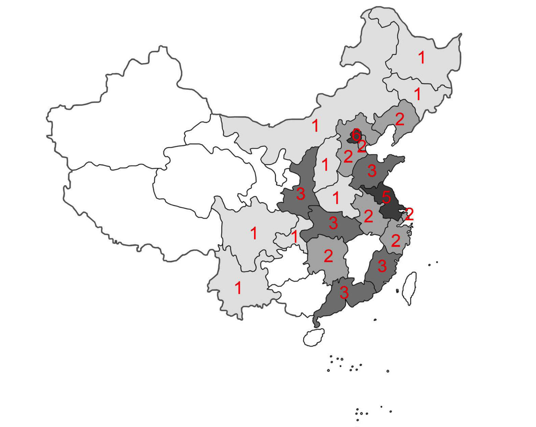
Overview | China’s Accreditation System
6/49
China has begun to apply accreditation system to architectural education since 1992. NBAA (National Board of Architectural Accrediting) is charged for the assessment.
By May of 2016, only 60 universities (21 % of the universities offering architectural programs) had won the accreditations from NBAA.
Map at right side presents the distribution of all the accredited universities over the contury.

Slide 8








1 HISTORY OF ARCHITECTURAL EDUCATION OF CHINA
Architectural education in China initiated from the early of the 20th Century. The first department of architecture was founded in the late of 1920s. After 1949, architectural education came to a new stage. There were eight main universities: Tsinghua University, Southeast University, Tongji University, Tianjin University, South China University of Technology, Chongqing University, Xi’an University of Architecture and Technology, Harbin Institute of Technology.

Slide 9
?
282
231
2009
2016
FUTURE
In the past decades, architectural education of China has been developing in a rapid speed, especially in the past ten years. Each year, about 15-20 universities initiate their architecture program. By May of 2016, there are in total 282 universities that offer architectural education in China.

Slide 10



14,346（2009）
15,503（2016）
61,721（2009）
87,325（2016）
9,486（2009）
16,143（2016）
According to the statistics of 2015, they have recruited 15,503 students that year and have celebrated the graduation of 16,143 students, leaving the number of registered students at 87,325.
DATA from country report in ARCASIA ACAE meeting

Slide 11
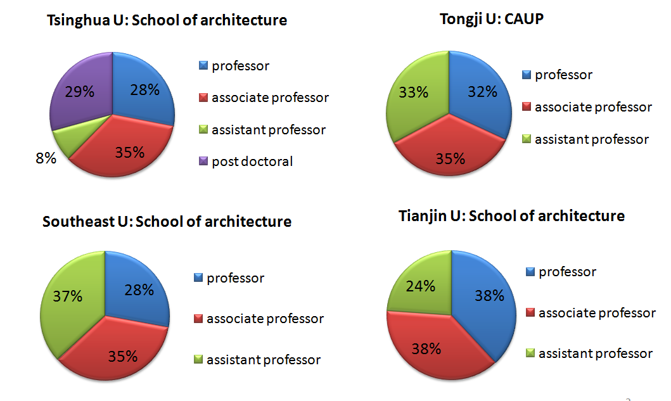
Faculty | Situation Analysis of well-known Schools of Architecture

Slide 12

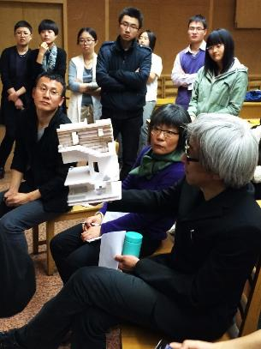


Open–Ended Teaching of Architectural Design | Solutions to the Challenges in SA of THU
Undergraduate third grade Open-Ended Teaching of Architectural Design
本科三年级开放式建筑设计课程教学
Innovation 创新：
1）Master passed to the apprentice 师徒相传
2）Professional Architect 职业建筑师的状态
3）Professionalism 职业精神
4）Sense of Ritual 仪式感
5）Critical and Diverse 批判性和多样性
Notes:
翻译

Slide 13



Joint Design Studio | Solutions to the Challenges in SA of THU
Joint Design Studio for Graduate Students:
Tsinghua-MIT，Tsinghua-GSD，Tsinghua-Yale，Tsinghua-Aalto University(Finland), Tsinghua-Vienna University of Technology，Tsinghua-Polytechnic University of Turin.
联合studio(11所高校)：ENSA Paria La Villete (France), Keio University (Japan), Gyeongsang National University (South Korea), Ho Chi Minh City University of Architecture (Vietnam), National University of Civil Engineering (Vietnam), Phranakhon Rajabhat University (Thailand), Polytechnic University of Puerto Rico (Puerto Rico), Tsinghua University (China), Victoria University of Wellington (New Zealand), Laval University (Canada), ETSAM-UPM (Spain).
From Wangminquan
From Wanglu

Slide 14


2 THE INSTITUTION OF ARCHITECTS
2.1 The Architectural Society of China (ASC)
Founded in October 1953, the Architectural Society of China (ASC) is an academic society and an independent corporate body registered by the Ministry of Civil Affairs of China.
The current ASC President is Mr. XIU Long.

Slide 15


2 THE INSTITUTION OF ARCHITECTS
2.1 The Architectural Society of China (ASC)
ASC joined the International Union of Architects as a national member in 1955 and joined the Architects Regional Council of Asia as a national member in 1989.

Slide 16


Liang Sicheng Architecture Prize

Slide 17
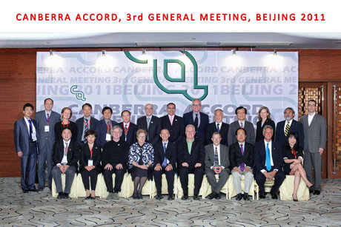
2 National Board of Architectural Accrediting (NBAA)
Architectural accreditation is the first professional accrediting system of China’s higher education. In 1988, the Ministry of Housing and Urban-Rural Development approved the Proposals for Architect Qualification and Architectural Accreditation; and in 1992, on the 11th meeting of China’s Academic Degree Committee of the State Council, the Proposal for Establishing Professional Degrees of Architecture was approved and the 1st National Board of Architectural Accrediting (NBAA) was formed. In 2008, the NBAA’s delegate signed the Canberra Accord on Architectural Education.

Slide 18
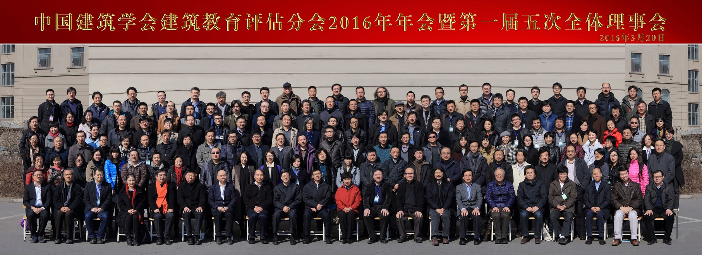

3 ACCREDITATION
In 1992, the 1st National Board of Architectural Accrediting was formed. By the same year, an accreditation on the B. Arch Program was carried out by the NBAA, and later in 1994, an accreditation on M. Arch Program was initiated. The NBAA is composed of well-known professors and experts from the field of architecture, which ensures its authority and honesty. The 6th NBAA was formed on January 2015 for a validity of five years. It is composed of 31 members, including 15 professors, 15 professional architects and one general secretary. NBAA’s accreditation may have three kinds of results: the seven-year validity, the four-year validity, the four-year validity under certain conditions.

Slide 19
By the end of May 2016, 60 universities in total have passed the NBAA’s accreditation (Fig.1), with 59 for B. Arch Program and 38 for M. Arch Program, accounting for 21% of 282 universities that offer architectural education.

Slide 20

02
建筑师职业实践
PROFESSIONAL PRACTICE
ZHANG WEI TSINGHUA ARCHITECTURAL DESIGN AND RESEARCH INSTITUTE

Slide 21
CONTENT
MEMBERS
REGISTRATION
CPD AND OTHER COURSES
FEES / COMPENSTAION STRUCTURE UPDATE
PRACTICE RELATED PUBLICATION & DOCUMENTATION UPDATE
PRACTICE & EDUCATION UPDATE
OTHER ISSUES

Slide 22
MEMBERS

Slide 23
Number Of Registered Architects
27,867 (Latest Of June, 2013)
Data Source: http://www.pqrc.org.cn/

Slide 24
Age Of Registered Architects
Survey Of 21872 Registered Architects
Data Source: http://www.pqrc.org.cn/

Slide 25
REGISTRATION

Slide 26
REGISTRATIONS AND LICENSE REQUIREMENT
The qualification system of Registered Architect is a whole procedure composed of
education accreditation, professional practice, qualification examination, certification
management, continuing education, and credit management. Professionals of architecture who intend to get the Certificate of Registered Architect are obliged to meet the standards for education accreditation, professional practice, and qualification examination.
According to the Ordinance on Architect Registration issued by the State Council of China in 1995, the graduates of the NBAA accredited architecture schools may participate to the National Examination of Architect Registration after a certain period of professional practice. In particular, three-year practice is required for graduates with B. Arch and two-year practice for those with M. Arch. Another two-year practice is obliged for the graduates of architecture schools that have not passed the NBAA’s accreditation.

Slide 27
NBAA also strengthens communication with Hong Kong Institute of Architects (HKIA).
Architectural Education Accreditation Mutual Recognition Agreement was signed in January 2013. This is the second time that the Mutual Recognition Agreement is signed.

Slide 28
Required Educational Qualification for registration - 5 year B.Arch. | Yes
Number of years Required as Working Experiences for registration | Bachelor degree of Engineering (not fits NBAA’s accrediting standards) : 5 years Bachelor degree of Architecture(fits NBAA’s accrediting standards) : 3 years
Required Professional Examination for registration | Yes

Slide 29
Qualification For License Exam
Academic Requirement:
3 year practice after getting B.A.
Or similar degree (e.g.: Urban Planning, Architecture Landscape) and person who has min. 5 years of related practical experience

Slide 30
Professional Qualification Examinations
Architectural Design
Pre-design and Site Planning
Architectural Physics and Equipment
Building Structure
Building Materials and Construction
Building economics, Construction and Management
Architectural design (Drawing)
Detail design (Drawing)
Site Planning (Drawing)

Slide 31
Practical Experience Requirement before Registration
700 Units
(1 Unit=8 hours)

Slide 32
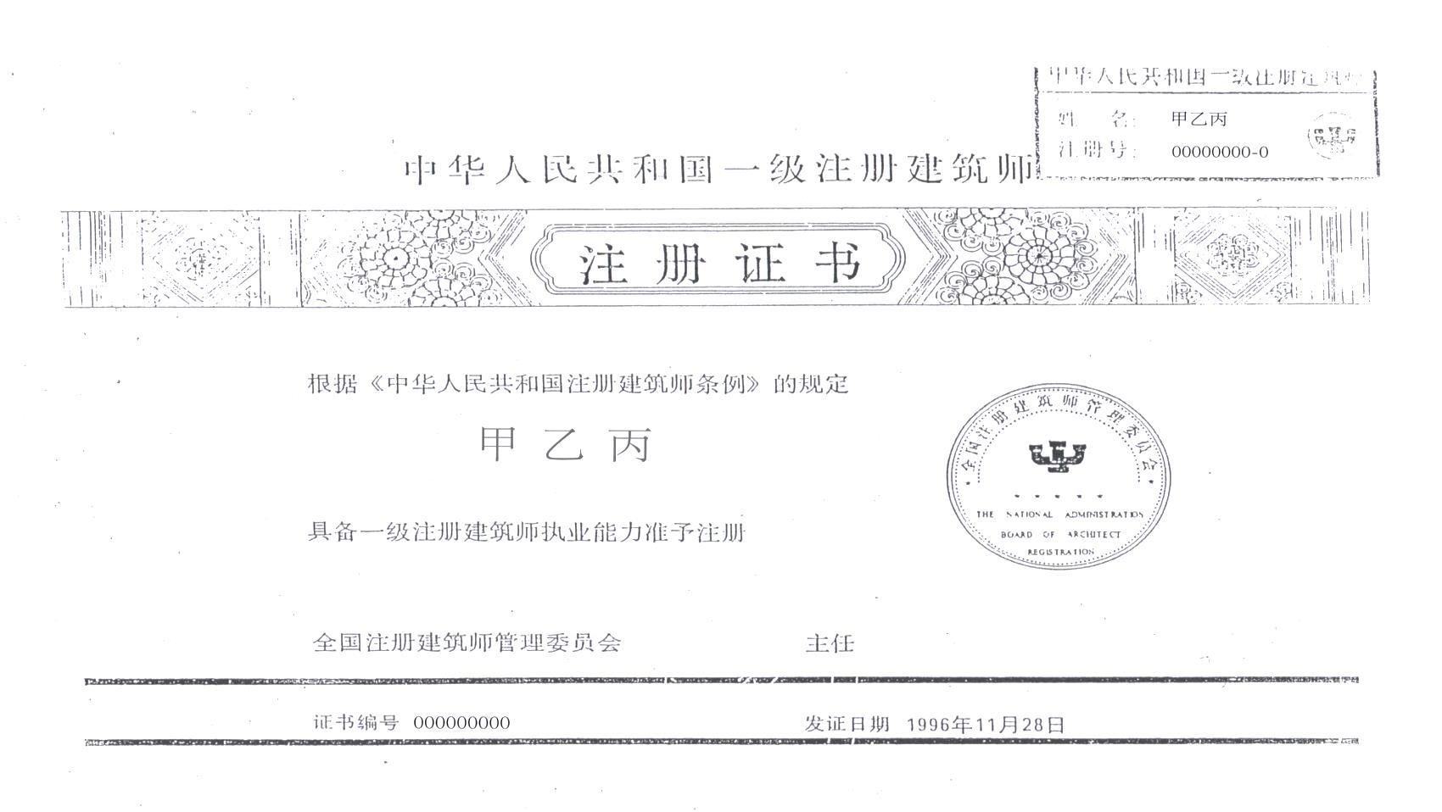

Slide 33
Professional Education Hours Within 2 Years After Registration
Required: 40 hours
Selected: 40 hours

Slide 34
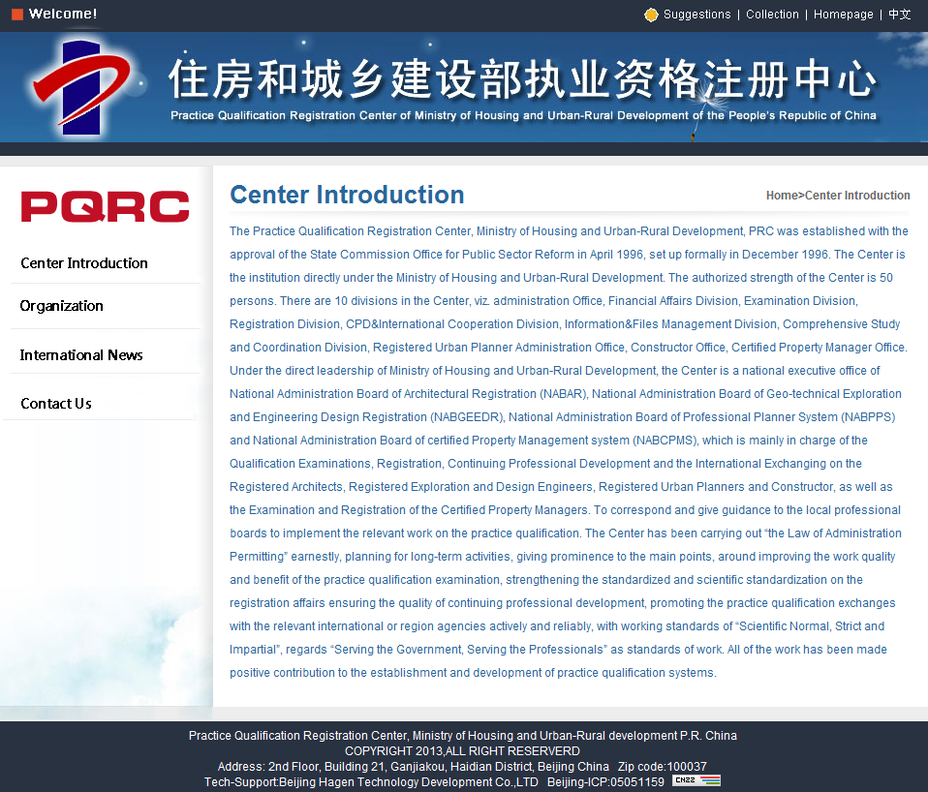
Registration Page & Information Website

Slide 35
CPD AND OTHER COURSES

Slide 36
Continued Professional Development (CPD) Courses Exists ? - Y/N | YES
If Yes to q17 then do you have Earned point System - Y/N | YES
Categories of CPD Courses | www.pqrc.org.cn
The number of CPD courses conducted by the institute last year | www.pqrc.org.cn
Any Other courses / Lecture conducted by the institute last year | Annual Conference Of ASC 2015

Slide 37
FEES /
COMPENSATION STRUCTURE UPDATE

Slide 38
Any Mandatory / Minimum Fees Structure for Architectural Services Exist ? - Y/N | No
Categories of Fees Structure | Exploration and Design fee Standards 2002
Basis for Fees structure : | In terms of percentage of Construction Cost

Slide 39
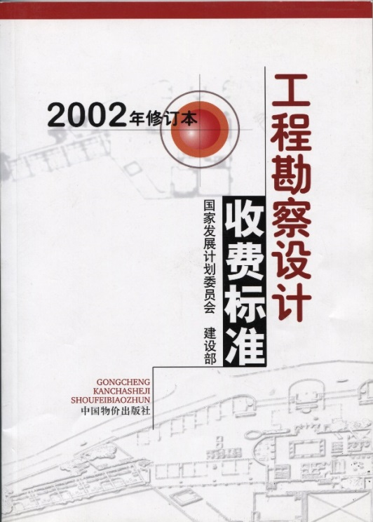
If not Any Recommended or Published Fees for Architectural Services Exist ? - Y/N | YES
Exploration and Design fee Standards 2002

Slide 40
PRACTICE RELATED PUBLICATION & DOCUMENTATION UPDATE

Slide 41
Published Ethics & Code of Conduct | NO
Published Standard form of Agreement | YES
Architects Practice Hand Book | NO

Slide 42
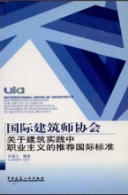
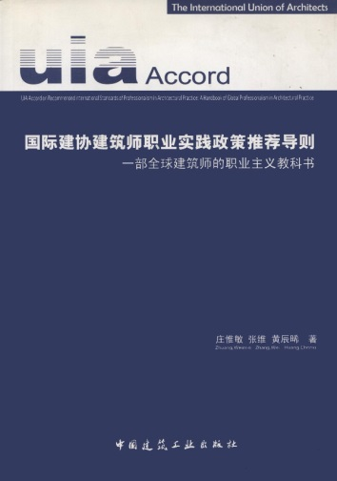

Any other forms and Documentation | UIA Accord Handbook of Professional Practice for Architects (HOPPA) in Japan, Korea and China

Slide 43
PRACTICE & EDUCATION UPDATE

Slide 44
Update on School Acerbation process | 60
Number of Accredited School | 60
Number Of Non Accredited School | 282
Duration of the Courses offered at most school 4Year / 5 year | 5
Number of students passing out as an architects each year from the school | 16,143

Slide 45
OTHER ISSUES

Slide 46
The practice Govern by Architects Act or any Other Legislation - status | The people's Republic of China registered architects regulations
Any Litigation or Hearing on Architects Mal practice or any other dispute in practice - status | NO
Cross Border Practice situation - what’s happening? Any MRA (Mutual Recognition Agreement) exist does it allow foreign architects to practice? (If Yes — what is the procedure ? | YES

Slide 47
03
建筑市场
STATUTES OF ARCHITECTURAL MARKET
ZHANG WEI TSINGHUA ARCHITECTURAL DESIGN AND RESEARCH INSTITUTE

Slide 48
At the end of 2015
 | Number (thousand)
Design Agency Unit Number | 20.48
Employees of Design Agency | 3,043.0
Professionals | 1,371.0
Data Source: The National Bureau of Statistics website 2016

Slide 49
2015 Scale 0f Registered Professionals 9.9%

Slide 50
THANK YOU

