Slide 1

JIA current strategies
2017
ASHIHARA, Taro
President
JIA
Updated and Edited by
FUJINUMA, Masaru

Slide 2
Beyond Disasters
Through Solidarity
Towards Sustainability of Architects

Slide 3
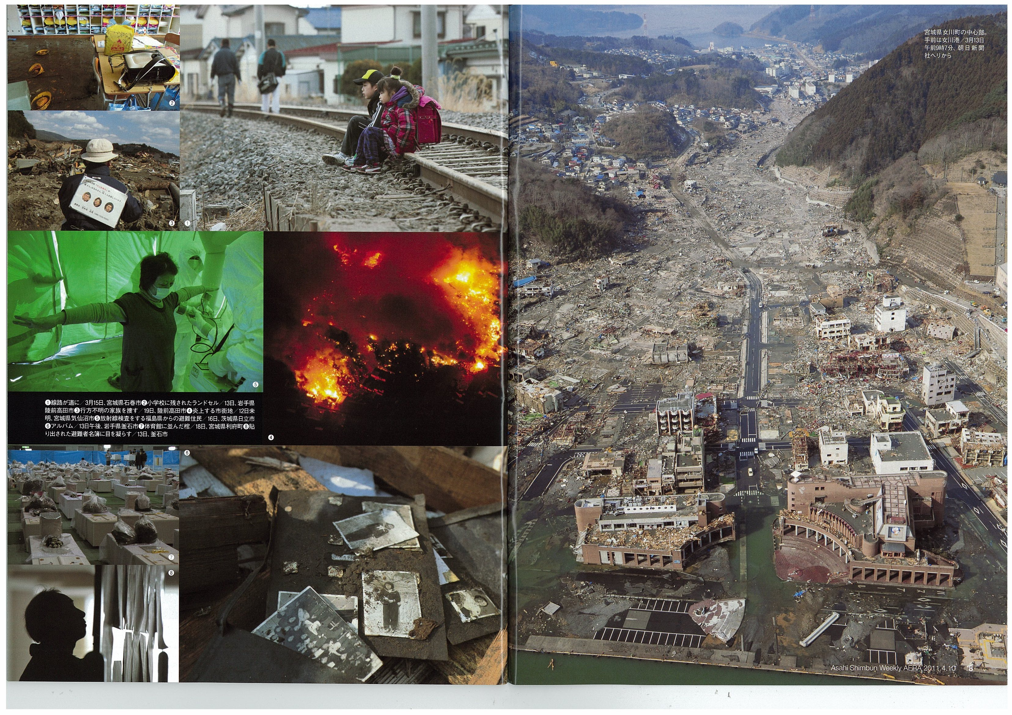
3
３・１１ earthquake and tsunami We realize the true value when we loose it
Notes:
３・１１ 東日本大震災

Slide 4
The New Architect
Maestro
Coordinator
Activity
Communication
artwork
enlightenment

Slide 5
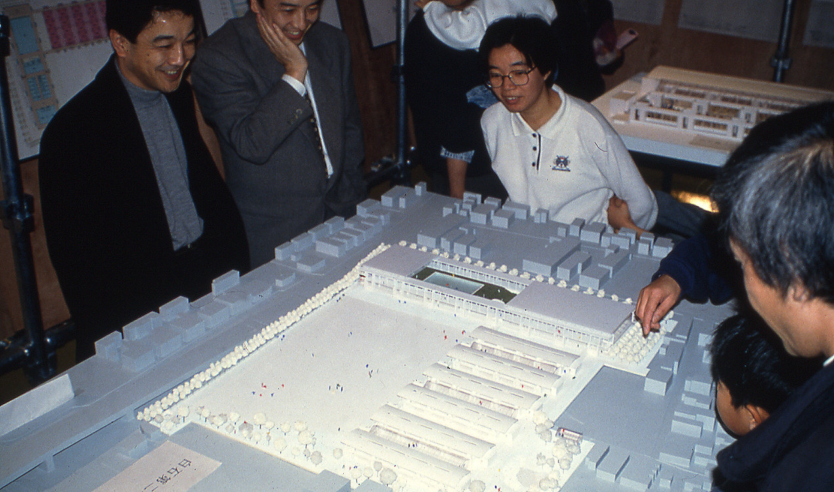

Slide 6
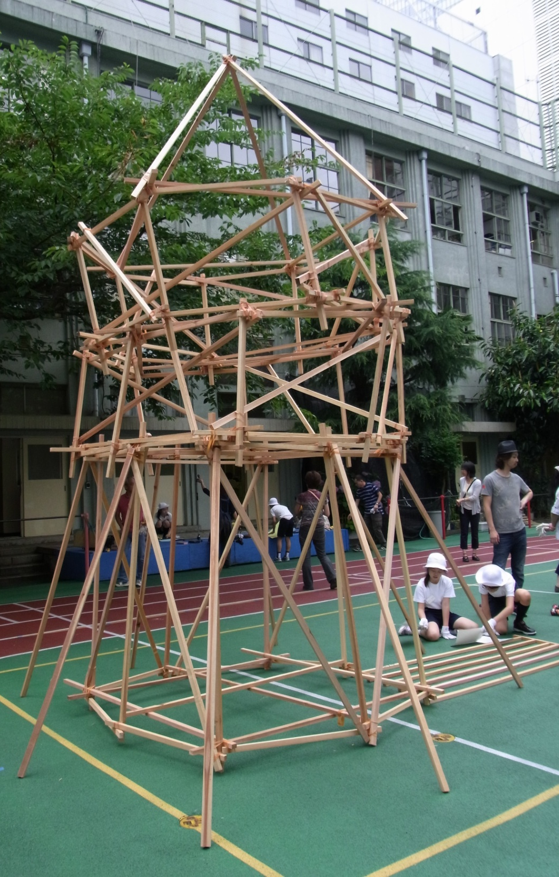
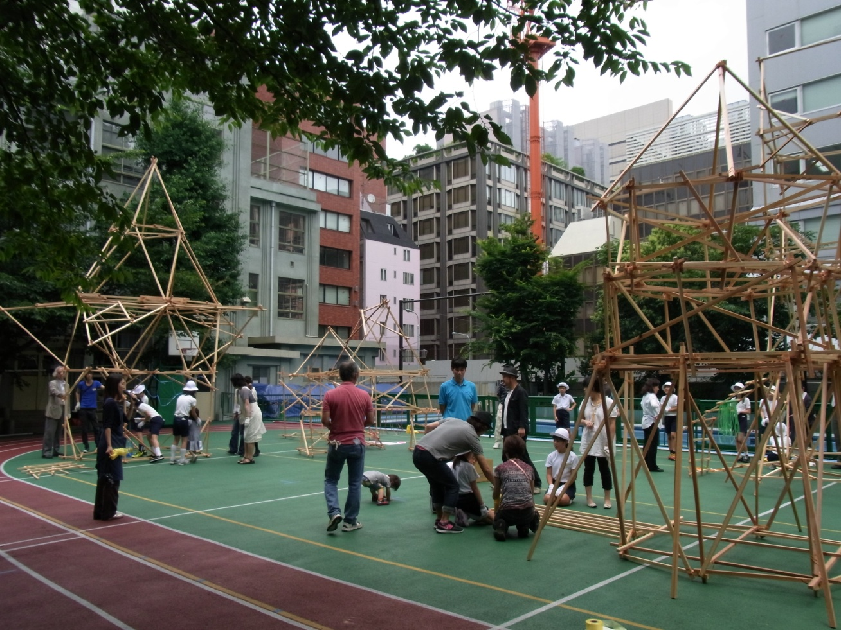

Slide 7
Japan Architecture
    Construction market
    Tokyo – the largest metropolitan

Slide 8


Slide 9
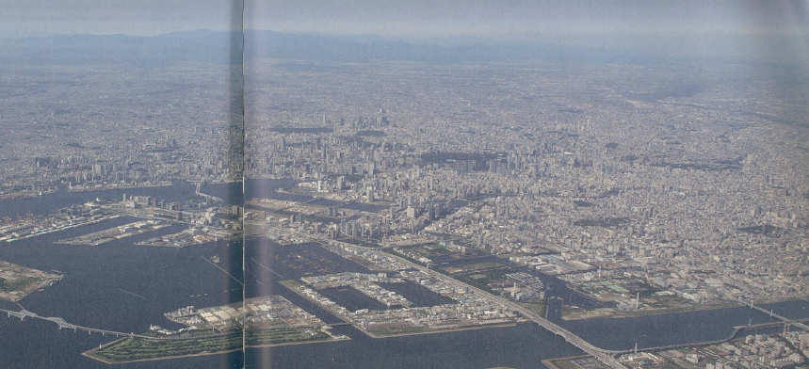

Slide 10
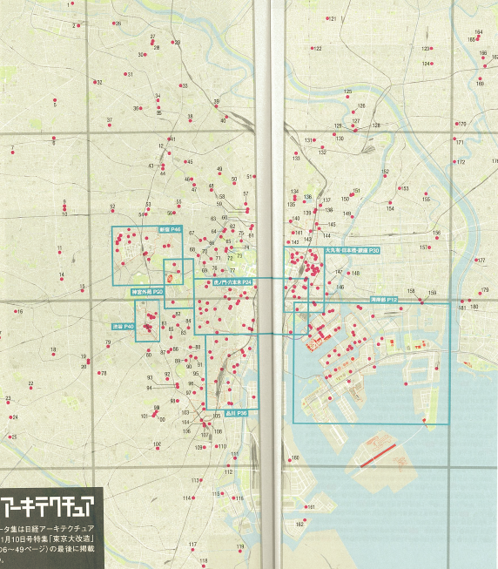

Slide 11
Major issues
1. Design Build
lead by Construction
2. Client responsibilities

Slide 12
Thank you
ASHIHARA, Taro
President
JIA
Updated and edited by FUJINUMA, Masaru

