Slide 1
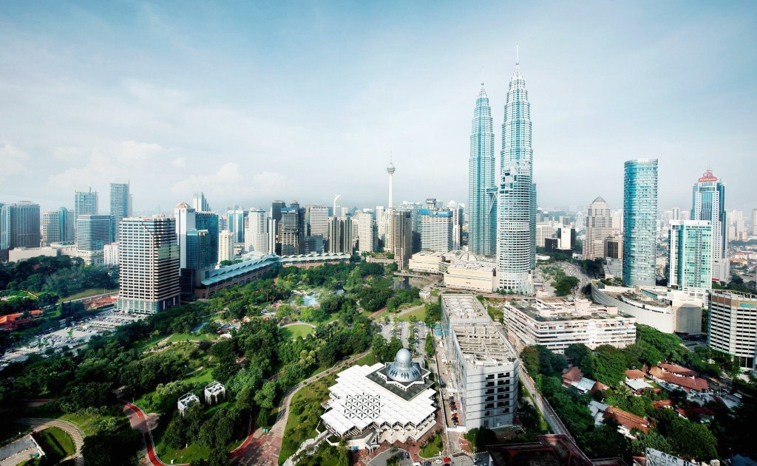

ACCP COUNTRY REPORT 2017
MALAYSIA
Prepared by:
Ar S.THIRILOGACHANDRAN

Slide 2
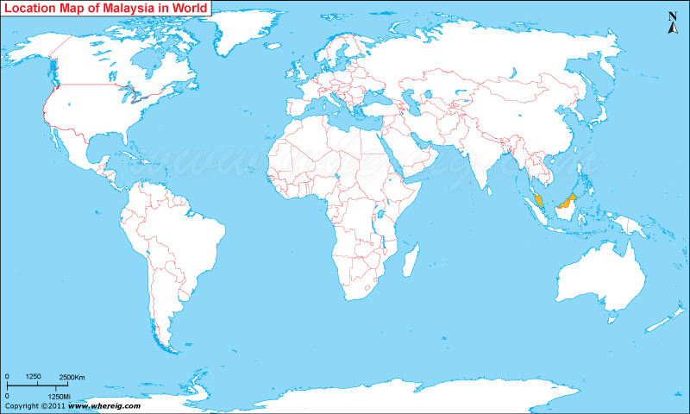
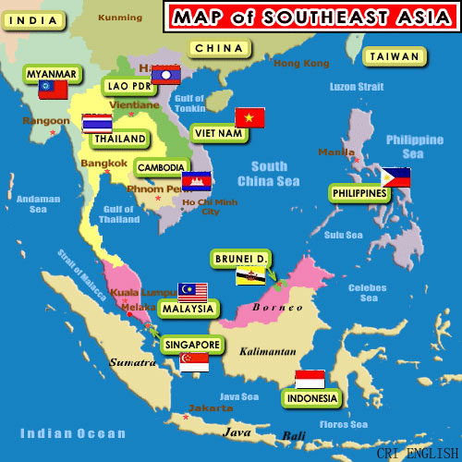
LOCATION OF MALAYSIA

Slide 3
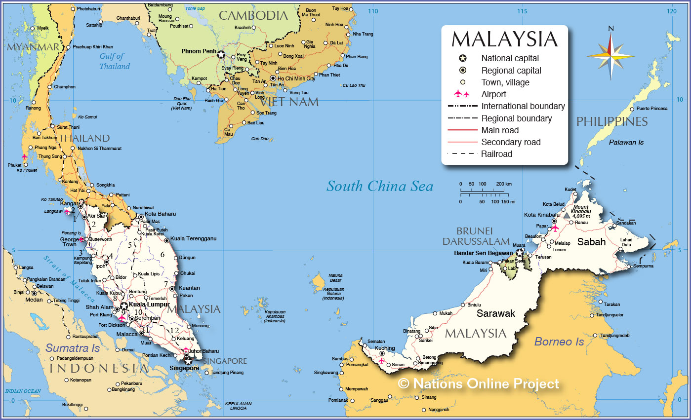
MALAYSIA MAP

Slide 4
KEY ECONOMIC INDICATORS
Population : 31.2 million (Dec 2015)
YEAR | GDP (BILLION) | GDP GROWTH | GDP PER CAPITA
2015 | $ 296.28 | 4.9 | 10,878
2014 | $ 338.10 | 6.0 | 10,512
2013 | $ 323.34 | 5.0 | 10,064
2012 | $ 314.44 | 5.1 | 9,759
2011 | $ 297.95 | 5.5 | 9,398

Slide 5
PERTUBUHAN AKITEK MALAYSIA (PAM)
Pertubuhan Akitek Malaysia (PAM)
– Malaysian Institute of Architects
– national professional institute representing
architects in Malaysia.
PAM was founded in 1920 as the Institute of Architects Malaya.
In 1948, the name and consequently the Constitution were changed to the Federation of Malaya Society of Architects (FMSA) which was allied to the Royal Institute of British Architects (RIBA).
Rgistered with ROS as Pertubuhan Akitek Malaysia (PAM) on 20/01/1967.
4 Chapters - Northern Chapter, Southern Chapter, Sarawak Chapter and Sabah Chapter

Slide 6
CONT’D
The Primary objectives of the Institute are:
  To promote and enlarge knowledge, study and practice of architecture.
  To provide a central organisation for architecture.
  To assist and advise Government, local authorities, or other private or public bodies.
  To promote friendly interaction and discourse amongst Architects.
  To obtain and disseminate among the Members, information on matters affecting the profession, and
  To preserve and to maintain the integrity and status of the profession.

Slide 7
BOARD OF ARCHITECTS MALAYSIA
The registration of Architects and practice of Architecture in Malaysia is governed by Board of Architects. The Board of Architect Malaysia is a statutory authority responsible for the enforcement of Architect Act, 1967.
The functions of the board are provided under section 4(1) of the Architects Act which include the following:
  Registration of Professional Architects, Architects and
  Building Draughtsman.
  Registration of Architectural consultancy practices.
  Regulation of their conduct and ethics.
  Conducting examinations for admission to the profession.
  Accreditation of architectural programme.
  Development and Promotion of the profession.
  Representing the architectural profession in any matters
  at local and international levels.

Slide 8
PAM MEMBERSHIP
Membership Category | 17th March 2014 (Nos) | 8th March 2015 (Nos) | 9th Sept 2016 (Nos) | 18th Apr 2017 (Nos)
Honorary | 8 | 8 | 8 | 8
Retired | 5 | 6 | 6 | 6
Fellow | 87 | 88 | 92 | 95
Corporate | 1,750 | 1,779 | 1,803 | 1,870
Graduate | 1,152 | 1,344 | 1,385 | 1,443
Associate Graduate | 43 | 68 | 58 | 68
Academic | 14 | 17 | 15 | 16
Student | 1,384 | 2,200 | 969 | 1,779
International | 1 | 3 | 5 | 6
Total: | 4,444 | 5,702 | 4,341 | 5,291
Source: Pertubuhan Akitek Malaysia

Slide 9
SUMMARY OF REGISTRATION WITH LAM
Total of Registered | As at Sept 2016 (Nos) | As at May 2017 (Nos)
Professional Architects | 1,986 | 1,993
Graduate Architects | 2,205 | 2,025
Interior Designers | 517 | 536
Building Draughtsman | 161 | 153
APEC Architect | 24 | 30
ASEAN Architect | 36 | 39
Architectural Body Corporate | 258 | 254
Architectural Partnership | 96 | 87
Architectural Sole Proprietorship | 1,147 | 1,154
Multi Disciplinary Practices | 44 | 42
Interior Design Body Corporate | 20 | 23
Interior Design Partnership | 1 | 1
Interior Design Sole Proprietorship | 18 | 28
Source: Lembaga Arkitek Malaysia

Slide 10
TYPE OF ARCHITECTURAL PRACTICE ENTITY
NO. | TYPE OF ENTITY | As at August 2015 |  | As at September 2016 |  | As at May 2017
 |  | TOTAL | PERCENTAGE (%) | TOTAL | PERCENTAGE (%) | TOTAL | PERCENTAGE (%)
1. | Sole Proprietorship | 1,129 | 74.9 | 1,147 | 74.2 | 1,154 | 75.1
2. | Partnership | 93 | 6.2 | 96 | 6.2 | 87 | 5.7
3. | Body Corporate | 246 | 16.3 | 258 | 16.7 | 254 | 16.5
4. | Multi Disciplinary Practice | 40 | 2.6 | 44 | 2.9 | 42 | 2.7
 | Main Total | 1,508 | 100 | 1,545 | 100 | 1,537 | 100
Source: Lembaga Arkitek Malaysia

Slide 11
VALUE OF CONSTRUCTION WORK DONE BY TYPE OF ACTIVITY,
Q1 2014 - Q1 2015
Quarters | Total |  | Residential Buildings |  | Non-Residential Buildings |  | Civil Engineering |  | Specials Trades
 | Value of Construction Work Done (RM Million) | % | Value of Construction Work Done (RM Million) | % | Value of Construction Work Done (RM Million) | % | Value of Construction Work Done (RM Million) | % | Value of Construction Work Done (RM Million) | %
Q1/15 | 28,741 | 100 | 8,606 | 29.9 | 10,006 | 34.8 | 8,753 | 30.5 | 1,376 | 4.8
Quarters | Total |  | Residential Buildings |  | Non-Residential Buildings |  | Civil Engineering |  | Specials Trades
 | Value of Construction Work Done (RM Million) | % | Value of Construction Work Done (RM Million) | % | Value of Construction Work Done (RM Million) | % | Value of Construction Work Done (RM Million) | % | Value of Construction Work Done (RM Million) | %
Q4/14 | 27,099 | 100 | 8,059 | 29.7 | 9,382 | 34.6 | 8,285 | 30.6 | 1,373 | 5.1
Q3/14 | 25,301 | 100 | 7,598 | 30.0 | 8,724 | 34.5 | 7,838 | 31.0 | 1,141 | 4.5
Q2/14 | 25,173 | 100 | 7,657 | 30.4 | 8,157 | 32.4 | 8,167 | 32.4 | 1,192 | 4.7
Q1/14 | 24,973 | 100 | 7,202 | 28.8 | 8,052 | 32.2 | 8,399 | 33.6 | 1,320 | 5.3
Total 2014 | 102,546 | 100 | 30,516 | 29.8 | 34,315 | 33.5 | 32,689 | 31.8 | 5,026 | 4.9
Source: Jabatan Perangkaan Malaysia

Slide 12
3.0 PROFESSIONAL PRACTICE
COMMITTEE – VISION & MISON
To address current issues and challenges affecting the Architectural practice and profession.
To uphold and upgrade PAM image to be leader in the building industry.
To empower members and expand marketing initiatives
To promote the professional contribution solving many of today’s economic, social and environmental challenges.

Slide 13
4.0 PROFESSIONAL PRACTICE FORUM/ CPD
PPC of PAM organised two full day forum this year. The forum covers topic related to professional practice. The objective is to enhance and strengthen members’ capacity in all practice matter. In addition to this, CPD programme are also held every month on practice matter and current issues.
Forum 7.0 – 12/08/2015 - “ARCHITECT’S FEES: ISSUES CHALLENGES AND WAY FORWARD”.
Forum 8.0 – 10/12/2015 - “OSC 3.0: ISSUES CHALLENGES AND WAY FORWARD.
Forum 9.0 – 03/12/2016 – “ART OF ARCHITECTURE BUSINESS”
CPD
PAM CENTRE – 24 CPD Lectures for 2016.
Chapter – 4 CPD each from PAM HQ.
      – 4-8 CPD organised by chapters.
      CPD Requirement for renewal of registration with the Board of Architects - 10 CPD points. Architects above 65 – 5 CPD

Slide 14
5.0 REPRESENTATIVES IN MINISTRIES &
GOVERNMENT AGENCIES
PPC committee members also continue to represent PAM on the various committee and meetings called by relevant Ministries and Government Agencies like:-
Construction Industry Development Board (CIDB)
Scientific and Industrial Research Institute of Malaysia (SIRIM)
Ministry of Housing and Local Government
Fire Services Department (BOMBA)
Ministry of International Trade and Industry (MITI)
Ministry of Energy, Green Technology and Water (KeTTHA)
Local Authorities (City Hall, Town Council, etc.)
Other Ministries and government agencies
PAM PPC also continues to address issues related to the profession with the relevant authorities and government agencies.

Slide 15
6.0 PUBLIC
6.1 COMPLAINTS & QUERIES
The committee continued to provide advisory support to members in practice and general public. The committee provide answers to the queries and complaints.
6.2 PAM ARCHITECTS – MEET THE PUBLIC SESSION
The committee continued its routine of having the monthly Architects
– Meet the Public Session, which is PAM’s contribution to the public. This event is held on first Saturday of every month.

Slide 16
7.0 IMPROVEMENT TO AUTHORITIES APPROVAL AND DEALING WITH CONSTRUCTION PERMIT (DCP)
PAM has contributed and continued to address the issue related to expedite and enhance the statutory Approvals by Authorities. Among the developments are:
One - stop centre at local authorities for planning, building and engineering approvals
OSC 3.0 – implemented in all local Authorities in Peninsular Malaysia to streamline all approval process through Malaysia from 1st June 2014
Certificate of completion and compliance (CCC) issued by Architects (submitting person)
Electronic submission (e-submission) implemented at some Local Authorities.
Self-certification of building plans
Involvement in Focus Group Dealing with Construction Permit (FGDCP) – established by Government comprising several Ministries, Government agencies, Technical agencies, Service/Utilities Provides and all stakeholders in the building industry, in addressing issues related to Dealing with Construction Permit (DCP).

Slide 17
8.0 PAM PRACTICE MANUAL
PAM Practice Manual is being developed and expected to be completed by end of 2017.
9.0 PAM PRACTICE NOTES
PAM PPC also sent out circulars on Practice Notes from time to time on numerous practice issues and on any latest development on the building industry.
10.0 PUBLICATIONS
PAM PPC also publishes online latest practice notes, professional Practice Forum papers and other matters related to practice to keep the members informed. PAM Directory published every year.

Slide 18
11.0 BUILDING INFORMATION MODELLING (BIM) TRAINING
PAM PPC conducts BIM Training, and has established a permanent BIM training centre at PAM new building, with the following objectives.
  To create awareness and promote the adoption of BIM among members.
  To conduct training programme and develop Malaysia standards for BIM.
  12.0 AFFORDABLE HOUSING & HOUSING FOR ALL
PAM has been supportive of government’s initiative to provide affordable housing for the lower income group and urban poor. PAM continued to provide input on innovative solutions to affordable housing. PAM has also organised several competition together with the industry on this.

Slide 19
13.0 ARCHITECTURAL EDUCATION
6 public universities
8 private universities and colleges
Programme – Part I -3-4 years, Bachelor’s Degree
Part II – 1-2 years, Master’s Degree
Total – 5 years
15.0 SCALE OF MINIMUM FEES (SOMF, 2010)
Mandated by Board of Architects Malaysia (LAM) under the Architects Act, 1967 and Architects (Scale of Minimum Fees) Rules 2010.
Architectural practices in Malaysia is mandatory to follow this scale of fees. However, many architects do not follow this.

Slide 20
ARCHITECTS SCALE OF MINIMUM OF FEES, RULES 2010
CATEGORY 1 |  |  | CATEGORY 2 |  |  | CATEGORY 3
Total Cost of Works | Minimum Percentage Fee (%) Range |  | Total Cost of Works | Minimum Percentage Fee (%) Range |  | Total Cost of Works | Minimum Percentage Fee (%) Range
RM500k and below | 10 | - | RM500k and below | 7.50 | - | RM1m and below | 5.00 | -
RM500k – RM1m | 9.25 | 9.62 | RM500k – RM1m | 7.00 | 7.25 | RM1m – RM2m | 4.75 | 4.88
RM1m – RM2m | 8.50 | 9.00 | RM1m – RM2m | 6.50 | 6.87 | RM2m – RM4m | 4.50 | 4.69
RM2m – RM4m | 7.75 | 8.40 | RM2m – RM4m | 6.00 | 6.44 | RM4m – RM8m | 4.25 | 4.47
RM4m – RM8m | 7.00 | 7.70 | RM4m – RM8m | 5.50 | 5.97 | RM8m – RM16m | 4.00 | 4.23
RM8m – RM16m | 6.25 | 6.97 | RM8m – RM16m | 5.00 | 5.48 | RM16m – RM32m | 3.75 | 3.83
RM16m – RM32m | 5.50 | 6.24 | RM16m – RM32m | 4.75 | 5.12 | RM32m – RM64m | 3.50 | 3.75
RM32m – RM64m | 5.00 | 5.62 | RM32m – RM48m | 4.50 | 4.91 | RM64m and above | 3.25 | -
RM64m – RM128m | 4.50 | 5.05 | RM48m – RM64m | 4.25 | 4.75
RM128m – RM256m | 4.25 | 4.65 | RM64m – RM80m | 4.00 | 4.59
RM256m – RM512m | 4.00 | 4.32 | RM80m – RM96m | 3.75 | 4.45
RM512m and above | 3.75 | - | RM96m – RM112m | 3.50 | 4.32
 |  |  | RM 12m and above | 3.25 | -

Slide 21
THANK YOU

