Slide 1


ARCASIA Committee on
Professional Practice
ACPP
Presented by :
YB Ar. Yanty Rahman
Vice President PUJA (B) / Chairlady PUJA Architect Division
MAY 2017, JAIPUR

Slide 2
“To promote, foster and advance the science and art of the professions of Surveyors, Engineers and Architects in line with the aims and objectives of the Government of His Majesty, the Sultan and Yang Di-Pertuan Negara Brunei Darussalam.”
PUJA (Brunei)

Slide 3

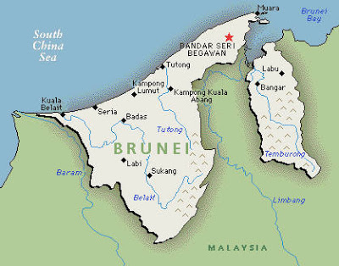
Brunei Darussalam
in a nutshell
ARCASIA ZONE B
PUJA Brunei – 21st Member Institute of ARCASIA

Slide 4
Brunei Darussalam
in a nutshell
CAPITAL BANDAR SERI BEGAWAN
POPULATION 413,000
AREA 5,765 SQM
LANGUAGES MALAY, ENGLISH, CHINESE
ETHNICITY 65% MALAY, 10% CHINESE
RELIGION 78% MUSLIM, 8% CHRISTIAN, 7% BUDDHIST
LIFE EXPECTANCY 76 YEARS (MEN), 81 YEARS (WOMEN)
LEADER HIS MAJESTY THE SULTAN HAJI HASSANAL BOLKIAH MU’IZZADDIN WADDAULAH DAN YANG
DI-PERTUAN NEGARA BRUNEI DARUSSALAM

Slide 5
Architectural Professionals
50 Registered Architects under MOD
40 Practicing Architects
40 Registered Architectural Companies under MOD
141 Members of PUJA Architects Division (including Student Members)

Slide 6
EDUCATIONAL REQUIREMENTS
how to become an Architect
Education to be an Architect requires a period of not less than 5 years of full-time studies in a University or an equivalent institution.
However, this remains a challenge as a degree and masters course is currently not offered in Brunei yet, therefore interested students are required to study overseas
Only those holding a Part II/Masters in Architecture (or equivalent) is entitled to sit for the APEQs Examination.

Slide 7
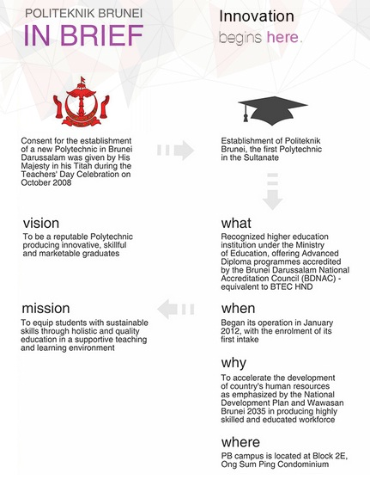


Slide 8

Formally known as Institute of Technology Brunei (ITB), UTB specializes in Engineering, Business and Computing.
Established as a higher learning institution in 1986 and upgraded to ‘University’ status in 2008.
UTB is currently exploring and preparing for an Architecture degree to be introduced. It is hoped to be launched by next year.
UNIVERSITI
TEKNOLOGI
BRUNEI

Slide 9
Registration and Licensing Bodies
Architects, Professional Engineers and Quantity Surveyors (APEQs) Board
REGISTRATION FORM
PART I – Personal Particulars
PART II – Qualifications
PART III – Professional Qualifications
PART IV – Continuous Professional Development
PART V – Employment Particulars
Part VI - Declaration

Slide 10
Part VI - Declaration
I hereby declare that if I am registered, I shall perform my duties and discharge my responsibilities in compliance with Architects, Professional Engineers and Quantity Surveyors Order 2011 and all notifications / circulars as issued by the Board of Architects, Professional Engineers and Quantity Surveyors.
I shall be personally in charge of all architectural services rendered for which I certify, stamp and sign all relevant documents. I also hereby declare my competency in the said architectural services.

Slide 12
APEQs Examination
how to become an Architect
The Architects Exam under APEQs will allow one to register as an Architect in Brunei – the purpose of the exam is to establish the required level of practical experience, skill, competence and maturity as a practicing architect in Brunei.
Stage 1 – Submission of Log Book, Personal Evaluation of Professional Experience and Case Study
Stage 2 – Written examination
Stage 3 – Oral examination

Slide 13
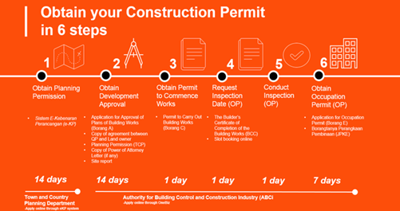
Building Control Laws
Regulated by the Authority for Building Control and Construction Industry (ABCi) under the Ministry of Development (MOD) Brunei
Any submissions for construction MUST be submitted by a QP (Qualified Person) registered under MOD

Slide 14
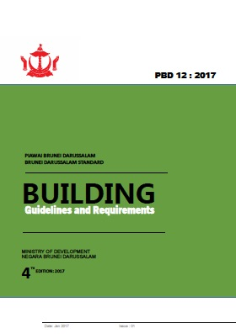

Building Control Laws
Regulated by the Authority for Building Control and Construction Industry
Building Control Order 2014 and Building Control Regulations 2014
PBD:12 4th Edition
Industrial Development Guidelines 2017

Slide 15
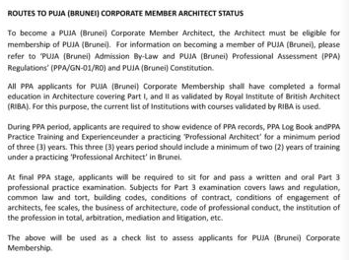
Routes to Corporate Member
Architect Status

Slide 16
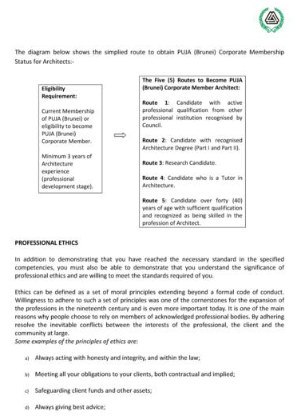

Slide 17
Ethics and Professional Conduct

Slide 18
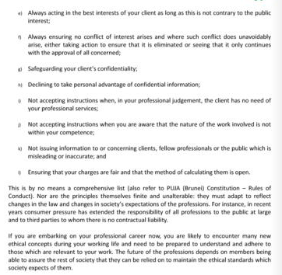

Slide 19
Issues faced by Architects

Slide 20
Thank you

